Slide 1

EasyReg
Ana Loureiro - 104063
Filipe Oliveira - 114640
Gonçalo Monteiro - 107758
Miguel Pinto - 108481
Miguel Francisco - 108304
1

Slide 2
CONTEXT
Multiple Compliance Requirements:
Need for an Integrated Solution:
Manual Processes and Risks:
Organizations need work across multiple frameworks, each with its own compliance requirements, resulting in significant complexity in managing the process.
There is a demand for a centralized platform that automates the tracking and management of requirements, optimizing workflows and ensuring security.
Manual evidence collection and audit execution increase the risk of inconsistencies and errors, while also requiring significant operational effort.
2

Slide 3
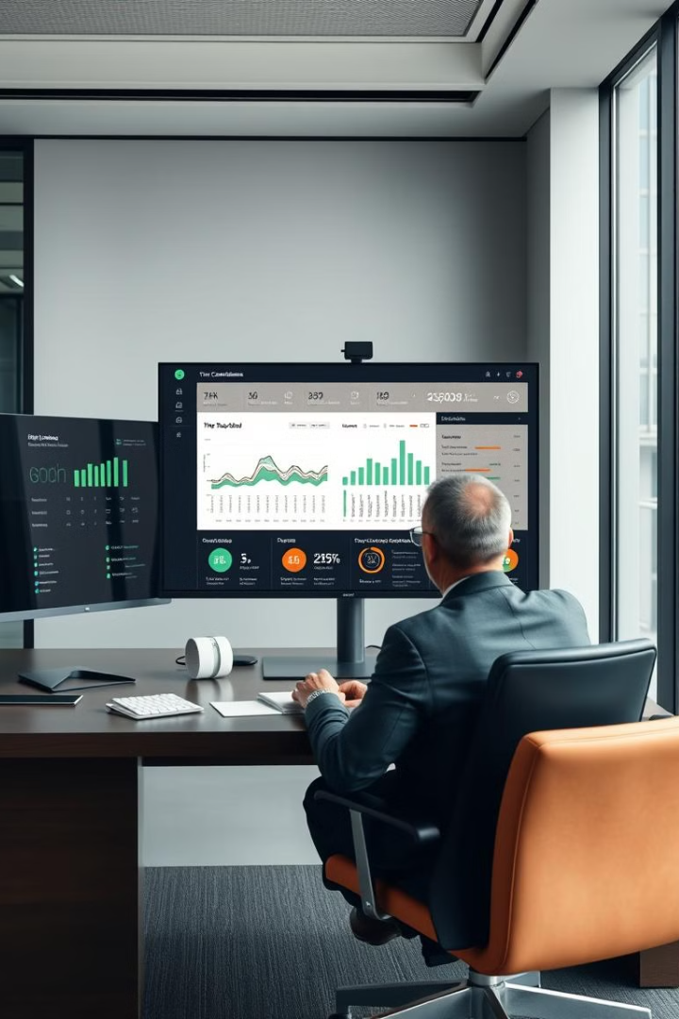



Objectives
Develop a centralized platform for managing requirements across multiple frameworks.
Detailed and customized reports with relevant insights for decision-making.
Automatic tracking of compliance status, ensuring accuracy and real-time updates.
3

Slide 4

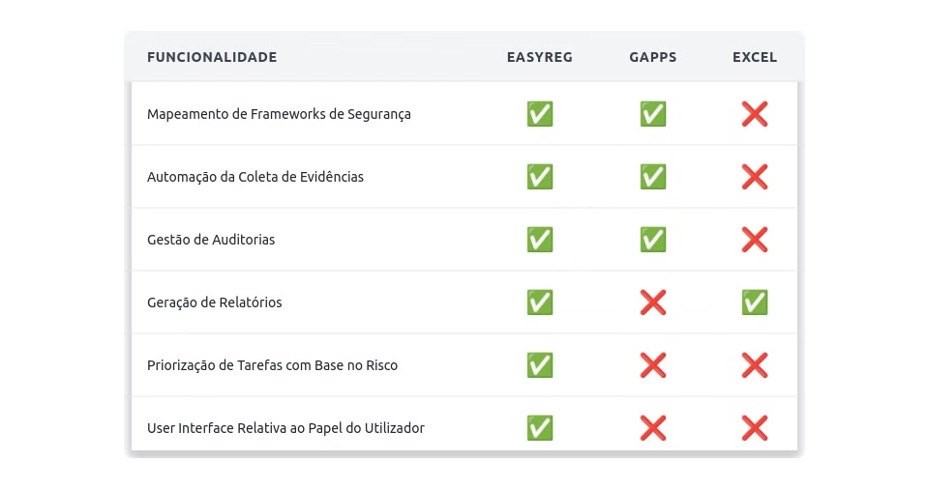


EasyReg: Similar Tools
1
Common Features: Both tools support security framework mapping, automation of evidence collection, and audit management.
2
EasyReg Differentiators: EasyReg includes automatic report generation, risk-based task prioritization, and a user role-adapted interface, making the process more efficient and accessible.
4

Slide 5
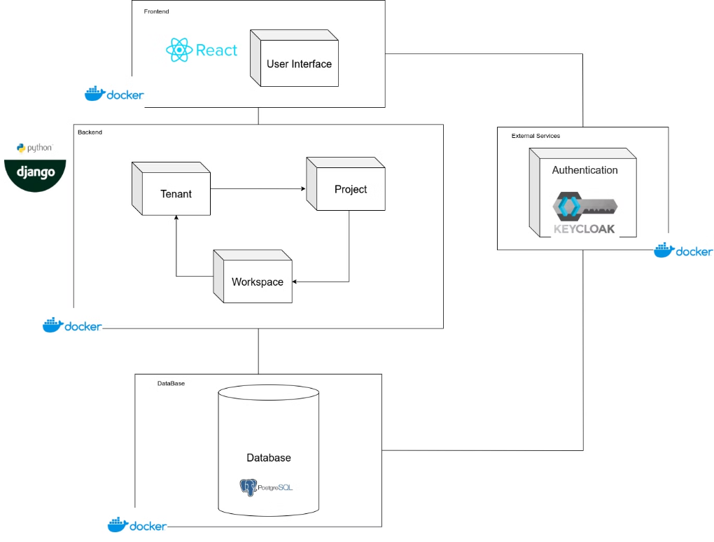
Architecture
5

Slide 6
Planning
1
Milestone 1 (inception)
Exploring the project and its objectives
2
Milestone 2 (elaboration)
User Stories for all of the actors, final architecture
3
Milestone 3 (construction)
Functional prototype, expecting to have multiple features implemented
4
Milestone 4 (transition)
Finish all features, prepare final report and final presentation
6

Slide 7
User Profiles
Administrator
Company Owner
Contributor
Configures system settings and manages user roles.
Manages overall company settings and user access.
Uploads evidence and responds to task requests.
Intern Auditor
External Auditor
Reviews evidence and creates reports.
Conducts independent audits and verifies compliance.
7

Slide 8
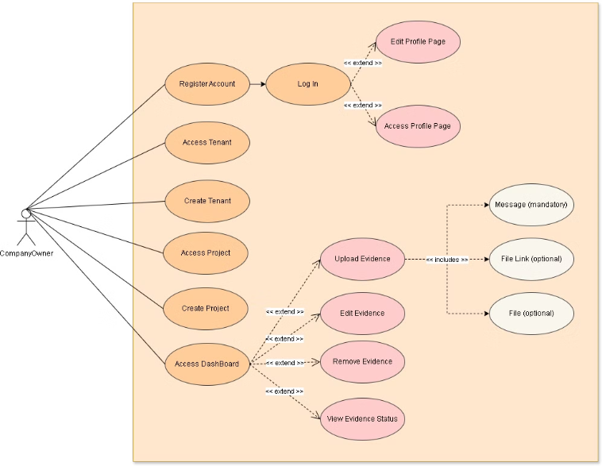
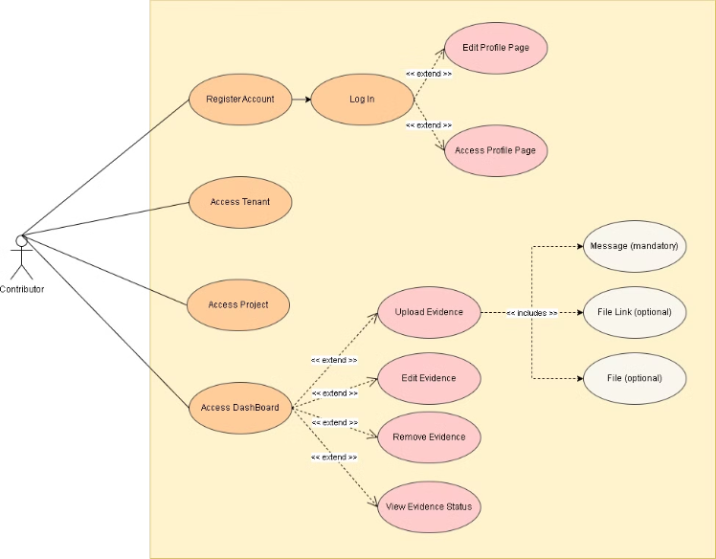
Use Cases(Company Owner & Contributor)
8

Slide 9
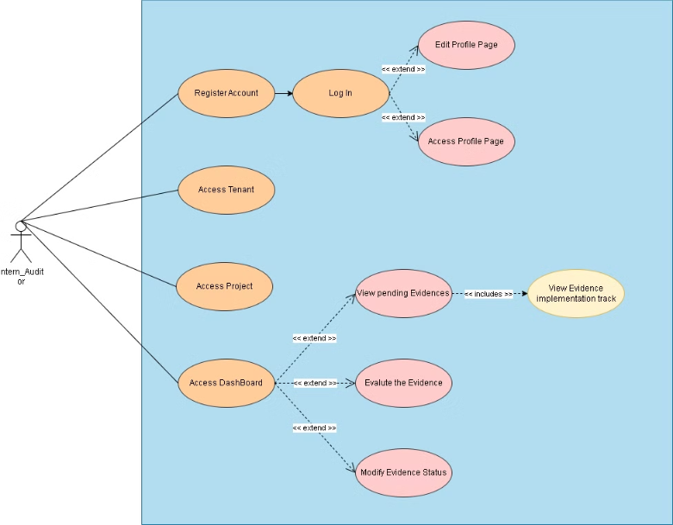
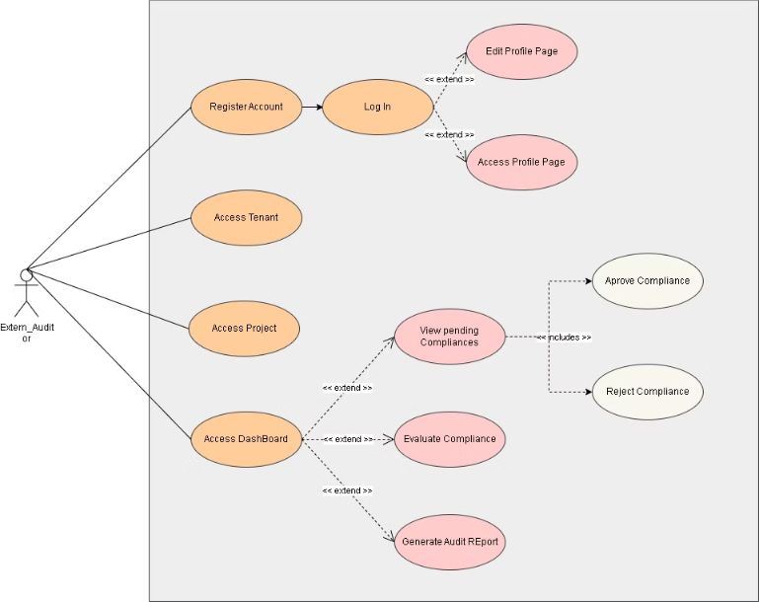
Use Cases(Internal & External Auditor)
9

Slide 10
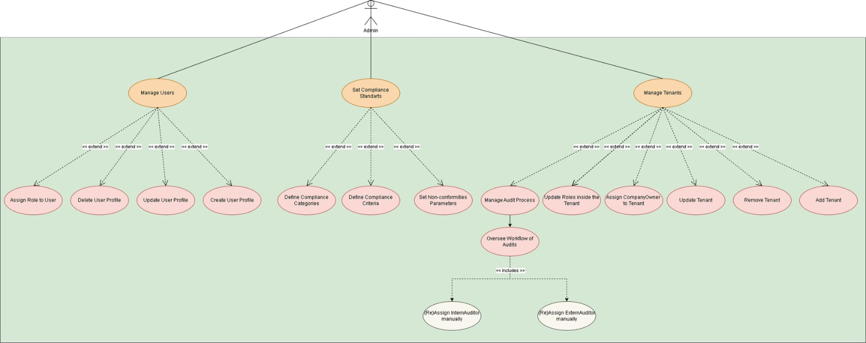
Use Cases(Admin)
10

Slide 11
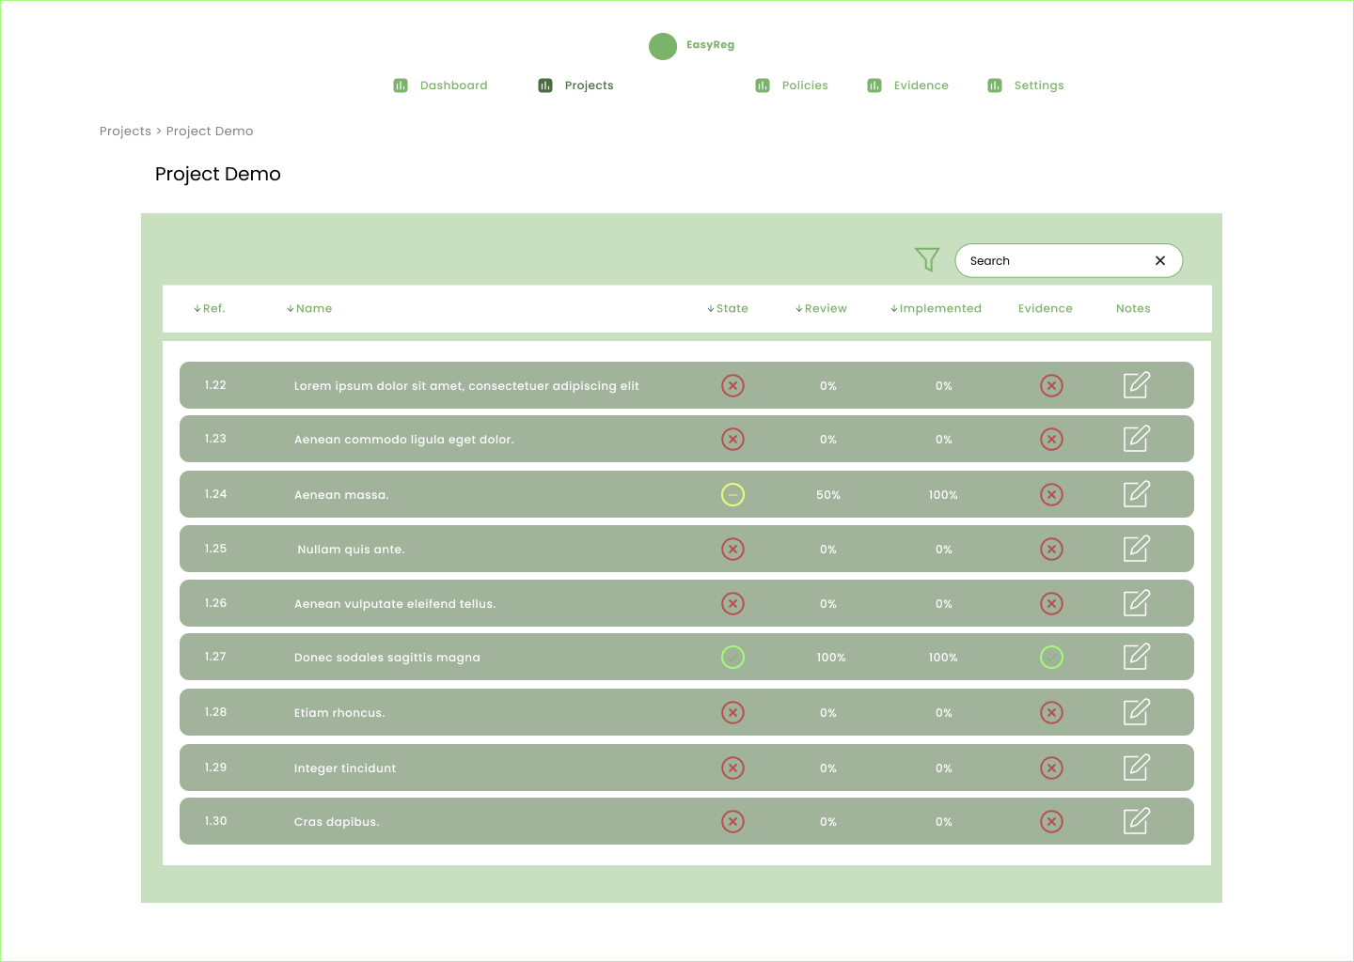
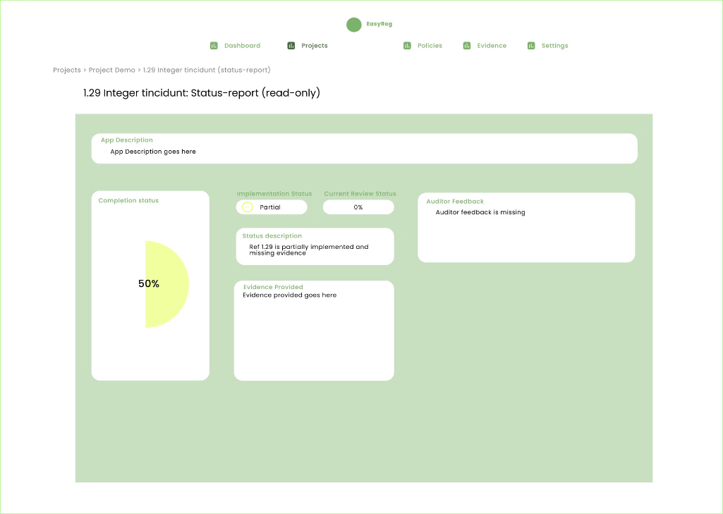
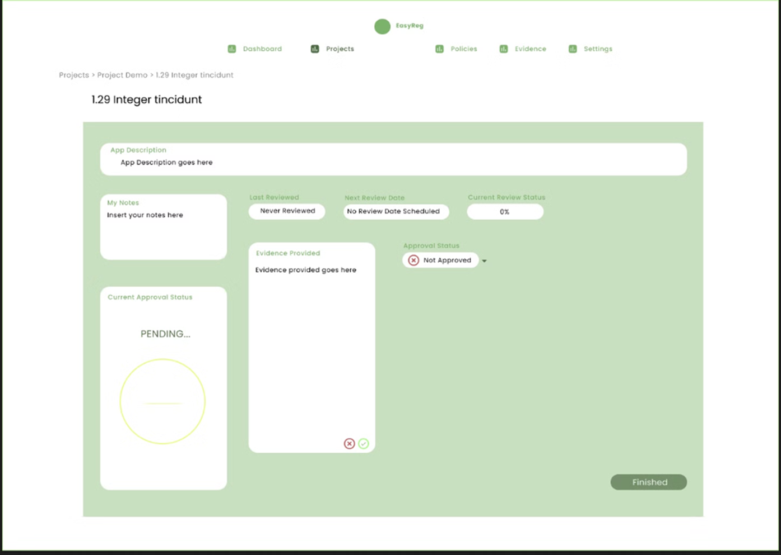
MOCKUPS
Practical simulation of EasyReg, demonstrating its functionalities and benefits in a real-world scenario.
11

Slide 12
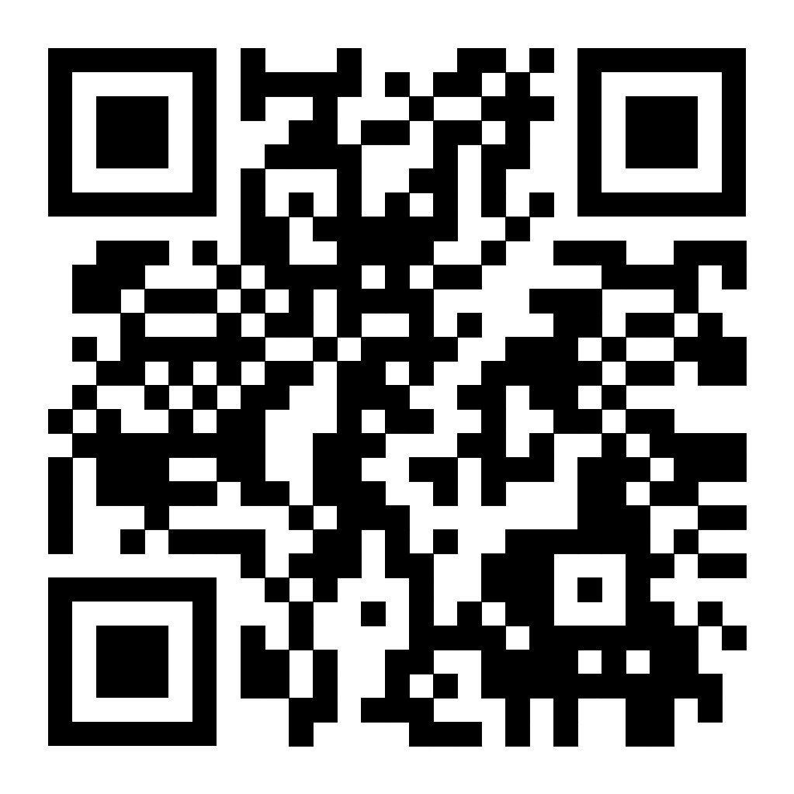
Micro Site
If you want to know more about us, scan the code or click the link. Feel free to ask any questions.
https://easyregpi.github.io/micro-site/
12

