Slide 1

EasyReg
Checkpoint 2
Universidade de Aveiro - DETI - May 2025
1

Slide 2
Table of Contents
01
02
03
04
Backlog
Currently working on
Next Steps
Calendar
2

Slide 3
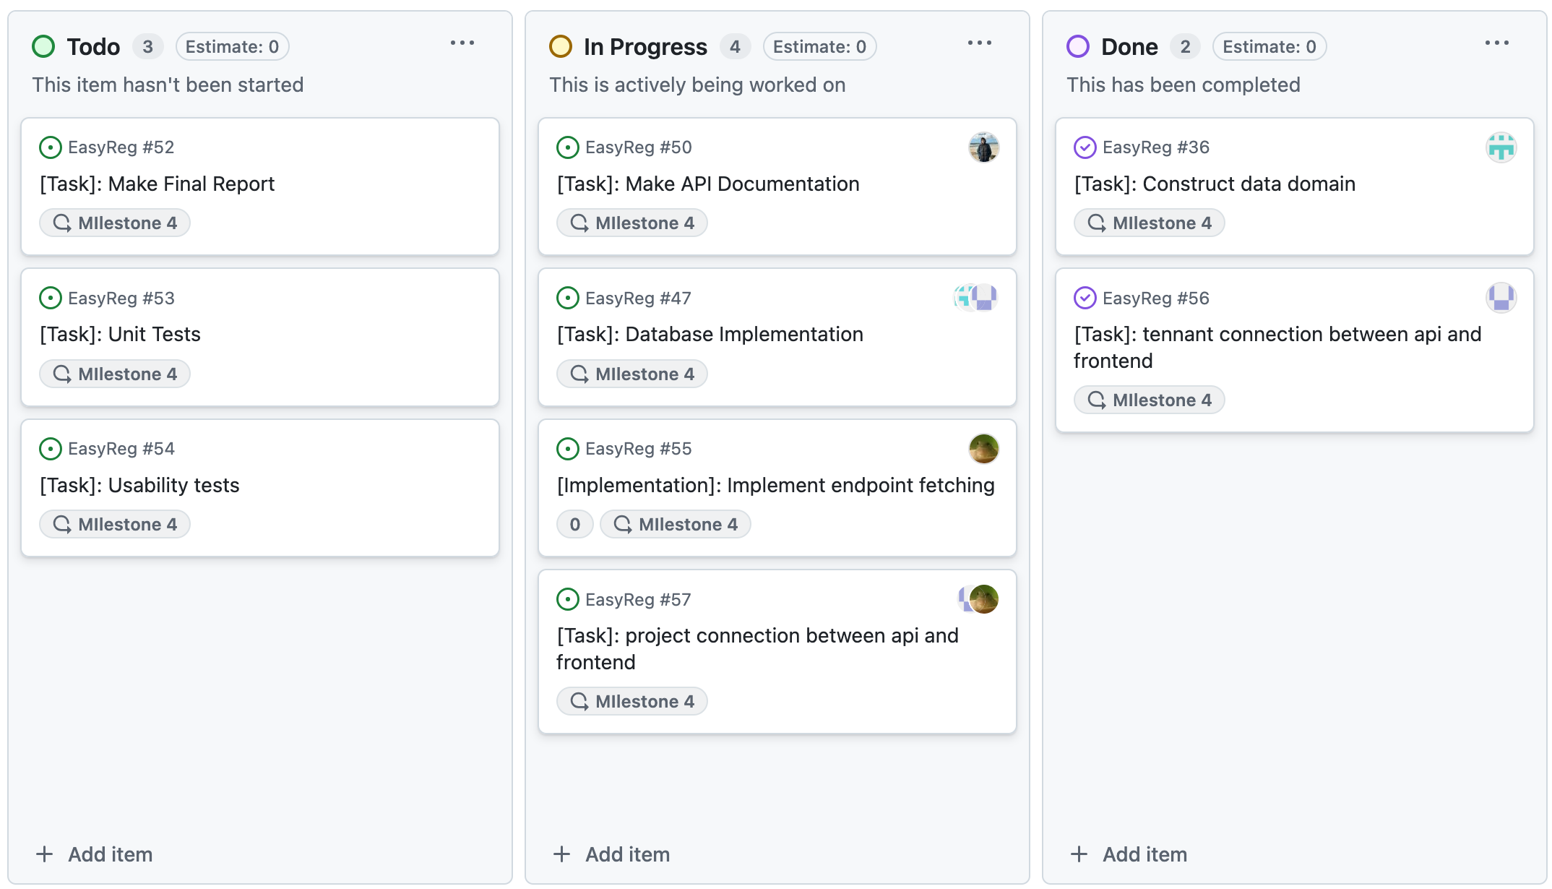
Backlog
3

Slide 4
Currently Working on (FrontEnd)
Connections between API and FrontEnd
CRUD methods for projects and tenants
Internal logic with associating:
Users -> Projects
Projects -> Tenants
Tenants -> Users
Keycloak information fetching and authentication
4

Slide 5
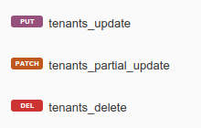

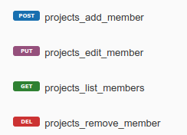

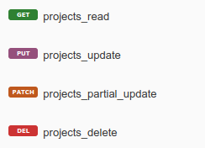
Currently Working on (BackEnd)
New tenant endpoints
Project endpoints
Project Members endpoints
5

Slide 6
Next Steps
Project Dashboard and evidence pages
Role Specific Screens
Tests
User Tests
Usability Tests
Feedback Analysis
Reports and Documentation
API Documentation
Technical Report
6

Slide 7
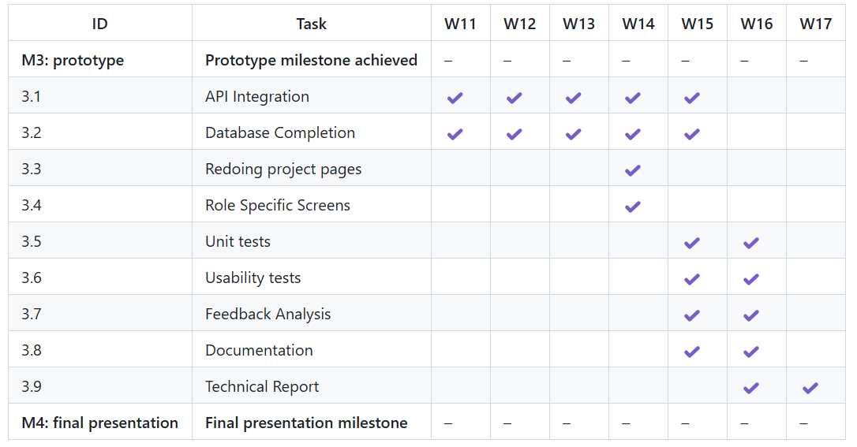
Calendar
7

Slide 8
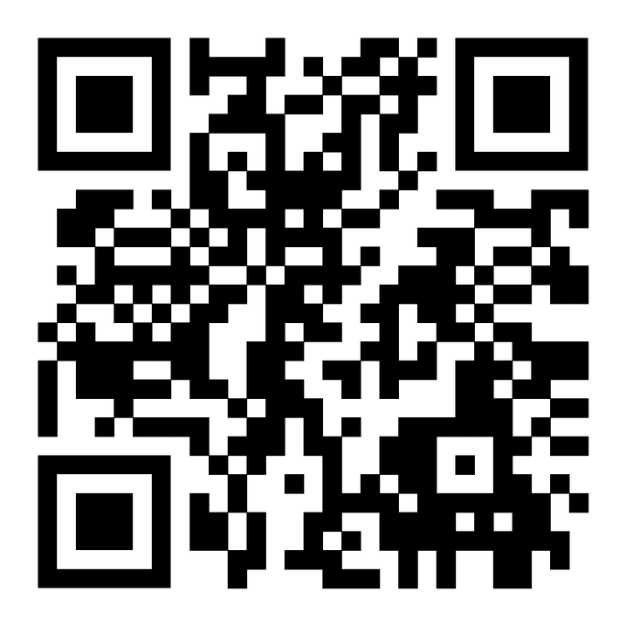
Micro-Site
Thank you!
8

