Slide 1
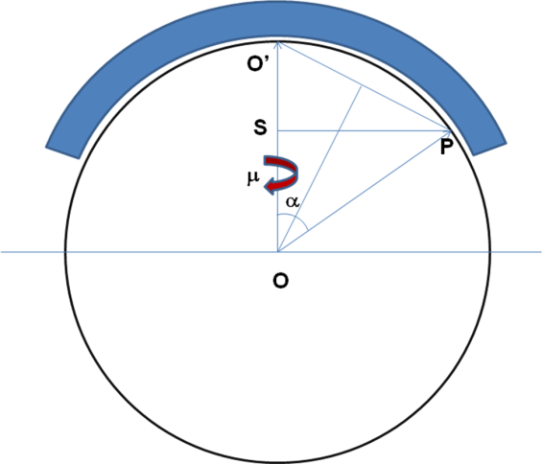

Slide 2
-z_{L}
x_{L}
O’
S
μ
P_{m}
α
μ
ν
γ
Q
O
y_{L}

Slide 3
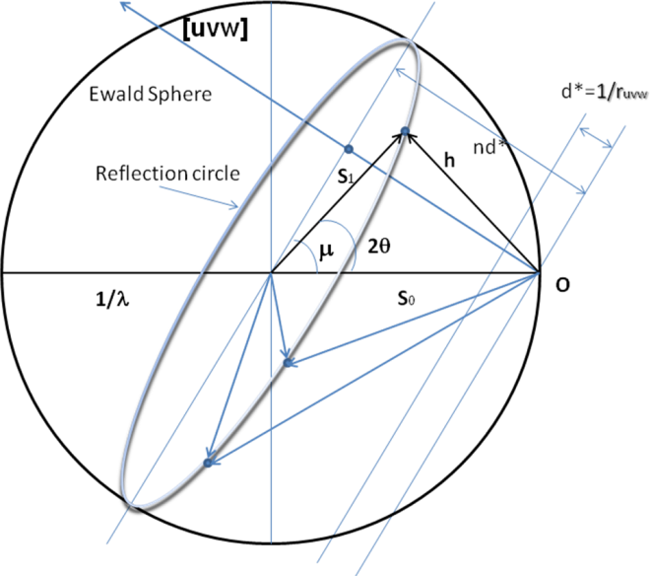
Flat cone geometry

Slide 4
Definition of the μ-rotation
y_{D}
μ
y_{L}
μ
z_{L}
z_{D}

