Slide 1
Interpretation of magnetic structures of insulators with the help of the computing programs SIMBO and ENERMAG
Juan Rodríguez-Carvajal
Institut Laue-Langevin
Diffraction Group

Slide 2
What is a magnetic structure? (1)
Paramagnetic state:
Snapshot of magnetic moment configuration
J_{ij}

Slide 3
What is a magnetic structure? (2)
Ordered state: Anti-ferromagnetic
Small fluctuations (spin waves) of static configuration
J_{ij}
Magnetic structure:
Quasi-static configuration of magnetic moments

Slide 4
Magnetic structures Magnetic moment → Fourier series
General expression of the Fourier coefficients (complex vectors) for an arbitrary site (drop of j indices ) when k and –k are not equivalent:
Only six parameters are independent. The writing above is convenient when relations between the vectors R and I are established (e.g. when |R|=|I|, or R . I =0)

Slide 5
Magnetic structures Magnetic moment → Fourier series
The program FullProf Studio performs the above sum and represents graphically the magnetic structure.
This program can help to learn about this formalism because the user can write manually the Fourier coefficients and see what is the corresponding magnetic structure immediately.
Web site: http://www.ill.eu/sites/fullprof/

Slide 6
Group theory: Representation analysis
According to the Landau theory of phase transitions, it is expected that the configuration of the magnetic moments can be described in terms of the basis functions of the Irreps of the propagation vector group G_{k} (subgroup of the SG formed by those elements that leave k invariant). The Irreps of G_{k} are tabulated or can be calculated independently of the problem
But, knowing the classical Hamiltonian of the spin system, the ground state (magnetic structure at T= 0 K) should minimize the energy
The symmetry of the Hamiltonian may be higher than the space group symmetry (e.g. isotropic exchange interactions)

Slide 7
Relation of Fourier coefficients and basis functions of Irreps
Fourier coeff.
Basis vectors
ν
The coefficients are the free parameters of the magnetic structure (order parameters of the phase transition in the Landau theory)
Indices:
k : reference to the propagation vector
ν : reference to the irreducible representation
n : index running from 1 up to n_{ν} ⇒
λ : index running from 1 up to

Slide 8
Basic Calculations (1)
The interaction energy between the spins i and j located respectively in the unit cells n and m, is supposed to be of the form:
The translation symmetry implies :

Slide 9
Basic Calculations (2)
The classical internal field approximation (H.M. James and T.A. Keenan, J. Chem. Phys. 31, 12, (1959)) assumes that the orientation distribution function for spin i is p_{i}(ω_{i}), which is normalized over all solid angle
The internal energy and the entropy of the spin system are:

Slide 10
Basic Calculations (3)
The minimisation of the free energy with respect to all p_{i} subject to the normalisation condition yields:
Anisotropic exchange
in terms of the average spins:
With the molecular field:

Slide 11
Basic Calculations (4)
The mean-field equation for all temperatures:
has the solution
representing the disordered state
At low temperature, the equation presents different solutions with
all of which evolves towards the disordered state as soon as the temperature increases.

Slide 12
Basic Calculations (5)
The temperature at which a solution disappears is called « branching temperature» T_{b}. In the neighborhood of T_{b}, the exponential function of the mean-field equation can be written in a linear form for the spin . When the average spin is small only the first non-null term is retained. We obtain the equations:
This equation can be simplified when taking into account the translational symmetry (Fourier transform).

Slide 13
Basic Calculations (6)
Using the Fourier expansion:
We obtain the equation:
Which is an eigen-value equation with:

Slide 14
Basic Calculations (7)
The final eigen-value/eigen-vector equation is:
If the equation is satisfied by the Fourier coefficients:
The first magnetically ordered state corresponds to the highest eigen-value (maximum branching temperature) of the Hermitical matrix representing the Fourier transform of the exchange interactions:

Slide 15
Interpretation of the magnetic structure as the ground state (first ordered state) of a classical spin system
Isotropic exchange
Classical magnetic energy: E = -Σ_{⟨ij⟩} J_{ij} S_{i} S_{j}
First ordered state corresponds to the lowest eigenvalue of the negative Fourier matrix of the exchange interactions:

Slide 16
Summary: SIMBO (1)
We have developed two programs (SIMBO and ENERMAG) that provide an important help for interpreting experimental magnetic structures in terms of relative exchange interactions
The program SIMBO analyses the crystal structure of an insulator in terms of super-exchange M₁-X-M₂ and super-super-exchange M₁-X₁-X₂-M₂ paths from the knowledge of the space group, atom coordinates in the asymmetric unit, ionic charges, magnetic moments and cell parameters.

Slide 17
Summary: SIMBO (2)
The program uses this information for calculating distances, angles and exchange paths. SIMBO provides a first file containing the list of paths connecting the magnetic atoms of the structure and attribute them the appropriate symbols for gathering the exchange interactions as a function of inter-atomic distances.
SIMBO provides also a formal description of the Fourier transform of the isotropic exchange interactions in a matrix form (exchange matrix) of dimension n × n, where n is the number of magnetic ions in the primitive cell.
This information is summarized in a file that is used by the program ENERMAG.

Slide 18
SIMBO input file
Input file: My_file.cfl
Example:
Title NiFePO5
Cell 7.1882 6.3924 7.4847 90.000 90.000 90.000
Spgr P n m a
! x y z occ B Spin Charge
Atom Ni NI 0.0000 0.0000 0.0000 0.74 0.5 2.0 2.0
Atom Fe FE 0.1443 0.2500 0.7074 0.63 0.5 5.0 3.0
Atom P P 0.3718 0.2500 0.1424 0.79 0.5 0.0 5.0
Atom O1 O 0.3988 0.2500 0.64585 0.71 0.5 0.0 -2.0
Atom O2 O 0.19415 0.2500 0.0253 0.70 0.5 0.0 -2.0
Atom O3 O 0.0437 0.2500 0.4728 0.83 0.5 0.0 -2.0
Atom O4 O 0.3678 0.0566 0.2633 0.77 1.0 0.0 -2.0

Slide 19
Phase diagram for the topology of MFePO₅

Slide 20
SIMBO output files
Output files:
My_file.nei ⇒ General output file
My_file.exc ⇒ Input file for ENERMAG
My_file.mcm ⇒ Input file for MCMAG

Slide 21
SIMBO running
C:\ProgCFML\Testing\Enermag>simbo mfepo5
------ PROGRAM SIMBO ------
---- Version 2.0 Oct-2003----
********************************************************
* Generates neighboring files for magnetic simulations *
********************************************************
(JRC- October 2003 )
=> Maximum bond-distance (Dmax) : 6.000
=> Maximum distance for direct exchange (Direct) : 0.000
=> Maximum distance for angle calculation(Dangl) : 0.000
=> Maximum distance for anion-anion bond (Dbond)
(also for cation-anion bonds) : 3.000
=> Maximum angle M-M'^M(M')-A(A') for S-E paths (Angm): 89.500
=> Minimum angle M-A-A'/M'-A'-A for S-E paths (Angn): 89.500
(if Dangl=0 no angles are calculated)
any change ? (Y/N=<cr>):

Slide 22
SIMBO running
any change ? (Y/N=<cr>): y
=> Give new values for Dmax, Direct, Dangl, Dbond, Angm and Angn :
5 0 0 3 90 90
=> List all distances & angles (y/n)? (def=n):
=> List detailed exchange paths (y/n)? (def=n):
Total CPU-Time
CPU-seconds: 0.45
CPU-minutes: 0.01
CPU-hours : 0.00
=> Results in files:
mfepo5.nei
mfepo5.exc -> input for ENERMAG
mfepo5.mcm -> input for MCMAG

Slide 23
SIMBO output (1)
============================================================
======> LIST OF INDEPENDENT EXCHANGE INTERACTIONS <=======
============================================================
=> Exchange interaction: J1 between Ni and Fe -> Distance: 2.9028
S-Exchange (d1,d2,theta): Ni_2-O1_3-Fe_4(0,0,0) ( 2.0676 2.0786 88.87 )
S-Exchange (d1,d2,theta): Ni_2-O2_4-Fe_4(0,0,0) ( 2.1301 2.4062 79.31 )
S-Exchange (d1,d2,theta): Ni_2-O4_7-Fe_4(0,0,0) ( 2.0427 2.0060 91.61 )
=> Exchange interaction: J2 between Ni and Ni -> Distance: 3.1962
S-Exchange (d1,d2,theta): Ni_1-O1_4-Ni_3(0,-1,0) ( 2.0676 2.0676 101.24 )
S-Exchange (d1,d2,theta): Ni_1-O2_3-Ni_3(0,-1,0) ( 2.1301 2.1301 97.22 )
SS-Exchange (d1,d2,d3,ang1,ang2,dihed): Ni_1-O4_4-O4_6-Ni_3(0,-1,0) ( 2.0427 2.4726 2.0427 100.20 100.20 0.00 )
=> Exchange interaction: J3 between Ni and Fe -> Distance: 3.3913
S-Exchange (d1,d2,theta): Ni_1-O1_2-Fe_2(-1,0,-1) ( 2.0676 1.8865 118.04 )
SS-Exchange (d1,d2,d3,ang1,ang2,dihed): Ni_1-O2_3-O4_5-Fe_2(-1,0,-1) ( 2.1301 2.5019 2.0060 91.11 108.22 34.14 )
=> Exchange interaction: J4 between Fe and Fe -> Distance: 3.6502
S-Exchange (d1,d2,theta): Fe_1-O1_2-Fe_2(-1,0,0) ( 2.0786 1.8865 133.97 )
SS-Exchange (d1,d2,d3,ang1,ang2,dihed): Fe_1-O3_1-O2_2-Fe_2(-1,0,0) ( 1.8990 2.5127 2.4062 112.06 98.89 0.00 )
=> Exchange interaction: J5 between Fe and Fe -> Distance: 4.9151
SS-Exchange (d1,d2,d3,ang1,ang2,dihed): Fe_1-O3_1-O4_8-Fe_3(-1,-1,0) ( 1.8990 2.5000 2.0060 147.80 110.96 15.72 )
SS-Exchange (d1,d2,d3,ang1,ang2,dihed): Fe_1-O4_4-O3_3-Fe_3(-1,-1,0) ( 2.0060 2.5000 1.8990 110.96 147.80 -15.72 )

Slide 24
SIMBO output (2)
-----------------------------
Effective Neighbouring matrix
-----------------------------
1 2 3 4 5 6 7 8
1 0 0 2 0 1 1 1 1
2 0 0 0 2 1 1 1 1
3 2 0 0 0 1 1 1 1
4 0 2 0 0 1 1 1 1
5 1 1 1 1 0 2 2 0
6 1 1 1 1 2 0 0 2
7 1 1 1 1 2 0 0 2
8 1 1 1 1 0 2 2 0

Slide 25
SIMBO output (3)
Terms of the Fourier transform of exchange interactions
=> J( 1, 1)[K] ( 0 terms)
=> J( 1, 2)[K] ( 0 terms)
=> J( 1, 3)[K] ( 2 terms)
Rn=(0,-1,0) dist= 3.1962 --> J2 exp{2pi(-Y)}
Rn=(0,0,0) dist= 3.1962 --> J2
=> J( 1, 4)[K] ( 0 terms)
=> J( 1, 5)[K] ( 1 terms)
Rn=(0,0,-1) dist= 2.9028 --> J1 exp{2pi(-Z)}
=> J( 1, 6)[K] ( 1 terms)
Rn=(-1,0,-1) dist= 3.3913 --> J3 exp{2pi(-X-Z)}
=> J( 1, 7)[K] ( 1 terms)
Rn=(-1,-1,0) dist= 2.9028 --> J1 exp{2pi(-X-Y)}
. . .
=> J( 5, 5)[K] ( 0 terms)
=> J( 5, 6)[K] ( 2 terms)
Rn=(-1,0,0) dist= 3.6502 --> J4 exp{2pi(-X)}
Rn=(0,0,0) dist= 3.6502 --> J4
=> J( 5, 7)[K] ( 2 terms)
Rn=(-1,-1,0) dist= 4.9151 --> J5 exp{2pi(-X-Y)}
Rn=(-1,0,0) dist= 4.9151 --> J5 exp{2pi(-X)}
=> J( 5, 8)[K] ( 0 terms)
. . .

Slide 26
SIMBO output (4)

Slide 27
Similar magnetic structures
k=(0,0,0), two sites M and Fe
of four sublattices
G_{M}+G_{Fe} = (+ - + - ; + - + -)

Slide 28
The program ENERMAG
The program handles the diagonalization of the Fourier matrix
solving the parametric equation:
ξ(k, J) v(k, J)= λ(k, J) v(k, J)
For a given set J ={J_{ij}}, and no degeneracy, the lowest eigenvalue λ_{min}(k₀, J) occurs for a particular k₀.
The corresponding eigenvector v_{min}(k₀, J) (that may be complex for incommensurate structures), describes the spin configuration of the first ordered state

Slide 29
ENERMAG (running)
C:\CrysFML\enermag>enermag
*****************************************************
**** PROGRAM ENERMAG ****
*****************************************************
*** Version 1.5 ***
*****************************************************
* Calculates the Magnetic Energy for k-vectors in BZ*
* Uses a Classical Heisenberg Hamiltonian *
* and isotropic exchange interactions *
*****************************************************
(JRC August-2001, LLB)
=> Code of the file xx.exc (give xx): mfepo5
=> Code of the .out file ( <cr>= mfepo5) :
=> Do you want to save data in *.res file (y/n)?: y
=> Code of the .res file ( <cr>= mfepo5) :
=> Give a comment for the .res file: Phase diagram of MFePO5

Slide 30
ENERMAG (running)
=> Input file read!!!
=> Do you want to calculate a phase diagram (y/n)?: y
=> Phase diagram will be calculated
=> Enter a target k-vector (3 reals): 0 0 0
=> Number of J's TO BE VARIED (<=15): 3
-> Number & Range of varied J-parameter 1 & No of points: 2 -100 100 15
-> Number & Range of varied J-parameter 2 & No of points: 3 -100 100 15
-> Number & Range of varied J-parameter 3 & No of points: 4 -100 100 15
=> Phase diagram for: 3375 sets of exchange integrals
Vectors k in BZ, components in [-1,1]
=> Options:
0: Special k-vectors
1: Give individual k-vectors
2: k-vectors along a line
3: k-vectors in a plane
4: General + Special k-vectors
5: Grid inside the Brillouin Zone
=> Give the option: 4
=> Number of k-vectors (<125000): 2000
=> Give region of k-vectors (in r.l.u.)
(kx1,kx2,ky1,ky2,kz1,kz2): 0 0.5 0 0.5 0 0.5

Slide 31
ENERMAG …
Once the program finishes the job, several files are generated and they can be analyzed by auxiliary programs.
Example:
The program PHASDIAG reads the file « *.res » generated by ENERMAG and gathers the solutions in two general types: commensurate and incommensurate (or not order at all), it generates a binary file that can be read by GFOURIER for graphical visualization of the phase diagram.

Slide 32
PhasDIAG
C:\ProgCFML\Testing\Enermag>phas
=> Code of the *.res file: mfepo5
=> Number of Js (only the first 3 Js may be varied!): 3
=> Number of Sites: 2
=> Number of atoms for site: 1: 4
=> Number of atoms for site: 2: 4
=> List of magnetic structure types:
Type Code Vk-Sign seq. J-domains ...... Frequency
1 17222 ( 1: + - + - + - + - ) k = ( 0 , 0 , 0 ) -100.0 100.0 -100.0 -14.3 -100.0 -14.3 689
2 16442 ( 1: + + + + - - - - ) k = ( 0 , 0 , 0 ) -100.0 100.0 -100.0 0.0 -14.3 100.0 936
3 56700 ( 4: + - - + 0 0 0 0 ) k = ( 0 , 0 , 1/2) -100.0 -71.4 -42.9 28.6 0.0 0.0 7
4 0 (10: 0 0 0 0 0 0 0 0 ) k = ( 0 , 1/4, 0 ) -100.0 100.0 -28.6 42.9 -85.7 85.7 61
5 82944 ( 6: + - - + 0 0 0 0 ) k = ( 1/2, 0 , 1/2) -100.0 -57.1 -28.6 14.3 -14.3 0.0 6
6 13174 ( 1: 0 0 0 0 + - - + ) k = ( 0 , 0 , 0 ) -100.0 14.3 -14.3 -14.3 -100.0 -85.7 5
7 95470 ( 7: + + - - + - - + ) k = ( 0 , 1/2, 1/2) -100.0 -85.7 -14.3 -14.3 -57.1 -57.1 2
8 17242 ( 1: + - + - - + - + ) k = ( 0 , 0 , 0 ) -100.0 100.0 0.0 100.0 -100.0 14.3 936
9 16686 ( 1: + + - - 0 0 0 0 ) k = ( 0 , 0 , 0 ) -100.0-100.0 0.0 0.0 0.0 0.0 1
10 42646 ( 3: + + + + + + + + ) k = ( 0 , 1/2, 0 ) -100.0 -85.7 14.3 14.3 57.1 57.1 2
11 13198 ( 1: 0 0 0 0 - - + + ) k = ( 0 , 0 , 0 ) -100.0 100.0 14.3 14.3 100.0 100.0 10
12 16402 ( 1: + + + + + + + + ) k = ( 0 , 0 , 0 ) -100.0 100.0 14.3 100.0 14.3 100.0 688
13 13190 ( 1: 0 0 0 0 - + + - ) k = ( 0 , 0 , 0 ) -85.7 100.0 -14.3 -14.3 -100.0-100.0 11
14 82296 ( 6: + + - - 0 0 0 0 ) k = ( 1/2, 0 , 1/2) -85.7 -85.7 0.0 0.0 0.0 0.0 1
15 96146 ( 7: + - - + - - - - ) k = ( 0 , 1/2, 1/2) -85.7 -42.9 14.3 14.3 71.4 71.4 4
16 43468 ( 3: + - + - + - - + ) k = ( 0 , 1/2, 0 ) -71.4 -71.4 -14.3 -14.3 -71.4 -71.4 1
17 13166 ( 1: 0 0 0 0 + + - - ) k = ( 0 , 0 , 0 ) -42.9 85.7 14.3 14.3 85.7 100.0 6
18 56581 ( 4: + - + - + + - + ) k = ( 0 , 0 , 1/2) -14.3 71.4 0.0 0.0 0.0 0.0 2
19 17224 ( 1: + - + - + - - + ) k = ( 0 , 0 , 0 ) 0.0 71.4 -14.3 -14.3 -100.0 -85.7 3
20 16438 ( 1: + + + + - - + + ) k = ( 0 , 0 , 0 ) 0.0 0.0 14.3 14.3 85.7 85.7 1
21 55781 ( 4: + + + + + - - - ) k = ( 0 , 0 , 1/2) 14.3 57.1 0.0 0.0 0.0 0.0 2
22 16406 ( 1: + + + + + + - - ) k = ( 0 , 0 , 0 ) 14.3 71.4 14.3 14.3 85.7 100.0 2
=> Density = Log(Frequency) (f) :
Density = Code (c) :
Density = Order (o) :
Density = User defined (u) (<cr>=u)?: o
=> Binary file : mfepo5.bin
=> Summary file : mfepo5.ana

Slide 33
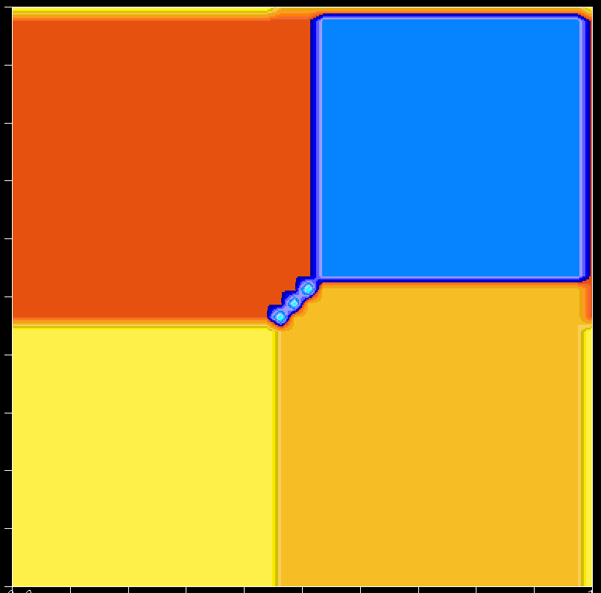
The compounds of formula MFePO₅ can be modelled with four exchange interactions:
J₂=-6.7
20
J₁ corresponds to the exchange between M²⁺ and Fe³⁺ nearest neighbours.
J₂ corresponds to the exchange between two M²⁺ cations (double oxygen bridge).
G_{M}+G_{Fe}
F_{M}+F_{Fe}
J₁
J₃ corresponds to the exchange between next nearest neighbours M²⁺ and Fe³⁺ cations (single oxygen bridge).
F_{M}-F_{Fe}
G_{M}-G_{Fe}
J₄ exchange between nearest neighbours Fe³⁺ cations (single oxygen bridge), taken here as J₄=-1
-20
-20
J₃
20

Slide 34
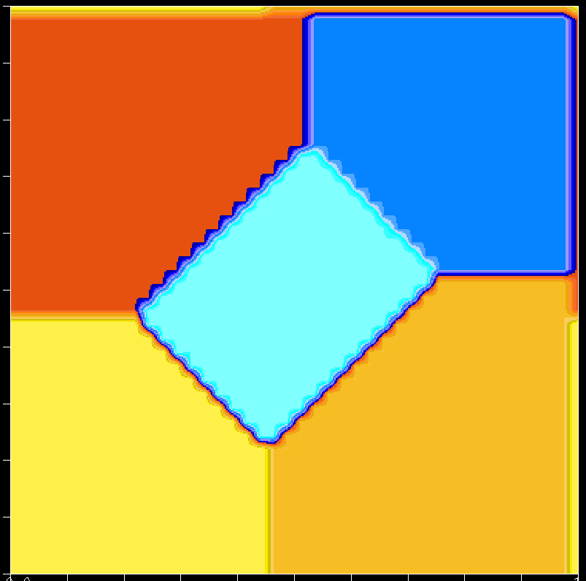
20
J₂ = -15
F_{M}+F_{Fe}
G_{M}+G_{Fe}
J₁
Incommensurate
F_{M}-F_{Fe}
G_{M}-G_{Fe}
-20
-20
J₃
20

Slide 36
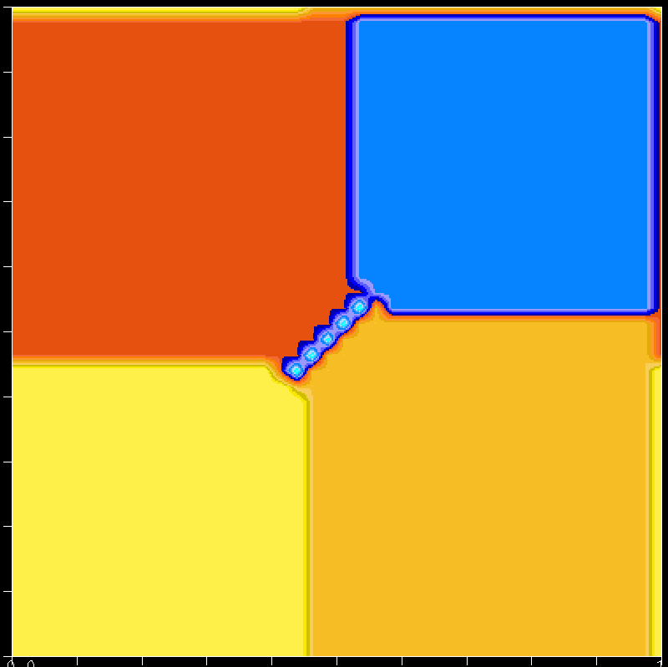

Slide 37
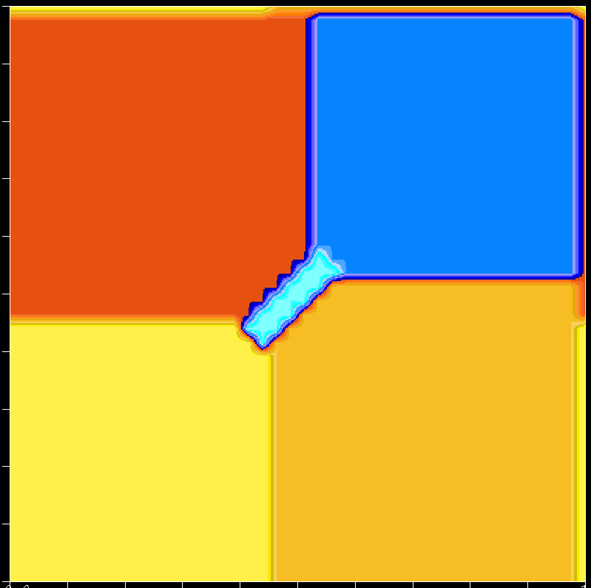

Slide 38
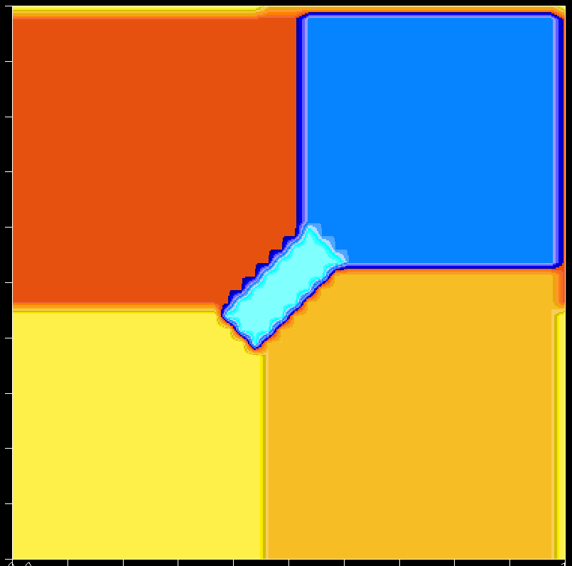

Slide 39
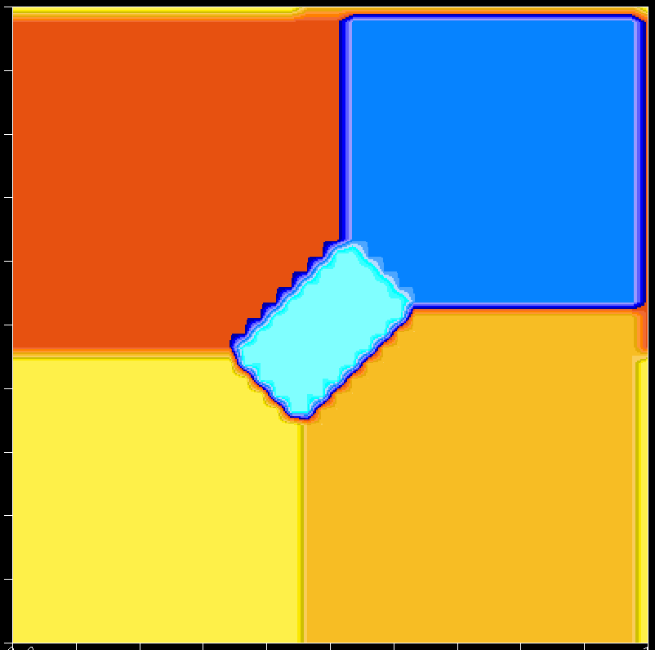

Slide 40
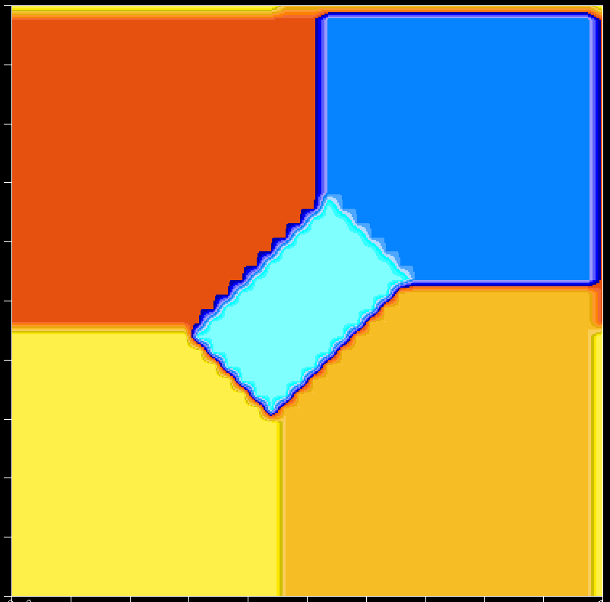

Slide 41
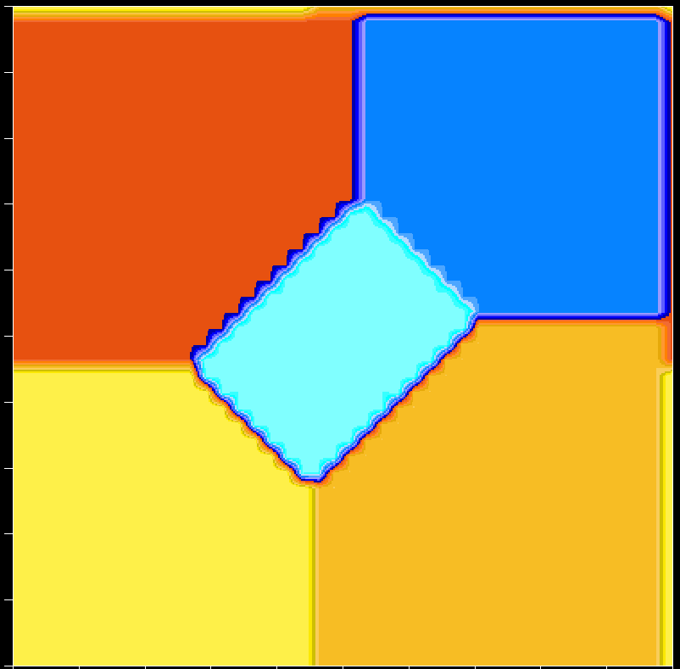

Slide 43
Paramelaconite Cu₄O₃
Magnetic properties of paramelaconite Cu₄O₃: A pyrochlore lattice with S=1/2, L Pinsard-Gaudart, J. Rodríguez-Carvajal, A. Gukasov, P. Monod. Physical Review B69, 104408 (2004).

Slide 44
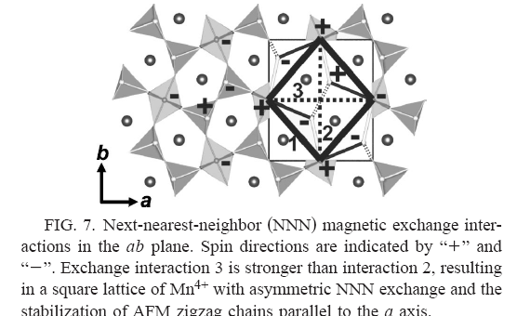
Multiferroics RMn₂O₅
Spin structure and magnetic frustration in multiferroic RMn₂O₅ (R=Tb, Ho, Dy), G.R. Blake, L.C. Chapon, P.G. Radaelli, S. Park, N. Hur, S.W. Cheong, J. Rodríguez-Carvajal. Physical Review B71, 214402 (2005).

Slide 45
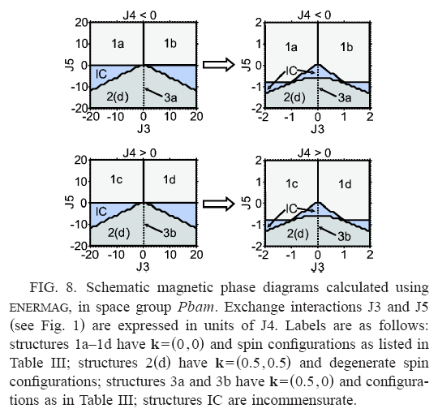
Multiferroics RMn₂O₅

Slide 46
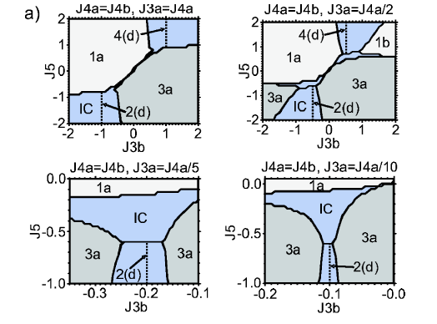
Multiferroics RMn₂O₅

Slide 47
Conclusions
In many cases neutron diffraction is not able to provide a unique solution for a magnetic structure. It is very important to have a good knowledge of the possible exchange interaction in order to be able to select one of the solutions.
The analysis of the exchange paths and the magnetic topology is crucial for understanding the observed magnetic structures.
The use of the programs SIMBO and ENERMAG can help considerably to this task.
If you want to get more detail contact me during the meeting or send me an e-mail to jrc@ill.fr

Slide 48
Some references using SIMBO and ENERMAG
Crystal and magnetic structures of the oxyphosphates MFePO₅ (M = Fe, Co, Ni, Cu). Analysis of the magnetic ground state in terms of superexchange interactions, N. El Khayati, R. Cherkaoui El Moursli, J. Rodríguez-Carvajal, G. André, N. Blanchard, F. Bourée, G. Collin, and T. Roisnel. The European Physical Journal B 22, 429-442 (2001).
Neutron diffraction study of the magnetic ordering in the series R₂BaNiO₅ (R=Rare Earth), E. García-Matres, J.L. Martínez, and J. Rodríguez-Carvajal. The European Physical Journal B 24, 59 (2001).
Magnetic Structural Studies of the Two Polymorphs of Li₃Fe₂(PO₄)₃: Analysis of the Magnetic Ground State from Super-Super Exchange Interactions, G. Rousse, J. Rodríguez-Carvajal, C. Wurm, and C. Masquelier. Chemistry of Materials 13, 4527 (2001).
A neutron diffraction study of the antiferromagnetic diphosphate LiFeP₂O₇, Gwenaelle Rousse, Juan Rodríguez-Carvajal, Calin Wurm and Christian Masquelier. Solid State Sciences 4, 973 (2002).
Magnetic structure and exchange interactions in CuFe₂(P₂O₇)₂, N. El Khayati, J. Rodríguez-Carvajal, F. Bourée, T. Roisnel, R. Cherkaoui, A. Boutfessi, A. Boukhari, Solid State Sciences 4, 1273 (2002).
Magnetic properties of paramelaconite Cu₄O₃: A pyrochlore lattice with S=1/2, L Pinsard-Gaudart, J. Rodríguez-Carvajal, A. Gukasov, P. Monod. Physical Review B69, 104408 (2004).
Spin structure and magnetic frustration in multiferroic RMn₂O₅ (R=Tb, Ho, Dy), G.R. Blake, L.C. Chapon, P.G. Radaelli, S. Park, N. Hur, S.W. Cheong, J. Rodríguez-Carvajal. Physical Review B71, 214402 (2005).

