Slide 1
RhoChi:
Input files
The program structure (GUI + internal calculations)
ToDo
19.03.2019

Slide 2
Input files

Slide 3
Experimental data:
single crystal: list of hkl reflections
powder: 1D, 2D diffraction profiles and background
Model parameters:
“.cif” or STAR-like file (International Tables vol. G)
Handbooks values:
space groupe
magnetic form-factors (<j₀>, <j₂>)
neutron scattering length

Slide 4
Structure of experimental data :
for single crystal:
#wavelength 1.40
#field 0.000 0.000 1.000
#orientation 0.6468462 -0.6860854 0.3300297 0.2141139 -0.2557555 -0.9343334 0.7319312 0.6810804 -0.0183183
# h k l FR sFR
0 0 8 0.64545 0.01329
2 0 6 1.75682 0.04540
...
for 1D powder diffraction:
#wavelength 2.35
#field 0.0 0.0 5.0
# ttheta IntUP sIntUP IntDOWN sIntDOWN
7.80 0.74282 0.55201 0.24785 0.29666
8.00 0.18608 0.18170 0.16548 0.17133
...
for 2D powder diffraction:
#wavelength 2.35
#field 0.0 0.0 5.0
#IntUP
241 4.00000 4.20000 ...
-40.00000 -85.31322 7.54655 ...
-39.50000 -53.87826 59.90163 ...
... ... ... ...
for background:
# ttheta IntBKGR
8.20 0.11000
80.40 0.18300
...

Slide 5
Structure of “.rcif” :
description of phase (totally correspond to .cif description)
description of experiment
description of refinement procedure
refinement
global_filerhochi
data_nacaalf
_cell_length_a 9.88888773144
_cell_length_b 9.88888773144
...
loop_
_atom_site_label
_atom_site_type_symbol
_atom_site_fract_x
_atom_site_fract_y
_atom_site_fract_z
_atom_site_occupancy
_atom_site_b_iso_or_equiv
F1 F 0.13847 0.30656 0.12052 1.0 0.0
...
data_ref
_refinement_file_name_output 'full.lis‘
loop_
_refinement_param1
$pnd_$nacaalf_pd_phase_scale
...
data_pnd
_2dpd_file_name_bkgr 'full.bkg'
_2dpd_file_name_input 'full.dat‘
...
loop_
_2dpd_phase_name
_2dpd_phase_scale
_2dpd_phase_igsize
_2dpd_phase_extinction_radius
_2dpd_phase_extinction_mosaicity
nacaalf 0.0110321630859 0.0 0.0 0.0
phase
experiment
It can be directly used to plot the structure

Slide 6

Handbook values: space group
Own format
(‘itables.txt’):
203 Fd-3 Cubic
choice: 1
centr: true
pcentr: -0.125,-0.125,-0.125
symmetry: x,y,z
symmetry: -x,-y,z
symmetry: -x,y,-z
symmetry: x,-y,-z
symmetry: z,x,y
symmetry: z,-x,-y
symmetry: -z,-x,y
symmetry: -z,x,-y
symmetry: y,z,x
symmetry: -y,z,-x
symmetry: y,-z,-x
symmetry: -y,-z,x
203 Fd-3 Cubic
choice: 2
centr: true
pcentr: 0, 0, 0
symmetry: x,y,z
symmetry: -x+1/4,-y+1/4,z
symmetry: -x+1/4,y,-z+1/4
symmetry: x,-y+1/4,-z+1/4
symmetry: z,x,y
symmetry: z,-x+1/4,-y+1/4
symmetry: -z+1/4,-x+1/4,y
symmetry: -z+1/4,x,-y+1/4
symmetry: y,z,x
symmetry: -y+1/4,z,-x+1/4
symmetry: y,-z+1/4,-x+1/4
symmetry: -y+1/4,-z+1/4,x
In prinicpal ‘spgra.dat’ can be used
203 1 14 0 24 F d -3
1917 816 910 7 0 0 5 0 6 6 0
x,y,z
-x,-y,z
...
-x+1/4,-y+1/4,-z+1/4
x+1/4,y+1/4,-z+1/4
...
203 2 14 1 12 F d -3
1917 816 910 7 0 0 5 0 6 6 0
x,y,z
-x+1/4,-y+1/4,z
-x+1/4,y,-z+1/4
x,-y+1/4,-z+1/4
z,x,y
z,-x+1/4,-y+1/4
-z+1/4,-x+1/4,y
-z+1/4,x,-y+1/4
y,z,x
-y+1/4,z,-x+1/4
y,-z+1/4,-x+1/4
-y+1/4,-z+1/4,x
but for some space group the expression can not be used:
$$F_{hkl}=0.5\left(F_{au}+F_{au}^{∗}e^{4πi\vec{p}⋅\vec{h}} \right)$$

Slide 7
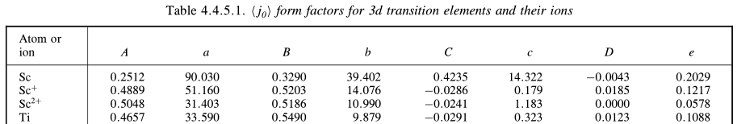


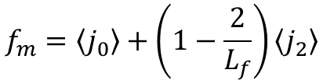
Handbook values: <j₀>, <j₂>
File ‘formmag.tab’ is used
Z <j0> form factors for 3d transition elements and their ions
Z
F Sc0 0 0.2512 90.0296 0.3290 39.4021 0.4235 14.3222 -0.0043
F Sc1 0 0.4889 51.1603 0.5203 14.0764 -0.0286 0.1792 0.0185
F Sc2 0 0.5048 31.4035 0.5186 10.9897 -0.0241 1.1831 0.0000
F Ti0 0 0.4657 33.5898 0.5490 9.8791 -0.0291 0.3232 0.0123
...
It is a replica of the tables from ‘International Tables vol.C’ section 4.4.5 ‘Magnetic form factors’:
$$f_{m}=\left\langle j_{0}\right\rangle +\left(1−\frac{2}{L_{f}}\right)\left\langle j_{2}\right\rangle$$

Slide 8
Handbook values: neutron scattering length
File ‘bscat.tab’ is used (taken for internet):
#Column Unit Quantity
#1 --- Isotope
#2 --- Natural abundance (For radioisotopes the half-life is given instead)
#3 fm bound coherent scattering length
#4 fm bound incoherent scattering length
#5 barn bound coherent scattering cross section
#6 barn bound incoherent scattering cross section
#7 barn total bound scattering cross section
#8 barn absorption cross section for 2200 m/s neutrons
#Note: 1 fm = 1E-15 m, 1 barn = 1E-24 cm2, scattering lengths and cross sections in parenthesis are uncertainties.
#
#
#
#Neutron scattering lengths and cross sections
#!Isotope conc Coh b Inc b Coh xs Inc xs Scatt xs Abs xs
H --- -3.7390 --- 1.7568 80.26 82.02 0.3326
1H 99.985 -3.7406 25.274 1.7583 80.27 82.03 0.3326
...

Slide 9
Structure of the program

Slide 10
General structure
handbook files
module ‘cfunc’
console block
module: ‘read_rcif.py’
The common functions are defined in ‘cfunc’
parameter file (.rcif)
object ‘ccore’
1.
2.
‘ccore’ is responsible for calculations
output files
‘cmodel’ is responsible for connection
(‘ccore’ know nothing about cmodel)
GUI block
‘widgets’ displays the parameters of ‘cmodel’
3.
the widget is changed
5.
widgets
user
object ‘cmodel’
‘cmodel’ is changed
the user action
4.
‘Main window’ defines the widgets which are displayed
user
main window

Slide 11
GUI block
main window
widget
cmodel

Slide 12
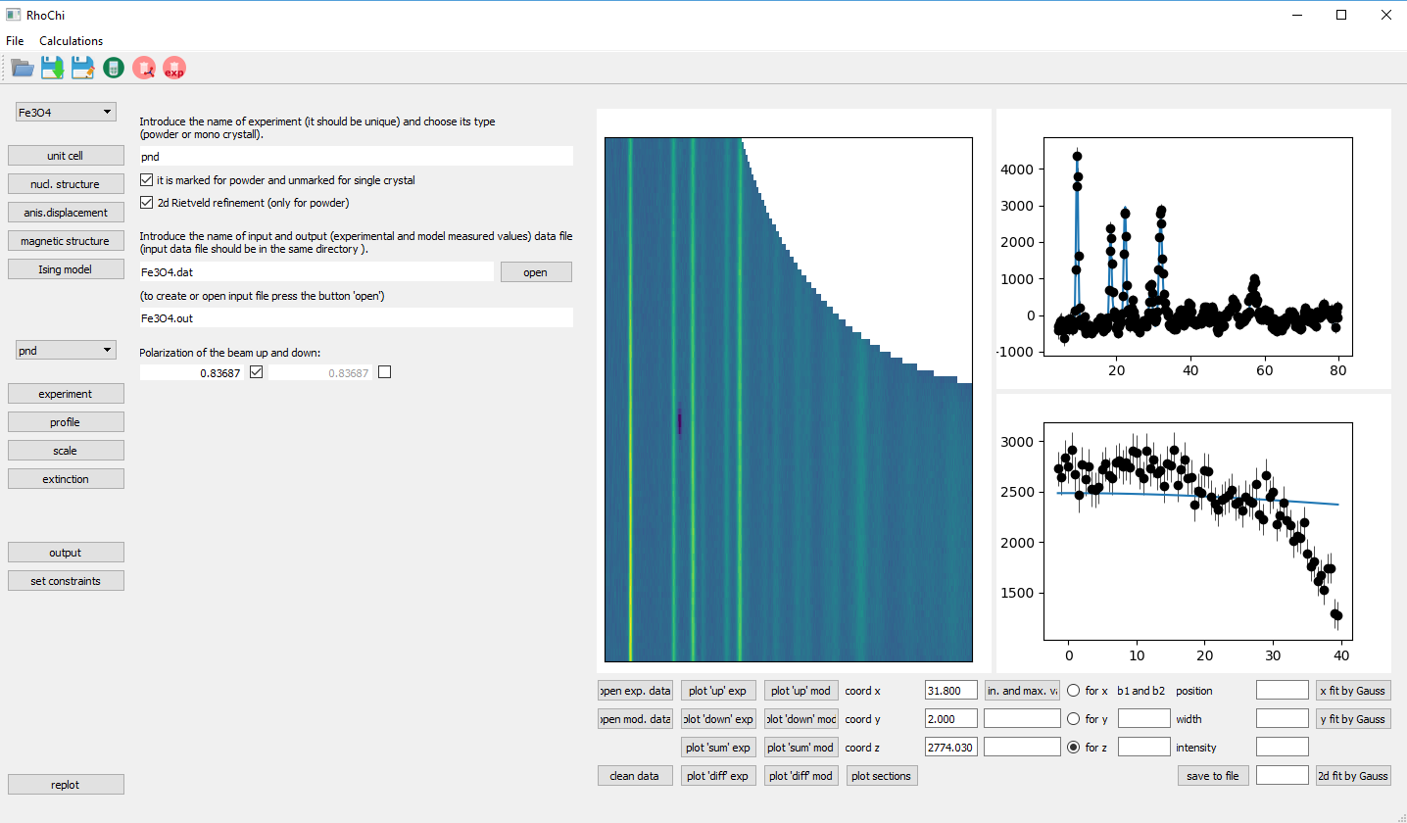
‘Main window’ (defined in the file ‘rhochi.py’)
The widgets:
widg_cpanel
widg_left
widg_right
The widget description is given in separate files.
info about ‘cmodel’
output files
The main methods:
open file
save file
run calculations in the separate thread

Slide 13
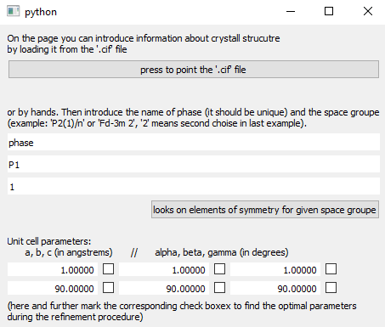
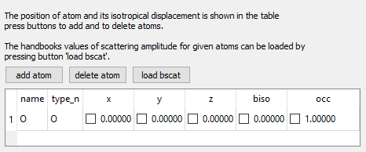
‘Widgets’ to interact with ‘cmodel’
List of widgets (each in the separate file ‘.py’):
widg_adp
widg_const
widg_exptype
widg_extinction
widg_magn
widg_magn_ising
widg_nucl
widg_output
widg_param
widg_profile
widg_results
widg_scale
widg_cb_exp
widg_cb_ph
widg_cb_ph_exp
widg_sconstr
widg_spgr
wind_create_file
example: widg_spgr.py
Common elements:
QCheckBox
QLineEdit
QTableWidget
example: widg_nucl.py
Parent class:
widg_min

Slide 14
Parent class ‘widg_min’
The main methods:
put_le
put_checkb
put_tab
signal_for_tab
set_val
get_val
the methods to create the widgets
the methods to interacte with cmodel

Slide 15
Object ‘cmodel’
cmodel
cmodel_ph
cmodel_at
cmodel_exp
cmodel_exp_ph
cmodel_ref:
‘cmodel’ has information about the model parameters
‘cmodel_ph’ has information about a phase
‘cmodel_at’ has information about an atom
‘cmodel_exp’ has information about an experiment
‘cmodel_exp_ph’ has information about a phase contributing in experiment
(these classes are defined in one file ‘cmodel.py’)
Tasks in front of cmodel:
interaction with ‘widgets’
interaction with ‘ccore’
Parent class:
cmodel_min
to define the interaction with ‘widgets’
(the class is defined in the file ‘widg.min’)

Slide 16
Parent class ‘cmodel_min’ (in the file ‘widdg_min.py’)
The main methods:
set_val
val_changed
set_val_by_link
mod_changed
add_obs_labs_pars
del_obs_labs_pars
del_obs
add_builder
del_builder
it change the cmodel parameter if the state of the cwidget is changed
the list of observers which change the state of the widget when ‘cmodel’ is changed

Slide 17
Console block

Slide 18
Object ‘ccore’
ccore
ccore_ph
ccore_at
ccore_exp
ccore_exp_ph
ccore_ref:
‘ccore’ has information about the model parameters
‘ccore_ph’ has information about a phase
‘ccore_at’ has information about an atom
‘ccore_exp’ has information about an experiment
‘ccore_exp_ph’ has information about a phase contributing in experiment
(these classes are defined in one file ‘ccore.py’)
Tasks in front of ccore:
load exerimental data
calculations

Slide 19
Ccore
The main methods:
run_refinement
refinement, by simplex method
run_errors
estimation of errorbars by calculation of Hessian
calc_chi2
calculation of chi2
out_to_string
print information into output files
take_param_ref
find the parameters which are refined ones
take_param_const
find the parameters which are constrained
reload_const
recalculate the constraint parameters and put it in the model

Slide 20
Ccore_exp
The main methods:
load_exp_data
make prelimiary calculations and load experimental points before refinement
calc_chi2
calculation of chi2 for one experiment
save_mod_data
save the calculated points in the output file
out_to_string
output information about experiment

Slide 21
Ccore_exp_ph
The main methods:
load_exp_data
make prelimiary calculations and load experimental points before refienement
out_to_string
output information about phase in the experiment

Slide 22
Ccore_ph
The main methods:
load_exp_data
make prelimiary calculations and load experimental points before refienement
out_to_string
output information about phase
calcmB
calculation of the B matrix
getsymm
get information about symmetry elements base on the space group
calcFNhkl
calculation of the nuclear structure factor
calcSFThkl
calculation of the structure factor tensor

Slide 23
Ccore_ph_at
The main methods:
load_exp_data
make prelimiary calculations and load experimental points before refienement
out_to_string
output information about phase
calcMFFSpherMod
calculation of the magnetic form factor in frame of Spherical model
get_j0j2
get information about coefficients for j0 and j2 calculations

Slide 24
Ccore_ref
The main methods:
out_to_string
output information about refined parameters

Slide 25
ToDo

Slide 26
Executable file
Organisation of modules by folders
Least square refinement

Slide 27
Thank you for your attention.

