Slide 1
RhoChi:
Input files
Program structure
ToDo
19.03.2019

Slide 2
Input files

Slide 3
Experimental data:
single crystal: list of hkl reflections
powder: 1D, 2D diffraction profiles and background
Model parameters:
“.cif” or STAR-like file (International Tables vol. G)
Handbook values:
space group
magnetic form-factors (<j₀>, <j₂>)
neutron scattering length

Slide 4


Experimental data
single crystal:
#wavelength 1.40
#field 0.000 0.000 1.000
#orientation 0.6468462 -0.6860854 0.3300297 0.2141139 -0.2557555 -0.9343334 0.7319312 0.6810804 -0.0183183
# h k l FR sFR
0 0 8 0.64545 0.01329
2 0 6 1.75682 0.04540
...
1D powder diffraction:
#wavelength 2.35
#field 0.0 0.0 5.0
# ttheta IntUP sIntUP IntDOWN sIntDOWN
7.80 0.74282 0.55201 0.24785 0.29666
8.00 0.18608 0.18170 0.16548 0.17133
...
2D powder diffraction:
#wavelength 2.35
#field 0.0 0.0 5.0
#IntUP
241 4.00000 4.20000 ...
-40.00000 -85.31322 7.54655 ...
-39.50000 -53.87826 59.90163 ...
... ... ... ...
$$2θ$$
$$φ$$
background:
# ttheta IntBKGR
8.20 0.11000
80.40 0.18300
...

Slide 5
Model parameters -- “.rcif”
phase (totally correspond to .cif description)
experiment
refinement
refinement
global_filerhochi
data_nacaalf
_cell_length_a 9.88888773144
_cell_length_b 9.88888773144
...
loop_
_atom_site_label
_atom_site_type_symbol
_atom_site_fract_x
_atom_site_fract_y
_atom_site_fract_z
_atom_site_occupancy
_atom_site_b_iso_or_equiv
F1 F 0.13847 0.30656 0.12052 1.0 0.0
...
data_ref
_refinement_file_name_output 'full.lis‘
loop_
_refinement_param1
$pnd_$nacaalf_pd_phase_scale
...
data_pnd
_2dpd_file_name_bkgr 'full.bkg'
_2dpd_file_name_input 'full.dat‘
...
loop_
_2dpd_phase_name
_2dpd_phase_scale
_2dpd_phase_igsize
_2dpd_phase_extinction_radius
_2dpd_phase_extinction_mosaicity
nacaalf 0.0110321630859 0.0 0.0 0.0
phase
experiment
It can be directly used to plot the structure

Slide 6
Handbook values
203 Fd-3 Cubic
choice: 1
centr: true
pcentr: -0.125,-0.125,-0.125
symmetry: x,y,z
symmetry: -x,-y,z
symmetry: -x,y,-z
symmetry: x,-y,-z
symmetry: z,x,y
symmetry: z,-x,-y
symmetry: -z,-x,y
symmetry: -z,x,-y
symmetry: y,z,x
symmetry: -y,z,-x
symmetry: y,-z,-x
symmetry: -y,-z,x
space group: ‘itables.txt’
coefficients for <j₀>, <j₂>: ‘formmag.tab’
neutron scattering length: ‘bscat.tab’
Z <j0> form factors for 3d transition elements and their ions
Z
F Sc0 0 0.2512 90.0296 0.3290 39.4021 0.4235 14.3222 -0.0043
F Sc1 0 0.4889 51.1603 0.5203 14.0764 -0.0286 0.1792 0.0185
F Sc2 0 0.5048 31.4035 0.5186 10.9897 -0.0241 1.1831 0.0000
F Ti0 0 0.4657 33.5898 0.5490 9.8791 -0.0291 0.3232 0.0123
...
#Neutron scattering lengths and cross sections
#!Isotope conc Coh b Inc b Coh xs Inc xs Scatt xs Abs xs
H --- -3.7390 --- 1.7568 80.26 82.02 0.3326
1H 99.985 -3.7406 25.274 1.7583 80.27 82.03 0.3326
...

Slide 7
Program structure

Slide 8
Principal scheme
handbook files
module ‘cfunc’
console block:
parameter file (.rcif)
object ‘ccore’
‘ccore’ is responsible for calculations
1.
2.
output files
‘cmodel’ is responsible for connection with ‘ccore’
GUI block:
‘cmodel’ informs ‘widgets’ about changes in the model
3.
5.
widgets
user
object ‘cmodel’
‘widgets’ displays the parameters of ‘cmodel’
4.
user
main window
‘Main window’ defines the displayed widgets

Slide 9
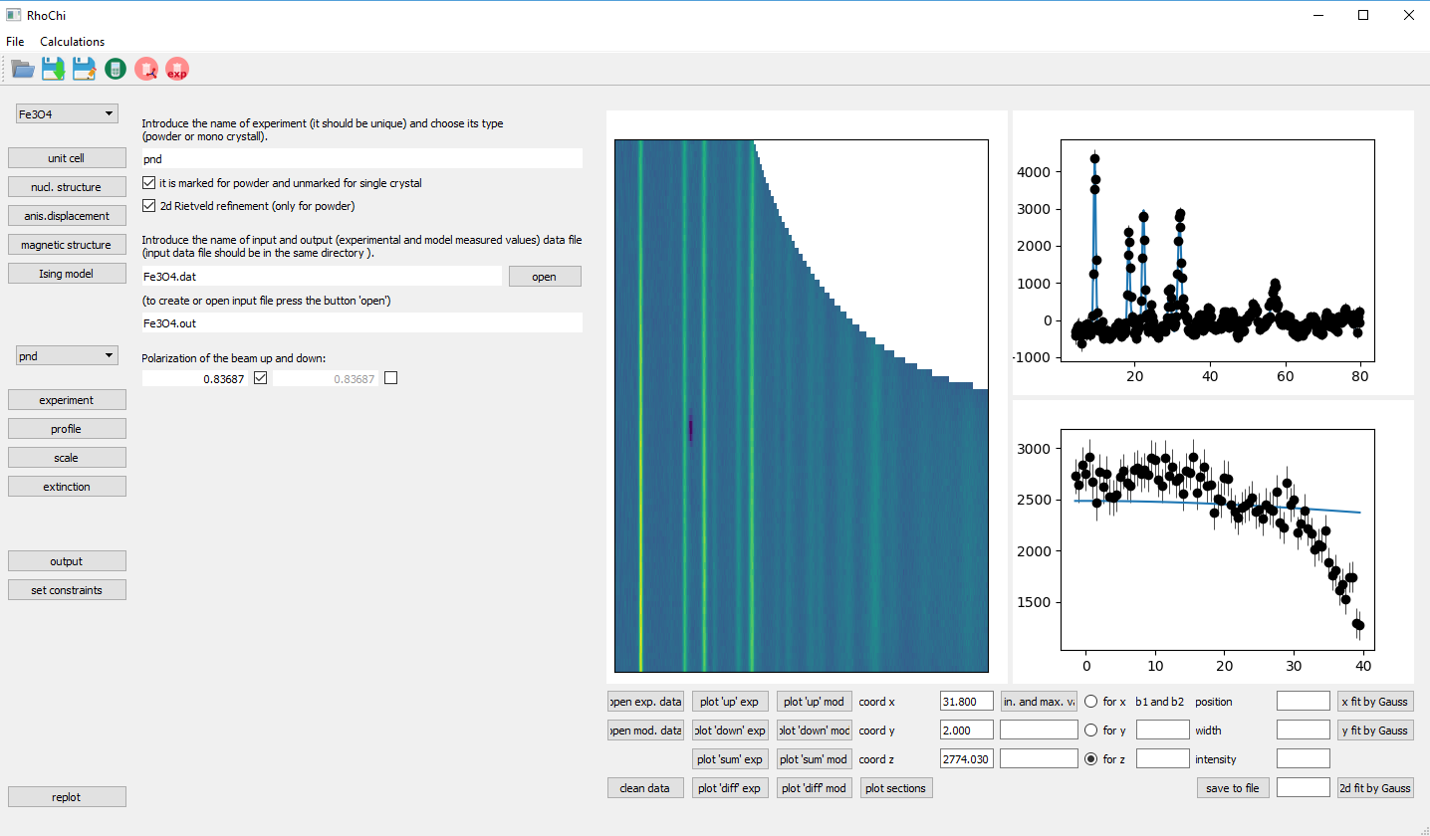
‘Main window’ (defined in the file ‘rhochi.py’)
The widgets:
widg_cpanel
widg_left
widg_right
The widget description is given in separate files.
info about ‘cmodel’
output files
The main methods:
open file
save file
run calculations in the separate thread

Slide 10
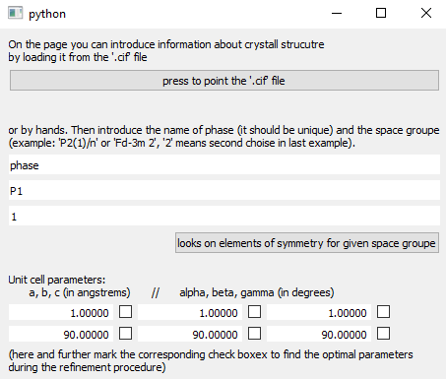
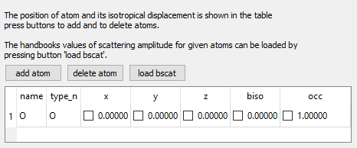
‘Widgets’ interacting with ‘cmodel’
List of widgets (each in the separate file ‘.py’):
widg_adp
widg_const
widg_exptype
widg_extinction
widg_magn
widg_magn_ising
widg_nucl
widg_output
widg_param
widg_profile
widg_results
widg_scale
widg_cb_exp
widg_cb_ph
widg_cb_ph_exp
widg_sconstr
widg_spgr
example: widg_spgr.py
Common elements:
QCheckBox
QLineEdit
QTableWidget
example: widg_nucl.py
Parent class:
widg_min
(methods to interacte with cmodel)

Slide 11
Object ‘cmodel’ (‘cmodel.py’)
cmodel
cmodel_ph
cmodel_at
cmodel_exp
cmodel_exp_ph
cmodel_ref:
‘cmodel’ has information about the model parameters
‘cmodel_ph’ has information about a phase
‘cmodel_at’ has information about an atom
‘cmodel_exp’ has information about an experiment
‘cmodel_exp_ph’ has information about a phase contributing in experiment
(these classes are defined in one file ‘cmodel.py’)
Tasks:
interaction with ‘widgets’
interaction with ‘ccore’
object ‘ccore’
Parent class:
cmodel_min
user
object ‘cmodel’
widgets
(method to interact with ‘widgets’)

Slide 12
Object ‘ccore’ (‘ccore.py’)
The main methods:
ccore:
run_refinement
refinement, by simplex method
run_errors
estimation of errorbars by calculation of Hessian
ccore_exp:
load_exp_data
make prelimiary calculations and load experimental data before refinement
calc_chi2
calculation of chi2 for one experiment
ccore_ph:
calcFNhkl
calculation of the nuclear structure factor
calcSFThkl
calculation of the structure factor tensor
ccore
ccore_ph
ccore_at
ccore_exp
ccore_exp_ph
ccore_ref:
Tasks:
load exerimental data
calculations

Slide 13
ToDo

Slide 14
Executable file
Organization of file location
Least square refinement

Slide 15
Thank you for your attention.

