Slide 1
RhoChi:
Input files
Program structure
ToDo
19.03.2019

Slide 2
Input files

Slide 3
Experimental data:
single crystal: list of hkl reflections
powder: 1D, 2D diffraction profiles and background
Model parameters:
“.cif” or STAR-like file (International Tables vol. G)
Handbook values:
space group
magnetic form-factors (<j₀>, <j₂>)
neutron scattering length

Slide 4


Experimental data
single crystal:
#wavelength 1.40
#field 0.000 0.000 1.000
#orientation 0.6468462 -0.6860854 0.3300297 0.2141139 -0.2557555 -0.9343334 0.7319312 0.6810804 -0.0183183
# h k l FR sFR
0 0 8 0.64545 0.01329
2 0 6 1.75682 0.04540
...
1D powder diffraction:
#wavelength 2.35
#field 0.0 0.0 5.0
# ttheta IntUP sIntUP IntDOWN sIntDOWN
7.80 0.74282 0.55201 0.24785 0.29666
8.00 0.18608 0.18170 0.16548 0.17133
...
2D powder diffraction:
#wavelength 2.35
#field 0.0 0.0 5.0
#IntUP
241 4.00000 4.20000 ...
-40.00000 -85.31322 7.54655 ...
-39.50000 -53.87826 59.90163 ...
... ... ... ...
$$2θ$$
$$φ$$
background:
# ttheta IntBKGR
8.20 0.11000
80.40 0.18300
...

Slide 5
Model parameters -- “.rcif”
phase (totally correspond to .cif description)
experiment
refinement
refinement
global_filerhochi
data_nacaalf
_cell_length_a 9.88888773144
_cell_length_b 9.88888773144
...
loop_
_atom_site_label
_atom_site_type_symbol
_atom_site_fract_x
_atom_site_fract_y
_atom_site_fract_z
_atom_site_occupancy
_atom_site_b_iso_or_equiv
F1 F 0.13847 0.30656 0.12052 1.0 0.0
...
data_ref
_refinement_file_name_output 'full.lis‘
loop_
_refinement_param1
$pnd_$nacaalf_pd_phase_scale
...
data_pnd
_2dpd_file_name_bkgr 'full.bkg'
_2dpd_file_name_input 'full.dat‘
...
loop_
_2dpd_phase_name
_2dpd_phase_scale
_2dpd_phase_igsize
_2dpd_phase_extinction_radius
_2dpd_phase_extinction_mosaicity
nacaalf 0.0110321630859 0.0 0.0 0.0
phase
experiment
It can be directly used to plot the structure

Slide 6
Handbook values
203 Fd-3 Cubic
choice: 1
centr: true
pcentr: -0.125,-0.125,-0.125
symmetry: x,y,z
symmetry: -x,-y,z
symmetry: -x,y,-z
symmetry: x,-y,-z
symmetry: z,x,y
symmetry: z,-x,-y
symmetry: -z,-x,y
symmetry: -z,x,-y
symmetry: y,z,x
symmetry: -y,z,-x
symmetry: y,-z,-x
symmetry: -y,-z,x
space group: ‘itables.txt’
coefficients for <j₀>, <j₂>: ‘formmag.tab’
neutron scattering length: ‘bscat.tab’
Z <j0> form factors for 3d transition elements and their ions
Z
F Sc0 0 0.2512 90.0296 0.3290 39.4021 0.4235 14.3222 -0.0043
F Sc1 0 0.4889 51.1603 0.5203 14.0764 -0.0286 0.1792 0.0185
F Sc2 0 0.5048 31.4035 0.5186 10.9897 -0.0241 1.1831 0.0000
F Ti0 0 0.4657 33.5898 0.5490 9.8791 -0.0291 0.3232 0.0123
...
#Neutron scattering lengths and cross sections
#!Isotope conc Coh b Inc b Coh xs Inc xs Scatt xs Abs xs
H --- -3.7390 --- 1.7568 80.26 82.02 0.3326
1H 99.985 -3.7406 25.274 1.7583 80.27 82.03 0.3326
...

Slide 7
Program structure

Slide 8
Principal scheme
handbook files
module ‘cfunc’
console block:
parameter file (.rcif)
object ‘ccore’
‘ccore’ is responsible for calculations
1.
2.
output files
‘cmodel’ is responsible for connection with ‘ccore’
GUI block:
‘cmodel’ informs ‘widgets’ about changes in the model
3.
5.
widgets
user
object ‘cmodel’
‘widgets’ displays the parameters of ‘cmodel’
4.
user
main window
‘Main window’ defines the displayed widgets

Slide 9
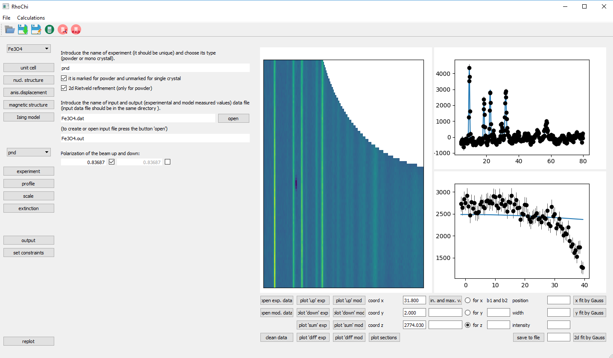
‘Main window’ (defined in the file ‘rhochi.py’)
The widgets:
widg_cpanel
widg_left
widg_right
The widget description is given in separate files.
info about ‘cmodel’
output files
Task:
the widgets arrangement

Slide 10
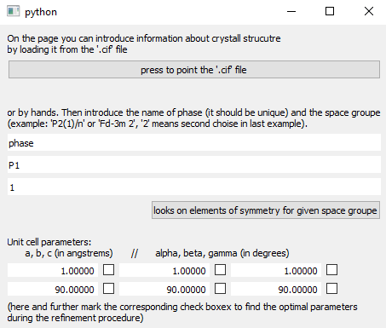
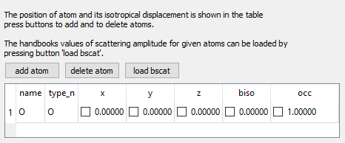
‘Widgets’ interacting with ‘cmodel’
List of widgets (each in the separate file ‘.py’):
widg_adp
widg_const
widg_exptype
widg_extinction
widg_magn
widg_magn_ising
widg_nucl
widg_output
widg_param
widg_profile
widg_results
widg_scale
widg_cb_exp
widg_cb_ph
widg_cb_ph_exp
widg_sconstr
widg_spgr
example: widg_spgr.py
Common elements:
QCheckBox
QLineEdit
QTableWidget
example: widg_nucl.py
Parent class:
widg_min
(defined methods to interact with ‘cmodel’)

Slide 11
Object ‘cmodel’ (‘cmodel.py’)
cmodel
cmodel_ph
cmodel_at
cmodel_exp
cmodel_exp_ph
cmodel_ref:
‘cmodel’ has information about the model parameters
‘cmodel_ph’ has information about a phase
‘cmodel_at’ has information about an atom
‘cmodel_exp’ has information about an experiment
‘cmodel_exp_ph’ has information about a phase contributing in the experiment
(the classes are defined in the file ‘cmodel.py’)
Tasks:
interaction with ‘widgets’
interaction with ‘ccore’
object ‘ccore’
Parent class:
cmodel_min
user
object ‘cmodel’
widgets
(defined methods to interact with ‘widgets’)

Slide 12
Object ‘ccore’ (‘ccore.py’)
The main methods:
ccore:
run_refinement
refinement, by simplex method
run_errors
estimation of errorbars by calculation of Hessian
ccore_exp:
load_exp_data
make prelimiary calculations and load experimental data before refinement
calc_chi2
calculation of chi2 for one experiment
ccore_ph:
calcFNhkl
calculation of the nuclear structure factor
calcSFThkl
calculation of the structure factor tensor
ccore
ccore_ph
ccore_at
ccore_exp
ccore_exp_ph
ccore_ref:
Tasks:
load exerimental data
calculations

Slide 13
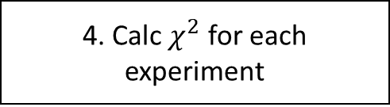
Structure of refinement
1. Load experimental data to the model
2. Define refined and constrained parameters
3. Load refined and constrained parameters to the model
Optimization by the simplex algorithm
4. Calc $χ^{2}$ for each experiment

Slide 14
ToDo:
Executable file
Organization of file location
Least square refinement

Slide 15
Thank you for your attention.

