Slide 1
Test Made Simple
- EasyTest Automation Test Tool
Zhu Zhong
2013w02

Slide 2
Agenda
Why EasyTest?
Overview
Write an automation test case in 5 minutes
What’s more?

Slide 3
Give me 5 – Why EasyTest
Object oriented: NE is Object with methods, for easy sharing between different groups
Simplification: Record & Replay, Xpath, regular expression, drag & drop
EasyTest
Support both manual and automation testing: Simple repeat w/o coding; also support scripting
Open System: NE/Methods are Customizable/Extendable with plug-in
Efficiency: free , quick support via Wiki/Forum/MailingList/Mail/Phone/IM

Slide 4
Overview
EasyTest is a general purpose automation test tool with cross platform capability. It was developed at Alcatel-Lucent and made freeware on Nov. 2, 2012.
It provides an easy approach for users to quickly develop, automate and maintain automation scripts.
EasyTest's Network Element (NE) based services are especially suitable for operators, service providers and network equipment manufacturers to test their carrier grade systems.
As of now, EasyTest has been used in many technologies such as LTE, WCDMA, GSM, CDMA, NGN and IP. It is an freeware under license "easytest license - commercial“

Slide 5
Key Features
Supports test most Network Elements as long as they have Command Line Interface such as Windows command shell, telnet, ssh, sftp, ftp, http, snmp, tcp socket.
Easy to start. With Record and Replay feature, you don't even need to write an single line of script to automate your test
With advanced Response Mapping technology, you can add check points by just clicking.
Provides easy-to-read reports and logs in HTML/PDF/XML format
Provides a command line interface and XML based outputs for easy integration into existing CI (continuous integration) systems
Cross platform. Supports Windows XP/Windows 7/Linux.(Only provide Windows version for freeware by now)

Slide 6
You can write an automation test case in 5 minutes
Step#1, Configure your Device Under Test
Step#2, Record your manual test operations
Step#3, Create your 1st test case
Step#4, Just run it!

Slide 7
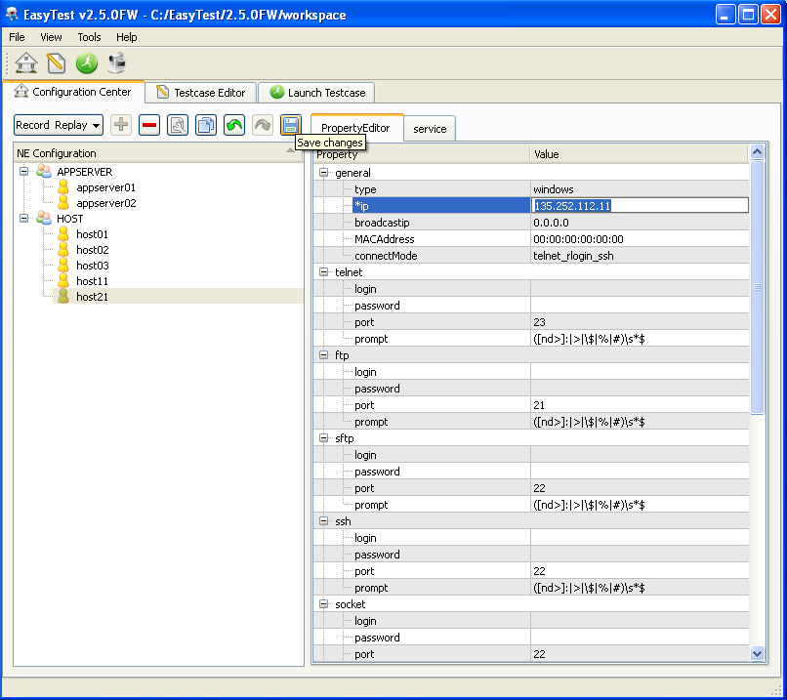
Step#1, Configure your Device Under Test
  You’ll configure your NE (Network Element or you may call it Device Under Test) here in Config Center.
  It’s mainly about how EasyTest connects to your NE.
  Open interface for you add your proprietary Network Elements.

Slide 8
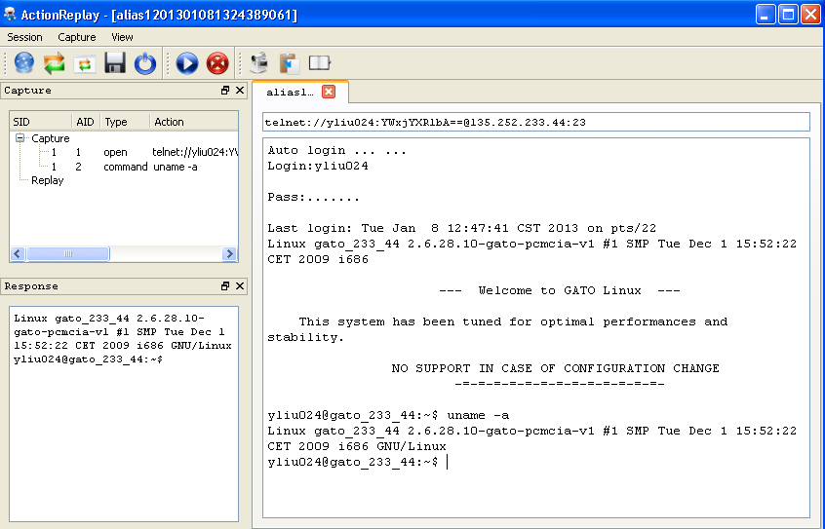
Step#2, Record your manual test operations
Just like how you use any telnet client to do your test.
Your operations will be recorded and saved to a capture file.

Slide 9
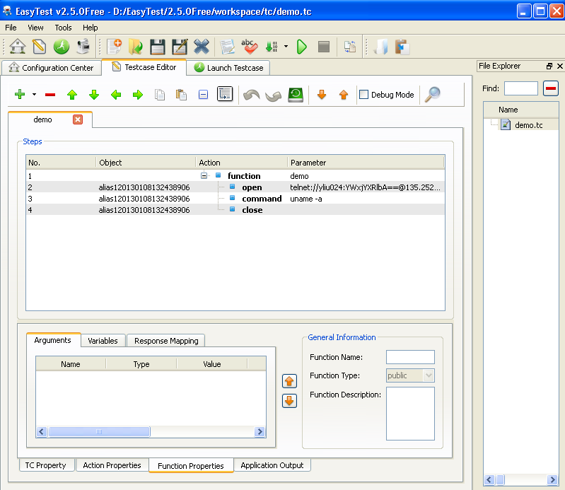
Step#3, Create your 1st test case
  Open the capture file created in step#2, EasyTest will create an test case for you automatically.
  You don’t even need to type in any code

Slide 10
Step#3, Create your 1st test case
  Open the capture file created in step#2, EasyTest will create an test case for you automatically.
  You don’t even need to type in any code

Slide 11
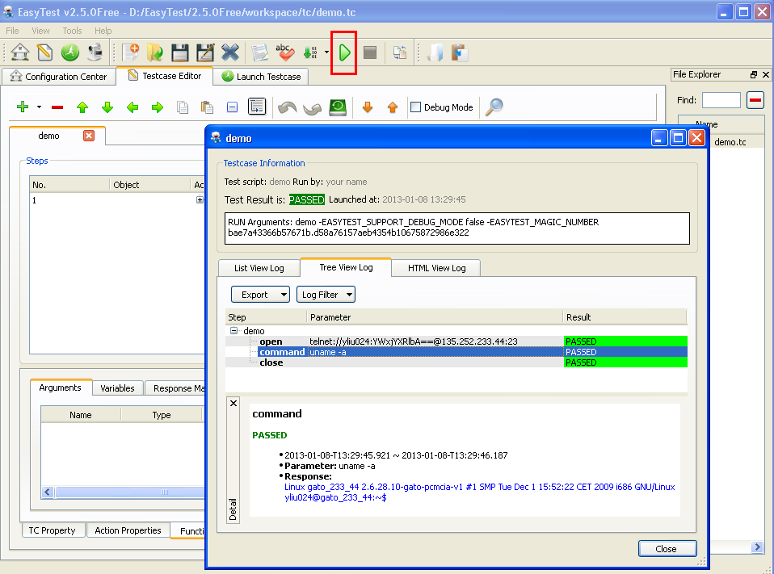
Step#4, Just run it!
  Click the run button, then there you go
  Detailed logs are shown in List/Tree/HTML format

Slide 12
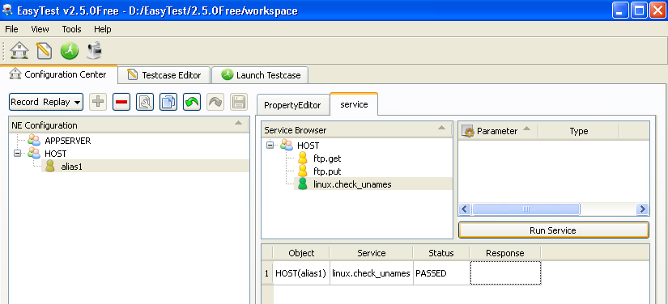
What’s more
- Service
  Service is like an API bound to an NE type.
  Service can be executed manually or be called in a test case.
  Open interface for you add your proprietary services.

Slide 13
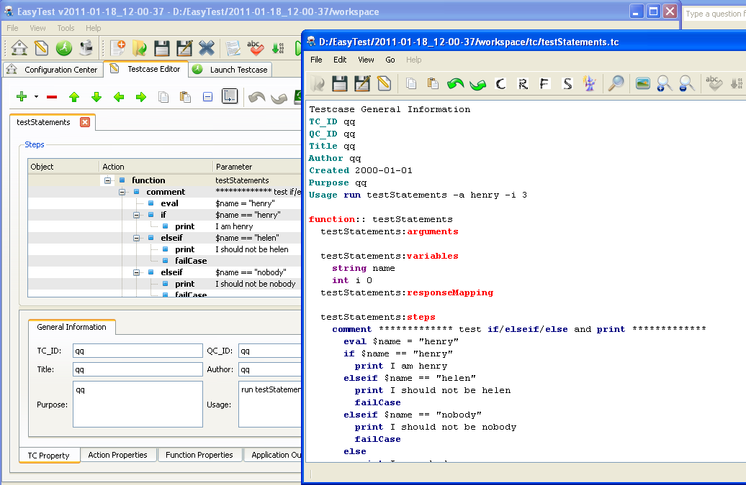
What’s More
– Two Kinds of Test Case Editor for you

Slide 14
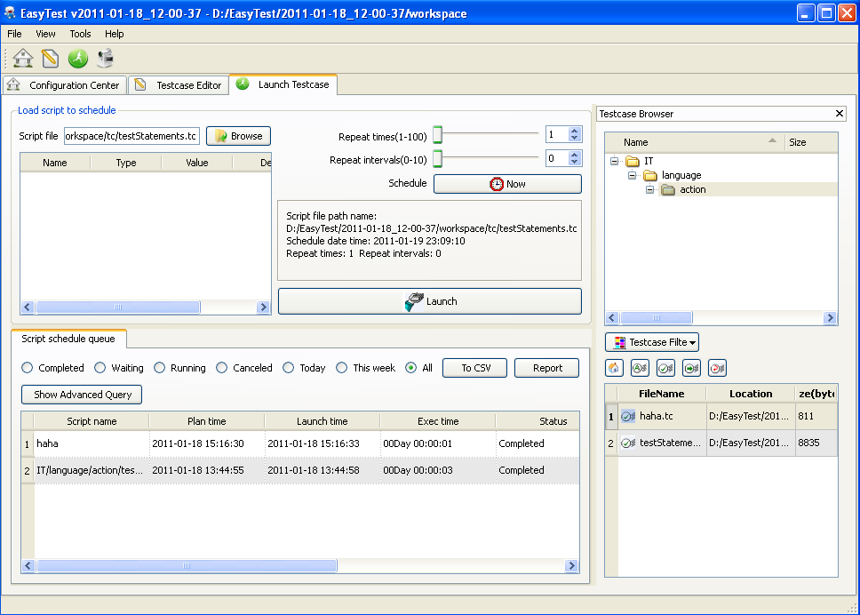
What’s More
– Schedual & Launch Test Case

Slide 15
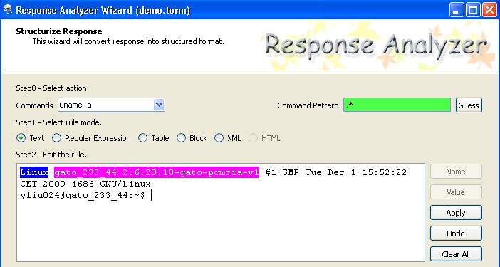
What’s More
- Advanced Response Mapping
Check/query a value is just a several mouse clickings

Slide 16
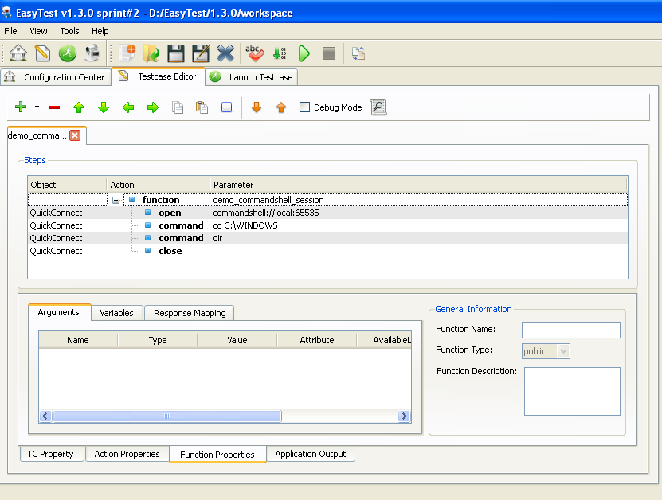
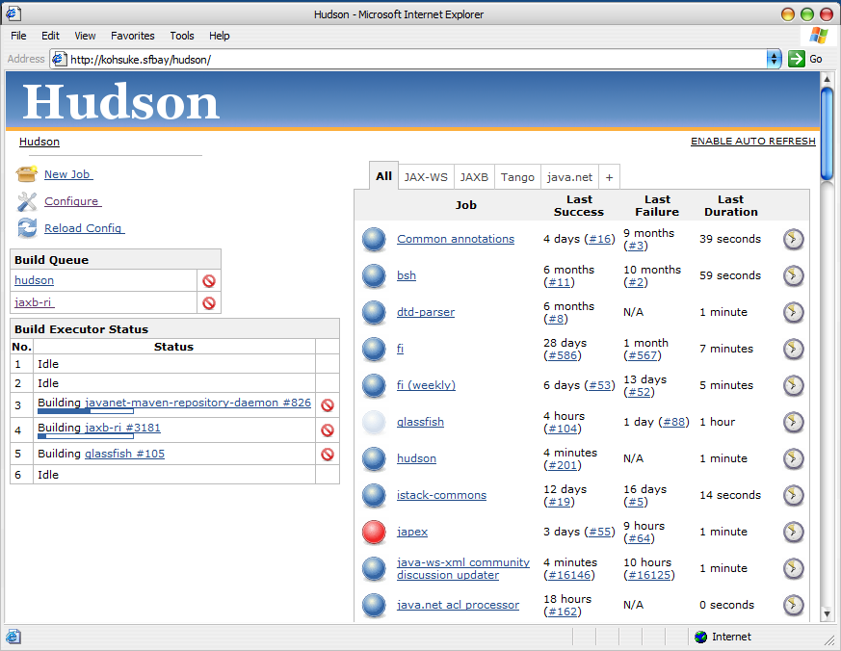
What’s More
- Continuous Integration
CI = EasyTest + Hudson
Start
Check out code
Load build
Unit Test
Package
End
Report
Regression
Test
Installation
Upgrade
Download load lineup

Slide 17
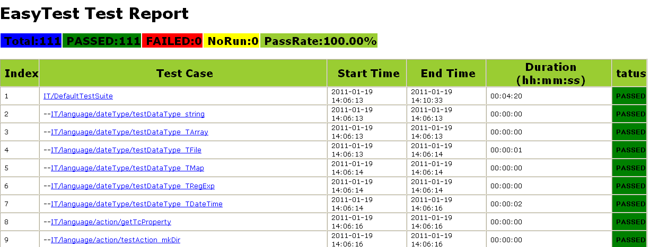
What’s More
- Continuous Integration –cont’d

Slide 18
Thank you!
多谢！

Slide 19
Easytest Useful info
  Easytest Website: https://github.com/EasyTest2012/EasyTest
  User Guide: After download & install EasyTest from above link, you can find the guide from menu Help->Help Topics
  Forum/Bug report: https://github.com/EasyTest2012/EasyTest/issues?state=open
  Support email: easytest-supports@alcatel-lucent.com
  Or Call me (Zhu Zhong) at +86 186-1056-5057

