Slide 1
Test Made Simple
- EasyTest Automation Test Tool
Zhu Zhong
2013w17

Slide 2
Agenda
Overview
Installation
Write an automation test case in 5 minutes
What’s more?

Slide 3
Overview
EasyTest is a general purpose automation test tool with cross platform capability. It was developed at Alcatel-Lucent and made free on Nov. 2, 2012.
It provides an easy approach for users to quickly develop, automate and maintain automation scripts.
EasyTest's Network Element (NE) based services are especially suitable for operators, service providers and network equipment manufacturers to test their carrier grade systems.
As of now, EasyTest has been used in many technologies such as LTE, WCDMA, GSM, CDMA, NGN and IP. It is a freeware under license "easytest license“

Slide 4
Key Features
Supports test most Network Elements as long as they have Command Line Interface such as Windows command shell, telnet, ssh, sftp, ftp, http, snmp, tcp socket.
Easy to use. With Record and Replay feature, you don't even need to write an single line of script to automate your test
With advanced Response Mapping technology, you can add check points by just clicking.
Provides easy-to-read reports and logs in HTML/PDF/XML format
Provides Command Line Interface and XML based outputs for easy integration into existing CI (continuous integration) systems
Cross platform. Supports Windows XP/Windows 7/Linux.(Only provide Windows version for freeware by now)

Slide 5
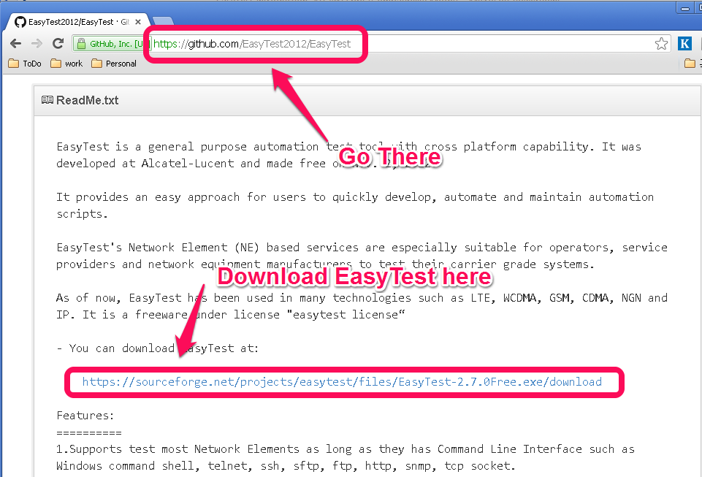
Installation
Download @https://github.com/EasyTest2012/EasyTest,
then double-click to install

Slide 6
You can write an automation test case in 5 minutes
Step#1, Configure your System Under Test
Step#2, Record your manual test operations
Step#3, Create your 1st test case
Step#4, Just run it!

Slide 7
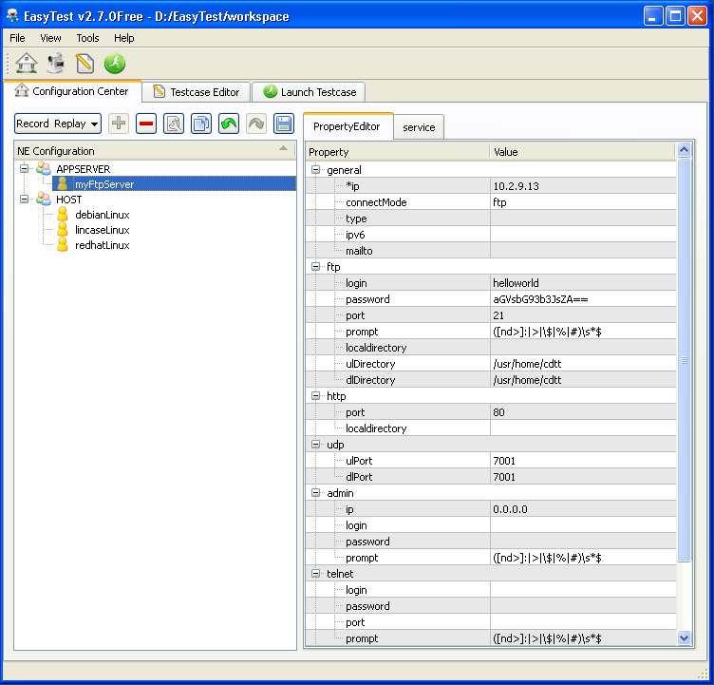
Step#1, Configure your System Under Test
  You’ll configure your NE (Network Element, you may call it System Under Test) here in Configuration Center.
  It’s mainly about your test environment and how EasyTest connects to your environment.
  Open interface for you to add your proprietary Network Element Types.

Slide 8
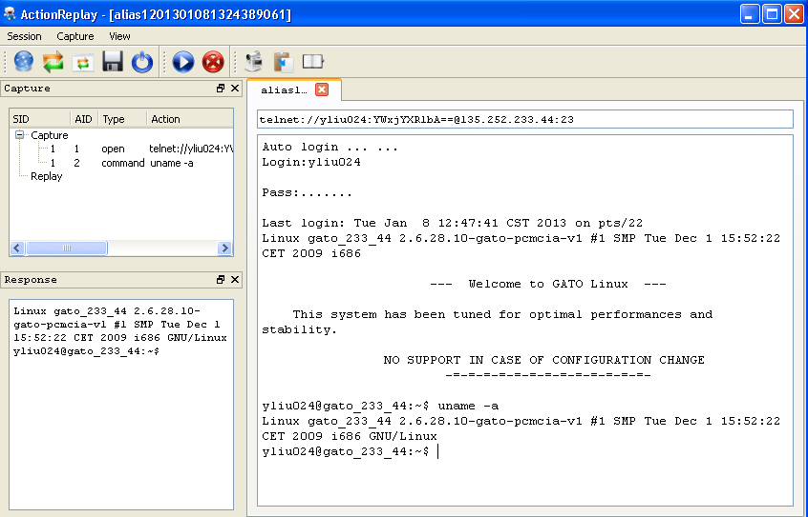
Step#2, Record your manual test operations
Just like how you use any telnet client to do your test.
Your manual operations will be recorded and saved to a capture file.

Slide 9
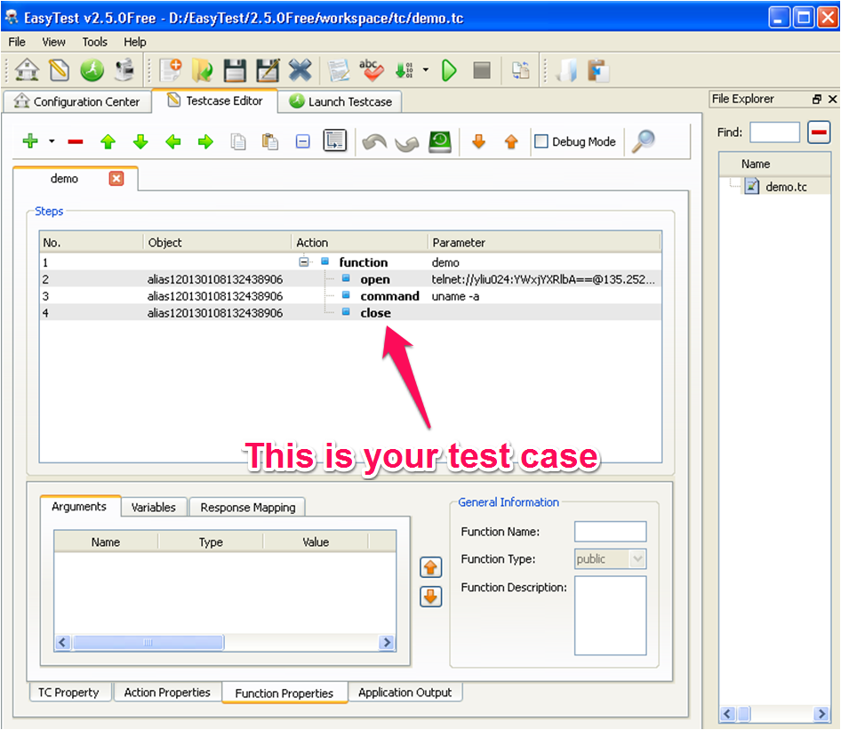
Step#3, Create your 1st test case
  Open the capture file created in step#2, EasyTest will create an test case for you automatically.
  You don’t even need to type in any code

Slide 10
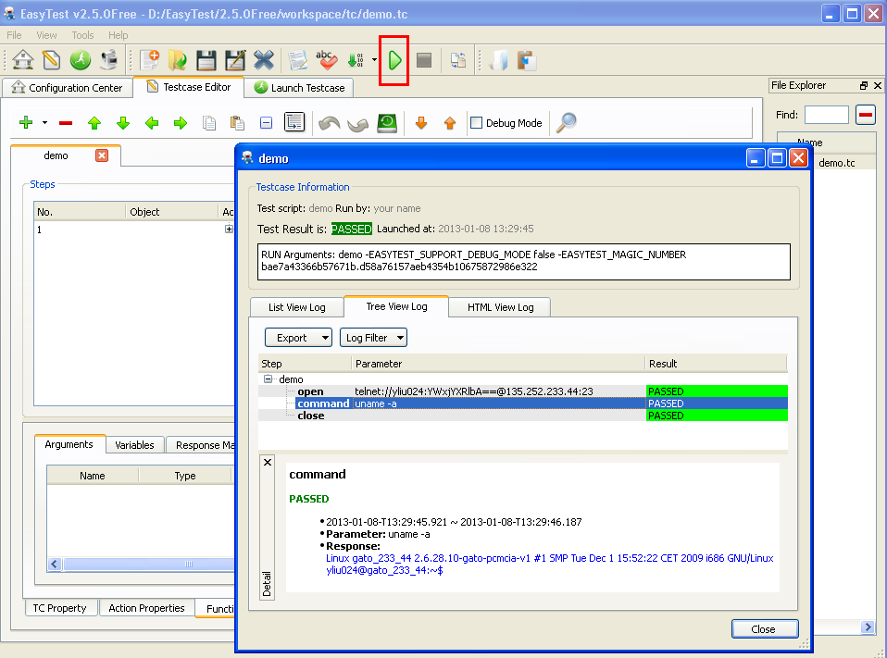
Step#4, Just run it!
  Click the run button, then there you go
  Detailed logs are shown in List/Tree/HTML format

Slide 11
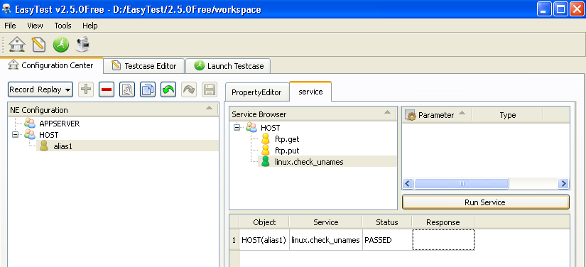
What’s more
- Service
  Service is like an API bound to an NE type.
  Service can be executed manually or be called in a test case.
  Open interface for you add your proprietary services.

Slide 12
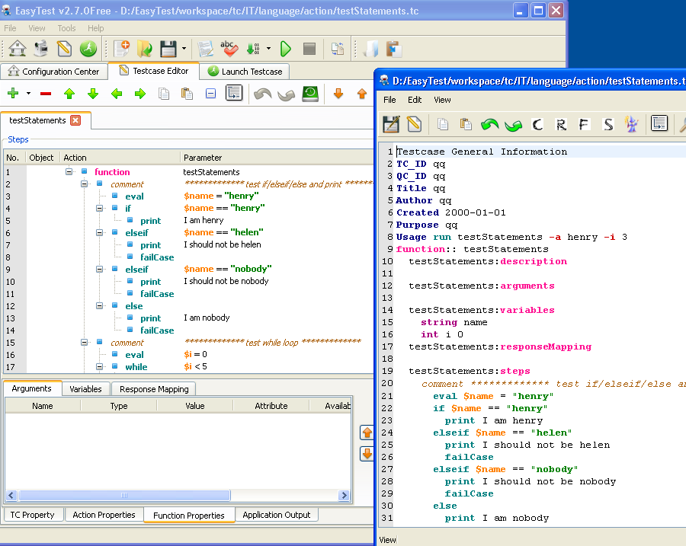

What’s More
– Two Kinds of Test Case Editor for you

Slide 13
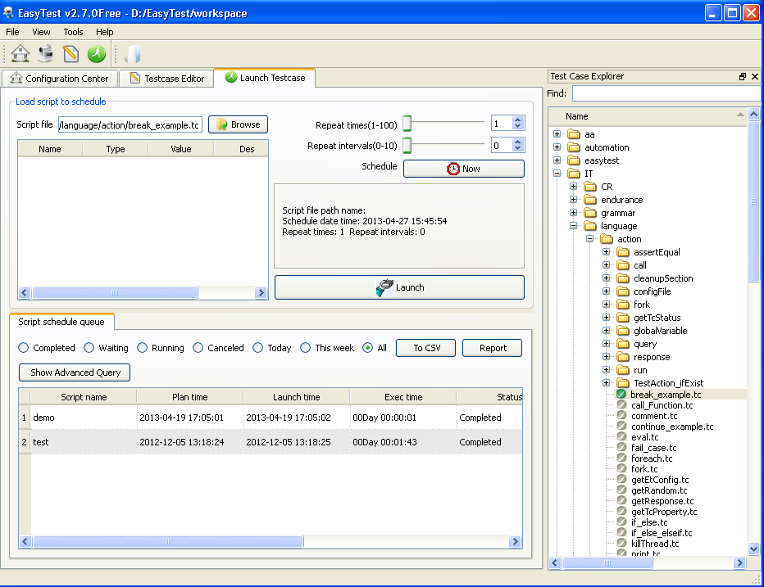
What’s More
– Schedual & Launch Test Case

Slide 14
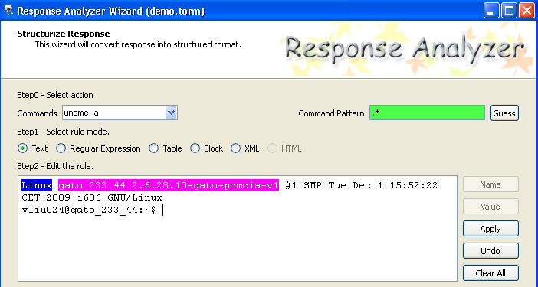
What’s More
- Advanced Response Mapping
Check/query a value by just mouse-clickings
No scripting needed

Slide 15
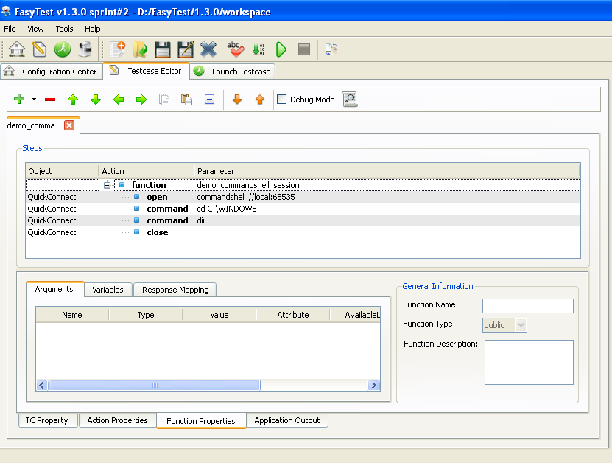
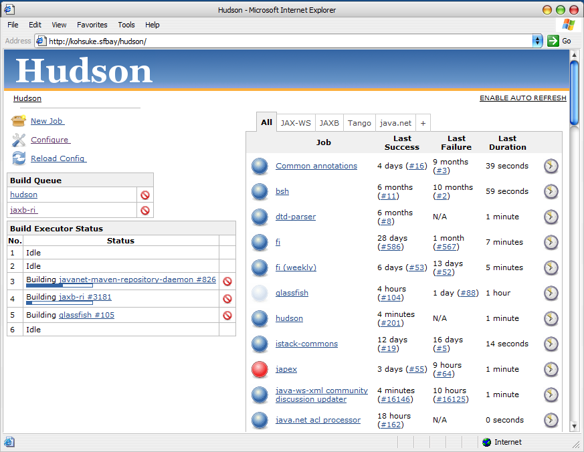
What’s More
- Continuous Integration
CI = EasyTest + Hudson
Start
Check out code
Load build
Unit Test
Package
End
Report
Regression
Test
Installation
Upgrade
Download load lineup

Slide 16
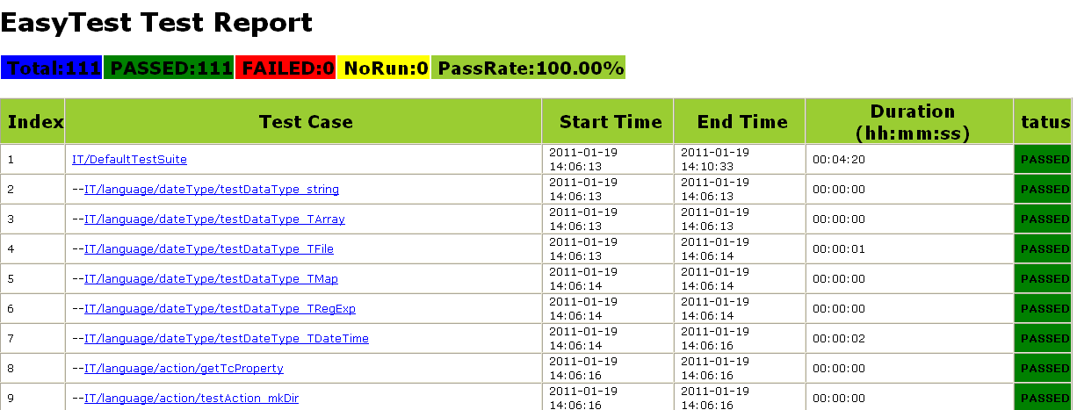
What’s More
- Continuous Integration –cont’d

Slide 17
Thank you!
多谢！

Slide 18
Useful info
  Easytest Website: https://github.com/EasyTest2012/EasyTest
  User Guide: User Guide is shipped with the installation. Start EasyTest after installation, you should be able to find the guide from menu Help->Help Topics
  Forum/Bug report: https://github.com/EasyTest2012/EasyTest/issues?state=open
  Support email: easytest-supports@alcatel-lucent.com
    Or Call me (Zhu Zhong, Product Owner of EasyTest) at +86 186-1056-5057
    Or follow me at Sina Weibo @钟柱

