Slide 1
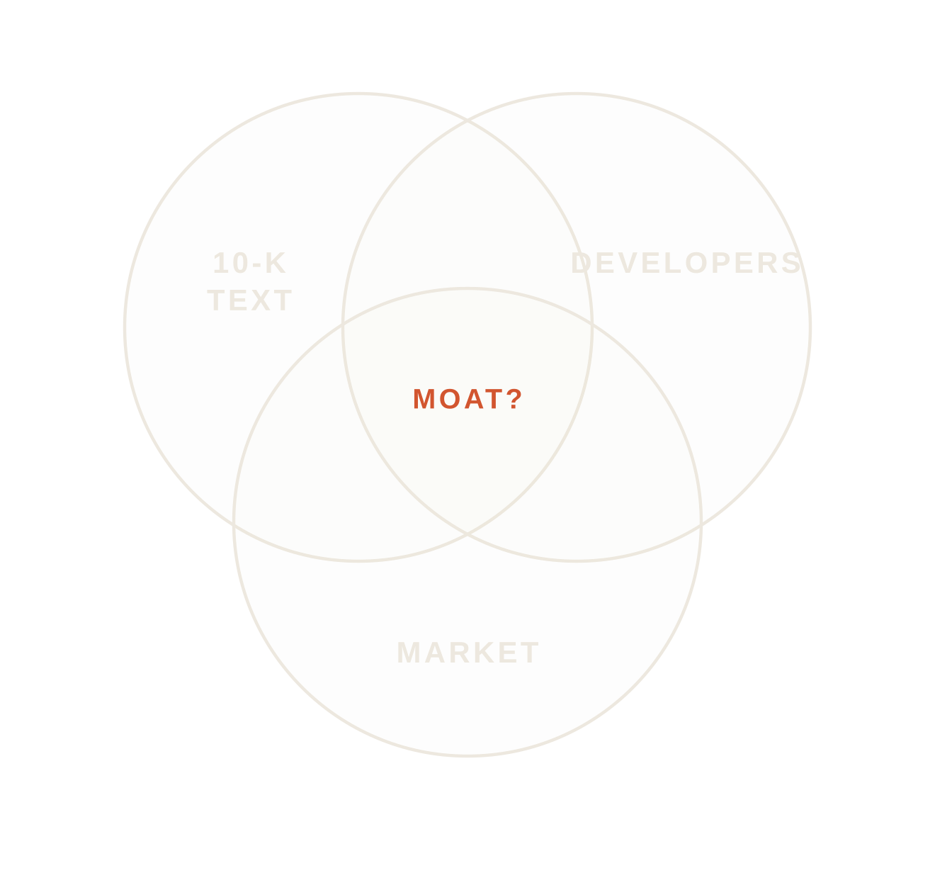
00 / 11
AI × SAAS DEFENSIBILITY
SAAS-PULSE
WHICH SAAS MOATS HOLD AGAINST AI?
An original dataset of 10-K filings, developer discussion and market data, read by a fine-tuned GenAI moat classifier.
100
COMPANIES
191k
10-K PARAGRAPHS
7,829
HN ITEMS
Daksh Chauhan · Semester VII · Adani University
SECTION 00 — SAAS-PULSE
Notes:
I built an original dataset to ask: as AI makes software cheaper to build, which protections do SaaS companies claim, and do those claims line up with what the market did? The GenAI part is a model that reads 10-K text and labels the type of moat.

Slide 2
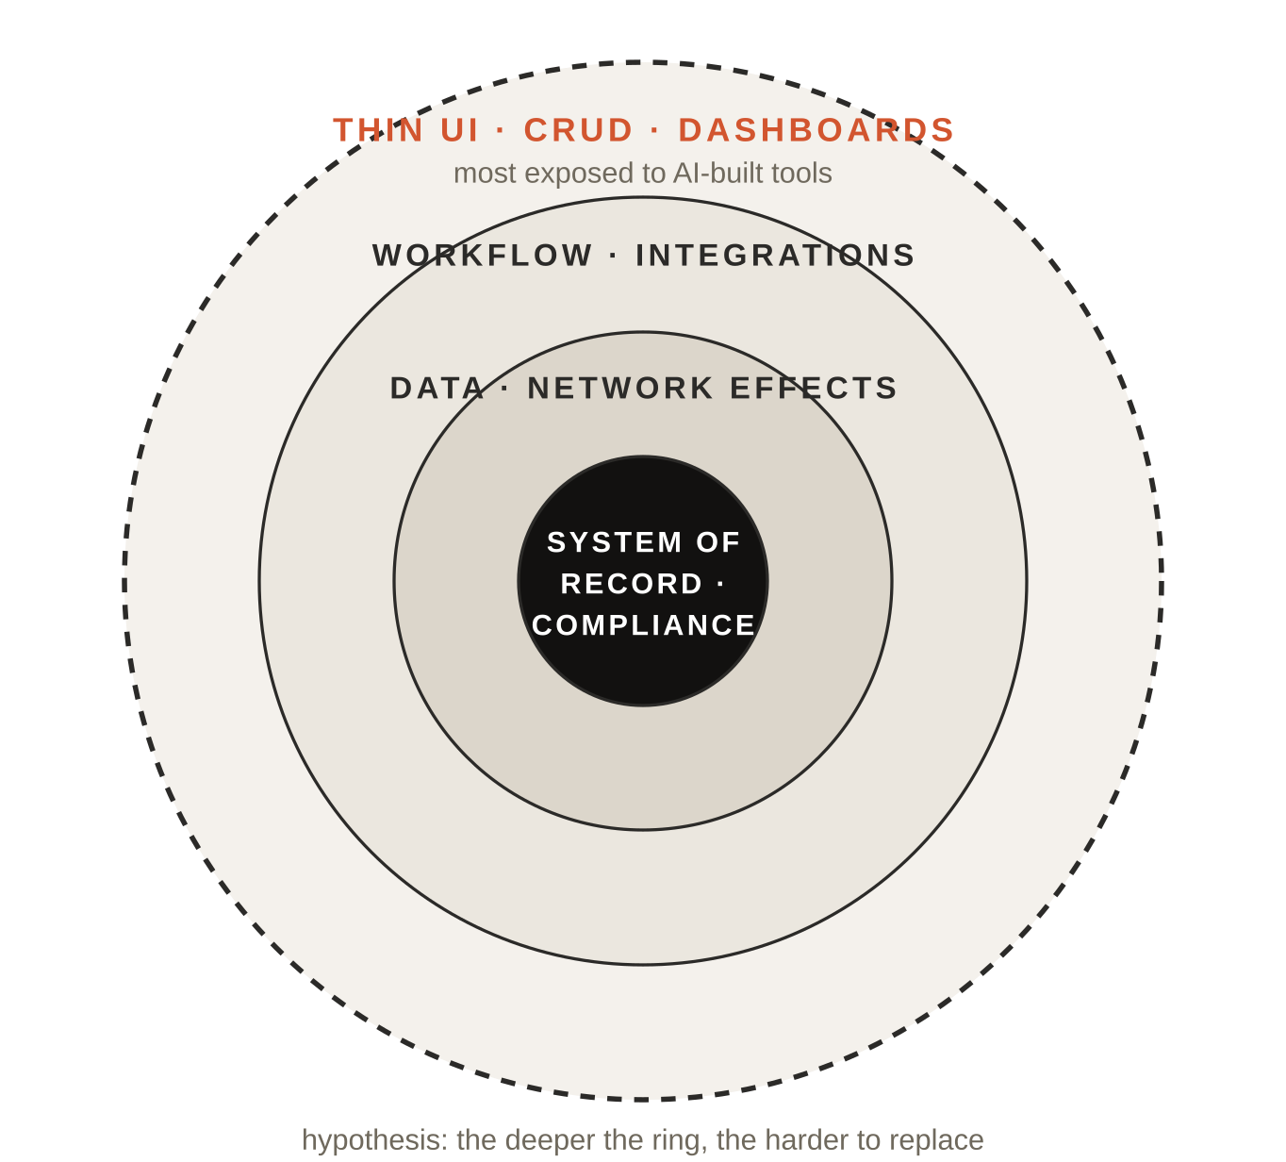
01 / 11
THE PRESSURE
WHY THIS QUESTION
AI coding tools make simple internal software much cheaper to build. Not every SaaS product is equally easy to replace.
THE PRESSURE
CRUD apps, dashboards and trackers can now be built in-house in days.
THE COUNTER-ARGUMENT
Systems of record, compliance and data platforms are hard to replace whatever the build cost.
WHAT WE TEST
Can we measure claimed moats in 10-Ks, and do they match outcomes?
This is the hypothesis. The rest of the deck tests it.
SECTION 01 — SAAS-PULSE
Notes:
This is the hypothesis, not a finding. If building software gets cheaper, the products at risk are the ones with no structural protection.

Slide 3
02 / 11
RESEARCH DESIGN
THREE QUESTIONS
RQ1 · CLASSIFY
Can a small LLM label moat types, and does fine-tuning beat prompting?
One GenAI task at the core, one developer view, one market check.
RQ2 · DEVELOPERS
Do Hacker News developers argue for building internal tools or buying SaaS?
CORE TASK
A 1.5B open LLM labels the moat type in each 10-K paragraph.
COMPARISON
Zero-shot vs few-shot vs LoRA fine-tuning, against simple baselines.
RQ3 · MARKET
Do companies with more moat language show better excess returns since 2023?
OUTCOME LINK
Model output is aggregated per company and tested against returns.
First, the data.
SECTION 02 — SAAS-PULSE
Notes:
Three questions. RQ1 is the core GenAI task. RQ2 is the developer side. RQ3 connects the model's output to financial outcomes.

Slide 4
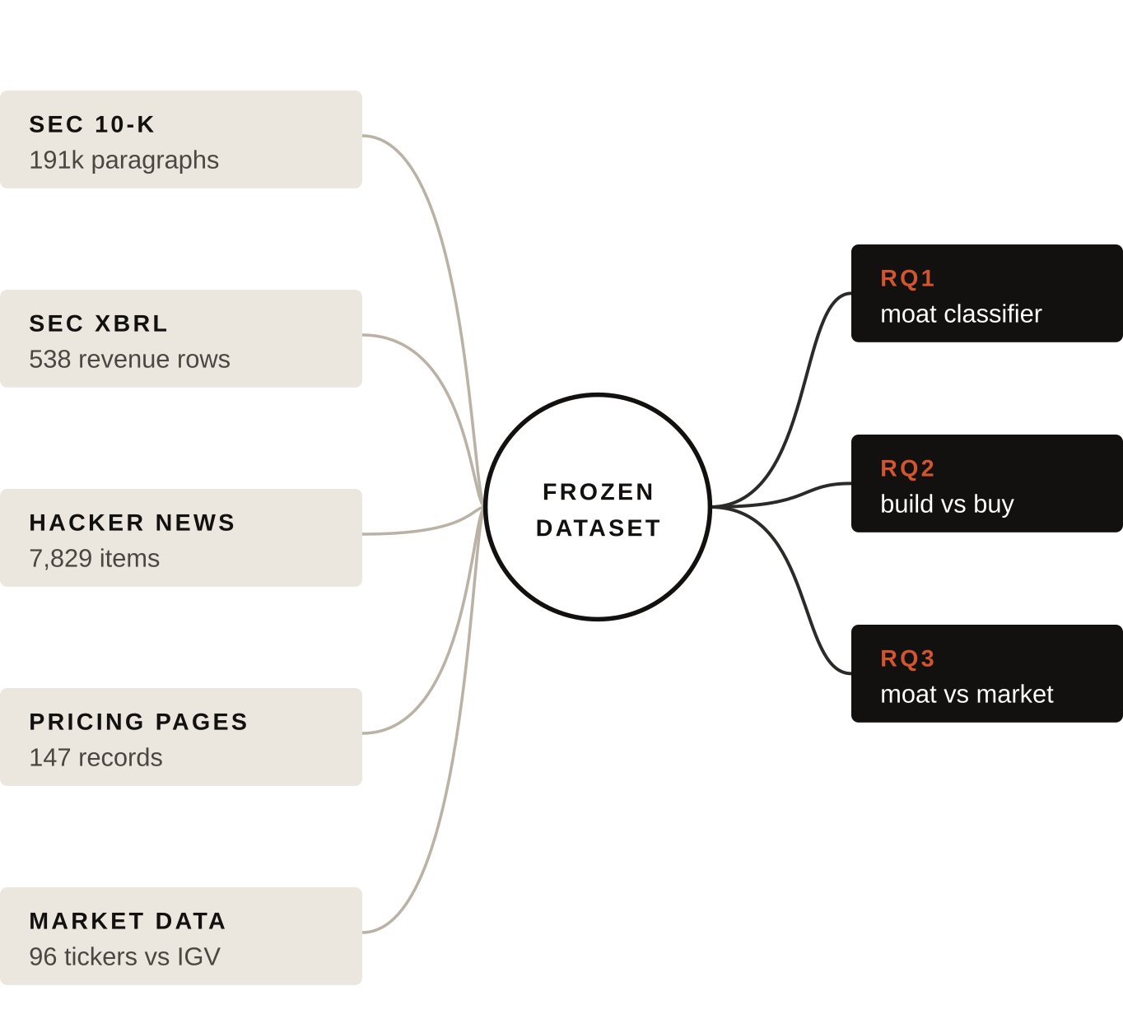
03 / 11
DATASET
OUR OWN DATASET
Collected and prepared for this project from five public sources, then frozen so every run reads the same files.
SCALE
464 filings · 190,655 paragraphs · 100 companies
MARKET
96 tickers, Jan 2023 → Oct 2026, vs IGV (+118.3%)
ETHICS
Declared user agent, rate limits, robots.txt, no login walls. Datasheet + SHA-256 manifest.
Pricing pages proved too patchy; they are used descriptively only.
SECTION 03 — SAAS-PULSE
Notes:
Everything was collected for this project from public sources. Pricing pages turned out too patchy: enterprise vendors often have no public pricing.

Slide 5
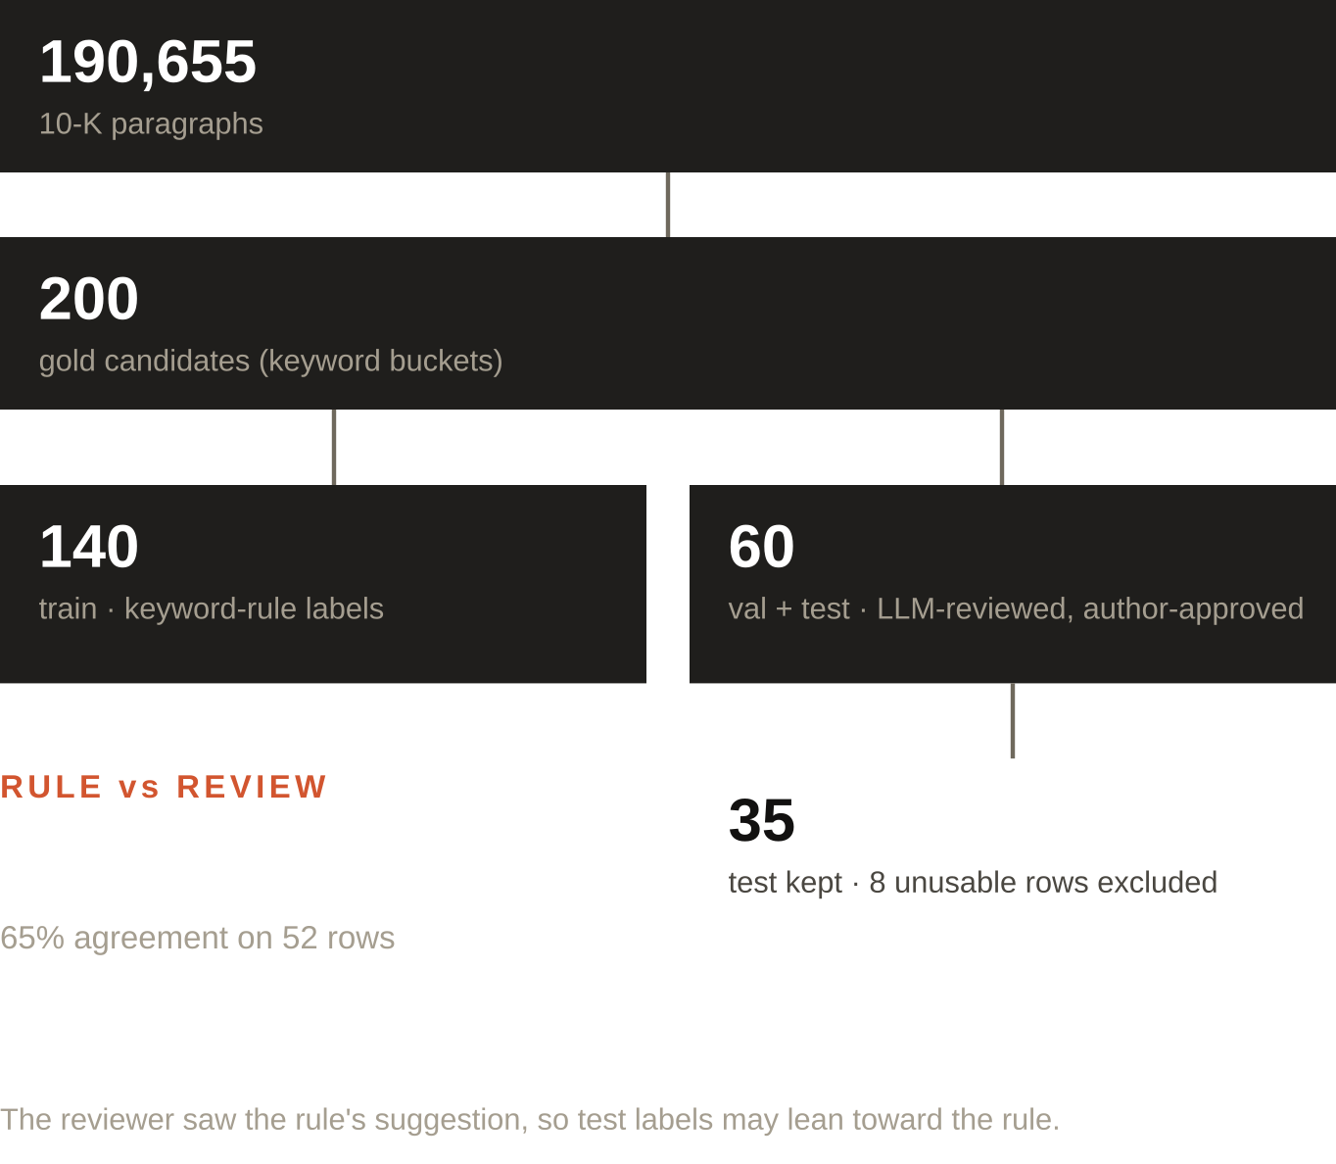
04 / 11
LABELS
AN HONEST GOLD SET
Six moat classes. Training labels come from keyword rules; test labels were reviewed.
CLASSES
System of record · data gravity · switching costs · compliance · network effects · none
TRAIN
140 paragraphs, keyword-rule labels (noisy by design)
TEST
35 paragraphs reviewed by an independent LLM (Claude Opus 5.5), approved by the author
The rules were right about two times in three.
SECTION 04 — SAAS-PULSE
Notes:
Training labels come from keyword rules. Validation and test were reviewed by a different, stronger LLM and approved by me. Rule and review agreed 65% of the time, kappa 0.57. The reviewer could see the rule's suggestion, which can bias the test labels toward the rule.

Slide 6
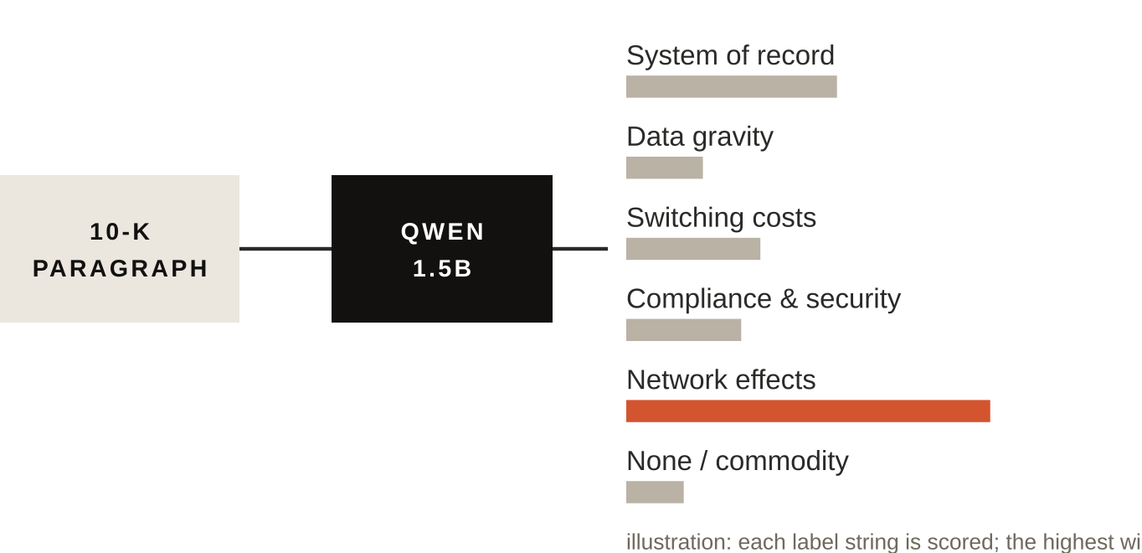
05 / 11
GENAI METHOD
ONE MODEL, THREE REGIMES
ZERO-SHOT
Taxonomy definitions + paragraph → label
FEW-SHOT
Plus 6 training examples, one per class
Qwen2.5-1.5B-Instruct on a Kaggle T4. Every method is scored the same way.
LORA
4-bit base, r = 8, α = 16, loss on label only, 4 epochs, 140 examples
FAIR SCORING
No free text: the model scores each of the six labels and the most likely wins.
BASELINES
Majority class, random, and the keyword rule itself.
Constrained scoring removed the parse failures of the first run.
SECTION 05 — SAAS-PULSE
Notes:
All three methods use the same 1.5 billion parameter model. Constrained scoring means the model never writes free text; it ranks the six labels. That makes the comparison fair.

Slide 7
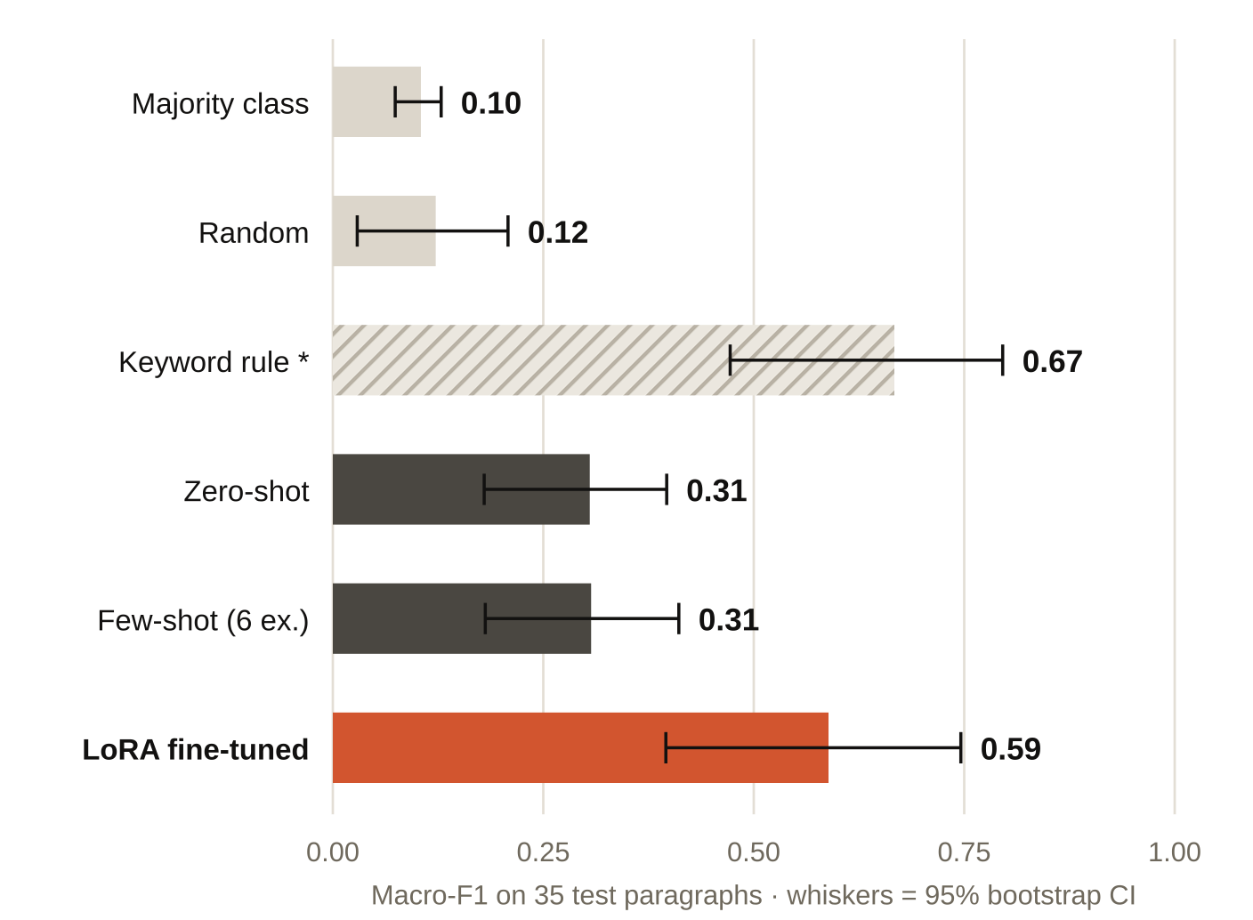
06 / 11
RQ1 · RESULTS
FINE-TUNING BEATS PROMPTING
0.59 vs 0.31
macro-F1, LoRA vs few-shot prompting
SIGNIFICANCE
McNemar vs few-shot p = 0.026; vs zero-shot p = 0.061. n = 35, so intervals are wide.
* KEYWORD RULE
Highest score but not a fair rival: 23 of 35 test labels are the rule's own label, kept on review.
The fair comparison is between the GenAI methods.
SECTION 06 — SAAS-PULSE
Notes:
Prompting gives about 0.31 macro-F1; LoRA lifts it to 0.59, significant against few-shot at p = 0.026, with wide intervals on 35 paragraphs. The keyword rule looks best because the test labels started from it.

Slide 8
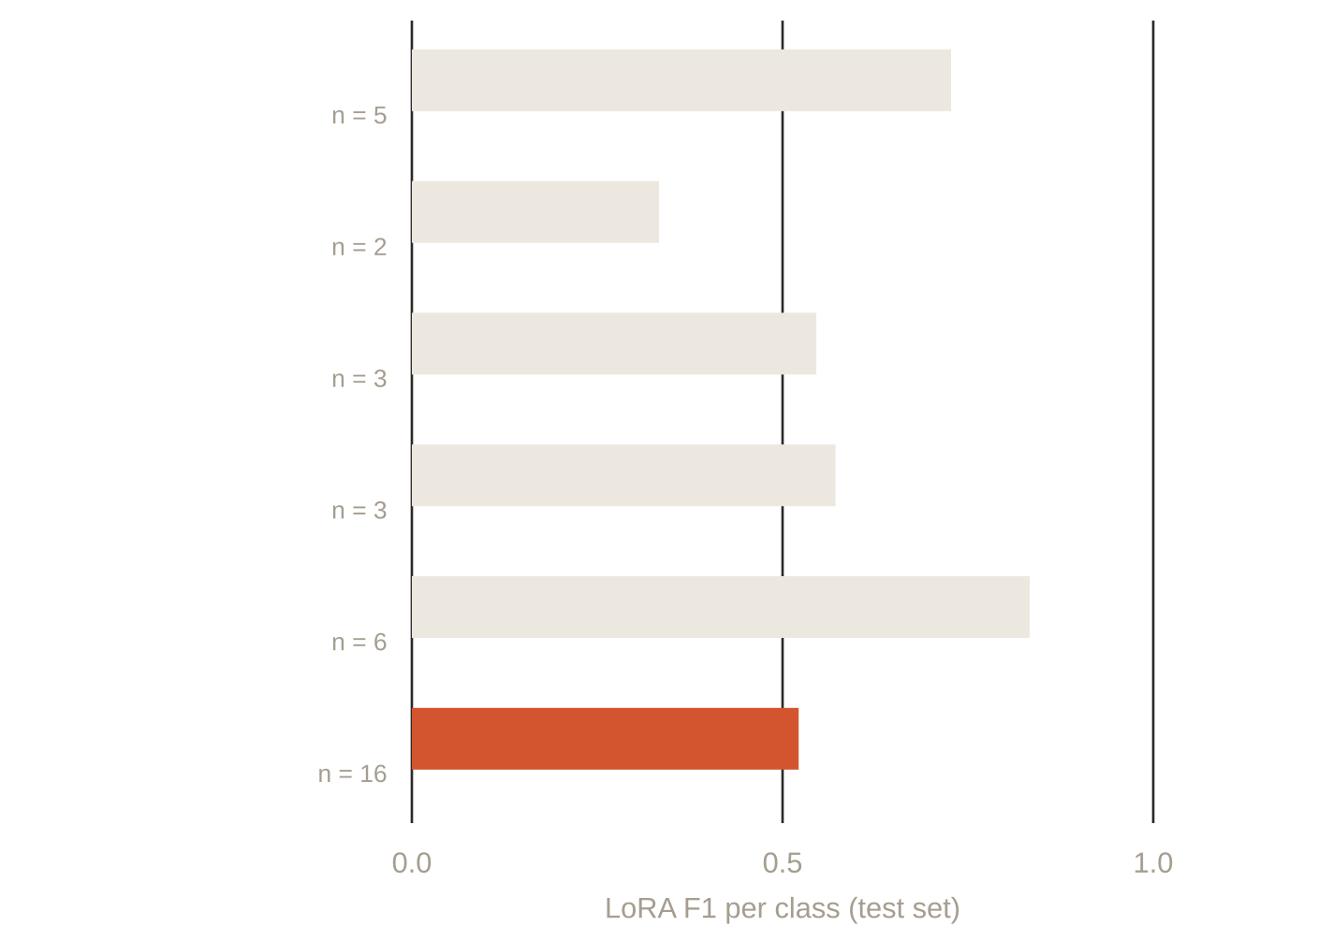
07 / 11
RQ1 · ERRORS
WHERE IT GOES WRONG
The model over-claims: plain business descriptions get labelled as moats.
STRONGEST
Network effects and systems of record: distinctive vocabulary.
WEAKEST
None / commodity recall 0.38: the biggest class (16 of 35).
CAVEAT
2 to 6 test examples per class: read these as rough.
More reviewed 'none' examples would help most.
SECTION 07 — SAAS-PULSE
Notes:
Per class, the model is strongest on network effects and systems of record. Its main error is over-claiming, so recall on the none class is low.

Slide 9
08 / 11
RQ1 · EVIDENCE
REAL TEST PARAGRAPHS
VERX · FY2025
DOCU · FY2022
FLYW · FY2022
“Our global compliance and reporting solutions enable the automation of signature-ready returns and remittance of indirect tax to appropriate jurisdictions. Companies use these solutions to leverage tax data files imported from …”
“. Companies can incorporate DocuSign Agreement Cloud into the fabric of their business systems and processes by using one of more than 400 pre-built connectors, or via a custom integration using our API. For a custom integration, …”
“clients. The BAAs largely mirror some of the statutory obligations contained in HIPAA, but many contain additional contractual undertakings that give these clients additional remedies in the event of a breach of our obligations …”
GOLD Compliance & security
LORA Compliance & security ✓
FEW-SHOT Data gravity
GOLD Switching costs
LORA Switching costs ✓
FEW-SHOT Data gravity
GOLD None / commodity
LORA Compliance & security ✗
FEW-SHOT Compliance & security
Quoted verbatim from the test set (truncated): two cases LoRA gets right where few-shot fails, and one LoRA error.
SECTION 08 — SAAS-PULSE
Notes:
These are real paragraphs from the test set. Two show where fine-tuning helped, and one shows a typical over-claiming error.

Slide 10
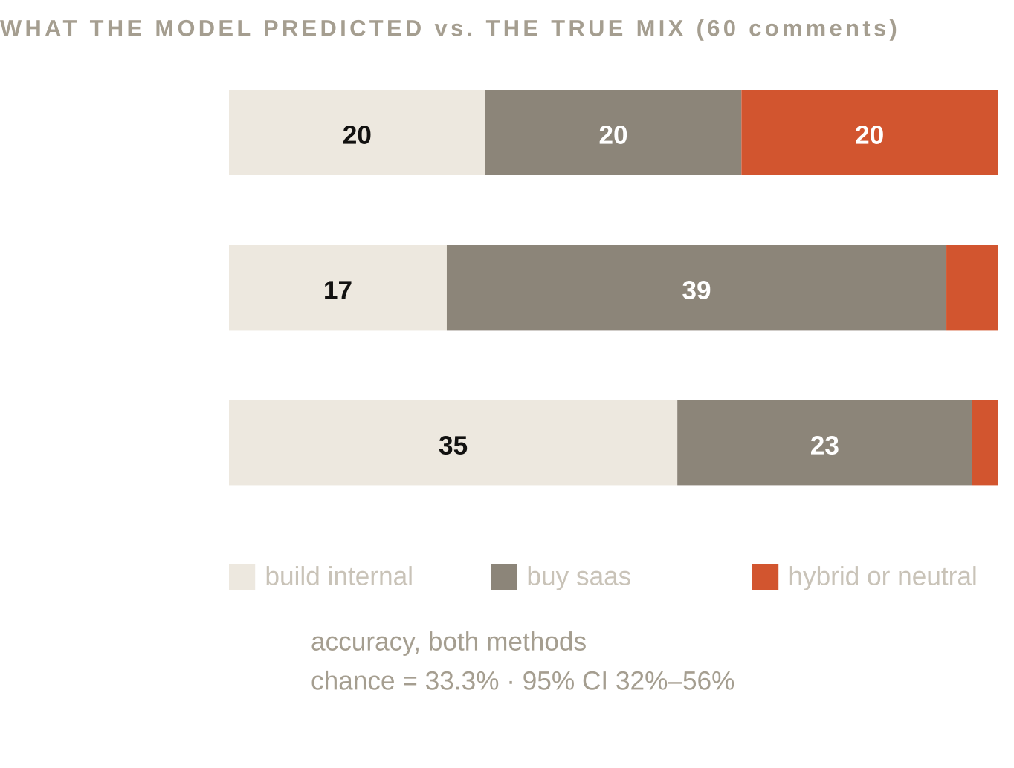
09 / 11
RQ2 · DEVELOPERS
A NEGATIVE RESULT
On Hacker News stance, both prompting methods are barely above chance.
RESULT
43.3% accuracy for zero-shot and few-shot; the 95% interval includes chance.
FAILURE MODE
The model almost never predicts “hybrid”, though it is a third of the benchmark.
DECISION
No corpus-wide build-vs-buy percentage is reported: it would turn bias into a fake trend.
Benchmark labels here are rule-generated, not reviewed.
SECTION 09 — SAAS-PULSE
Notes:
This one did not work, and I report it. Developer comments are sarcastic and nuanced, and a 1.5B model without fine-tuning is barely above chance. I deliberately do not turn its predictions into a percentage.

Slide 11
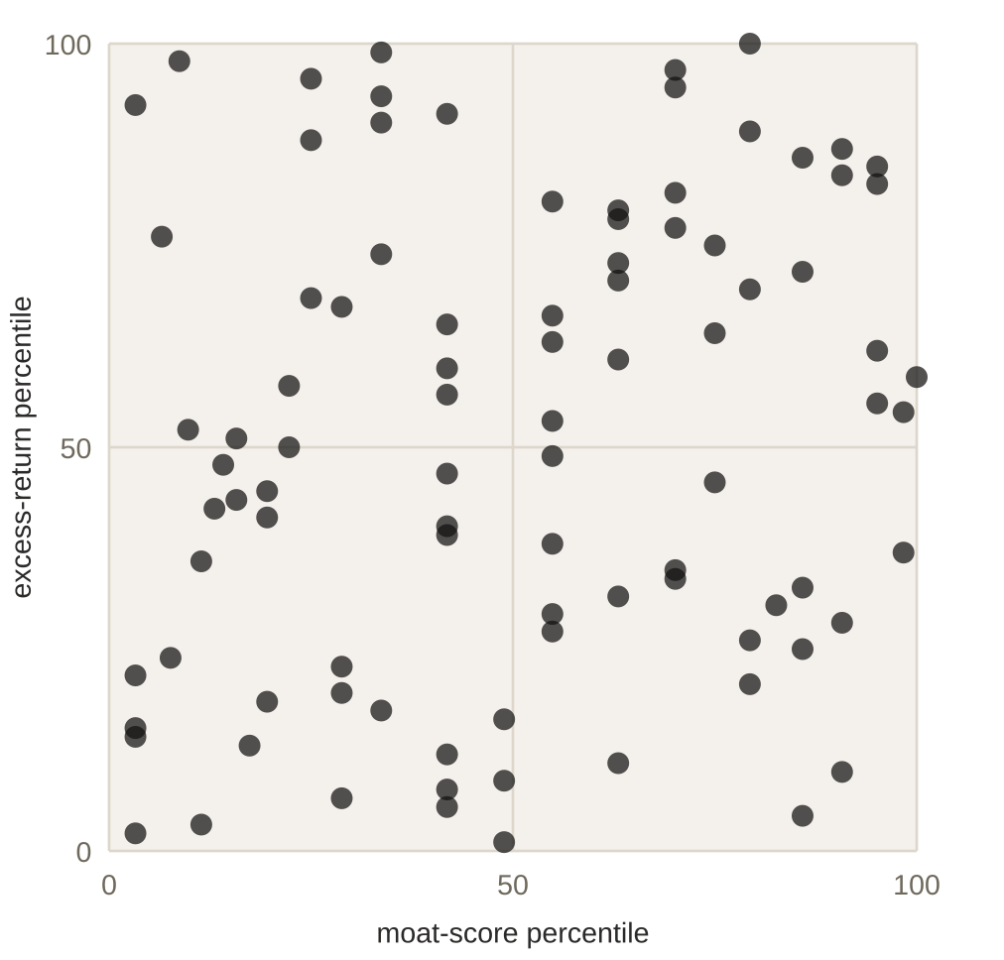
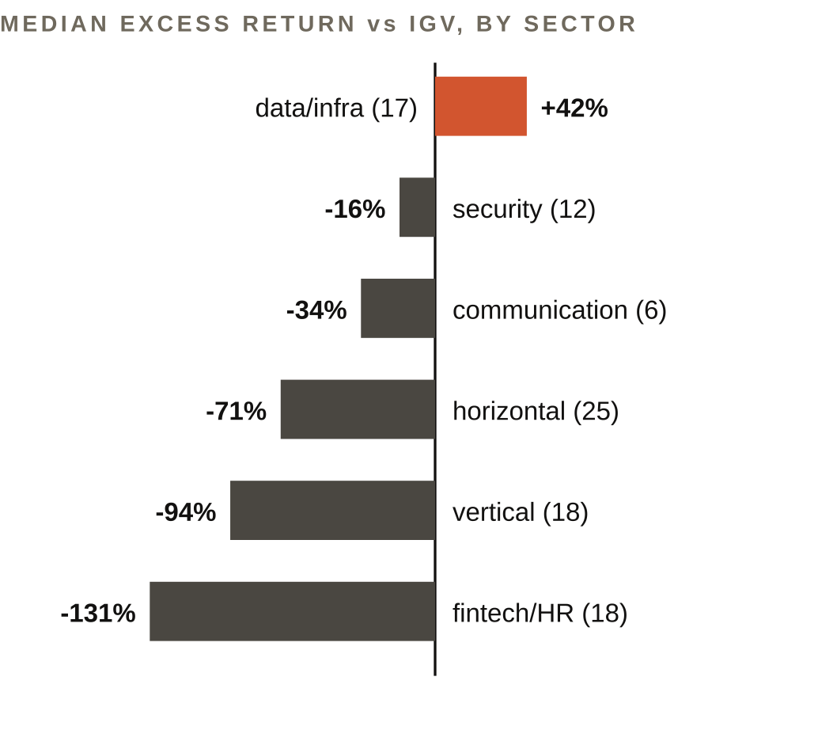
10 / 11
RQ3 · MARKET
NO MOAT PREMIUM
ρ = 0.18
p = 0.079 · 95% CI [-0.02, 0.37] · n = 92
MOAT VS RETURN
Weakly positive, not significant. Revenue growth: ρ = -0.02.
SECTOR MATTERS MORE
Descriptive only; we do not claim what caused it.
Each dot = one company (percentile ranks, as Spearman uses).
NOISE
Moat scores come from a 60%-accurate model, which weakens any correlation.
“No link found” is not “moats don’t matter”.
SECTION 10 — SAAS-PULSE
Notes:
The correlation between moat share and excess return is 0.18, p = 0.079: not significant. Sector differences are much larger, and they are descriptive.

Slide 12
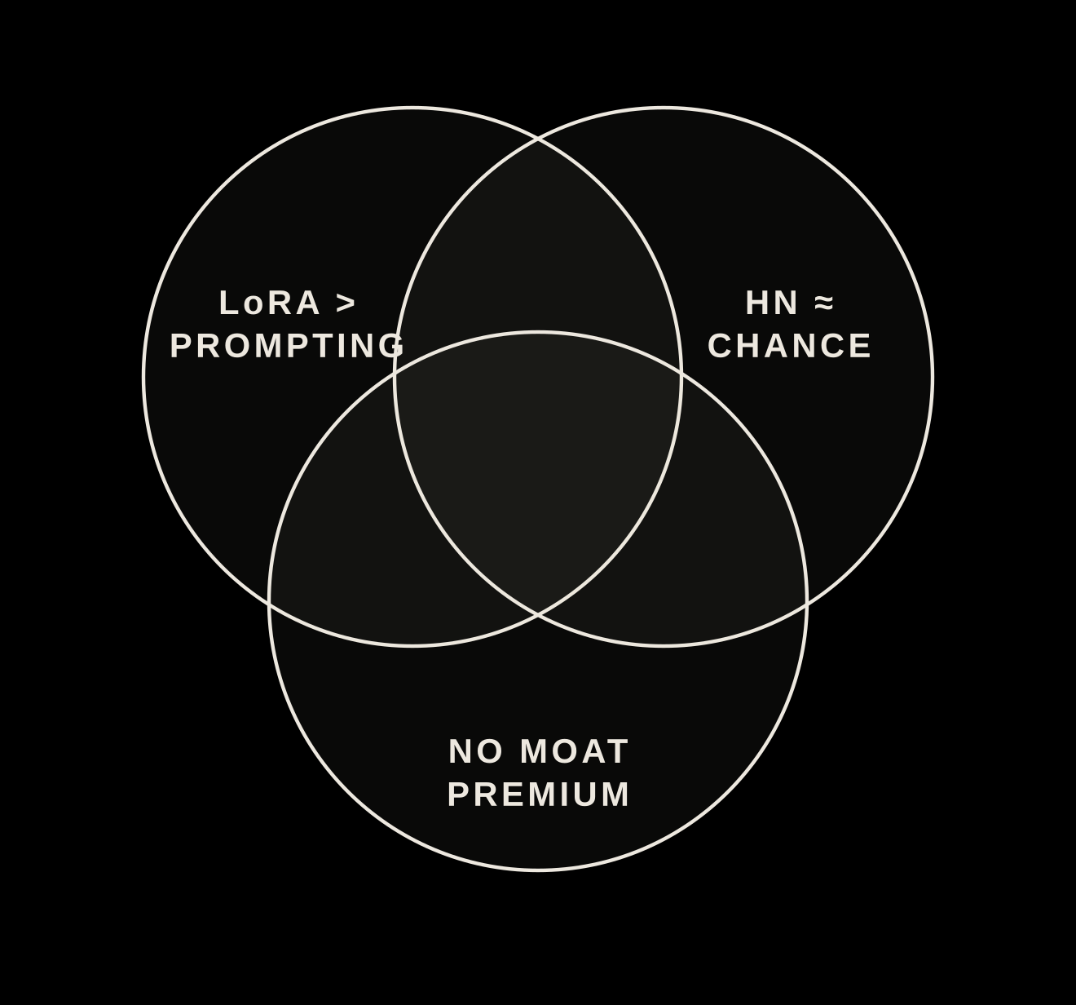
11 / 11
THE BIG PICTURE
THREE TAKEAWAYS
1 · GENAI WORKS HERE
LoRA on 140 weak labels: 0.59 macro-F1, about double prompting.
2 · STANCE IS HARD
Developer build-vs-buy stance stayed near chance.
3 · MARKET LINK NOT SHOWN
Moat language did not significantly predict 2023–26 excess returns.
LIMITATIONS
Rule-based training labels, anchoring risk, n = 35, self-reported 10-K claims, survivorship, no causal claims.
NEXT
Blind human labels, a larger test set, a bigger model for HN.
SECTION 11 — SAAS-PULSE
Notes:
Fine-tuning clearly helps a small model learn this taxonomy, developer stance was a negative result, and the market link was not significant. The main improvement would be blind human labels and a bigger test set. Thank you.

