Slide 1
Weekly Meeting
Time:2020.10.12
Reporter:Yuting Feng

Slide 2
work
Continuous action and state(ddpg)
Quarter (Sim-to-(Multi)-Real: Transfer of Low-Level Robust Control Policies to Multiple Quadrotors) ppo
Q-learning

Slide 3
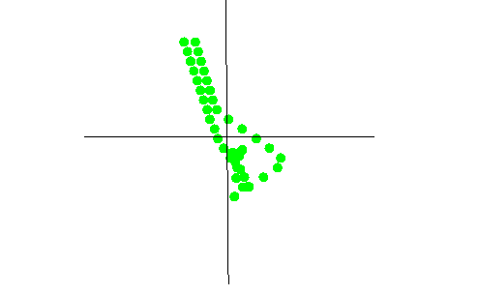
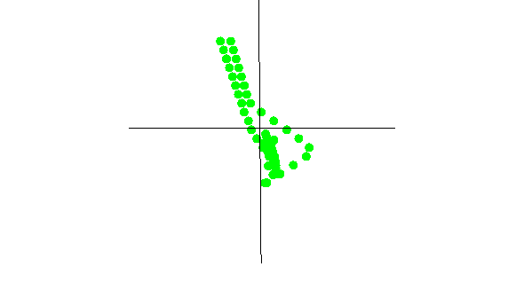
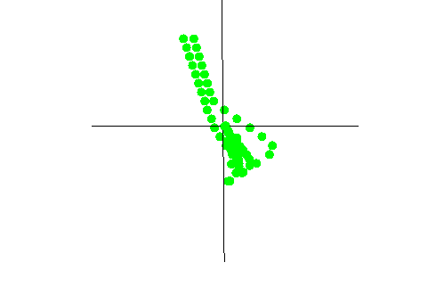
Continues action and state
Algorithm : ddpg
Item: Make the point return to the origin faster
jpg: 50 100 150

Slide 4
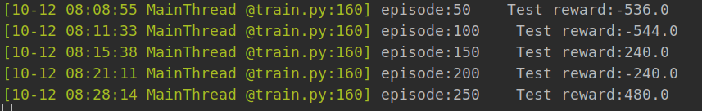
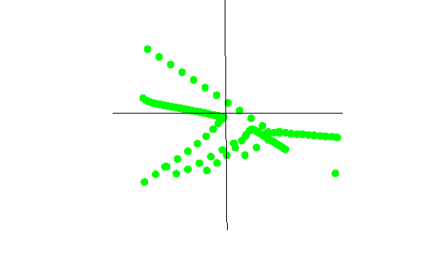
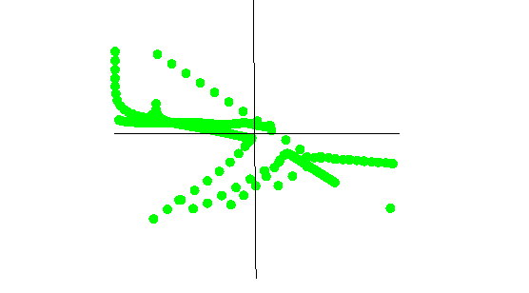
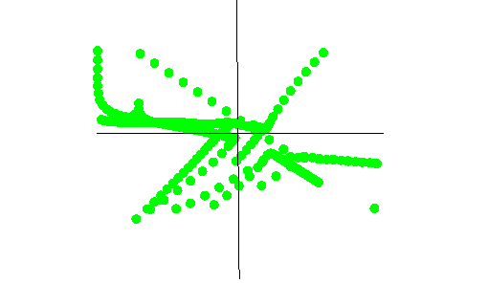
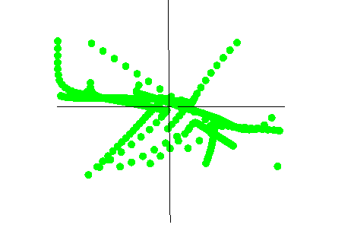
Reward

Slide 5
Quadrotors
Algorithm:ppo
Item:Train the quadrotors to fly smoothly
MP4:

Slide 6
强化学习

Slide 7
Reinforcement learning
定义：强化学习是智能体（Agent）以“试错”的方式进行学习，通过与环境进行交互获得的奖赏指导行为，目标是使智能体获得最大的奖赏。
分类：value-based、policy-based
Q-learning（value-based）

Slide 8
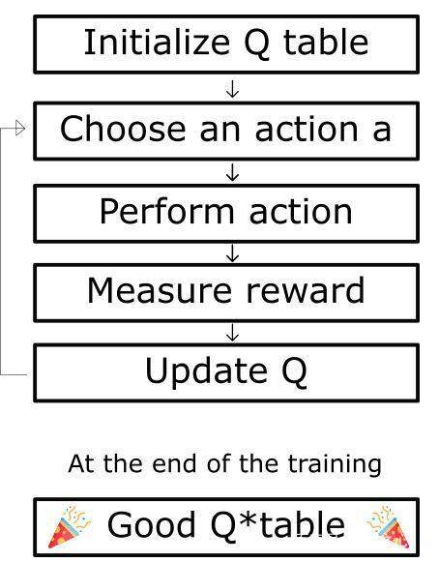
根据代码

