Slide 1













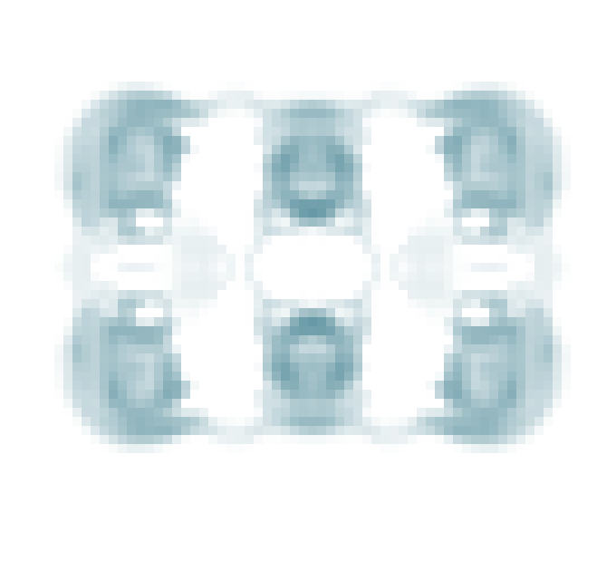
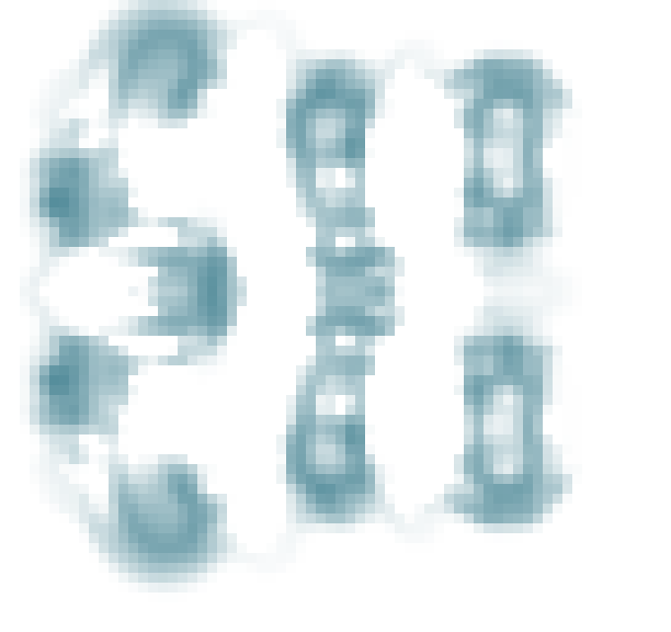
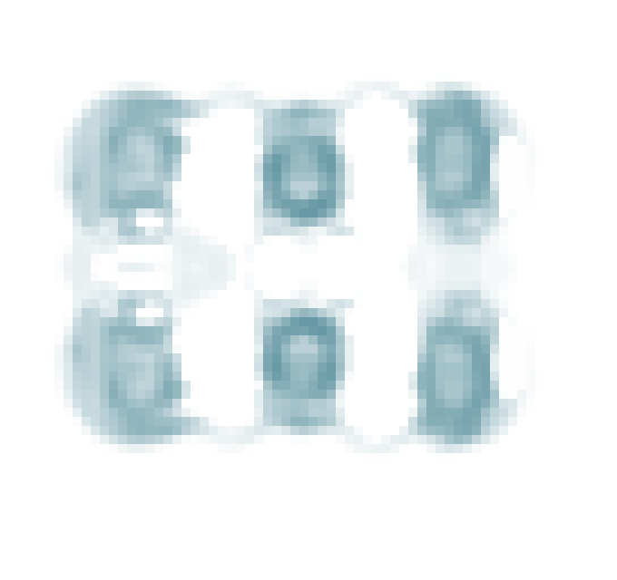
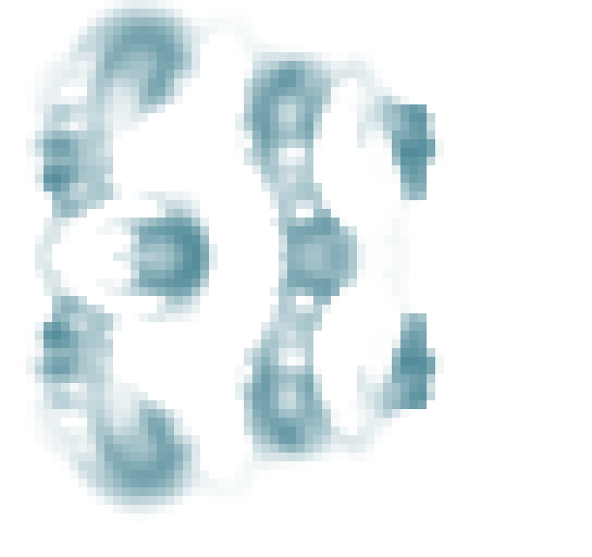
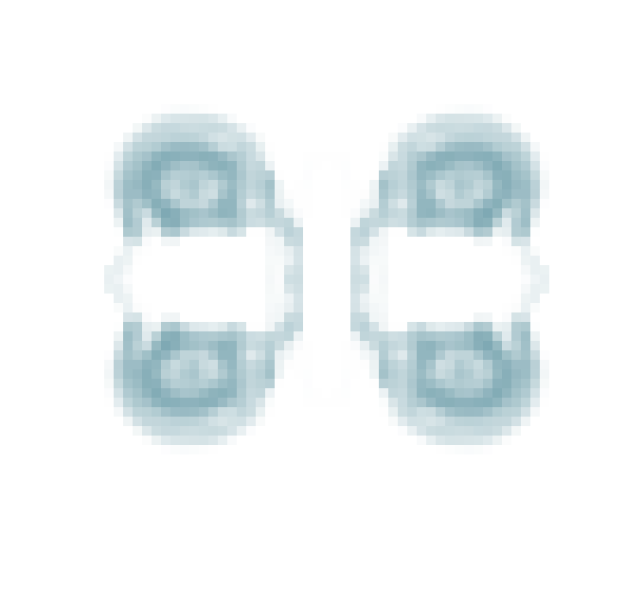
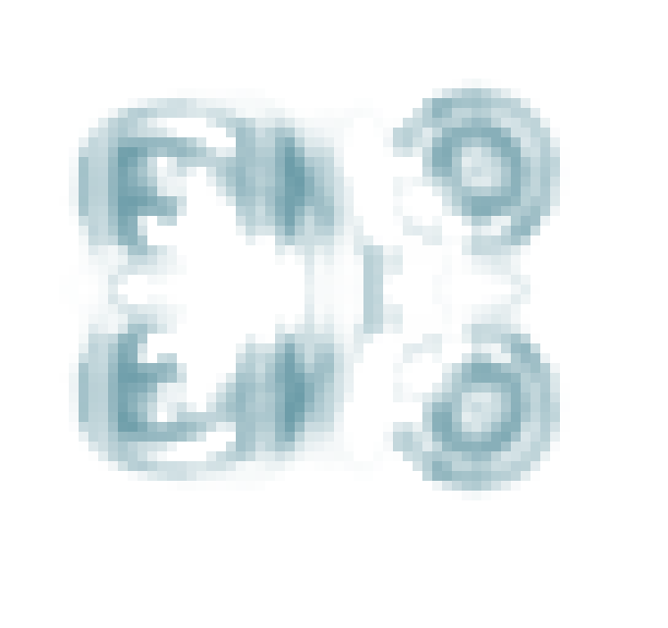
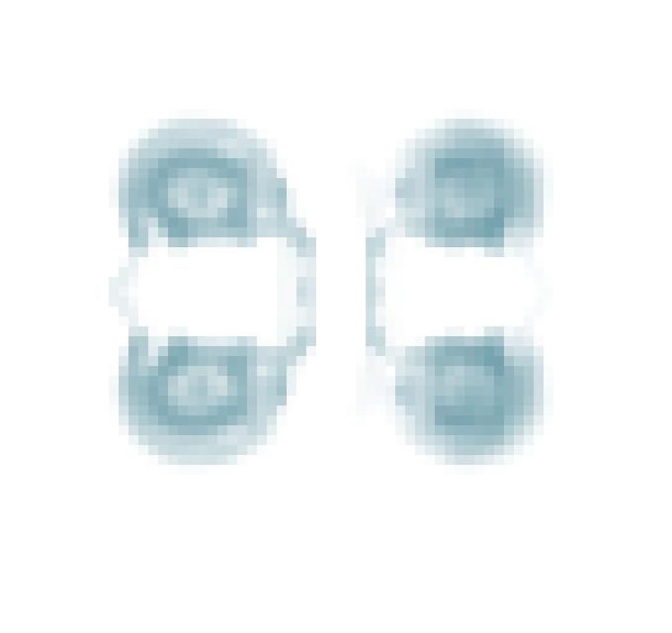
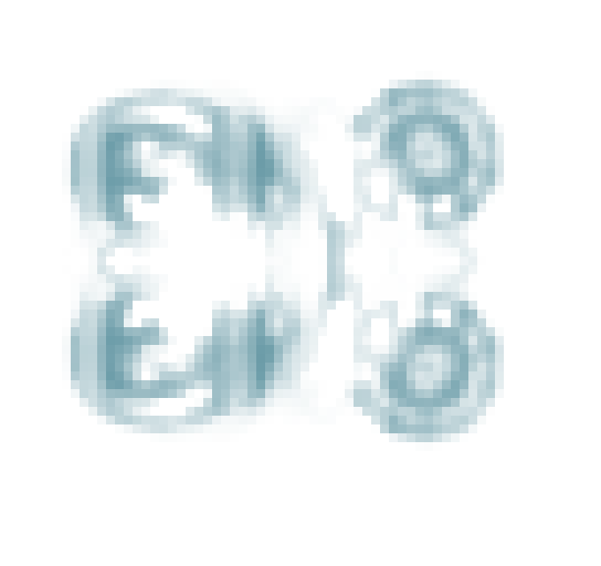
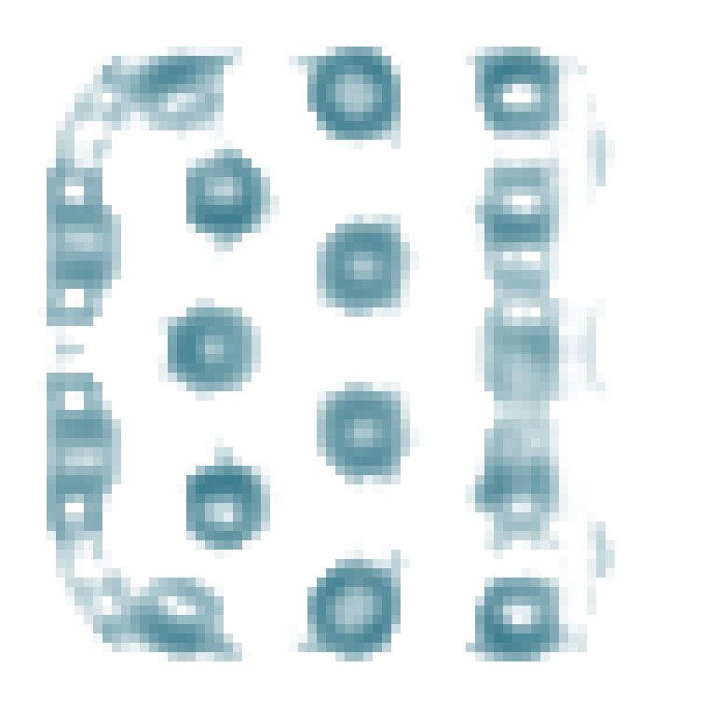
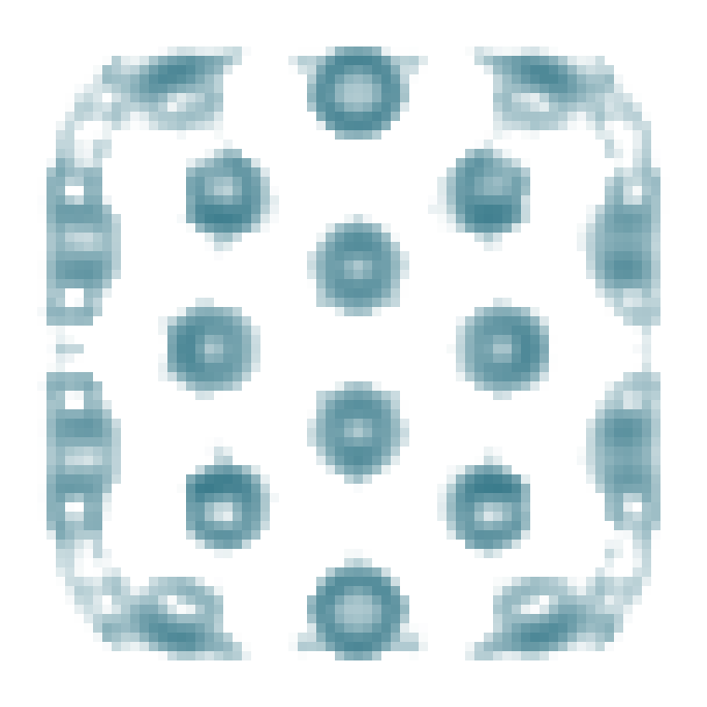
Inherited tolerance and injury experience have different consequences
Formation 0–128 (T00) → Histories 129–160 → Test 161–224
N: no prior cut; C: 10% +x cuts before 129 / 145. N and C use paid P/F transport (T11).
Test: none or 20% +x cut before 161. T00: no prior cut, no transport capability or transport charge.
A Compact offspring survives cuts that kill its parent
160: before
after cut
184
224
All six cut paths · body mass (M)
Parent
N
0
0
80
Parent
C
0
0
40
Offspring
N
0
0
128
224
N
C
T00
Light: parent; dark: offspring
Offspring
C
Compact R × I follow-up (N/x, C/x)
R0
I0
I1
R1
178 / 183: zero
178 / 184: zero
both >0 at 224
both >0 at 224
Density ρ: white 0 → teal 1 M/cell. Same x28–67, y28–63 crop; y up.
R1I0 C − N, x: ΔM +.687; ΔE −6.279;
ΔT −40.633 (T = full-cycle body-time).
B Positive interaction does not make injury experience beneficial
160
224
Complete 0–224: C − N body-time (M × time)
Parent N
Multiring:
all six matched
child − parent
M / E / body-time < 0
0
Parent C
-30
R/I follow-up:
At each I, R1 − R0:
M / E / T < 0 in all
four matched paths.
R × I is nonzero.
Child N
-60
Parent and child:
all six original futures
grow at every final-32
update.
0
Compact none −24.085
128
224
Child C
Compact x −46.596
Multiring none −56.516
Multiring x −50.218
Fixed 68 × 64 crop; same ρ scale; smaller than A.
Multiring: interaction +6.298, but both C − N totals < 0.
C Regaining total mass is not restoration of the missing structure
Cut · 384
Uninjured · 384
160
Compact: extinct 273.
Multiring: old total M regained at 312;
cut region ends at 22.78% of control.
Cut
region
M
80
Cut region peaks at 325, then falls.
Shape L1 = 373.060 after registration
(displacement 0): not restored.
Separate state 256 excision.
Fixed x10–85, y10–85 crop.
0
256
Step
384
Grey: uninjured region; orange: cut region. This is a different receiver and clock from A/B.
One compound mutation per parent; one tape / +x scenario. Learning off; no stable-recovery or general-adaptation claim.

