Slide 1


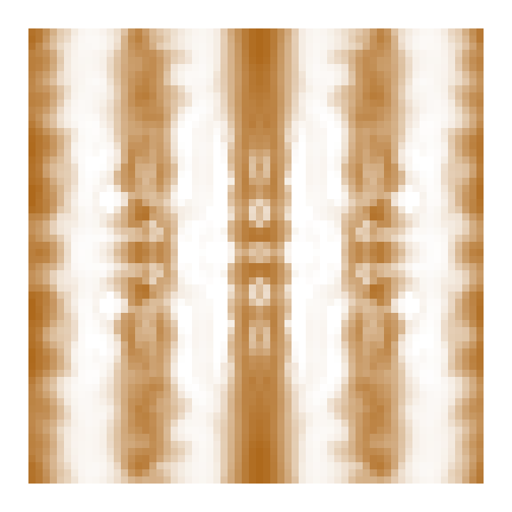







A P transport exposes an existing fuel constraint
Two bodies, each from its own state 128. Actual action 129; same K, q, support and L within each body.
T00: neither resource moves T10: P only T01: F only T11: P + F (body transport remains on)
Body ρ · T00
Licensed request L
Available fuel F
P-admitted · T00
P-admitted · T10
0ac · porous network
6bd · four-lobed body
0 → 1.1 M/cell
0 → .05 M/cell
0 → 1.75 F/cell
0 → .05 M/cell
0 → .05 M/cell
White = 0; darker = larger. Same crop x,y = 12–83 of 96²; y up. P-admitted = min(L, P).
L and F are identical in T00 / T10. P admission changes without any deterioration of the F field.
B Sequential rejection is not the independent fuel deficit
q → capacity → template → L → P admission → F admission → paid birth
Independent F deficit · M
F rejection after P · M
Σ max(0, L − F / 0.42)
Σ max(0, min(L, P) − F / 0.42)
0
12
0
.3
0ac
11.432606
unchanged
0.078555
0.286307
6bd
2.107857
unchanged
0.121870
0.243360
Grey T00 · Teal T10. Independent deficits may overlap; do not add P and F deficits.
P releases requests into an unchanged F constraint. Later q/support evolve with each body.
C More mass, more energy and late growth are different outcomes
P effects (F off / on): 0ac ΔM +6.70 / +7.73; ΔE −100.55 / −95.96; ΔT +61.18 / +88.65
6bd ΔM +55.72 / +63.05; ΔE −16.54 / −15.49; ΔT +109.78 / +120.92
F effects below: grey = T01 − T00 (P off); blue = T11 − T10 (P on). T: integrated body-time.
12
0ac · ΔM (M)
12
6bd · ΔM (M)
-2
0ac · ΔE (EU)
-2
6bd · ΔE (EU)
100
100
0
128
176
224
0
128
176
224
0ac: all four lose M over the final 32 updates.
6bd: all four gain M at every late update.
Energy interaction has brief negative intervals: 0ac at 147; 6bd at 159–164. No steady-state claim.
Capability + payment; fixed rules, learning off. Two bodies differ in rules and history, not independent replicates.

