Slide 1



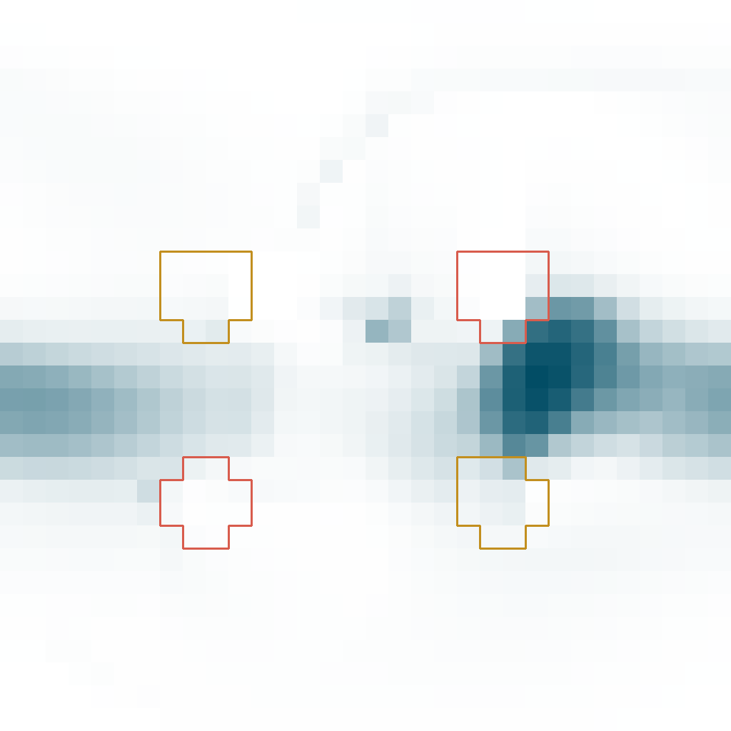









a Shared body,
diverging spatial futures
400
560
720 steps
Continued
writing
F
H
Shared state at 240
Food site
Hazard site
M = 20.72
M = 5.90
F
H
8 cells
Writing stopped
at 240
Tissue density ρ
0
.2
.75
Square-root colour scale
M = 16.13
M = 8.72
b Local state at 400
c Local energy at 560
d Early advantage, late loss
F: m₀ at
food site
H: m₁ at
hazard site
Continued writing
Writing stopped
Continued writing
Writing stopped at 240
m₀ ≈ 0
56.23%
16.85%
of tissue mass below E/ρ = 0.08
0
.08
.16+
−1
0
+1
Specific energy E/ρ (EU/M)
240–720 losses: continued − stopped
Injury −6.062 | Starvation +8.889 M
White: m ≈ 0
Grey: ρ < 0.001
Grey: ρ < 0.001
White: E/ρ near 0.08
E720 (EU): continued 4.755 | stopped 1.170
e Local update sequence (schematic)
Next-step drive
State travels with tissue
Food contact after movement
Circles: carried memory m
Cue-driven z gates m writing
Energy limit → transport
Writing term off; z dynamics, m decay and transport remain active.
Schematic; arrows not to scale.

