Slide 1
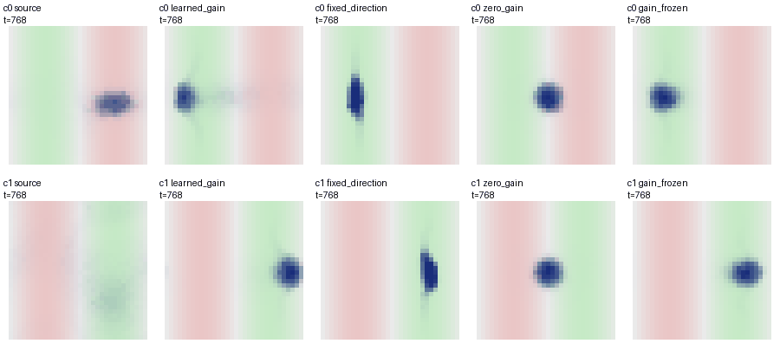
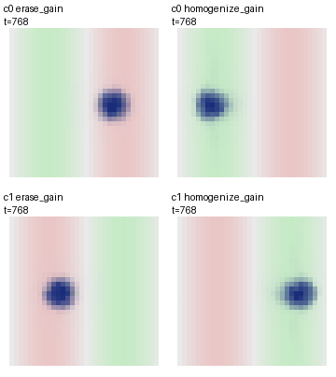
Acquired gain enables responsive movement
Reversal can succeed with the acquired gain held fixed.
A A learned gain reads a preset sensory direction
Paid local outcomes
→ previous gradient g
Preset direction
d = g / |g|
Local mean = κ d
+ noise → paid transport
κ starts at 0; local source-credit updates κ. No additive bias.
κ = 1 is a strong fixed control.
1–320 Acquire
Paid outcomes + writes
321–640 Reverse
New relation, unannounced
641–768 No new feedback
Old records transported; writes off
B Fixed gain also succeeds: all conditions and stages
Final-64 mean body field score; P / F = pass / fail the original full gate
Method
Acquire
Reverse
No new feedback
All stages
Learned κ
C0 +0.7312 P
C1 +0.7226 P
C0 +0.3419 P
C1 +0.7633 P
C0 +0.5714 P
C1 +0.7883 P
2/2
Fixed κ = 1
C0 +0.9783 P
C1 +0.9780 P
C0 +0.7483 P
C1 +0.7510 P
C0 +0.9689 P
C1 +0.9661 P
2/2
Source bias
C0 +0.7279 P
C1 +0.7177 P
C0 -0.7987 F
C1 +0.0149 F
C0 -0.7307 F
C1 +0.3633 P
0/2
Zero κ = 0
C0 +0.0197 F
C1 -0.0065 F
C0 -0.0125 F
C1 +0.0098 F
C0 -0.0226 F
C1 +0.0208 F
0/2
Gate: M ≥ 12, connected fraction ≥ 0.75, score > 0.25, positive mass fraction ≥ 0.60.
C0 / C1: two opposite-field/noise conditions, not independent worlds. Occupancy alone is not relearning.
C Same acquired parent; all subsequent κ writes frozen
Two parents at 320 → retain, erase or mass-mean homogenize κ; body / energy / records / RNG matched.
Retain κ
Erase κ
Homogenize κ
Mean command, original axis
+0.6
321: paid gradient → 322: read
C0
0
-0.6
321
336
352
Rev +0.5696 P
No fb +0.8850 P
Rev -0.8293 F
No fb -0.8226 F
Rev +0.5726 P
No fb +0.8955 P
Retain (writes frozen)
Homogenize (writes frozen)
Erase (writes frozen)
+0.6
C1
0
-0.6
321
336
352
Rev +0.6139 P
No fb +0.8836 P
Rev -0.8133 F
No fb -0.8130 F
Rev +0.6159 P
No fb +0.8947 P
Actual step after reversal
Positive = old direction; negative = new
All fields: t = 768, 32 × 32 periodic coordinates; blue density at one scale (saturates at ρ = 0.8).
Green / red: positive / negative evaluation field. No birth; M = 24. Two parents, not six independent repeats.
Actual outcome transfers / basal / movement recorded; sensing hardware, computation and communication unpriced.

