Slide 1
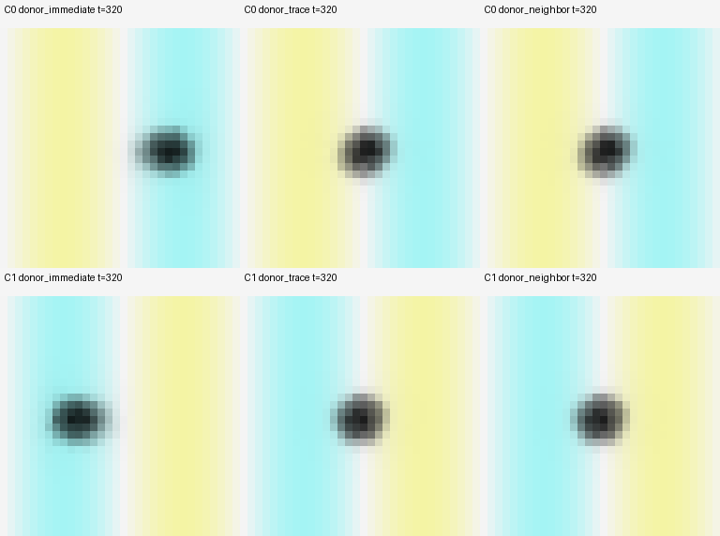
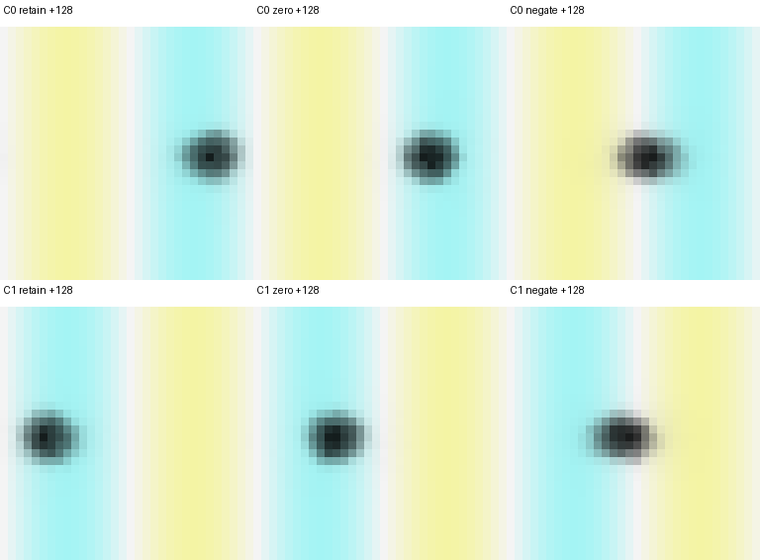
Local motor content redirects a conserved body
Acquisition succeeds; prescribed reversal fails. Erasure and sign inversion test stored direction.
A Return local consequences to the source
B Acquisition ≠ reversal
actual K
Body-weighted field • mean of last 64 steps
Source i
Recipient j
Acquire 1–320
Reverse 321–640
θ + noise
paid y
C0
C1
C0
C1
Immediate
0.7215
0.7406
-0.1861
-0.0119
Return along K
source
Source + EMA
0.0463
0.0659
-0.0865
-0.1275
Update θᵢ with local source-credit
+ one-hop mix
0.0433
0.0642
-0.0949
-0.1117
Immediate perturbation × local outcome change
Recipient
0.0091
0.0710
0.1802
-0.4182
Updated content is transported forward.
immediate*
No central aggregate; actuator and cohesion are preset.
Immediate source: acquire 2/2; reverse 0/2.
*Delivery and update location both change.
C Same acquired parent; only local motor content is changed
128 steps with feedback and writes OFF • body, E, trace and RNG matched within each parent
Parent at 320
Retain θ
Zero θ
Negate θ
C0
32 × 32 periodic coordinates • same spatial scale • final forks at parent +128
C1
Cyan: positive field; yellow: negative. Darkness: ρ/max(ρ) within each tile. All final M = 24.
Signed displacement (lattice units)
-4.4242
-0.0018
+4.3071
Positive = original learned direction
C0
Two matched parents, not six repeats.
C1
-4.3005
-0.0017
+4.1842
Zero remains in good territory;
this does not demonstrate learned stopping.
Negate
Zero
Retain
Finite full-grid nutrition; no birth. Costs persist without feedback; one-hop communication is unpriced.

