Slide 1
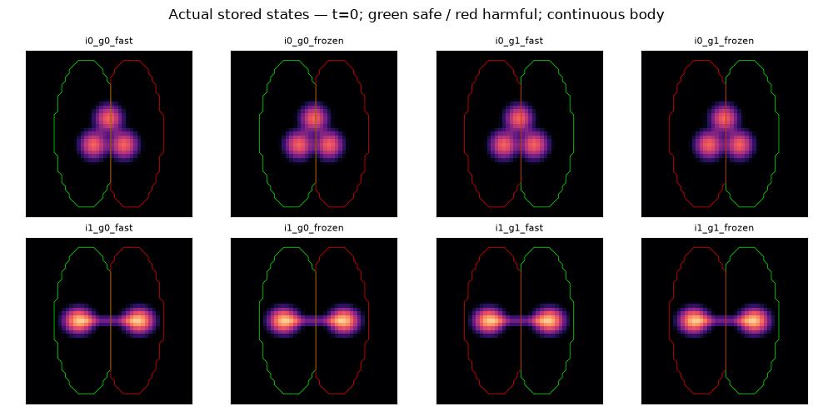
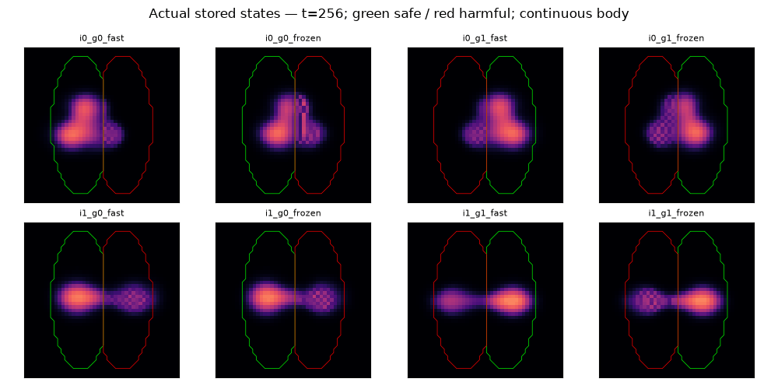
Density-regulated material CA • external supply • central action
Acquisition with new tissue; correct newborn copying is not required in this finite window.
A Real compact bodies
B Safe-contact share: acquisition and reversal
Life 0
Fast, t = 256
g0: safe on left
g0: acquired
C / L = compact / long; 0 / 1 = meaning; F / X = fast / fixed.
Acquire: compact fast 2/2; fixed 0/2; long fast 0/2. Reverse: 0/8.
C Two actual 256 parents → six stop-writing futures
g1: safe on right
g1: acquired
Acquire safe M: 75.14 / 68.96 (64-step means)
Retained post-life0 tissue at 256
g0: 83.22% g1: 83.70%
Births coexist with net growth.
This is not one-for-one old-tissue replacement.
Saved density views; green safe / red harmful.
Long-body tails after 512 missing; no retention score.
g0 safe = .884; physics/actions identical. g1 safe = .832 / .833 / .826.
Copy / same-fee zero / norm-preserving swap; all retain safe contact.
Physical feedback remains ON. Different host from local-motor Fig3; these are not one continuous life.

