Slide 1
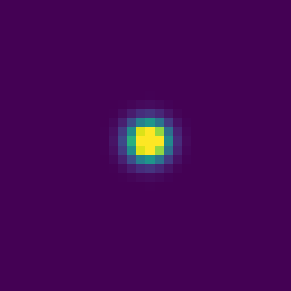
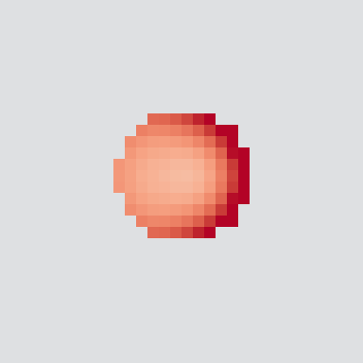



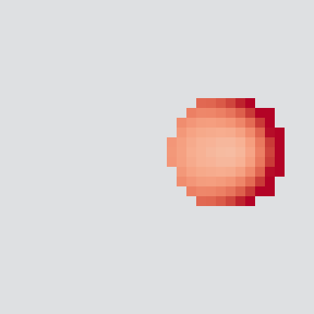



Carried evidence changes decisions after reversal
Complete parent at 1024 → update / freeze | Compact, seed …2101, α = 0.4
1056 First write (−cue channel)
Local write; freeze: none
1191 First action difference
Update left; freeze right
1201 Uptake difference
6.984 vs 0.000154 EU
Events from step tables. Images below are saved post-step fields, not invented intervening states.
A
Update: density ρ
Update: Q+ (R−L)
Freeze: density ρ
Freeze: Q+ (R−L)
1056
cue−
1201
cue+
1521
cue+
0
2
−0.5
0
+0.5
Original periodic 32 × 32 coordinates. Q+ = Q(+cue,R) − Q(+cue,L); grey masks same-frame ρ < 0.001.
B All paired uptake effects: update − freeze
C Uptake ≠ energy balance
EU over 16 cycles; each cell α = 0.4 / α = 1
Mean E (EU); completed cycles 32–48
Context
Same
Reversal
Independent
50
α = 1
α = 0.4
Freeze
Compact 1
Compact 2
Ring 1
Ring 2
Bilobed 1
Bilobed 2
0 / 0
0 / 0
0 / 0
0 / 0
0 / 0
0 / 0
+41.98 / +41.98
+27.98 / +62.98
+41.65 / +41.65
+27.45 / +62.53
+41.96 / +41.96
+27.92 / +62.85
-7.00 / +7.00
+0.00 / +7.00
-7.00 / +7.02
+0.00 / +7.03
-7.00 / +7.00
+0.00 / +6.99
25
0
32
40
48
1/2 identify the two shared tapes, not independent bodies.
Three shapes × two seeds: six dependent parent contexts.
Update ΔE: −23.91 / −14.65
(α0.4 / α1; relative to own parent)
Translated-density host; global actuator and shared energy. Freeze retains capture / payment; no new n/d content.

