Slide 1


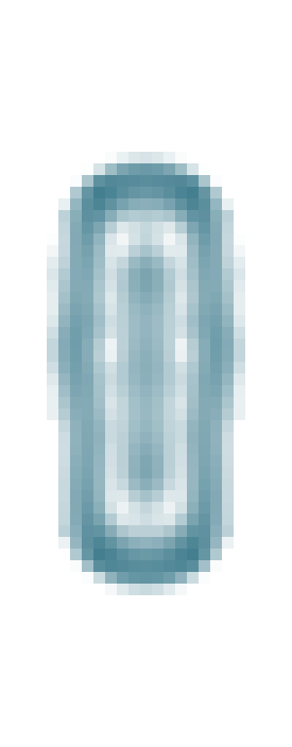
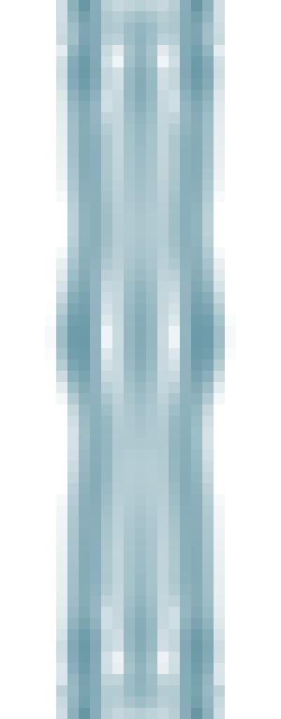
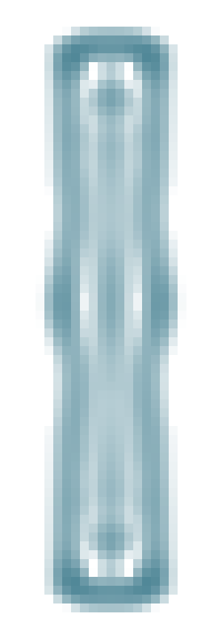


A Formation does not guarantee persistence
Four fixed rules × two initial bodies · all eight qualify at 128 in the 64² domain
Rule
Trilobe
Bridged
Two non-rigid initial shapes
Reference
●
①
Core ring
②
●
Double shell
●
●
Core + outer
●
●
① / ② continued; six eligible bodies not continued
Same initial M = 71.249; E = 56.999
B Matched state 128 → paid adjacent F transport off / on
② Ring: 64 / 96 domains; both arms alive
① Double blobs · 64 domain
64: 128
64: 384
96: 384
128
192
64 x20–44,y0–63; 96 x36–60,y12–83
Both exactly zero from 220 through 384
x 0–63; y 24–43 ↓; same window at both times
Transport-on fields; density ρ: white 0 → teal 1 M/cell. All fields use the same colour scale.
64: gap 7 < K₂ reach 8 at 232; 317 is not onset. 96: no new-edge contact (ρ > .01).
C Transport changes reserves without changing either fate
Tissue mass (M)
Stored energy (EU)
64 off
64 on
400
400
200
Ring: 64 / 96
200
0
Double blobs: zero tail
0
128
220
256
384
128
220
256
384
64: grey / teal; 96: violet / orange = off / on
96: 297–384 continuous net loss
D Energy gains coexist with declining late generation
On versus off (%): 64 teal; 96 orange
Last-32 births, off / on (M)
0
8
16
64: 21.376 / 21.146
End E
+15.637
End M
+0.281
+15.938
96: 5.026 / 4.860
+0.303
On fee (64 / 96): 6.614 / 6.536 EU
Body-time
+0.208
ΔE: +55.077 / +59.821 EU
+0.203
96 outer P = births = 0: tissue is transported in.
Learning off; domain sensitivity, not a steady state or pure boundary mediation.

