Slide 1
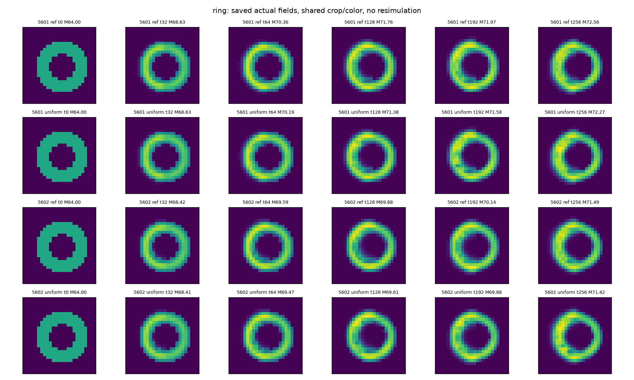
Regenerative host • fixed physiology
Finite ring replacement | 2 tapes × 4 initial bodies × 2 deletion layouts | 256 steps
A Saved density fields | input tape 202610195601
Density rho: 0–0.5983
Purple → yellow
Same spatial crop
A prescribed ring persists;
its density redistributes.
Not de novo ring formation.
t = 0 (given ring)
greedy, t = 128
greedy, t = 256
uniform, t = 256
B All 16 trajectories | joint window test
C Live birth-cohort mass at t = 256
Initial body | 5601 G | 5601 U | 5602 G | 5602 U
Compact | FAIL | FAIL | FAIL | FAIL
Ring | PASS | PASS | PASS | PASS
Double lobe | FAIL | FAIL | FAIL | FAIL
Separated | FAIL | FAIL | FAIL | FAIL
Tape | Layout | Founder | Born>0 | Born>128
5601 | Greedy | 36.87 | 35.69 | 22.03
5601 | Uniform | 36.60 | 35.66 | 22.07
5602 | Greedy | 36.18 | 35.31 | 22.00
5602 | Uniform | 35.98 | 35.43 | 21.95
G = original prestate greedy; U = uniform.
PASS: all four 64-step windows; last-two result identical.
Founder initially 64; Born>128 is a subset of Born>0.
Both labels are observers, never inputs to the rule.
Only ring passes (4/16); original greedy already supports renewal.
Renewal is supported here; cue learning was tested in a different, non-renewing host.

