Slide 1
Fuzzing Project
Project in the scope of the practical semester of
Andreas Eisele

Slide 2
What is fuzzing
Fuzzing also called “robustness testing” is a technique to test software on vulnerabilities.
The basic idea is to execute a wide range of random input datas against the target interfaces to recognize unexpected behavior.
This offers the possibility to find leaks by bad, invalid or unexpected input in all components of the target, which cause the application to crash or hang.
origins of bugs (stackoverflows, heapoverflows, …)
The idea of fuzzing was developed by Barton Miller and his students from the University of Wisconsin-Madison in 1989
Notes:
https://en.wikipedia.org/wiki/Fuzzing

Slide 3
American Fuzzy Lop
AFL developed by Michal Zalewski is a free brute force fuzzing tool combined with an instrumentation-guided genetic algorithm.
This method of fuzzing improves the results a lot. Through the instrumentation during the compile time reaches AFL a high edge-coverage.
afl steps
The instrumentation adds instructions to the assembly code.
While the run time, will AFL modify the file(s) in the queue and execute them to the target .
If this results into a new state transition, the file will added to the output queue otherwise it will discard.
This process is going to be repeated until all possible modified input-cases are tested.
Notes:
https://en.wikipedia.org/wiki/Fuzzing

Slide 4
What software can be fuzzed?
AFL is chiefly developed to fuzz software which expects input from files or stdin like editors, parsers ….
If not, it might be necessary to write a small harness program that surrenders the modified input to the target application.
Essential in this case is to figure out which datas must be stored as initial-sample-file.
Arguments of interfaces and functions stored in an binary file would be one way.
Divide instead of testing your software as whole!
Notes:
https://en.wikipedia.org/wiki/Fuzzing

Slide 5
A little part of the AFL bug-o-rama trophy case
IJG jpeg ¹ | libjpeg-turbo ¹ ² | libpng ¹
libtiff ¹ ² ³ ⁴ ⁵ | mozjpeg ¹ | PHP ¹ ² ³ ⁴ ⁵
Mozilla Firefox ¹ ² ³ ⁴ | Internet Explorer ¹ ² ³ ⁴ | Apple Safari ¹
Adobe Flash / PCRE ¹ ² ³ ⁴ ⁵ ⁶ ⁷ | sqlite ¹ ² ³ ^{4...} | OpenSSL ¹ ² ³ ⁴ ⁵ ⁶ ⁷
LibreOffice ¹ ² ³ ⁴ | poppler ¹ | freetype ¹ ²
GnuTLS ¹ | GnuPG ¹ ² ³ ⁴ | OpenSSH ¹ ² ³
PuTTY ¹ ² | ntpd ¹ ² | nginx ¹ ² ³
bash (post-Shellshock) ¹ ² | tcpdump ¹ ² ³ ⁴ ⁵ ⁶ ⁷ ⁸ ⁹ | JavaScriptCore ¹ ² ³ ⁴
pdfium ¹ ² | ffmpeg ¹ ² ³ ⁴ ⁵ | libmatroska ¹
libarchive ¹ ² ³ ⁴ ⁵ ⁶ ... | wireshark ¹ ² ³ | ImageMagick ¹ ² ³ ⁴ ⁵ ⁶ ⁷ ⁸ ⁹ ...
BIND ¹ ² ³ ... | QEMU ¹ ² | lcms ¹
Oracle BerkeleyDB ¹ ² | Android / libstagefright ¹ ² | iOS / ImageIO ¹
FLAC audio library ¹ ² | libsndfile ¹ ² ³ ⁴ | less / lesspipe ¹ ² ³
strings (+ related tools) ¹ ² ³ ⁴ ⁵ ⁶ ⁷ | file ¹ ² ³ ⁴ | dpkg ¹ ²
rcs ¹ | systemd-resolved ¹ ² | libyaml ¹
Info-Zip unzip ¹ ² | libtasn1 ¹ ² ... | OpenBSD pfctl ¹
NetBSD bpf ¹ | man & mandoc ¹ ² ³ ⁴ ⁵ ... | IDA Pro ^{[reported by authors]}
clamav ¹ ² ³ ⁴ ⁵ | libxml2 ¹ ² ⁴ ⁵ ⁶ ⁷ ⁸ ⁹ ... | glibc ¹
Notes:
https://en.wikipedia.org/wiki/Fuzzing

Slide 6
Instrumentation
/* example */
void foo(int x)
{
if(x > 1)
dosometh(x);
else(x < 1)
do_diff(x);
}
/* example */
void foo(int x)
{
__afl_stub();
if(x > 1)
__afl_stub();
dosometh(x);
else(x < 1)
__afl_stub();
do_diff(x);
}
instrument
Example where AFL set it`s instructions, what is actually done in the assembly code.
Notes:
https://en.wikipedia.org/wiki/Fuzzing

Slide 7
How to detect new branches?
During the instrumentation process will AFL create a tuple-catalouge.
Comparing the tuple-catalouge with previous and present executions can AFL fast recognize which input generates new tuples that turn into a new program state.
*Example for instruction sequences:*
A → B → C → D → E
Sequence tuples: (AB),(BC),(CD),(DE)
A → B → C → A → E
Sequence tuples: (AB),(BC),(CA),(AE)
A → B → C → A → B → C → D → E
Sequence tuples: (AB),(BC),(CA),(CD),(DE)
→ first tuples = (AB),(BC),(CD),(DE)
→ new recognized tuples = (CA),(AE)
→ no new tuples are recognized
Notes:
https://en.wikipedia.org/wiki/Fuzzing

Slide 8
inital file(s)
store file in queue
next input
yes
modify input
no
new behavior
exec. Input to target
Rough activity-diagramm that shows how the afl-fuzz step runs.
AFL does not stops the process by itself, if enough cycles are passed just use CTRL + C to stop.
Notes:
https://en.wikipedia.org/wiki/Fuzzing

Slide 9
Mutation
The tool will under consideration of the initial sample case mutate every given input/files.
Those inputs which cause a new state transition will be stored in a queue. This process repeats itself until a new input is found which passes into a new program state.
The modification starts with deterministic steps:
flipping every bit in the sample file, then flipping every byte
break the file into 8, 16 and 32 bit chunks to run arithmetic operations on these chunks.
replacing bytes through insertion of known interesting integers (0, 1, INT_MAX, etc),
After the deterministic steps afl makes several random mutations which place and replace datas, arithmetic operations and also bit flipping.
Notes:
https://en.wikipedia.org/wiki/Fuzzing

Slide 10



Example of how afl mutates files, shown in hexadecimal
the original file, based on a saved struct contains integer and char-array members
→ mutated version, see the difference in the third block
→ also mutated version, among other operations is a arithmetic one done here additional to added data
Notes:
https://en.wikipedia.org/wiki/Fuzzing

Slide 11
User guideline
AFL is available at the website of it`s founder Michal Zalewski, download the
latest version and install AFL.
offical AFL website: http://lcamtuf.coredump.cx/afl/
recommendend site: https://fuzzing-project.org/
README.txt and other documentation files come with the AFL archive and it is worth to have a look.
Notes:
https://en.wikipedia.org/wiki/Fuzzing

Slide 12
Sample file(s)
At least one valid testcase, prefered as binary file must be placed in the input directory.
More files are recommended only if they end in a new progam status.
The following files will cause a different behavior in the target:
file1.sql:
file2.sql:
Keep the files small < 1 kb is ideal!
CREATE TABEL a(id INTEGER PRIMARY KEY NOT NULL, name TEXT NOT NULL);
INSERET INTO a(id,name)
VALUES(1,'Benny');
UPDATE a SET name = 'Tommy' WHERE id = 1;
Notes:
https://en.wikipedia.org/wiki/Fuzzing

Slide 13
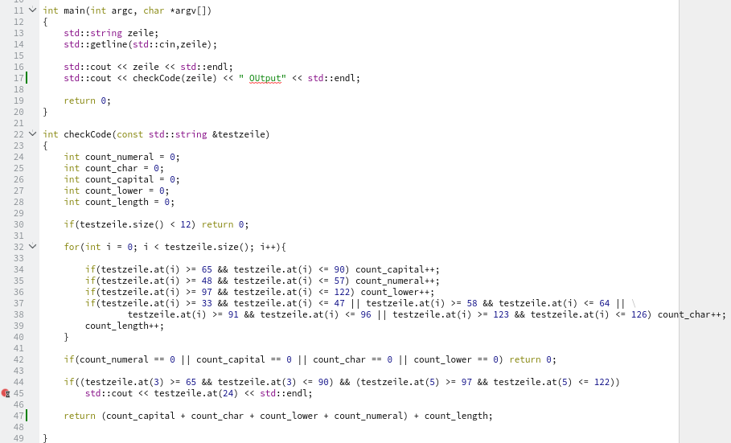
The testprogram evaluates a given string on it`s complexity.
See the weak line at the breakpoint?

Slide 14
Quick example
compile instrument
find sample input
→ 3pü-(jPiflä_K (13 chars)
→ 123sicher
probarbly minimize the file(s)/ the content
run fuzzing
$:afl-gcc tool.c -o tool
$:afl-cmin -i in/ -o red_out/ -- ./tool
$:afl-tmin -i in/ -o mini_out/ -- ./tool
$:afl-fuzz –i in/ -o out/ ./tool

Slide 15
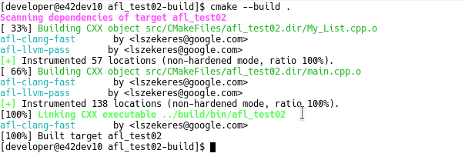
That screen shows a correct run of the build/ instrumentation process:
afl-clang-fast = stands for the used compiler, could also afl-clang, afl-gcc etc.
afl-llvm-pass = in llvm mode it is allowed to instrument the code by true compiler-level instead of instrument assembly-level with afl-cc
[+] instrumented locations = the number of locations give an idea how complex the respective file is.
Notes:
https://en.wikipedia.org/wiki/Fuzzing

Slide 16
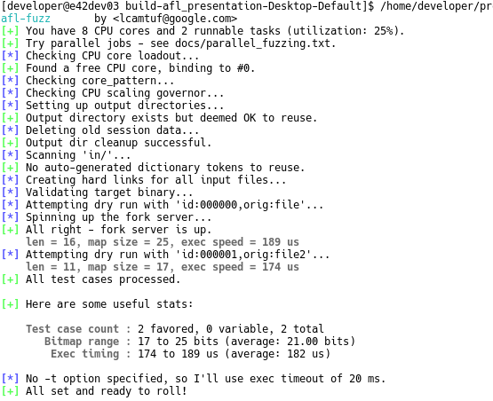
This screen will be shown for some seconds after executing afl-fuzz.
It shows the preparation of the tool.
Notes:
https://en.wikipedia.org/wiki/Fuzzing

Slide 17
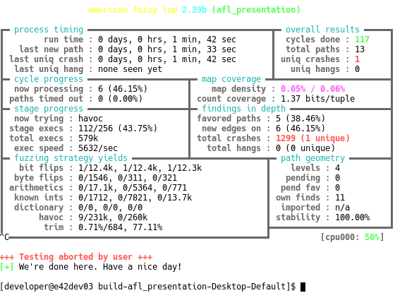
This is the actual state window which shows the fuzzing progress.
Notes:
https://en.wikipedia.org/wiki/Fuzzing

Slide 18
Detected behavior
In the crash folder „ out/crashes/ “ was one file created while the fuzzing session.
After 579.000 executes is one unique crash occured.
Crashed file content → 3 p j P i f ( j y . p Ä (12 chars)
Source file & modification → 3 p ü - ( j P i f l ä _ K
.at(3)
upper
.at(5)
lower

Slide 19
Fuzzing end & evaluation
After stopping your fuzzing session it is time to evaluate the output. If in the fuzzing run have crashes or hangs occured, then you have found a potencial weakness or vulnerability.
AFL has created in your out/ directory three more directories and files:
queue → in the queue folder, you can find the given sample files and all the mutated files which cause a state transition (new path) in the program.
hangs → files which cause a hang in the software are placed here
crashes → files which cause a crash in the software are placed here

Slide 20
Find the origin
The filenames of AFL produced files help to figure out the origin of the file and which operations are done by it. This can be used for debugging.
All files are named in the same way:
given sample file *id:00000,orig:originalfilename.bin
mutated file *id:00001,src:000004,op:int32,pos:8,val:-1+cov
The id of the file, source id from which file it was mutated and the kind of operations that were done and at which position
Notes:
https://en.wikipedia.org/wiki/Fuzzing

Slide 21
Should we use this tool, and involve it in our testing-process?

Slide 22
Sources:
https://fuzzing-project.org/tutorial1.html
http://lcamtuf.coredump.cx/afl/README.txt
http://lcamtuf.coredump.cx/afl/technical_details.txt
https://steemit.com/security/@burnin/finding-software-vulnerabilities-by-fuzzing-with-american-fuzzy-lop
https://en.wikipedia.org/wiki/Fuzzing

