Slide 1
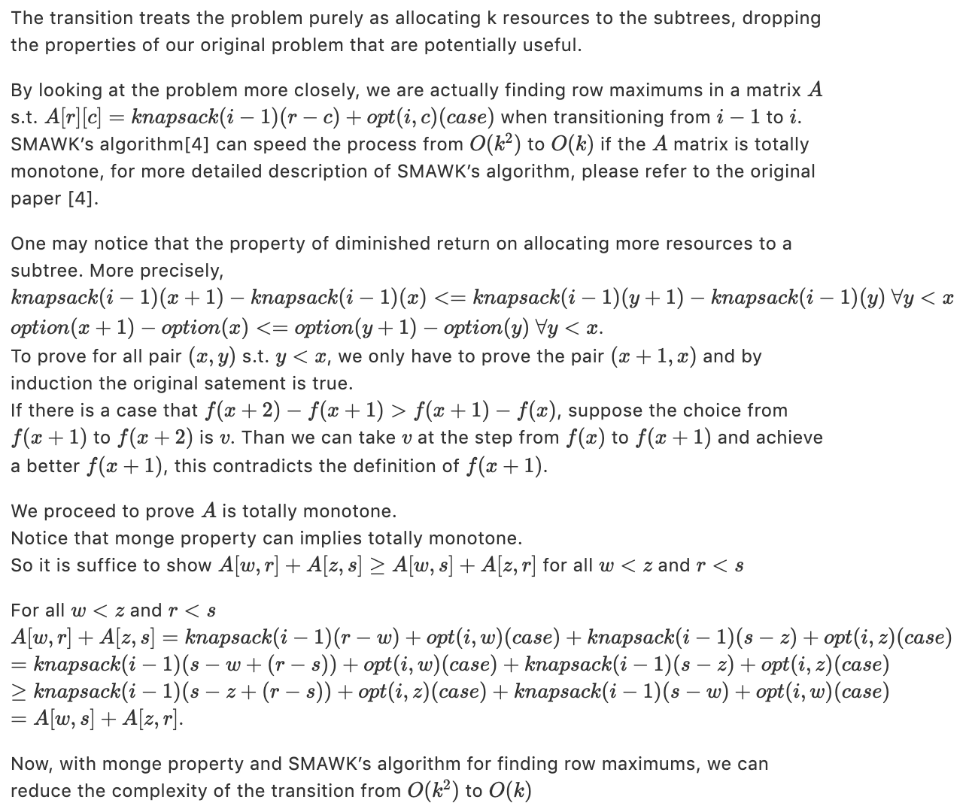
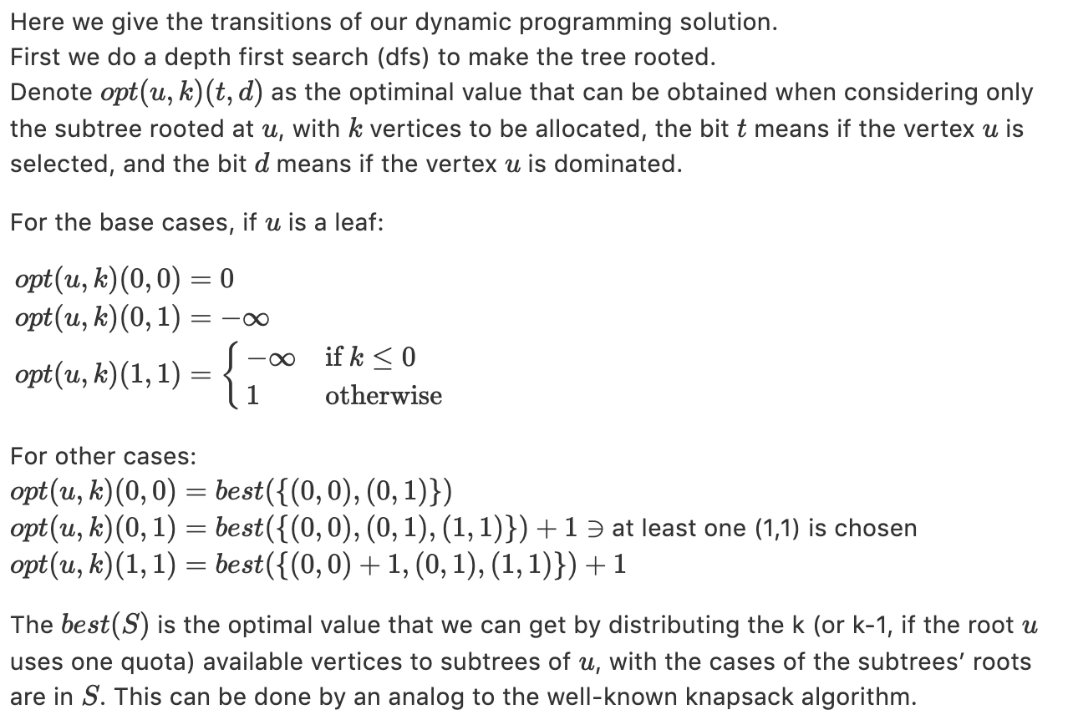
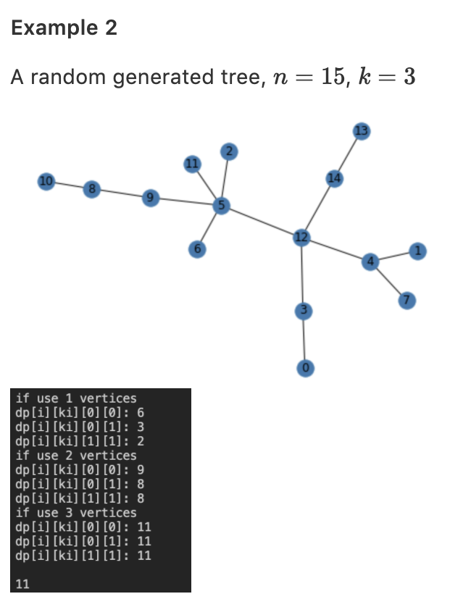
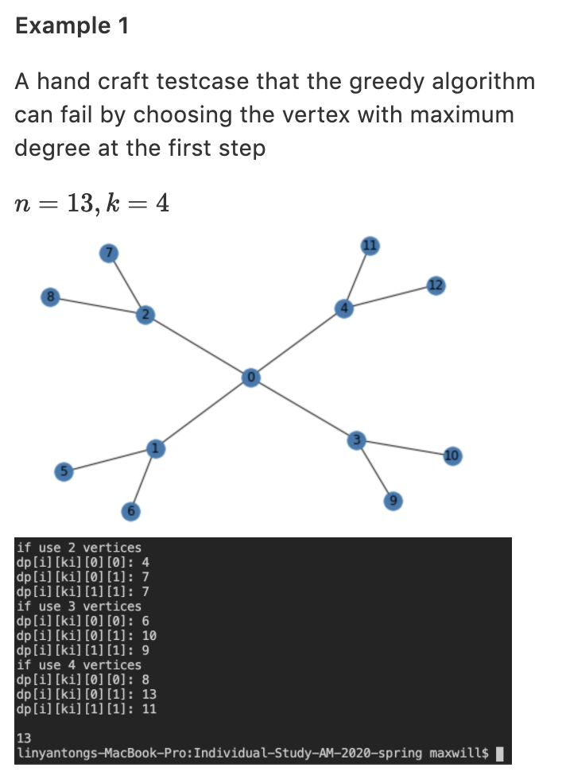
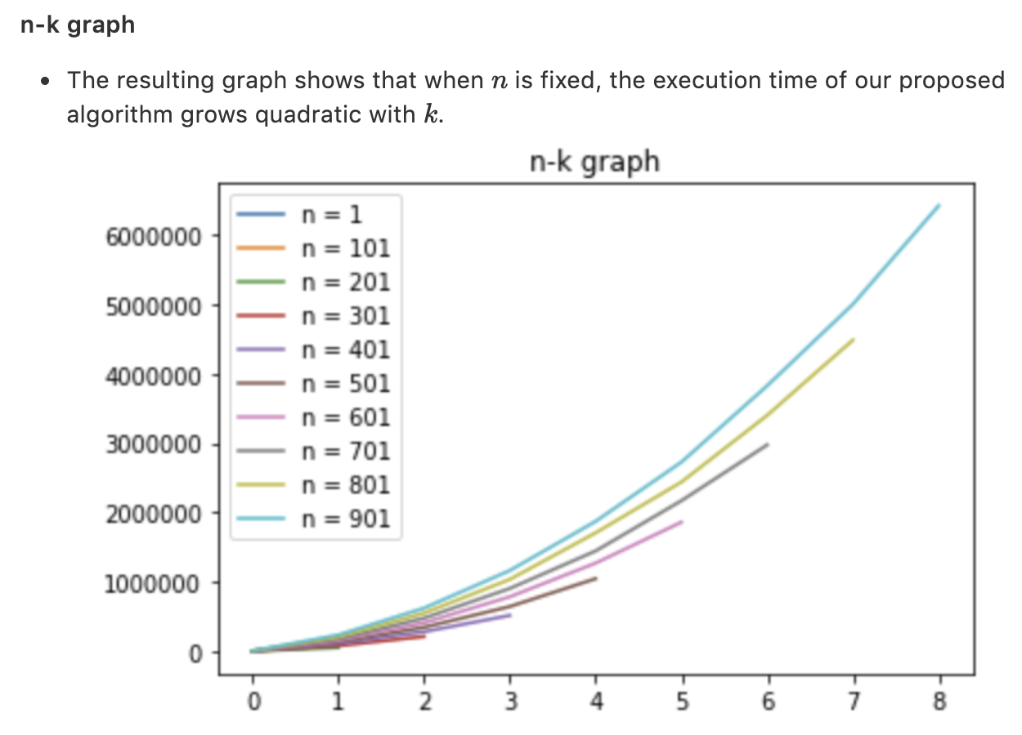
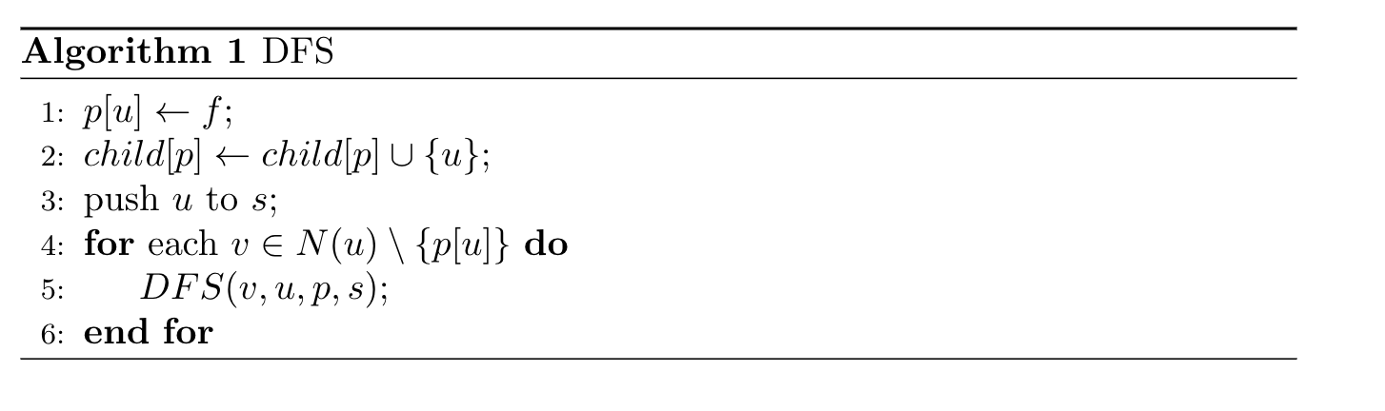
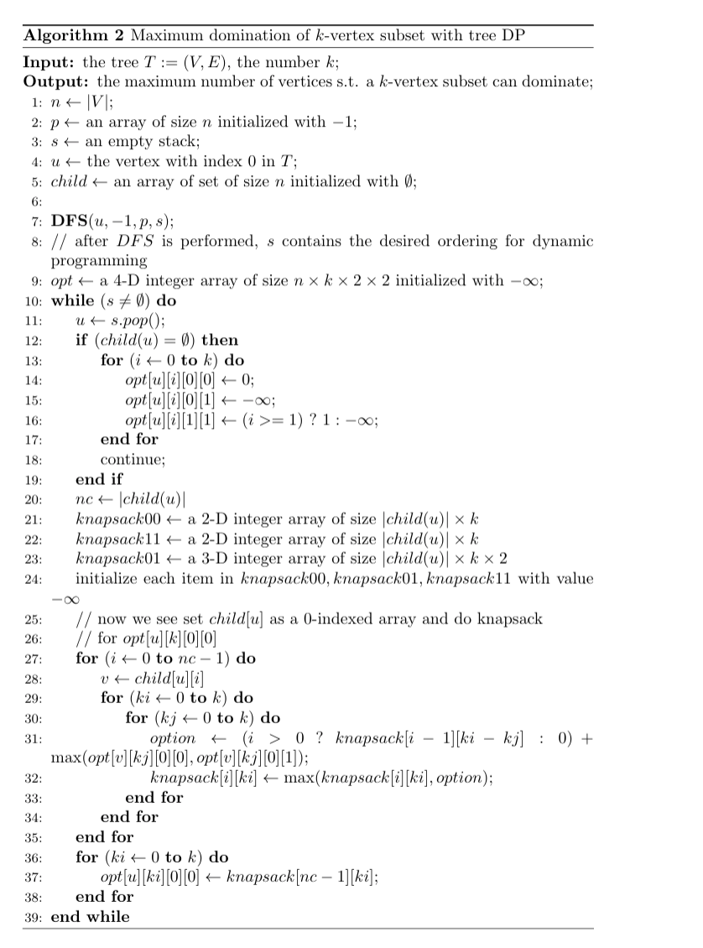
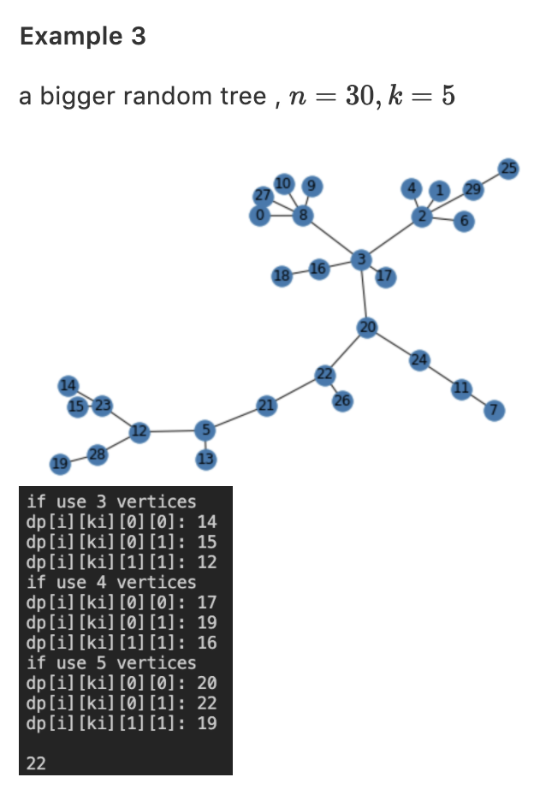
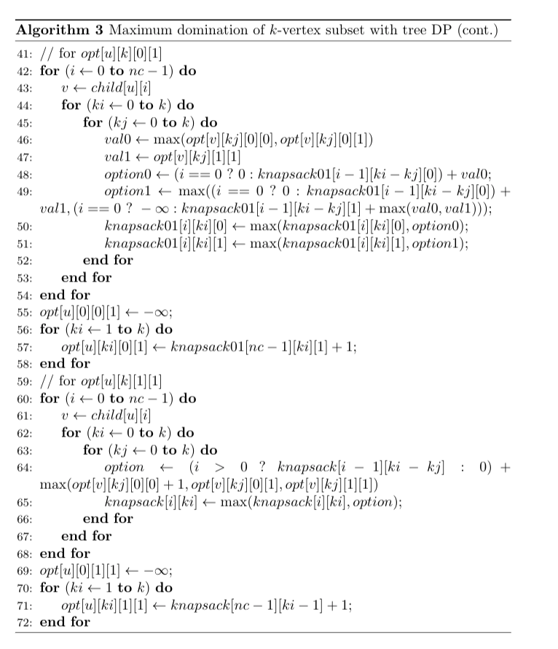
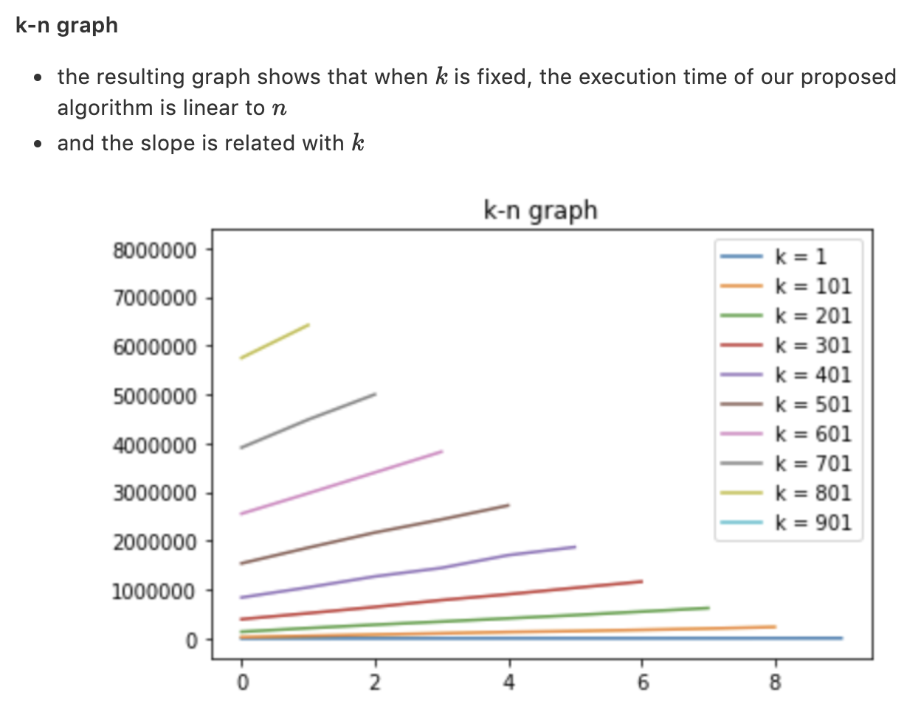
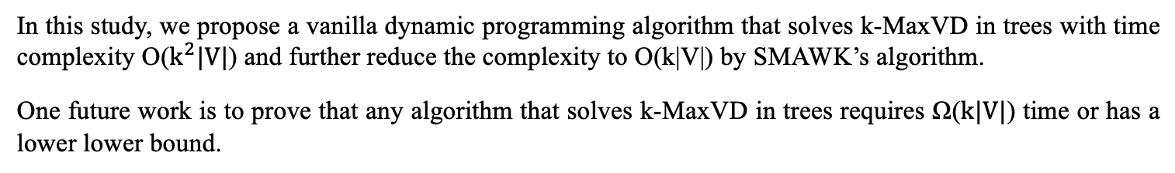

Maximum domination of k-vertex subset in trees
Yan-Tong Lin(林彥彤) (0312fs3@gmail.com)
Department of Applied Mathematics, National Chiao Tung University, Taiwan
Advisor: Prof. Chiuyuan Chen (陳秋媛)
Abstract
The minimum dominating set (MDS) problem has been widely studied and has numerous applications in computer networks. Here we consider a variation of MDS, the maximum domination problem (k-MaxVD). Given a positive integer k, find the maximum number of vertices that can be dominated by a k-vertex subset. The problem is NP-hard since one can solve MDS, an NP-hard problem, with a binary search on the parameter k. And the best approximation ratio of k-MaxVD problem is shown to be (1−1/e) unless P=NP. In this paper, we provide a polynomial dynamic programming solution for k-MaxVD in trees in O($k^{2}|V|$) time. And optimize the time complexity to O($k|V|$) by the monge property of the dynamic programming table and SMAWK’s algorithm [4].
Introduction
Optimization with monge property
Terminologies regarding to the domination problem:
Let G = (V,E) be a graph. N(v) of a vertex v is defined to be the set of all vertices adjacent to v. And we define N[v], the closed neighborhood of v, to be N(v)∪{v}. For any subset of V, named S, N(S):=${\text{⋃}}_{\text{v}\text{∈}\text{S}}$N(v) and N[S]:=⋃v∈S N[v] A vertex v is said to dominate all vertices in N[v]. A subset D⊆V is a dominating set of G if every vertex in V−D is adjacent to at least one vertex in D.
Definition of the k-MaxVD Problem:
Given a graph G = (V,E) and a positive integer k, find the maximum number of vertices in G that can be dominated by a k-vertex subset of V.
Previous works:
It is well-known that finding an MDS in general graphs is NP-hard. For one can solve MDS in polynomial time with a binary search on k with a polynomial time algorithm for k-MaxVD, we know k-MaxVD is NP-hard. Due to the submodularity property, a straightforward greedy algorithm can achieve an approximation of 1-1/e for k-MaxVD [2]. A related research [1] shows some upper bounds of the approximation ratio for the k-MaxVD problem.
The problem in general graphs has shown its NP-hardness and a certain degree of inapproximability. However, since there is a linear time algorithm for MDS on cactus graphs [3], we believe the existence of a polynomial time algorithm for k-MaxVD problem on trees. This motivates us to study the problem.
Main contributions:
In this study, we develop a O($k^{2}|V|$)-time dynamic programming algorithm for solving k-MaxVD on trees, and we further improve the complexity to O(k|V|) by using SMAWK’s algorithm [4].
Purposed Algorithm
Experimental results
⧫ Demo of the proposed algorithm running on a handcraft testcases and some bigger random testcases
⧫ Experiments on the time complexity of the Vanilla DP algorithm
Concluding remarks
In this study, we propose a vanilla dynamic programming algorithm that solves k-MaxVD in trees with time complexity O($k^{2}|V|$) and further reduce the complexity to O(k|V|) by SMAWK’s algorithm.
One future work is to prove that any algorithm that solves k-MaxVD in trees requires Ω($k|V|$) time or has a lower lower bound.
References
[1] E. Miyano and H. Ono, Maximum domination problem. in: Proceedings of the Seventeenth Computing: The Australasian Theory Symposium (CATS 2011), CRPIT vol. 119, pp. 55–62, Australian Computer Society Inc. (2011).
[2] S. Fujishige, Submodular Functions and Optimization, Annals of Discrete Math., vol. 47, 1st Ed., 1990.
[3] S.T. Hedetniemi, R. Laskar, and J. Pfaff, A linear algorithm for finding a minimum dominating set in a cactus, Discrete Appl. Math., vol. 13 (2–3) (1986), pp. 287–292.
[4] A. Aggarwal, M.M. Klawe, S. Moran, P. Shor, and R. Wilber, Geometric applications of a matrix-searching algorithm, Algorithmica, vol. 2, pp. 195–208.
I would like to thank Prof. Chiuyuan Chen, my instructor of this individual study, for giving me a lot of advices and helping me come up with interesting ideas.
I would also like to thank Prof. Meng-Tsung Tsai, my teacher of the course Advanced Algorithms, for encouraging me to utilize the knowledge in the course.

