Slide 1
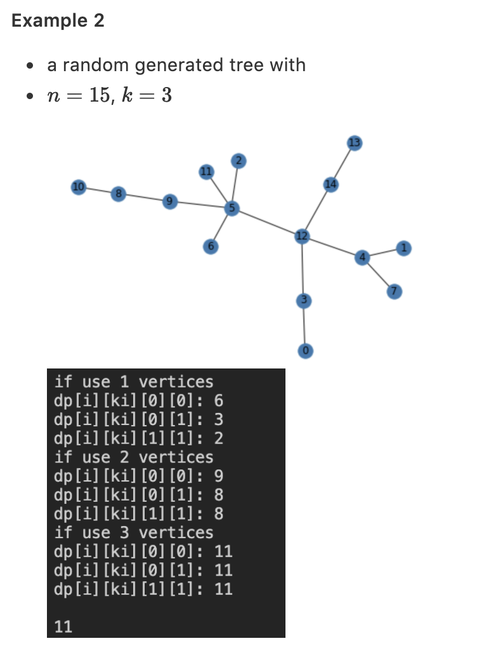
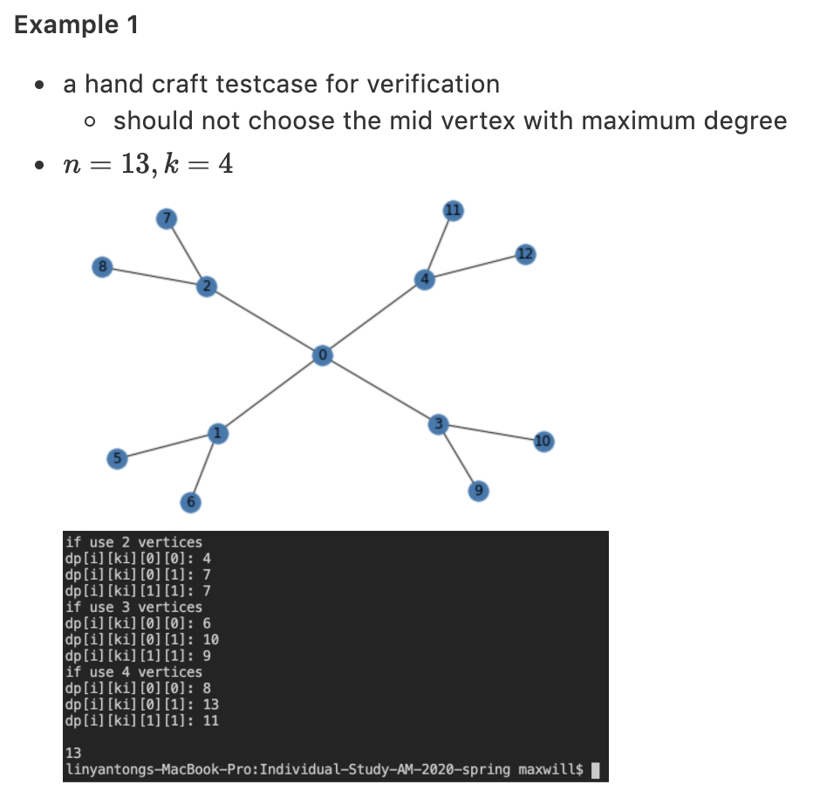
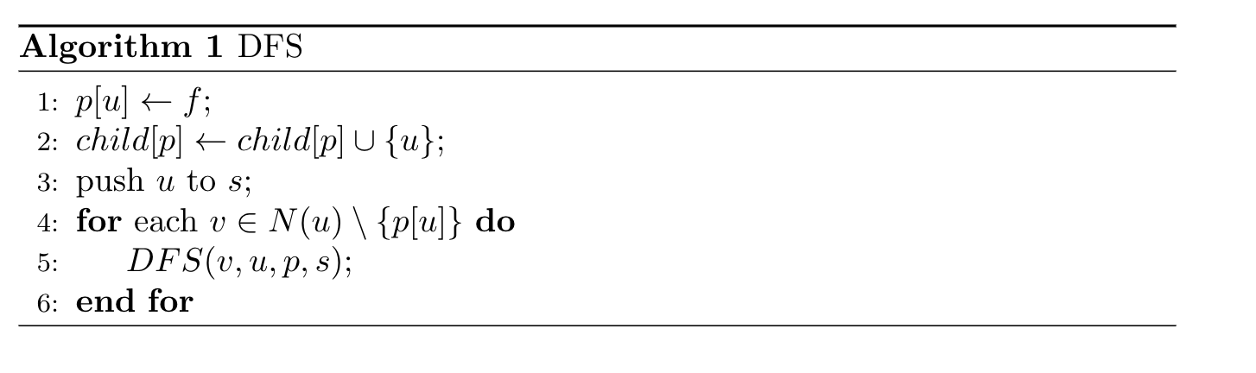
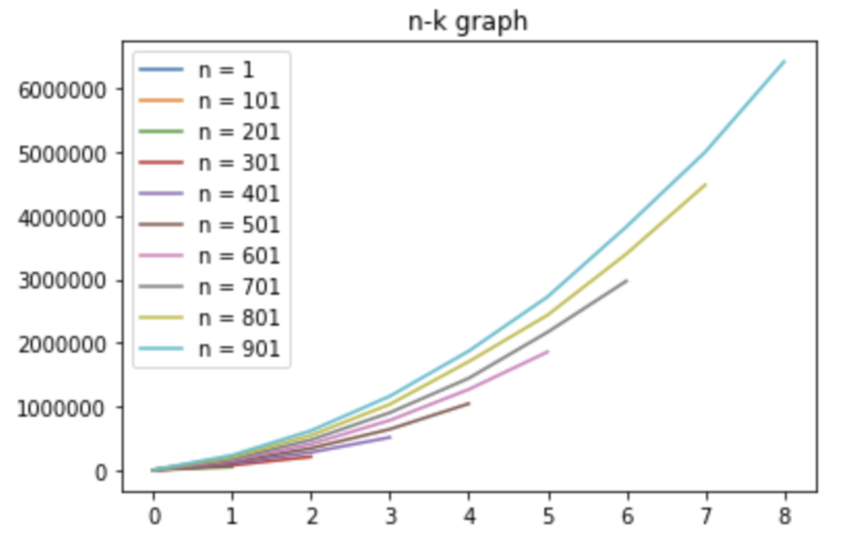
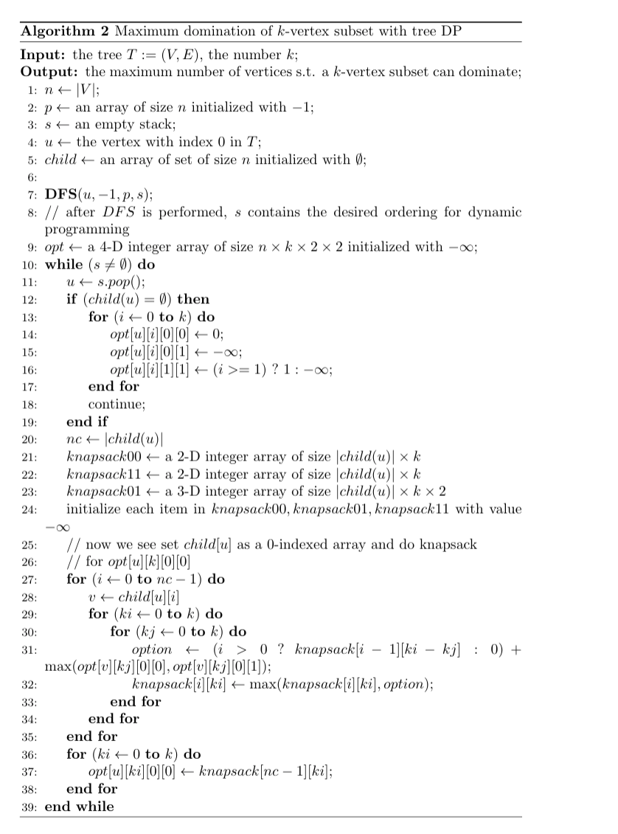
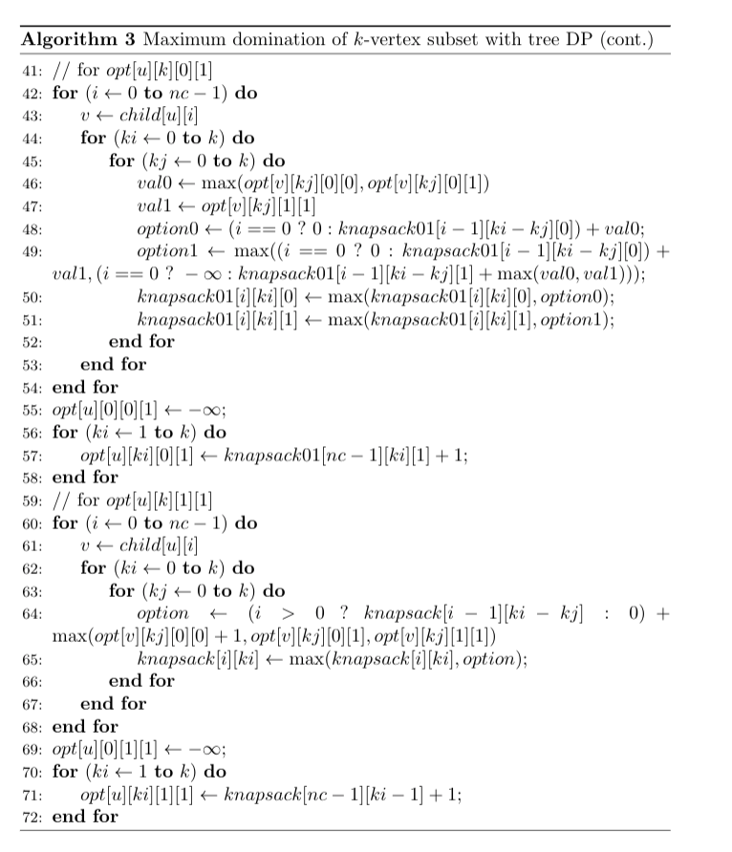
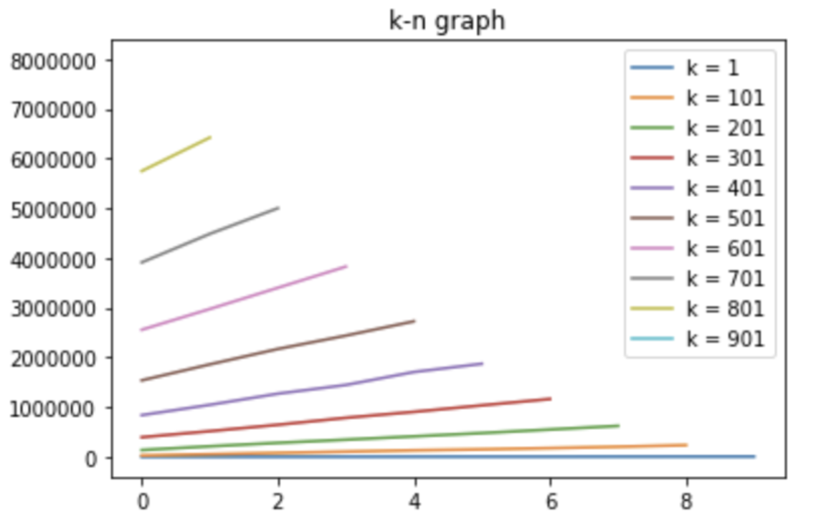
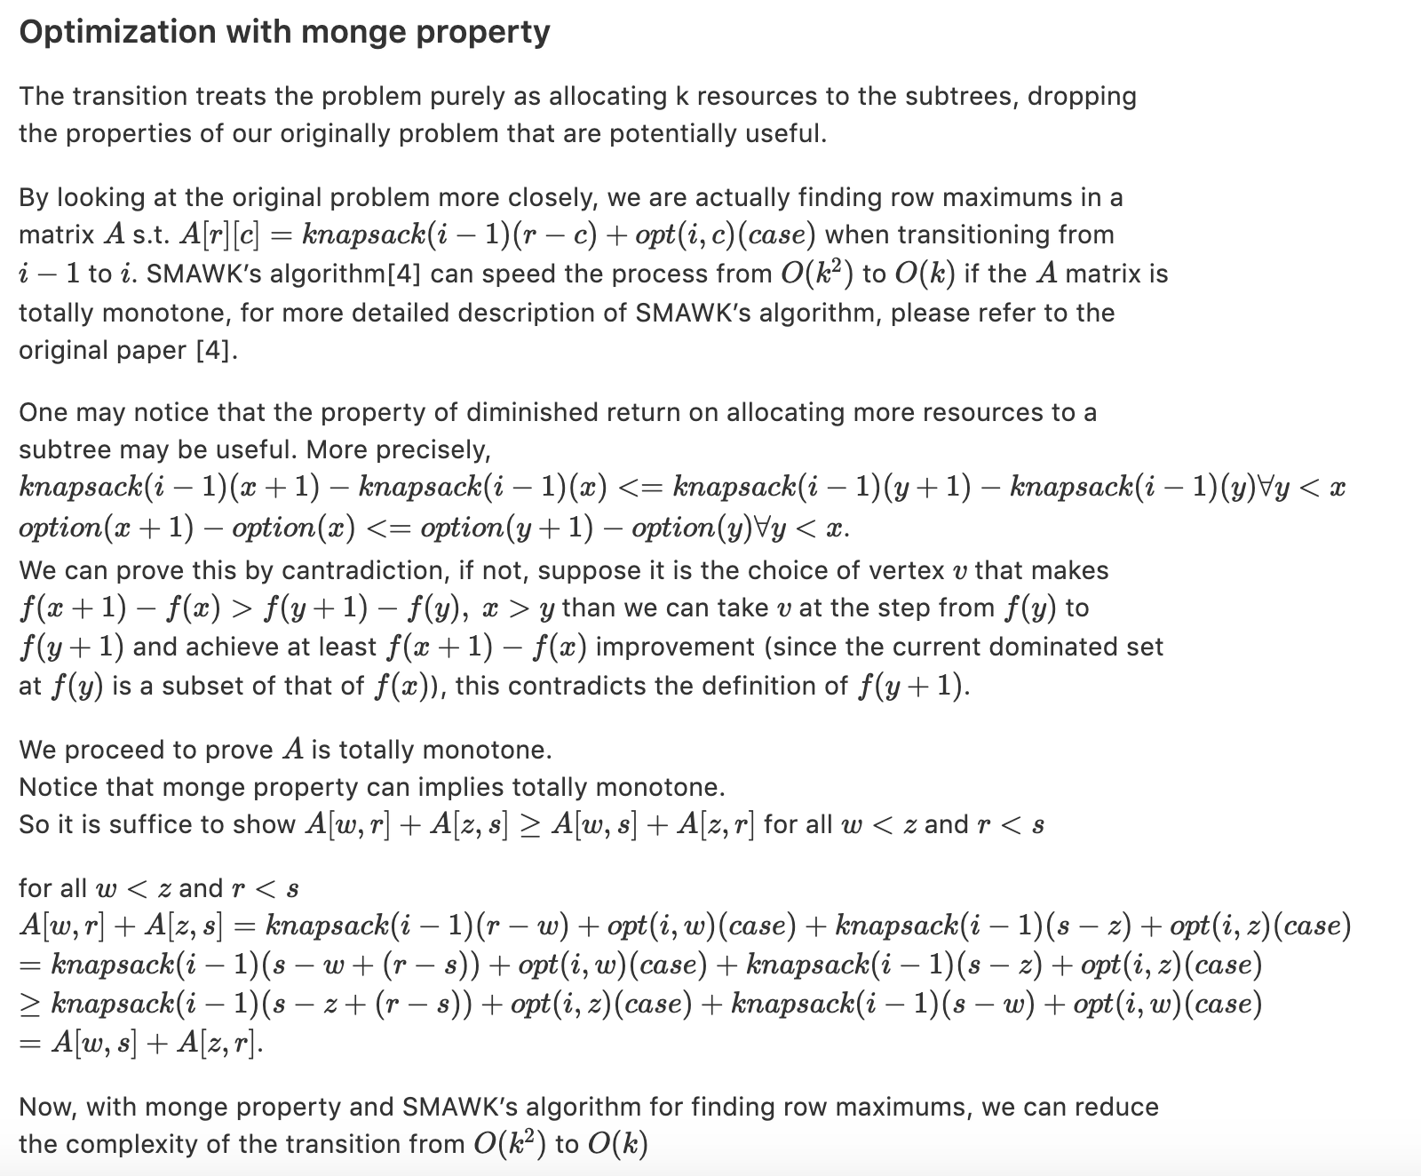
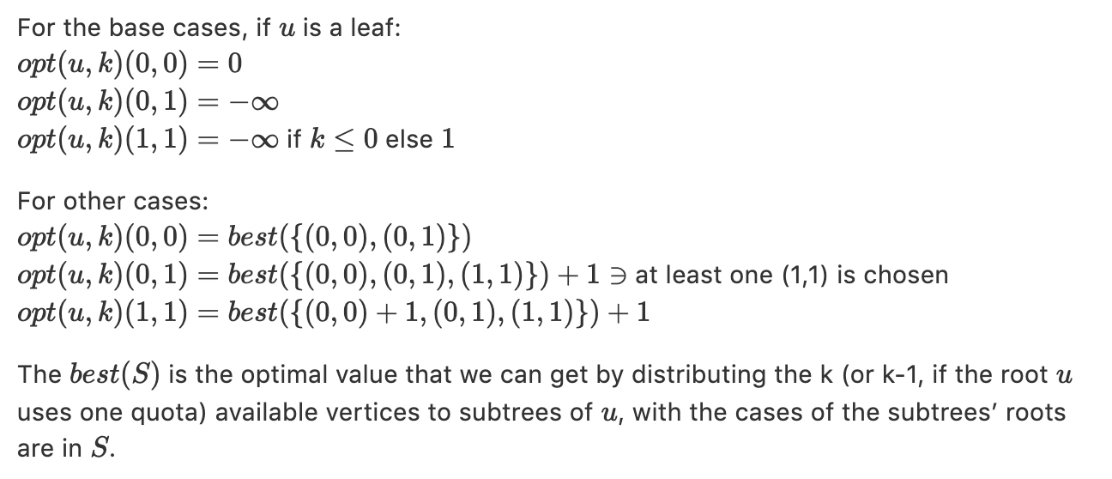
Maximum domination of k-vertex subset in trees
Yan-Tong Lin(林彥彤) (0312fs3@gmail.com)
Department of Applied Mathematics, National Chiao Tung University, Taiwan
Advisor: Prof. Chiuyuan Chen (陳秋媛)
Abstract
The minimum dominating set (MDS) problem has been widely studied and has numerous applications in computer networks. Here we consider a variation of MDS, the maximum domination problem (k-MaxVD). Given a positive integer k, find the maximum number of vertices that can be dominated by a k-vertex subset. The problem is NP-hard since one can solve MDS, an NP-hard problem, with a binary search on the parameter k. And the best approximation ratio of k-MaxVD problem is shown to be (1−1/e) unless P=NP. In this paper, we provide a polynomial dynamic programming solution for k-MaxVD in trees in O(k2|V|) time. And optimize the time complexity to O(k|V|) by the monge property of the dynamic programming table and SMAWK’s algorithm [4].
Introduction
Experimental results
Terms regarding to domination problems:
Let G = (V,E) be a graph. N(v) of a vertex v is defined to be the set of all vertices adjacent to v. And we define N[v], the closed neighborhood of v to be N(v)∪{v}. For any subset of V, named S, N(S):=⋃v∈S N(v) and N[S]:=⋃v∈S N[v] A vertex v is said to dominate all vertices in N[v]. A subset D⊆V is a dominating set of G if every vertex in V−Dis adjacent to at least one vertex in D.
Definition of the k-MaxVD Problem:
Given a graph G = (V,E) an integer k, find the maximum number of vertices that can be dominated by a k-vertex subset of V.
Previous works:
It is well-known that finding a MDS in general graphs is NP-hard. For one can solve MDS in polynomial time with a binary search on k with a polynomial time algorithm for k-MaxVD, we know k-MaxVD is NP-hard. Due to the submodularity property, A straight-forward greedy algorithm can achieve an approximation of 1-1/e for k-MaxVD [2]. A related research [1] shows some upper bounds of approximation ratio for the k-MaxVD problem.
The problem in general graphs has shown its NP-hardness and a certain degree of inapproximability. However, since there is a linear time algorithm for MDS on cactus graphs[3], we believe the existence of a polynomial time algorithm for k-MaxVD problem on trees. This motivated us to solve the problem.
Main contributions:
In this paper, we devised a O(k^2|V|) dynamic programming algorithm for solving k-MaxVD on trees, and further improve the complexity to O(k|V|) using SMAWK’s algorithm [4].
Demo of the proposed algorithm running on a handcraft testcases and some bigger random testcases
Purposed Algorithm
Experiments on the time complexity of the Vanilla DP algorithm
Concluding remarks
In this paper, we proposed a vanilla dynamic programming algorithm that solves k-MaxVD in trees with time complexity O(k2|V|) and further reduce the complexity to O(k|V|) with SMAWK’s algorithm.
One remaining work is to prove that any algorithm that solves k-MaxVD in trees runs in Ω(k2|V|) time or has a lower bound.
References
[1] Miyano, E., Ono, H.: Maximum domination problem. In: Proceedings of the Seventeenth Computing: The Australasian Theory Symposium, vol. 119, pp. 55–62. Australian Computer Society Inc (2011)
[2] S. Fujishige, Submodular Functions and Optimization, Annals of Discrete Math., vol. 47, 1990.
[3] Hedetniemi S.T., Laskar R., Pfaff J.: A linear algorithm for finding a minimum dominating set in a cactus, Discrete Appl. Math., 13 (2–3) (1986), pp. 287-292
[4] Peter Shor, Shlomo Moran, Alok Aggarwal, Robert Wilber, and Maria Klawe: Geometric applications of a matrix-searching algorithm. Algorithmica, 2:195–208
I want to thank Dr. CY Chen, my instructor of individual study, for giving me a lot of advices and help me come up with interesting ideas.
And special thanks to Dr. MT Tsai, my teacher of advanced algorithms, for encouraging me to utilize the knowledge in the class.

