Slide 1
Biobrick Tutorial
12/17

Slide 2
Basic Element
Promoter
RBS
Target Gene
Terminator
Backbone

Slide 3
Promoter

Slide 4
Promoter
First element in biobricks
Leads to initiation of transcription
Use “arrow” to represent

Slide 5
Promoter types 1
Constitutive
Express constitutively Ep：J23101
RNA
J23101

Slide 6
Promoter types 2
Positive
Express while protein (complex) bind Ep：Plux
LuxR
AHL
RNA
Plux

Slide 7
Promoter types 3
Negative
Expression will be inhibited by protein Ep：Plac
LacI
RNA
Plac

Slide 8
Promoter example
T7
Expression is induced by IPTG
Advantage：Almost no leakage

Slide 9
RBS
Ribosome Binding Site

Slide 10
Categories
BBa_B0034 Most Used
BBa_B0031 Weak
BBa_B0032 Medium
BBa_B0030 Strong

Slide 11
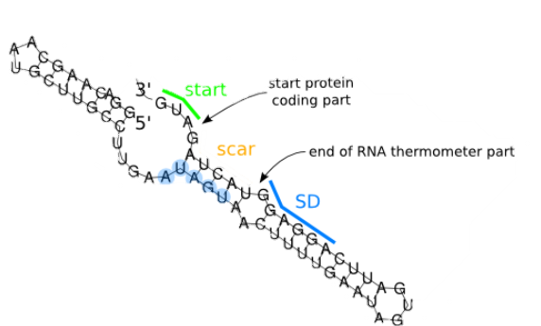
BBa_K115002 - 37°C RBS

Slide 12
Target Gene

Slide 13
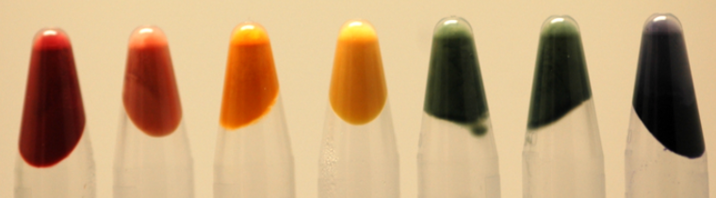
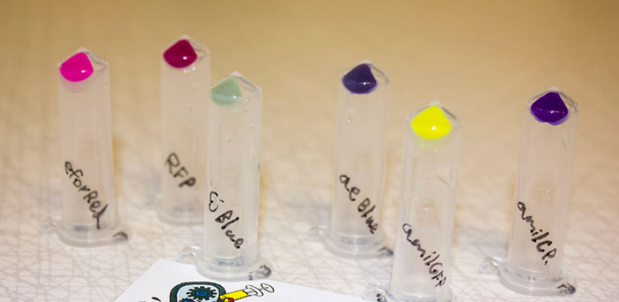
Reporter Protein

Slide 14


Enzyme Protein
IPP
+
DMAPP
GPP
linalool

Slide 15

Regulation Protein
Tet Promoter
TetR
lux
Promoter
LuxR
AHL
LuxI

Slide 16
Regulation RNA – Toehold switch
RBS
Trigger RNA
AUG
Repressed
gene
Active
Gene
ribosome
AUG

Slide 17
Terminator

Slide 18
Terminator
Last element in biobricks
Leads to the end of transcription
Use “hexagon” to represent

Slide 19
Backbone

Slide 20
Backbone
Biobrick carrier
Have anti-antibiotic gene
To select correct host
Use “line” to represent

Slide 21
Host

Slide 22
Host
To express our gene
E. coli
Replicate DNA DH5α
Protein express BL21
Yeast

Slide 23
Example 1 :
2009 NCTU Formosa

Slide 24
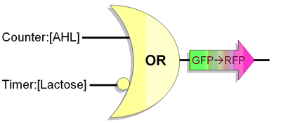
Goal
To insert the sequences into the E.coli which serve the functions of both timer and bacteria counter

Slide 25
RBS
LacI
RBS
LuxR
Term.
LuxR
Lactose
Pcon
Term.
RBS
tetR
RBS
GFP
Term.
RBS
tetR
RBS
GFP
Plac
Term.
RBS
LuxI
Term.
RBS
LuxI
AHL
Ptet
Term.
RBS
ccdB
RBS
RFP
Term.
RBS
ccdB
RBS
RFP
Plux

Slide 26

RBS
LacI
RBS
LuxR
Term.
LuxR
Lactose
Pcon
RBS
tetR
RBS
GFP
Term.
Plac
Term.
RBS
LuxI
Term.
AHL
RBS
LuxI
Ptet
Term.
RBS
ccdB
RBS
RFP
Term.
RBS
ccdB
RBS
RFP
Plux

Slide 27
Example 2 :
2011 NCTU Formosa

Slide 28
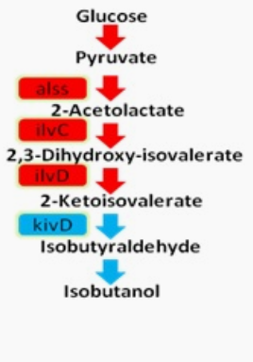
Notes:
induction

Slide 29


37°C
42°C
Ptet
Ptet
kivD
kivD
RBS
RBS
Plac
37°C
RBS
37°C
RBS
37°C
RBS
ilvD
37°C
RBS
ilvD
tetR
tetR

Slide 30
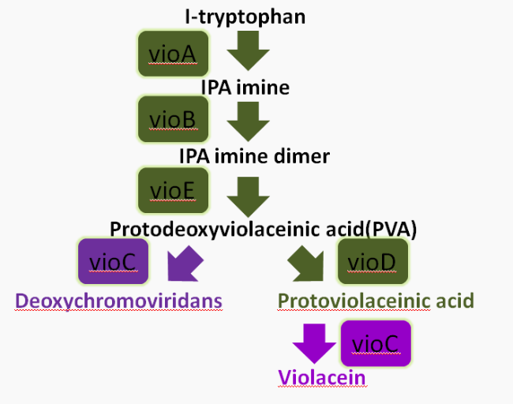

Slide 31
37°C
42°C
Pcon
P42°C
P42°C
CI
vioC
tetR
vioC
lacI
tetR
RBS
RBS
LacI
RBS
Ptet
Ptet
vioC
vioA
vioB
vioC
RBS
vioA
vioB
RBS
Plac
Plac
37°C
RBS
37°C
RBS
37°C
RBS
vioD
37°C
RBS
vioD
tetR
tetR

