Slide 1
KKoNEcT
想不到隊名啦XD

Slide 2
Our Goal
Front page + blabla

Slide 3
Explore
Graph of map and people

Slide 4
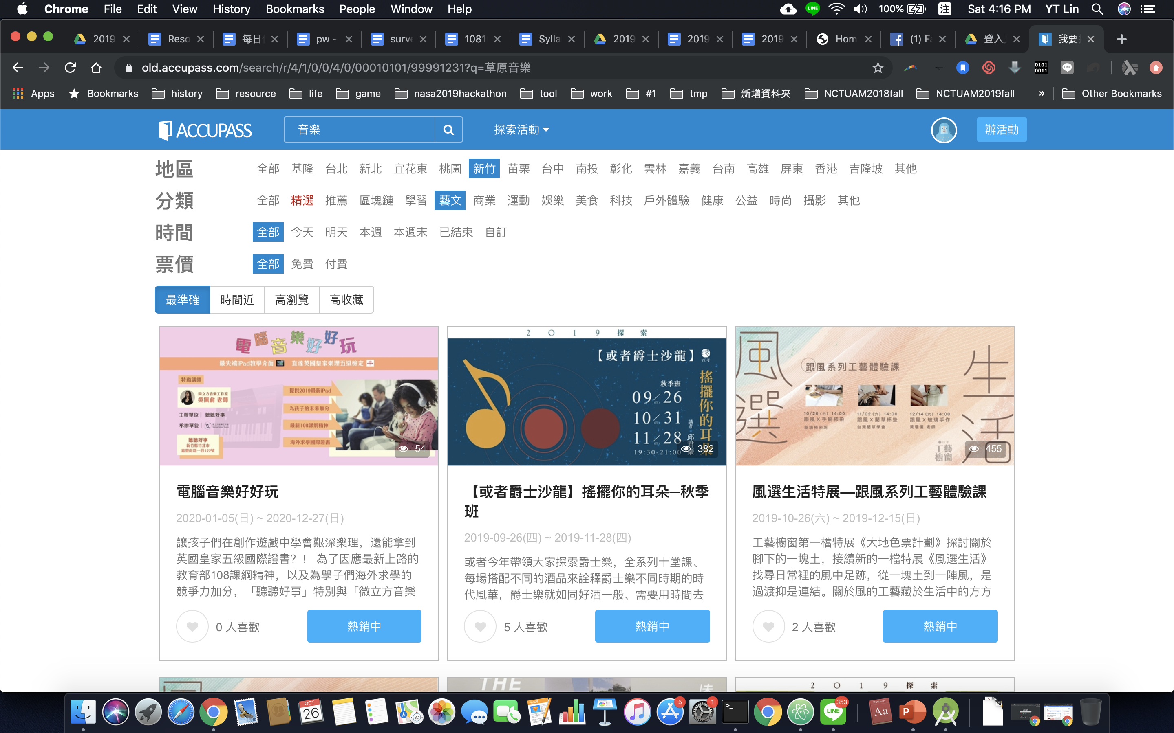

Slide 5
Posts

Slide 6
Message

Slide 7
Implementation

Slide 8
Model
Client
Display
Server
OAuth code
Services
KKbox
Google map
Cache
Subscribe
Locations

Slide 9
Login KKBOX OAuth – Authorization Code Flow

Slide 10
Location Page

