Slide 1
Social Matchmaking Prototype
SWE 6813 - Web Service Engineering
Spring 2026
Group 2
Elliotte Wideman, Steve SeuKap, Gabriel Jean-Louis

Slide 2
Project Overview
Problem With Curren Matchmaking
Skill-based matching only
No consideration of player’s behavior
Leads to toxic interactions
Poor team compatibility

Slide 3
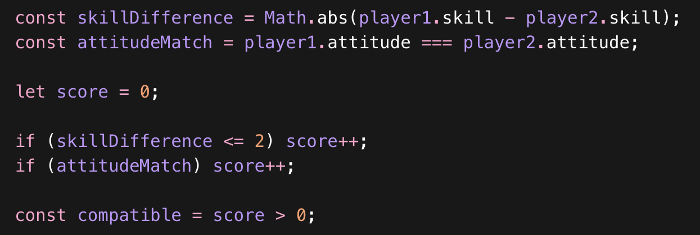
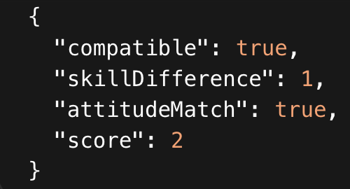
Solution
Our Solution
Evaluate player compatibility
  Skill difference
  Attitude matching
Generate a compatibility score (0-2)
Determine if players are compatible
Improves team quality
Matchmaking algorithm calculating compatibility based on skill difference and attitude matching.
API response showing compatibility result based on matchmaking algorithm.

Slide 4
Sprint 2 Goals
• Implement Continuous Integration (CI) with GitHub Actions
• Deploy application to production environment (Render)
• Expand test coverage (TDD + BDD)
• Improve matchmaking logic and API reliability
• Provide live API endpoints for real-world testing

Slide 5
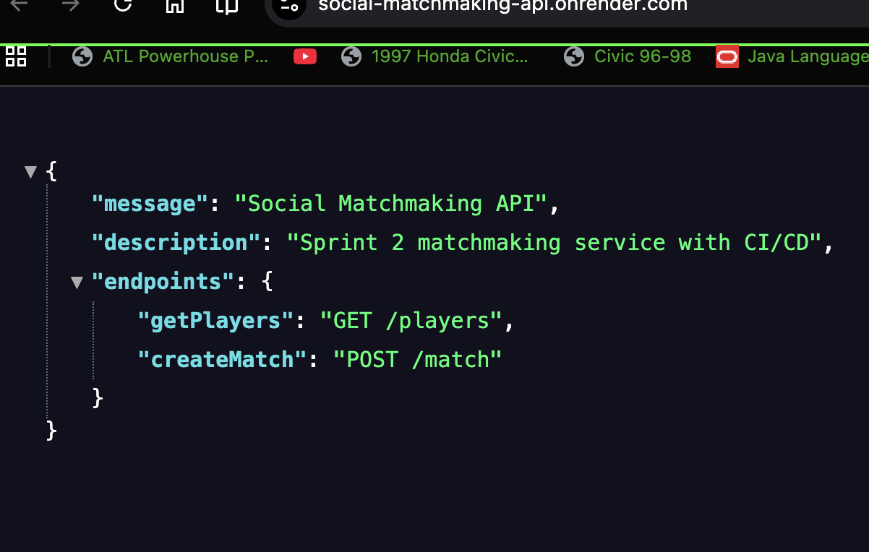
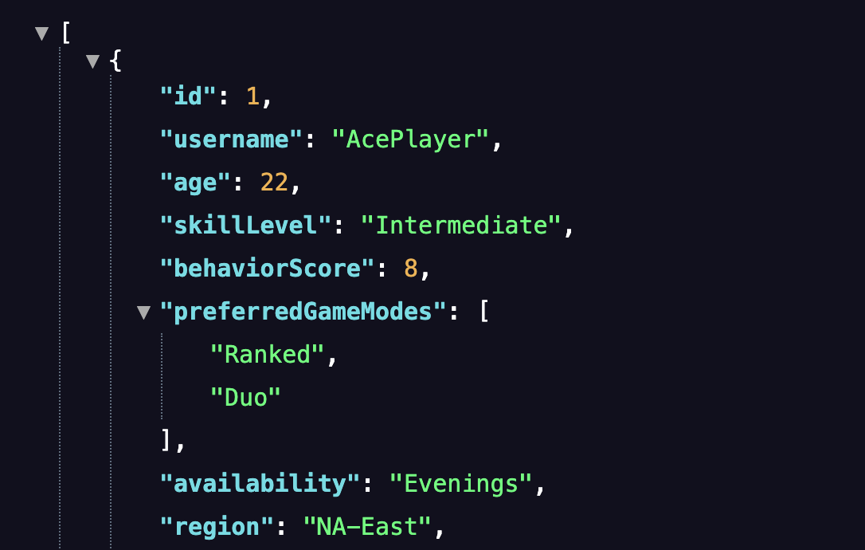
Live API
• Deployed to Render (cloud hosting)
• Public API endpoints:
- GET / → API overview
- GET /players → Retrieve player data
- POST /match → Evaluate player compatibility
  • Enables real-time matchmaking testing
  • Accessible from any device or client
API Home - https://social-matchmaking-api.onrender.com/
https://social-matchmaking-api.onrender.com/players

Slide 6
Agile Process
Scrum-based development (Sprint planning & reviews)
• Kanban board used to track stories and tasks (Trello)
• Burndown chart used to monitor sprint progress
• Daily scrums for team coordination and issue tracking

Slide 7
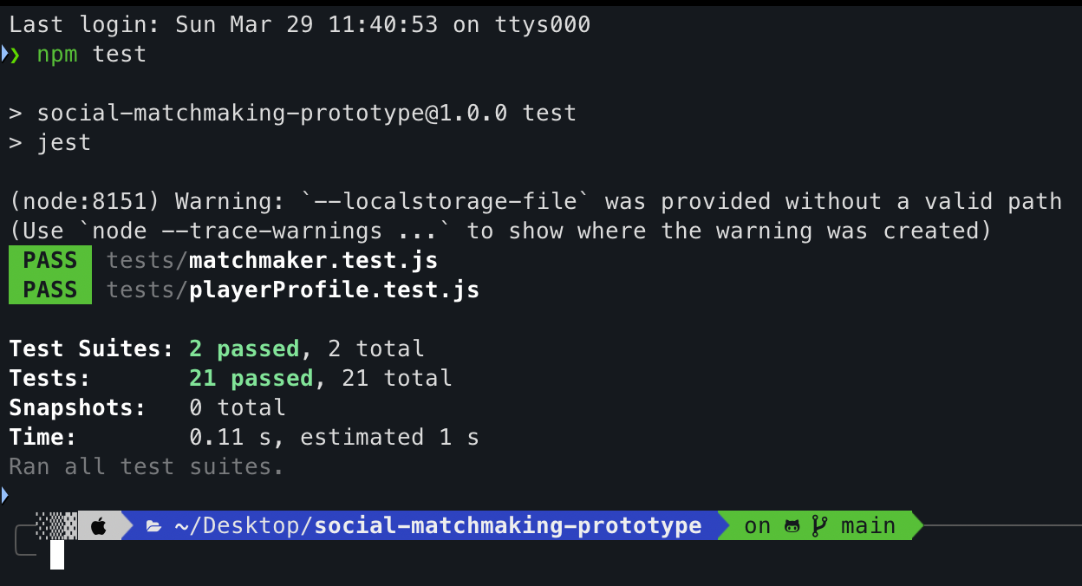
Testing (TDD)
Followed test-first development approach
• Wrote failing tests before implementation
• Implemented logic to pass tests
• Refactored code after tests passed
• Added 20+ unit tests for matchmaking and API
All test pass!!

Slide 8
CI/CD
• Continuous Integration using GitHub Actions
• Automatically runs tests on every push
• Ensures code quality before deployment
• Continuous Deployment to Render
• Deploys latest version to live production environment

Slide 9
Challenges
CI pipeline initially failed due to configuration issues
  - Fixed workflow triggers and test setup
• Deployment issues with incorrect port configuration
  - Updated server to use environment PORT
• TDD failures during development
  - Refined matchmaking logic to pass tests
• API endpoint errors ("Not Found")
  - Debugged routes and verified endpoints
• Team coordination and merging conflicts
  - Improved Git workflow and communication

Slide 10
Accomplishments
Successfully deployed live API using Render
• Implemented CI/CD pipeline (GitHub Actions + Render)
• Built fully functional REST API endpoints (/players, /match)
• Expanded test coverage (20+ unit tests, TDD + BDD)
• Developed behavior-based matchmaking algorithm
• Integrated Agile practices (Kanban, burndown, daily scrums)

Slide 11
Conclusion
In conclusion, our Social Matchmaking Prototype demonstrates how a more human-centered approach can improve online gaming experiences.
By combining skill with behavioral factors such as attitude, our system creates more compatible teams.
Throughout this project, we applied key software engineering practices including Agile development, Test-Driven Development, and Continuous Integration and Deployment.
As a result, we were able to design, build, test, and deploy a fully functional API.
Overall, this project reflects a complete real-world software development workflow.

