Slide 1
Milkshake MACHINE
Supervisor: Dr. Abdallah Rashed
Eba Khalil Samah Sheeha

Slide 2
AGENDA
Introduction Main features
Constraints and challenges
Hardware components Future work
Demo

Slide 3
INTRODUCTION
Hardware project
3
Our machine offers a completely automated solution for producing milkshakes, managing everything from order placement to delivering the final product. With its independent operation, there’s no longer a need for a staff member to prepare milkshakes, resulting in cost and labor savings. Moreover, the machine is designed to be intuitive and secure, making it an ideal choice for use in schools, universities, and institutions, where it provides a fresh and healthy alternative to coffee machines.

Slide 4
MAIN FEATURES
Hardware project
4
Users can order multiple cups in same order.
Cleaning mode.
2 Ways of ordering drinks.
Small or medium cup.
3 Types of drinks.
Control sugar level.
Pay the order by RFID
card.
Cover the cup.

Slide 5
CONSTRAINTS AND CHALLENGES
Hardware project
5
Control the amount of ingredients.
Difficulties in moving and aligning the circuit .
Due to heavy load on the circuit, we replaced the motor.
Difficulty pouring the mixture into the cup.

Slide 6
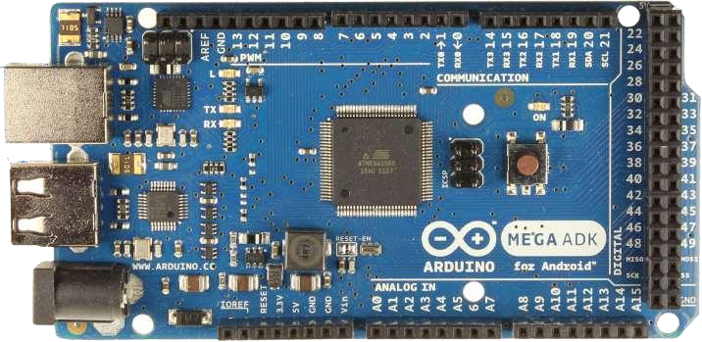
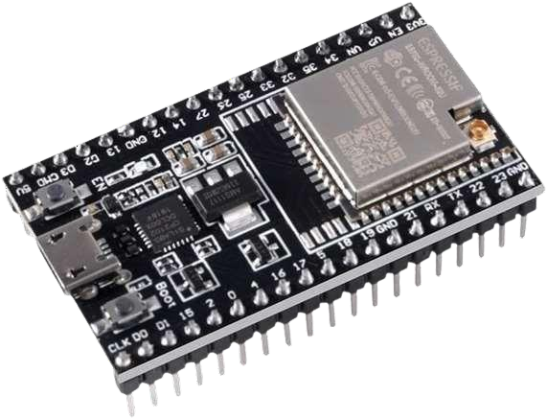
HARDWARE COMPONENTS
Hardware project
6
Arduino Mage
ESP32-DevKitC

Slide 7

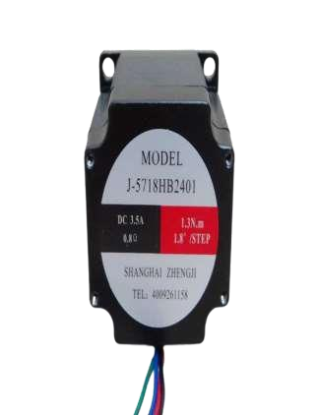
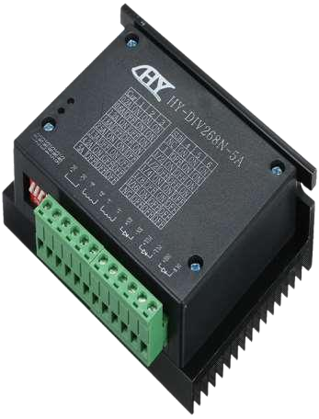
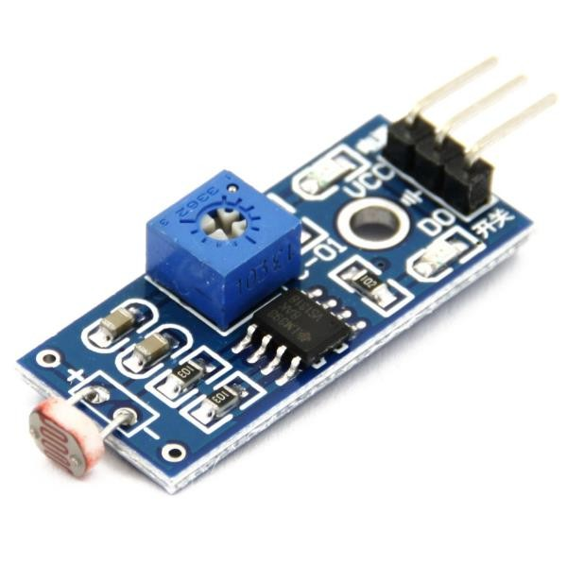
Hardware project
7
LDR Module
J-5718HB2401 Stepper motor
YS-DIV268N driver

Slide 8

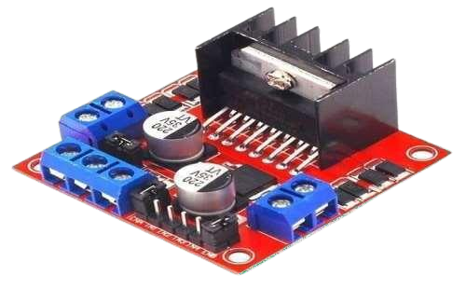
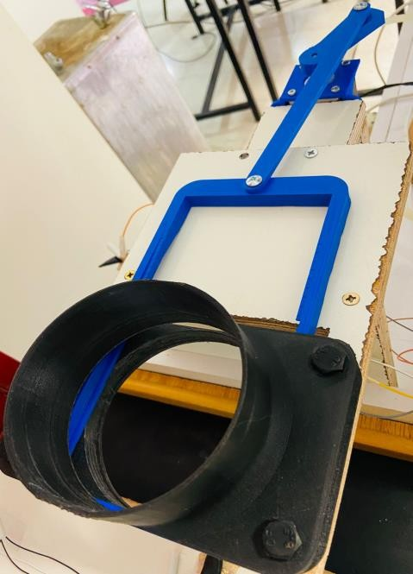
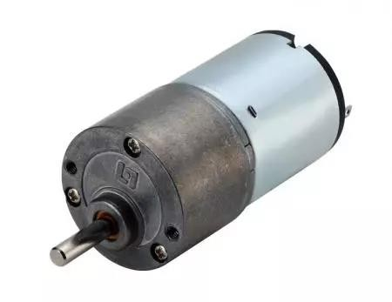
Hardware project
8
Piece to download cups
DC motor
H-Bridge

Slide 9
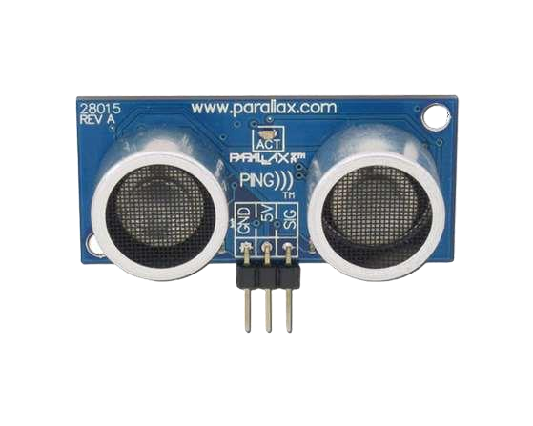
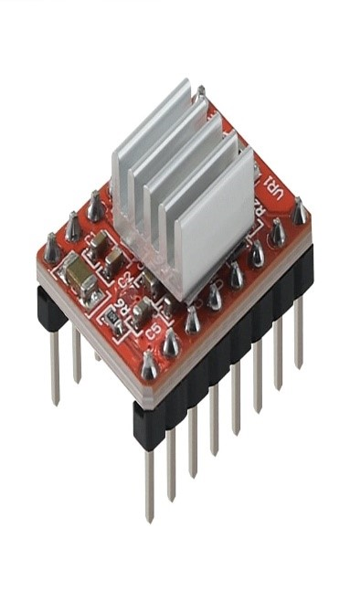
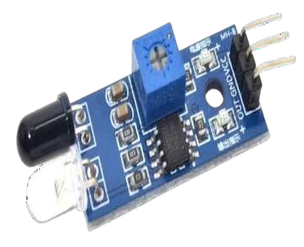
Hardware project
9
Peltier Plate Module "Thermoelectric Cooler"
IR Sensor
Ultrasonic Sensor

Slide 10
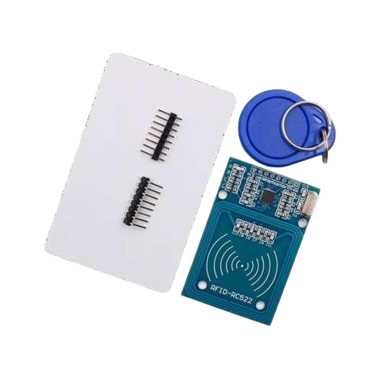
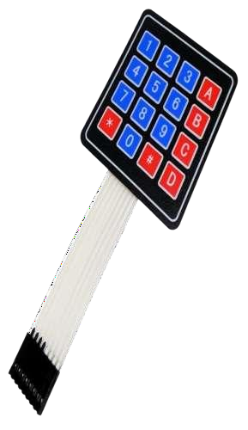
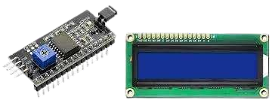
Hardware project
10
LCD and I2C
Keypad
RFID

Slide 11
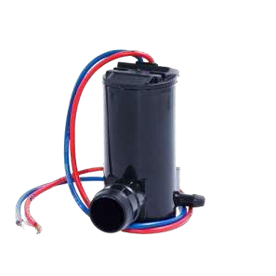
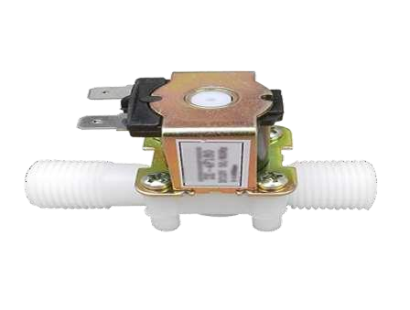
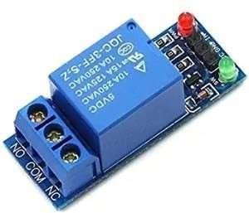
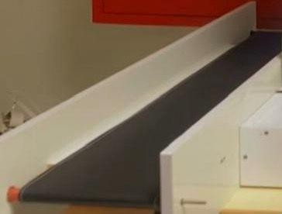
Presentation title
11
Valves
Relay
Conveyor Belt
Pumps

Slide 12
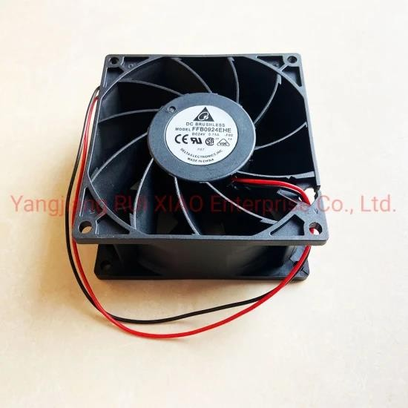
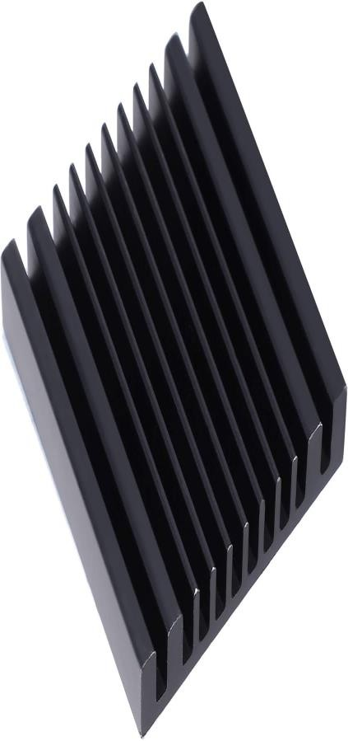
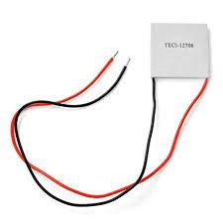
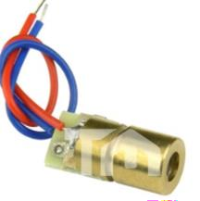
Hardware project
12
Cooling promoter
Heat sink
A4988 Stepper Motor Driver
laser

Slide 13


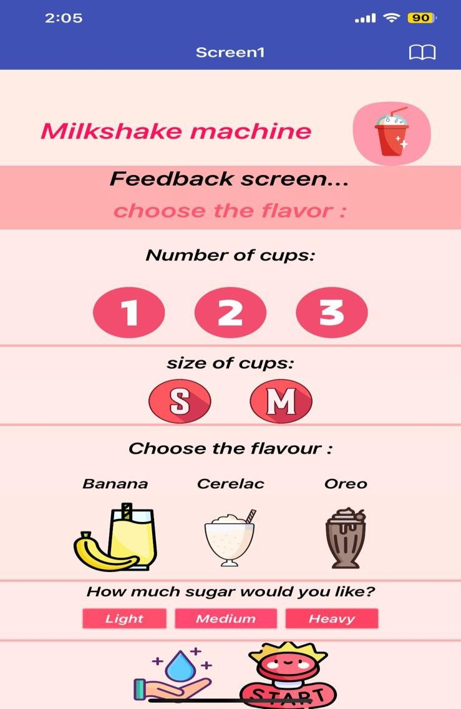

MOBILE APPLICATION

Slide 14
FUTURE WORK
Hardware project
13
Develop a system for automatically refilling ingredients, milk, and water.
Add a wider variety of ingredients and flavors tothe milkshake options.
Implement order tracking to generate reports on the drinks ordered.

Slide 15

DEMO
Hardware project
14

Slide 16

THANK YOU

