Slide 1


Real madrid fc
.

Slide 2
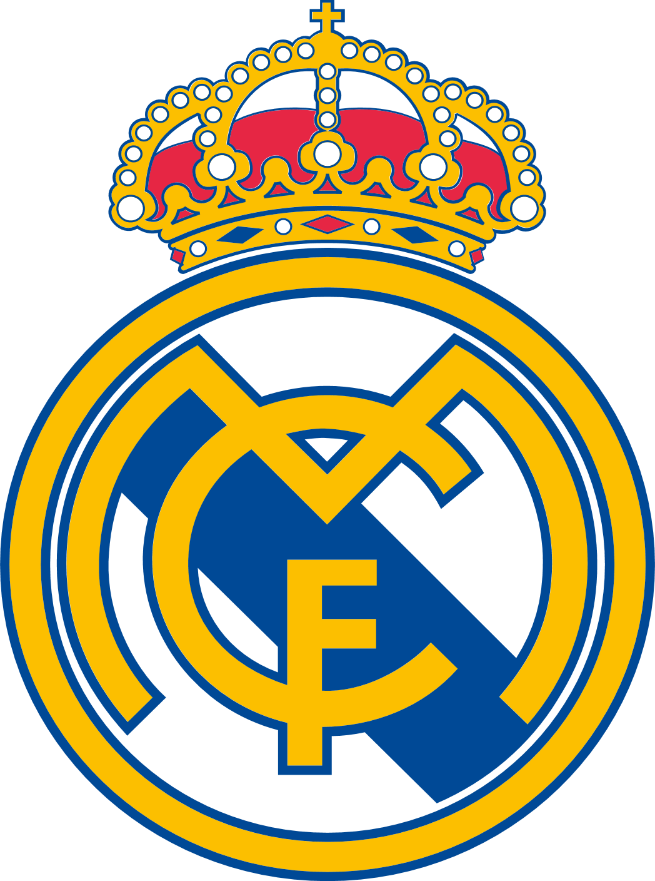
What is madrid
Real Madrid Club de Fútbol is a professional football club based in Madrid, Spain. Founded on March 6, 1902, it is one of the most successful and popular football clubs in the world. Known for its iconic white kit, the team is often referred to as "Los Blancos" or "Los Merengues."

Slide 3
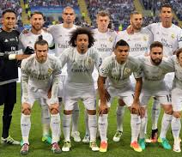
Players
Currently real madrid has world best players which includes Kylian Mbappé, Jude Bellingham, Vini Jr.

Slide 4
trophies
Domestic
La Liga: 35 titles (Record as of 2023)
Copa del Rey: 20 titles
Supercopa de España: 12 titles
European/International
UEFA Champions League: 16 titles (Record)
UEFA Super Cup: 5 titles
FIFA Club World Cup: 5 titles (Record)
Intercontinental Cup: 3 titles

Slide 5
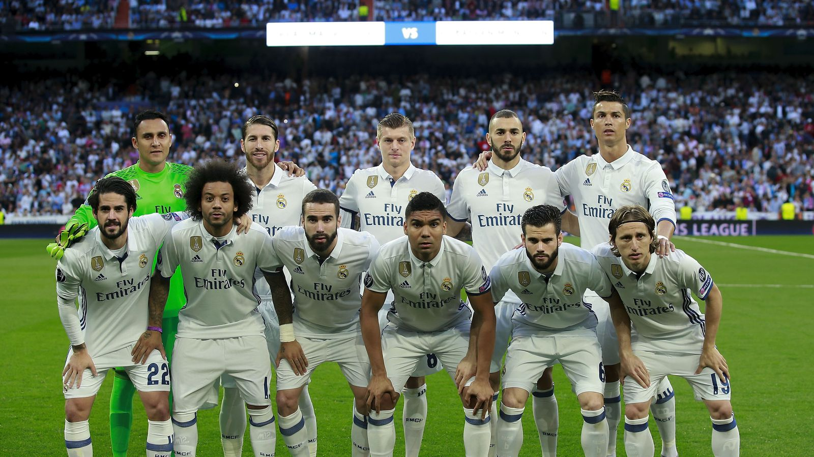
Best players
Here are some legendary Real Madrid players:
Keylor Navas
Dani Carvajal
Sergio Ramos
Raphaël Varane
Marcelo
Casemiro
Luka Modrić
Toni Kroos
bale
Cristiano Ronaldo
Karim Benzema

