Slide 1


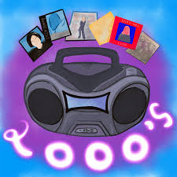
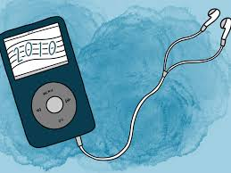

Analyzing Chart-Topping Music
Leveraging Billboard and Spotify Web APIs
Elizabeth Bauer, Sarah Jung
Kevin Linder, Ana Pertuz

Slide 2
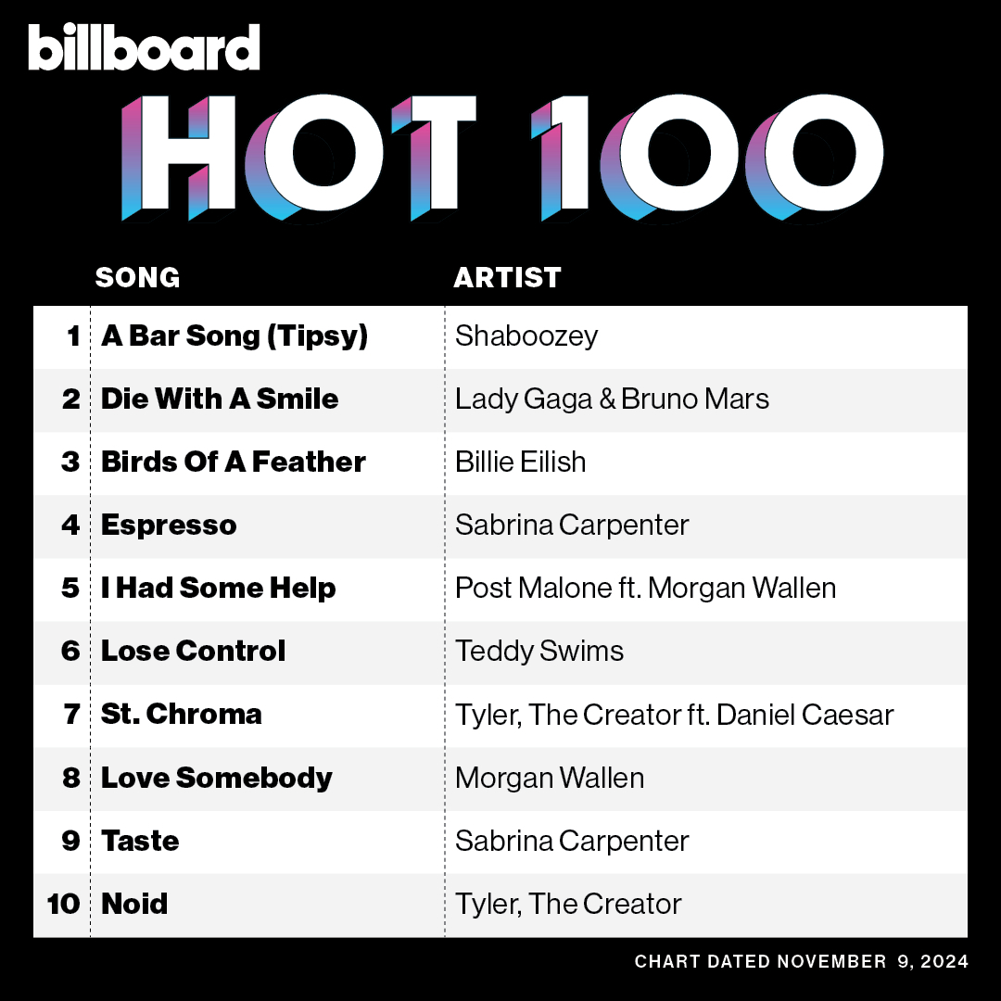
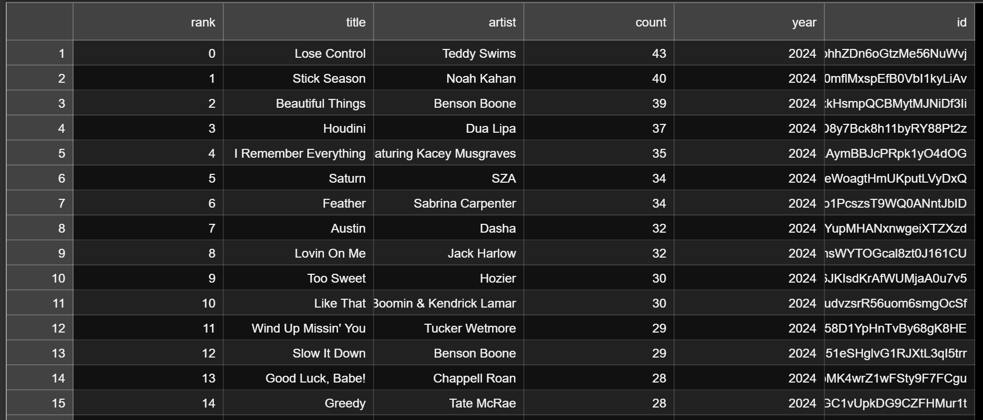

What data did we use?
Billboard charts the top 100 songs in the United States every week on the Hot 100; we took this data for every week since 1980
We evaluated the most recurring, “popular” songs per year based on how many weeks they charted on the Hot 100 to make a “Top 100 Songs” each year
We then obtained information about these 4500 songs across 45 years by running them through Spotify API

Slide 3


Questions to Evaluate:
How the length of the most popular songs has changed over time?
Are popular songs getting faster?
Are popular songs getting more dance-able?
Are songs getting more energetic overtime?
Are songs getting more positive or negative over time?
Are popular songs getting louder?
Is popular music getting more or less complex/diverse (in key and time signature)?
Are popular songs becoming more or less explicit?
Based on historical trends, what do we expect to see in popular music in the near future?

Slide 4
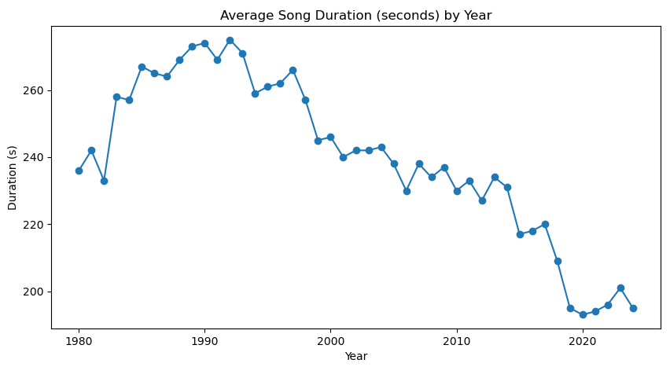
Song Duration
How the length of the most popular songs has changed over time?
This trend could be due to a variety of factors like streaming influence where Shorter songs are more common now, potentially influenced by streaming platforms (spotify), where shorter, catchy songs tend to perform better in terms of engagement and replay.

Slide 5
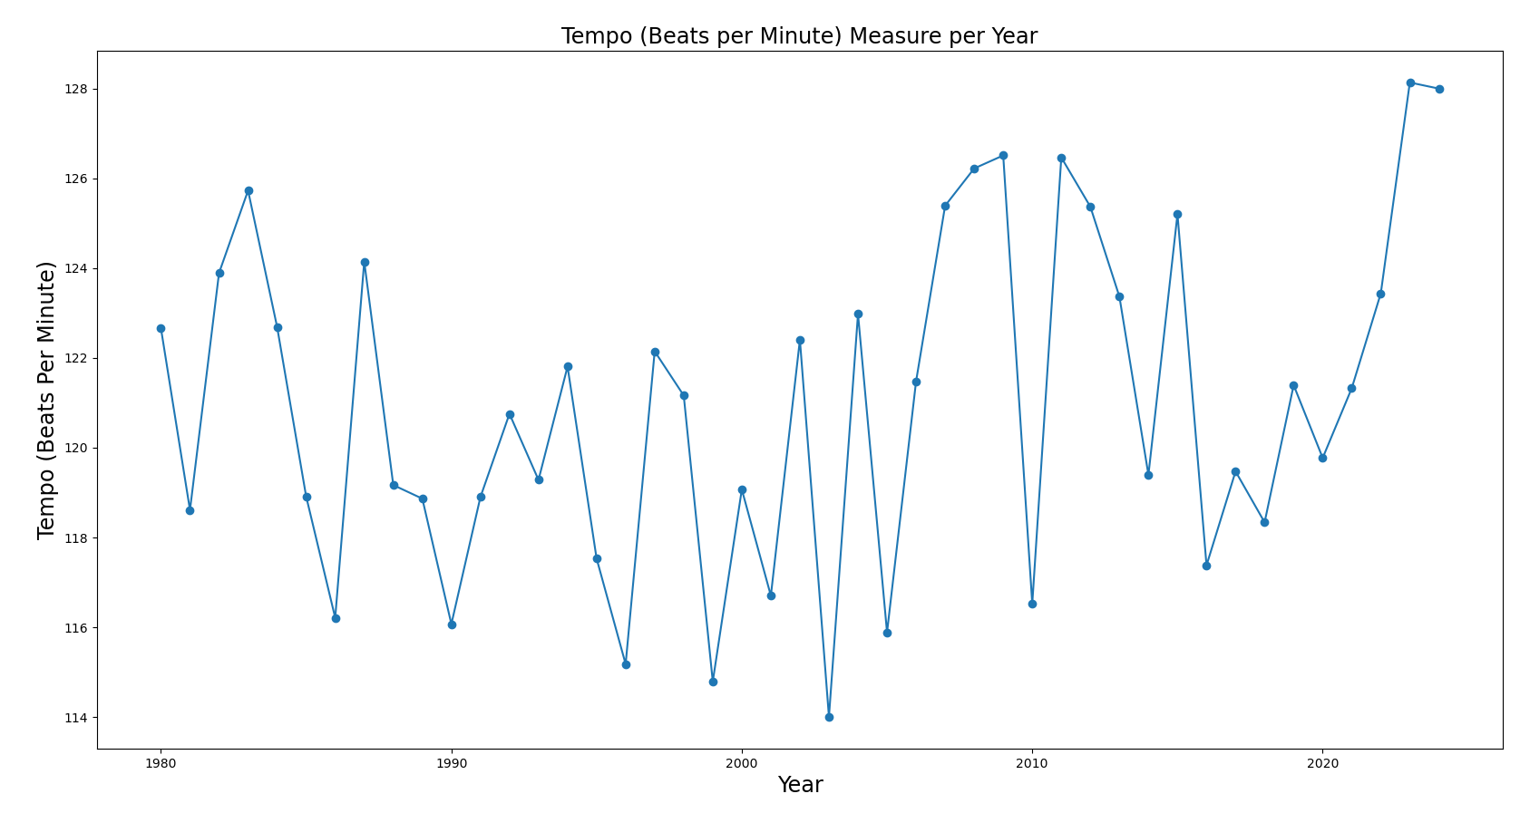
Tempo
Tempo
No apparent trend from beginning of the measurement period to the end (1980 – 2024)
Large variation from year to year.

Slide 6
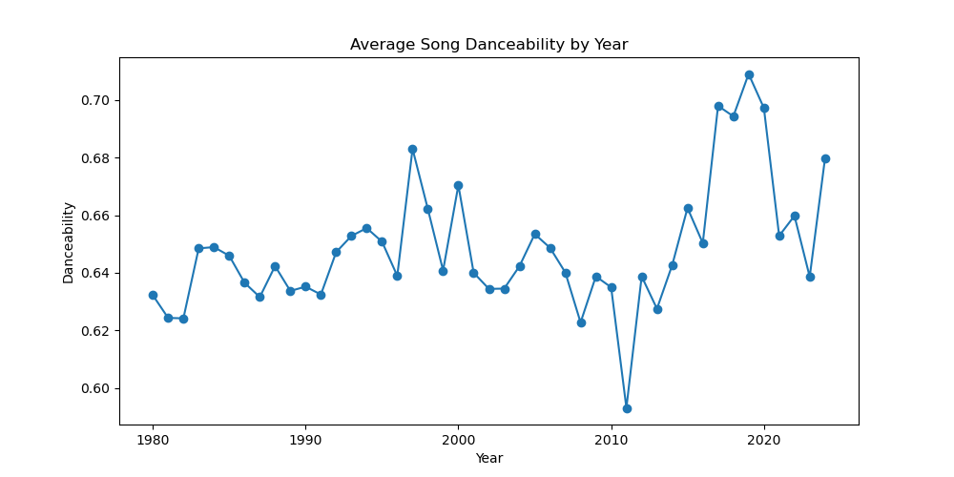
Danceability
Are popular songs getting more dance-able?
Danceability is how suitable a track is for dancing based on a combination of musical elements including tempo, rhythm stability, beat strength, and overall regularity.
A value of 0.0 is least danceable and 1.0 is most danceable.
danceability seems relatively stable from 1980 to 2000 with only slight variations but there appears to be an upward trend in danceability starting around the late 2000s.
the highest around 2019 and 2020. When we compare the data on danceability and song length, we can see that around 2020, song length had its lowest levels with shorter songs, and danceability for those same years had its highest levels. This could have been influenced by multiple factors such as social media platforms like tik-tok.

Slide 7
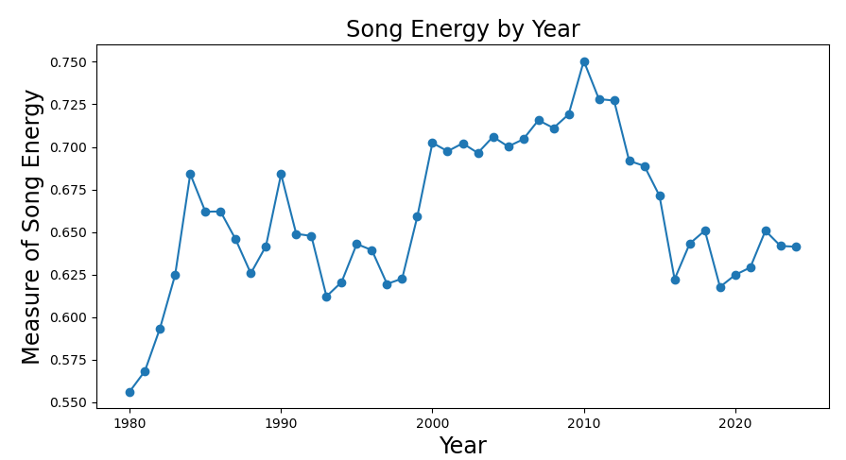
Energy represents the perceptual measure of intensity and activity.
Energy Peak 2010
Ex. Top Albums by:
Lady Gaga
Ke$ha
Katy Perry
Ex. Top Singles by:
Enrique Iglesias
Usher
Danceability and Tempo were mid range during 2010 however Loudness peaked during 2010
Energy - Are songs getting more energetic over time?
Notes:
ENERGY ANALYSIS Energy: Energy trends in music from 1980 to 2024 showcase an overall upward trend with 2 distinct peak and valley cycles. Starting at it's lowest point in 1980, between 1983 - 1993 we see the first peak and valley with two peaks in 1984 and 1990, dropping down in 1993. Over the next 18 years there is a positive trend in energy levels within music leading to the top peak in 2010 at .750, before the data starts trending downward til present day. Energy peak year 2010 - Singles:I like it Enrique Iglesias, OMG Usher Albums: Katy Perry: Teenage Dream Album | Lady Gaga: The Fame Monster (Bad Romance) | Kesha: Animal Album (Tik Tok) Valence 2010 (.57 right in the middle of the range) Danceability 2010 (.64 also right in the middle of the range) Tempo: 117 on the very low end Loudness: also peaked in Spotify's 2010.
Energy De"finition: Energy is a measure from 0.0 to 1.0 and represents a perceptual measure of intensity and activity. Typically, energetic tracks feel fast, loud, and noisy. For example, death metal has high energy, while a Bach prelude scores low on the scale. Perceptual features contributing to this attribute include dynamic range, perceived loudness, timbre, onset rate, and gener."al entropy

Slide 8

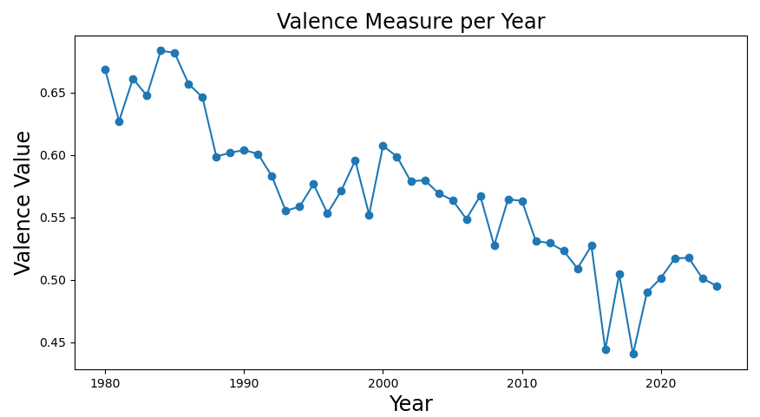
Valence: a measure of musical positiveness conveyed by a track measured from 0.0 to 1.0.
Songs have steadily decreased in positiveness over the decades meaning there is an increasing trend in sad, depressed, angry music.
2018 Top Songs:
Love Lies by Khalid & Normani
Meant to Be by Bebe Rexha/Florida Georgia Line
I Like Me Better by Lauv
Perfect by Ed Sheeran
Valence - Are songs getting more positive or negative over time?
Notes:
VALENCE ANALYSIS Since 1980 Valence, which describes the musical positiveness conveyed by a track has steadily declined over time with the highest peak in 1985 (Energy and Tempo were slightly above the average rate in 85), reaching its lowest point in 2018 followed by a slight increase over the last 6 years, but still within the general decades over time decline. 2018 events: Politics: Trump’s 2nd year in office, Brett Kavanaugh SC battle, Democrats won the House back, John McCain, Barbara Bush and George HW Bush all passed away, Climate: most destructive year of Wildfires in California, major UN report on CLimate Change/heating of the planet Culture: #MeToo movement went global, major data mining Facebook scandal, mass shootings in Florida, Texas and SoCal, Pittsburgh synagogue https://www.history.com/topics/21st-century/2018-eve
Spotify definition of Valence: "A measure from 0.0 to 1.0 describing the musical positiveness conveyed by a track. Tracks with high valence sound more positive (e.g. happy, cheerful, euphoric), while tracks with low valence sound more negative (e.g. sad, depressed, angry)."nts

Slide 9
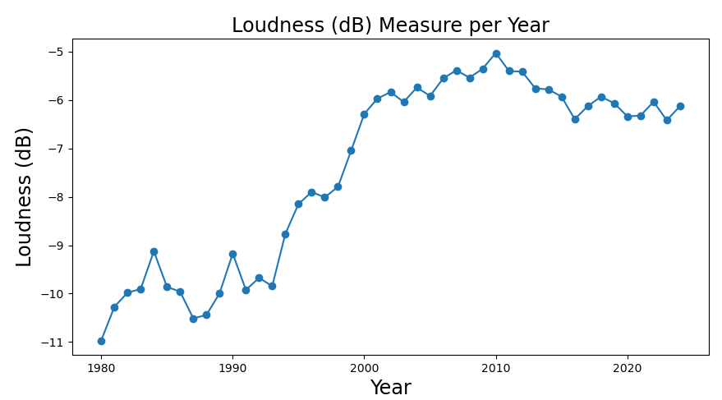
Loudness
General increase in loudness from 1980 to 2024.
Decrease from the peak in 2010, but still maintaining levels well above the first two measurement decades.
Greatest increase in average measured loudness occurred in the 1990s.
Loudness in the context of Energy: there is a similar trend between the two.
There is a general increase in both loudness and energy from 1980 to a peak in 2010, with spikes in the mid '80s and 1990.
There is also a shared peak in 2010, and a downward trend to the present day.
In Spotify's data, it's possible that loudness is a critical factor in evaluating energy. Beyond that, it's possible that loudness in popular songs is one of the primary drivers in the perception of energy in popular music.

Slide 10
Is popular music getting more or less complex/diverse?

Slide 11
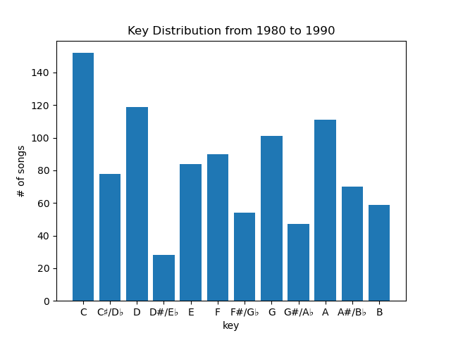
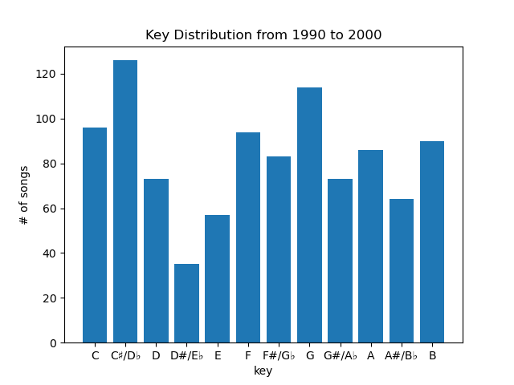
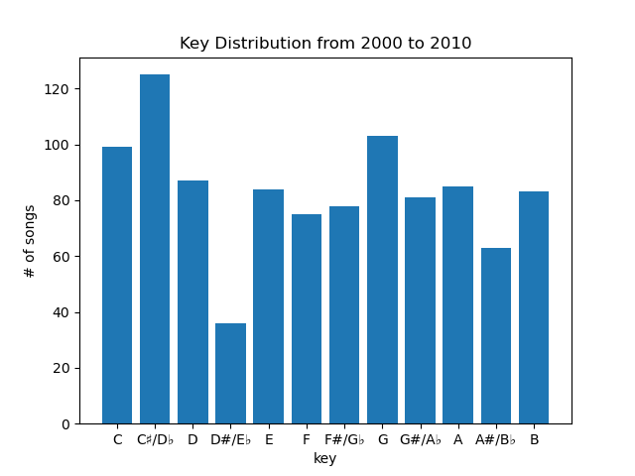
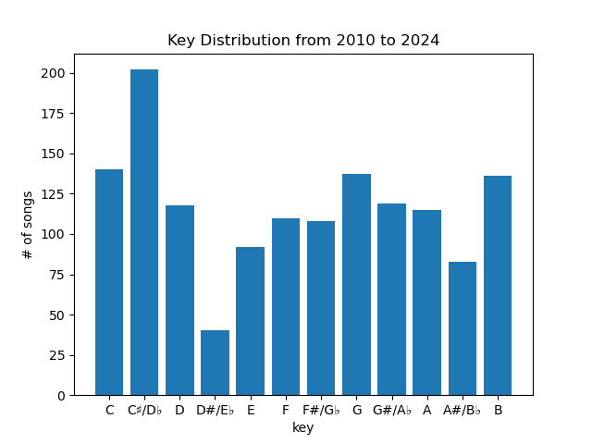
Key Distribution
popular/”easier” keys in music are C major/A minor, G major/E minor
those easier keys are heavy used in popular music in the ‘80s
afterwards, music keys seem to be getting more diverse, with songs using more obscure keys
C and G remain popular keys through the decades

Slide 12
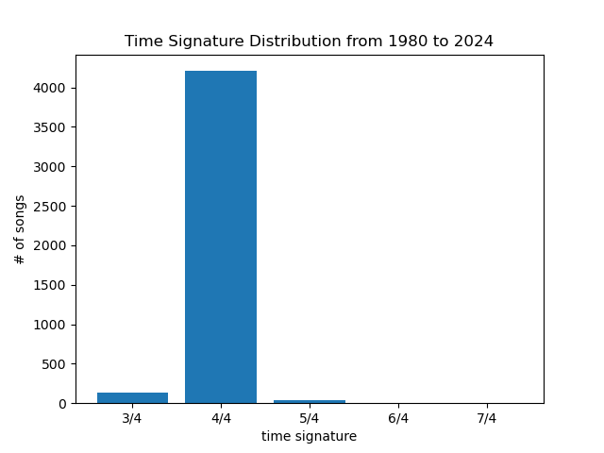
Time Signature

Slide 13
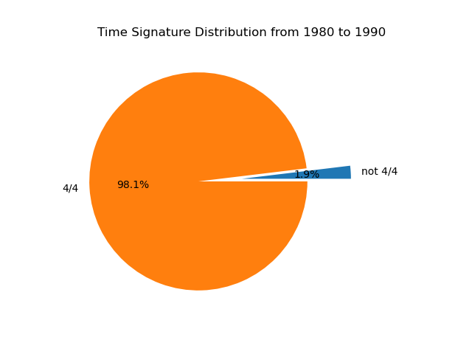
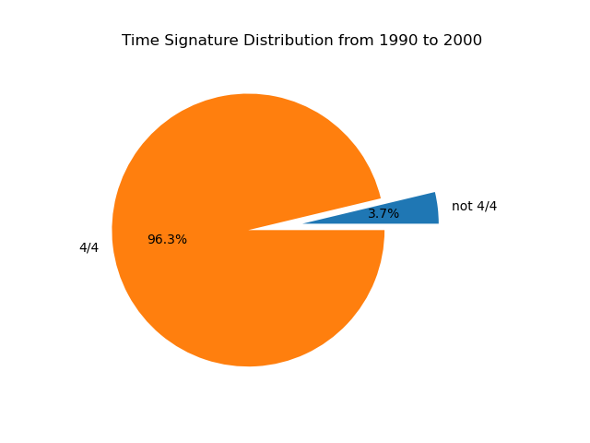
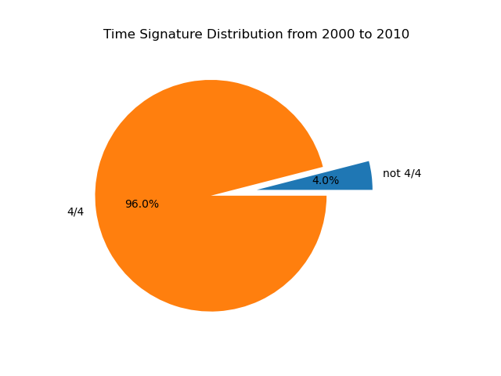
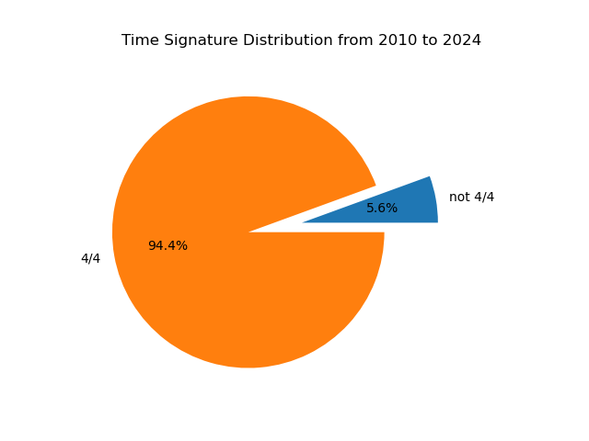
Time Signature
4/4 is a sort of “standard” time signature
trend in a rising portion of songs not in 4/4
implication: popular songs are experimenting more with time signatures outside 4/4

Slide 14
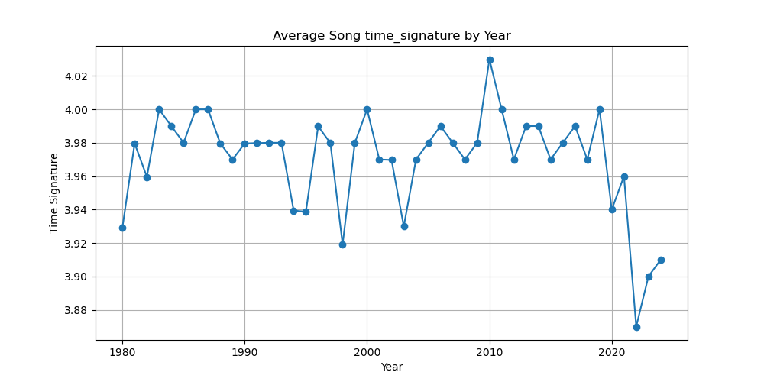

Slide 15
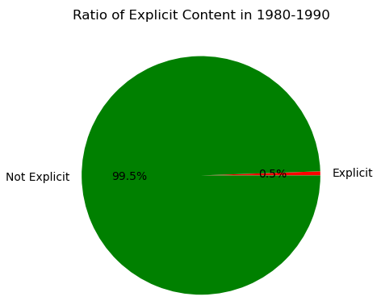
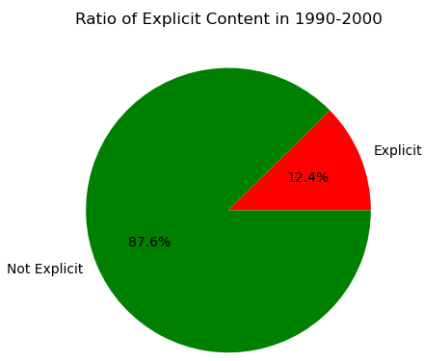
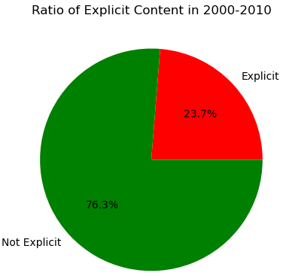
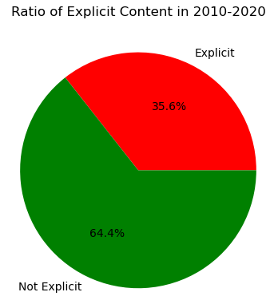
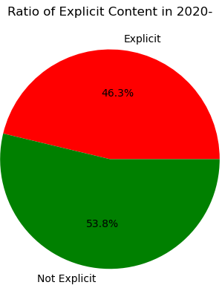
Explicit Content
There is a clear increasing trend in the ratio of explicit content in popular compared to non-explicit content.
Per decade, the ratio of explicit to non-explicit songs has increased by at least 10 percent.
Starting in the 1980s, explicit content in music was extremely uncommon.
By 2020 and onward, explicit songs now constitute nearly half of our sample of popular songs.

Slide 16

Based on historical trends, what do we expect to see in future hits?
Low valence: songs will become increasingly negative (e.g. sad, depressed, angry).
Duration: songs will continue to get shorter.
Explicit: we expect explicit songs to soon outnumber non-explicit songs in top 100 charts.

