Slide 1
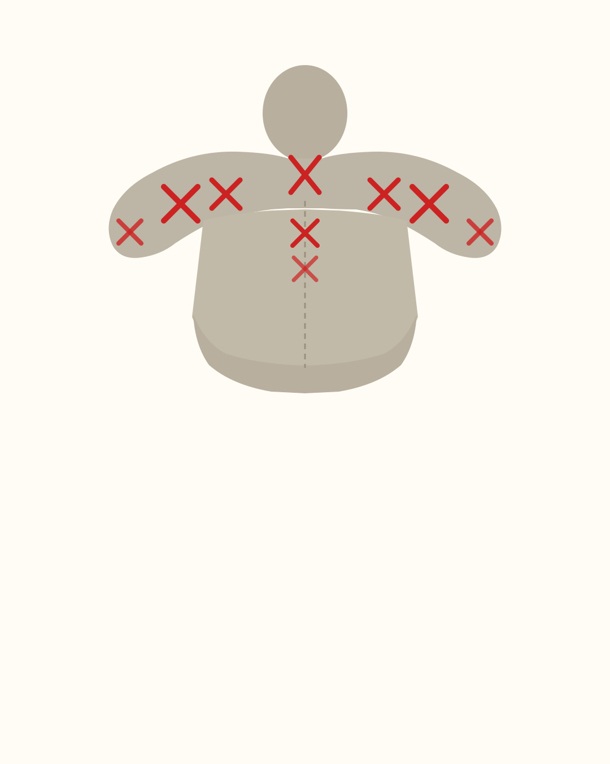
change this tension
pattern forever
swipe →

Slide 2
Are your upper back,
traps and neck
constantly tense?
Take a minute to
decompress this area.

Slide 3
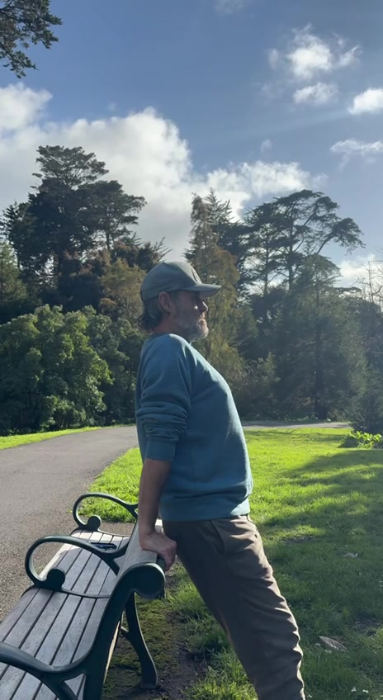


Slide 4
HOW IT WORKS
Lock your elbows straight.
Drop into gravity.
Let your spine decompress.
That’s it. 60 seconds.

Slide 5
WHAT THIS DOES
Creates leverage for
your entire spine
to drop and let go.
Releases the upward holding pattern
of the traps & neck.
Nothing forceful. Just gravity.

Slide 6
Notice the
difference.

Slide 7
Want to understand
how your body
creates balance?
Take our quiz — link in bio

