Slide 1
RailPass
Frontend onboarding course
Expo passenger app + React/Vite operations dashboard
Real code, interactive demos, debugging and review practice
NEW EMPLOYEES
FRONTEND
GHANA RAIL
Notes:
Open by positioning RailPass as a realistic training monorepo: mobile passenger app, staff dashboard, and backend API contract. Tell learners the course is about decisions and trade-offs, not memorizing libraries.

Slide 2
RailPass system map
RailPass
One API, two frontends, one design language
Expo passenger app
mobile/
PostgreSQL
Prisma
NestJS API
/api + /admin
Vite staff dashboard
dashboard/
Mailpit
password reset
Frontend lessons reference backend contracts only where they shape UX.
Design tokens mirror across mobile constants and dashboard CSS variables.
Server owns pricing and seat-concurrency truth.
Notes:
Use this as the mental model for the course. Learners should not edit backend in frontend exercises, but they must understand pricing, validation and seat reservation guarantees.

Slide 3
Course paths
RailPass
Run the core lessons in one day, two days, or four half-days
1-day intensive
2-day course
4 half-days
Codebase map
Tokens
State
API failure
Review
Day 1: lessons 1–4
Day 2: lessons 5–8
Exercises between blocks
Mini PR review
Map + tokens
Flow + state
API + debugging
Quality + extension
Notes:
Explain that the course length is modular. The deck supports all schedules; detailed timing lives in the README and lesson notes.

Slide 4
Course rule: token-first UI
RailPass
No hard-coded design values in components
Real code excerpt
// Do
row: { borderRadius: radii.xl, padding: spacing.md }
// Don't
row: { borderRadius: 24, padding: 12, backgroundColor: '#FF4D5A' }
Why it matters
Light/dark themes stay aligned.
Danger and red brand remain distinct.
Screenshots become predictable.
Reviews focus on intent, not magic numbers.
Notes:
This is the convention the user emphasized. Repeat it often. Tokens include colours, spacing, radii, typography, sizes, motion and drawing geometry.

Slide 5
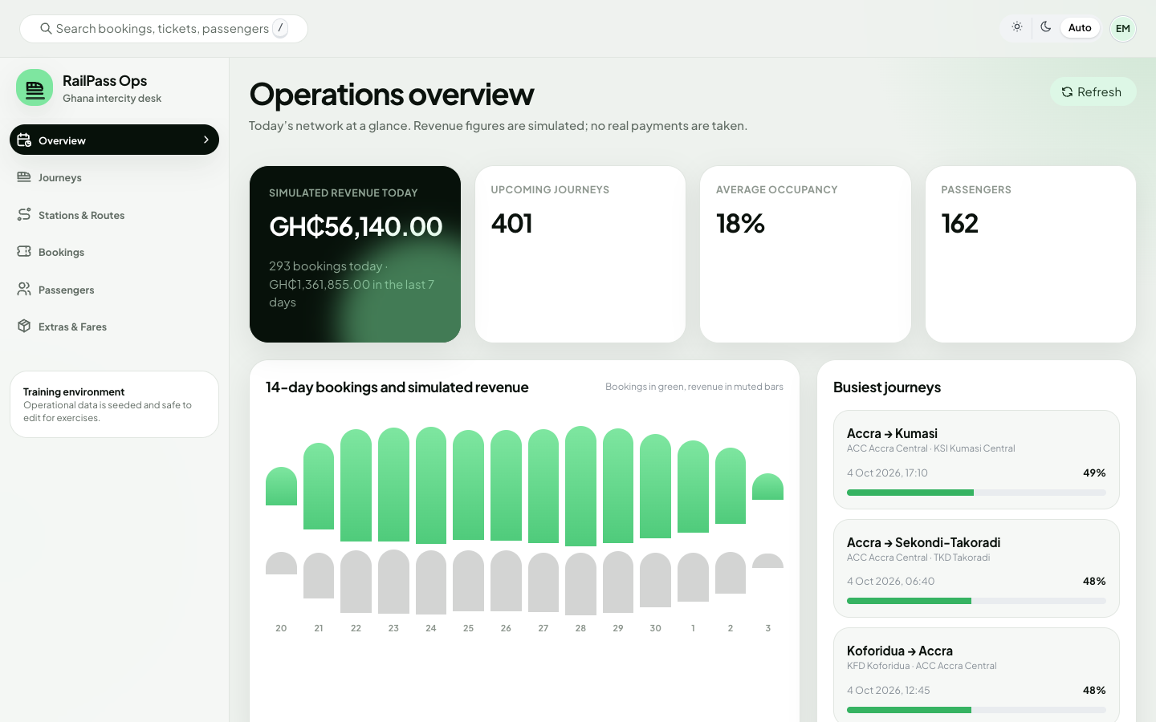
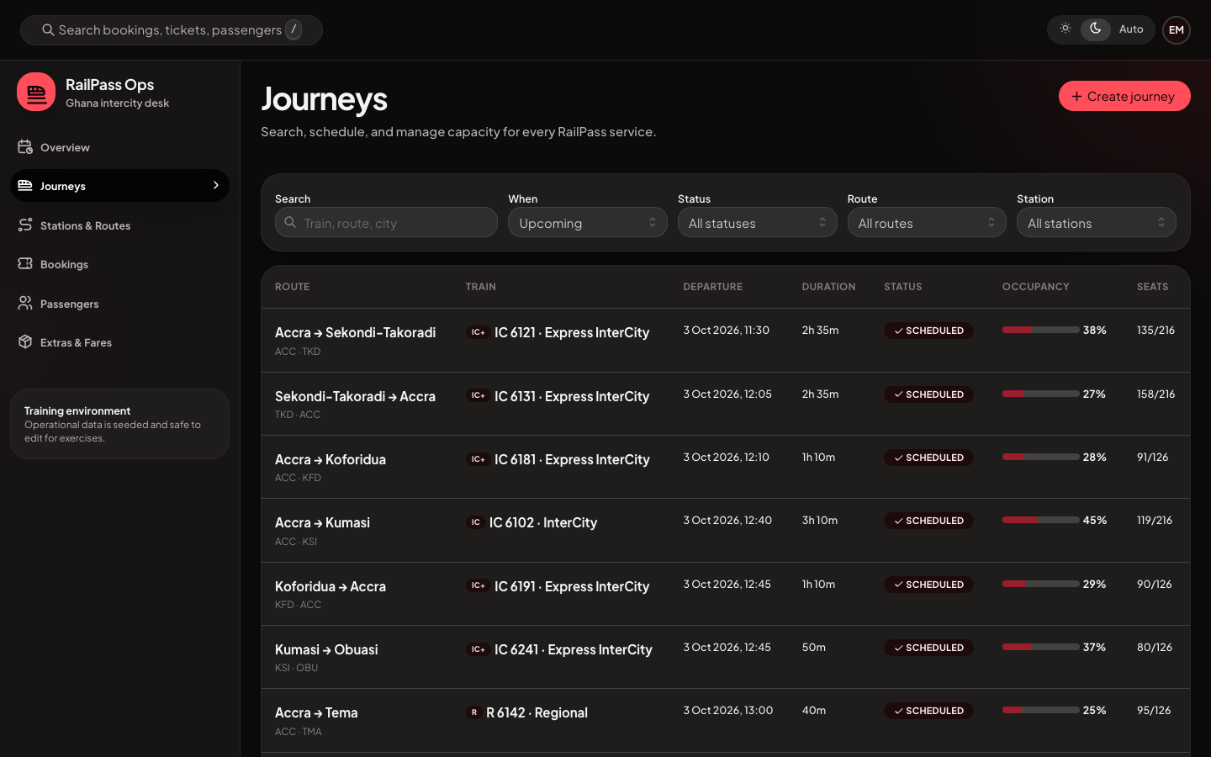
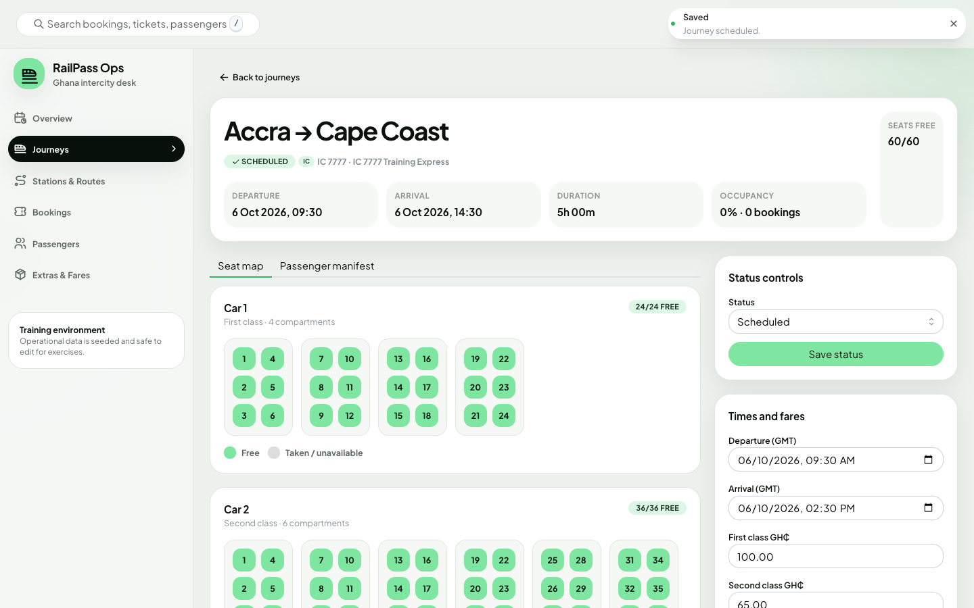
Screenshots as review artifacts
RailPass
Use visuals to discuss tokens, states and layout
Dashboard overview
Dark journeys list
Seat occupancy
Mobile screenshots were not present when this deck was generated; use live Expo demos for mobile flows.
Notes:
Use dashboard screenshots for visual review. If mobile screenshots are later added to .artifacts/mobile, rerun build-deck.mjs; the script can be extended to include them.

Slide 6
Lesson 01
Project organisation
60 min · mobile/app → features → constants/config
Thin Expo Router entries
Feature boundaries
Naming and import order
Constants vs runtime config
Notes:
Open mobile/app/_layout.tsx and station-picker route. Emphasize that app/ is the navigation layer, not the place for full implementation.

Slide 7
Lesson 01: objectives
RailPass
Project organisation
Thin Expo Router entries
Feature boundaries
Naming and import order
Constants vs runtime config
Code paths to open
mobile/app → features → constants/config
Keep slides light; use lesson notes for detailed facilitation.
Notes:
Objectives for Project organisation. Ask learners to predict where the code lives before opening files.

Slide 8
Lesson 01: decisions and trade-offs
RailPass
What we chose, why, and when to choose differently
Routes delegate
Feature screens are testable
Config separated
Runtime values differ from design
Dashboard router central
Staff routes are guarded once
Review prompt: what would make us choose differently?
Notes:
Use the lesson note table for complete What/Why/Trade-offs/When differently. This slide is for discussion, not lecture.

Slide 9
Lesson 01: anchor snippet
RailPass
Short, real excerpts from the monorepo
Real code excerpt
import { SignInScreen } from '@/features/auth/screens/sign-in-screen';
export default SignInScreen;
Ask learners
Which layer owns this code?
What invariant does it protect?
What bug appears if we move it?
What test or review check covers it?
Notes:
Use this actual snippet to keep the lesson grounded in the codebase. Avoid generic framework tours.

Slide 10
Lesson 01: activity
RailPass
Interactive practice
Refactor a hypothetical route that does fetching, rendering and styling into route + feature screen + components.
Prediction first: what will happen if…?
Debugging task: reproduce or trace the issue.
Code review: leave actionable comments.
Implementation challenge: small, accepted by criteria.
Notes:
Run the activity from the lesson notes. Keep the group focused on evidence from actual files.

Slide 11
Lesson 02
Components and design tokens
75 min · mobile/constants + dashboard tokens.css
Use tokens everywhere
Understand light/dark palettes
Keep danger separate from red brand
Extend reusable components safely
Notes:
Use docs/design-tokens.md. The red dark-mode accent is brand, not error. Unavailable seats use hatching and grey token.

Slide 12
Lesson 02: objectives
RailPass
Components and design tokens
Use tokens everywhere
Understand light/dark palettes
Keep danger separate from red brand
Extend reusable components safely
Code paths to open
mobile/constants + dashboard tokens.css
Keep slides light; use lesson notes for detailed facilitation.
Notes:
Objectives for Components and design tokens. Ask learners to predict where the code lives before opening files.

Slide 13
Lesson 02: decisions and trade-offs
RailPass
What we chose, why, and when to choose differently
StyleSheet + constants
Plain, typed, searchable
Mantine + CSS variables
Accessible dashboard primitives
Danger token
Not the dark brand red
Review prompt: what would make us choose differently?
Notes:
Use the lesson note table for complete What/Why/Trade-offs/When differently. This slide is for discussion, not lecture.

Slide 14
Lesson 02: anchor snippet
RailPass
Short, real excerpts from the monorepo
Real code excerpt
danger: {
background: colors.dangerSoft,
border: colors.danger,
tone: 'danger',
}
Ask learners
Which layer owns this code?
What invariant does it protect?
What bug appears if we move it?
What test or review check covers it?
Notes:
Use this actual snippet to keep the lesson grounded in the codebase. Avoid generic framework tours.

Slide 15
Lesson 02: activity
RailPass
Interactive practice
Find and replace a hard-coded style in a flawed example with tokens.
Prediction first: what will happen if…?
Debugging task: reproduce or trace the issue.
Code review: leave actionable comments.
Implementation challenge: small, accepted by criteria.
Notes:
Run the activity from the lesson notes. Keep the group focused on evidence from actual files.

Slide 16
Lesson 03
Navigation and flows
75 min · Expo Router groups + dashboard RequireStaff
Trace one-way and round-trip booking
Explain Stack.Protected
Use modal station picker
Trace dashboard routes
Notes:
Demonstrate home → seat → checkout → tickets. For dashboard, show passenger refused and staff allowed.

Slide 17
Lesson 03: objectives
RailPass
Navigation and flows
Trace one-way and round-trip booking
Explain Stack.Protected
Use modal station picker
Trace dashboard routes
Code paths to open
Expo Router groups + dashboard RequireStaff
Keep slides light; use lesson notes for detailed facilitation.
Notes:
Objectives for Navigation and flows. Ask learners to predict where the code lives before opening files.

Slide 18
Lesson 03: decisions and trade-offs
RailPass
What we chose, why, and when to choose differently
Protected groups
Screens avoid auth checks
Modal station picker
One picker handles origin/destination
Route params
Minimal addressable context
Review prompt: what would make us choose differently?
Notes:
Use the lesson note table for complete What/Why/Trade-offs/When differently. This slide is for discussion, not lecture.

Slide 19
Lesson 03: anchor snippet
RailPass
Short, real excerpts from the monorepo
Real code excerpt
<Stack.Screen name="station-picker" options={{ presentation: 'modal' }} />
<Stack.Screen name="journeys/[id]" />
<Stack.Screen name="checkout" />
Ask learners
Which layer owns this code?
What invariant does it protect?
What bug appears if we move it?
What test or review check covers it?
Notes:
Use this actual snippet to keep the lesson grounded in the codebase. Avoid generic framework tours.

Slide 20
Lesson 03: activity
RailPass
Interactive practice
Draw the booking flow and mark which state is route params vs draft store.
Prediction first: what will happen if…?
Debugging task: reproduce or trace the issue.
Code review: leave actionable comments.
Implementation challenge: small, accepted by criteria.
Notes:
Run the activity from the lesson notes. Keep the group focused on evidence from actual files.

Slide 21
Lesson 04
State management
90 min · Zustand + useApiQuery vs Redux + TanStack Query
Classify client vs server state
Use persist/partialize safely
Use selectors/useShallow
Invalidate query caches
Notes:
Stress that selected seats are volatile and should not be persisted. Dashboard Redux does not own server lists.

Slide 22
Lesson 04: objectives
RailPass
State management
Classify client vs server state
Use persist/partialize safely
Use selectors/useShallow
Invalidate query caches
Code paths to open
Zustand + useApiQuery vs Redux + TanStack Query
Keep slides light; use lesson notes for detailed facilitation.
Notes:
Objectives for State management. Ask learners to predict where the code lives before opening files.

Slide 23
Lesson 04: decisions and trade-offs
RailPass
What we chose, why, and when to choose differently
Zustand mobile draft
Small client intent store
useApiQuery mobile
Modest server-state needs
TanStack dashboard
Server cache and mutations
Review prompt: what would make us choose differently?
Notes:
Use the lesson note table for complete What/Why/Trade-offs/When differently. This slide is for discussion, not lecture.

Slide 24
Lesson 04: anchor snippet
RailPass
Short, real excerpts from the monorepo
Real code excerpt
partialize: ({ origin, destination }) => ({ origin, destination }),
queryClient.invalidateQueries({ queryKey: ['journeys'] });
Ask learners
Which layer owns this code?
What invariant does it protect?
What bug appears if we move it?
What test or review check covers it?
Notes:
Use this actual snippet to keep the lesson grounded in the codebase. Avoid generic framework tours.

Slide 25
Lesson 04: activity
RailPass
Interactive practice
Classify ten example values as route, component, client store or server state.
Prediction first: what will happen if…?
Debugging task: reproduce or trace the issue.
Code review: leave actionable comments.
Implementation challenge: small, accepted by criteria.
Notes:
Run the activity from the lesson notes. Keep the group focused on evidence from actual files.

Slide 26
Lesson 05
API, forms and failures
90 min · Axios clients, ApiError, checkout recovery
Normalize API errors
Map field errors
Trust server quote
Recover from SEAT_TAKEN
Notes:
Server-side pricing and final seat conflicts are not optional. The UI is resilient, not authoritative.

Slide 27
Lesson 05: objectives
RailPass
API, forms and failures
Normalize API errors
Map field errors
Trust server quote
Recover from SEAT_TAKEN
Code paths to open
Axios clients, ApiError, checkout recovery
Keep slides light; use lesson notes for detailed facilitation.
Notes:
Objectives for API, forms and failures. Ask learners to predict where the code lives before opening files.

Slide 28
Lesson 05: decisions and trade-offs
RailPass
What we chose, why, and when to choose differently
One Axios client
Central auth and 401
Server quote
Prices are authoritative
Conflict recovery
Concurrency is normal
Review prompt: what would make us choose differently?
Notes:
Use the lesson note table for complete What/Why/Trade-offs/When differently. This slide is for discussion, not lecture.

Slide 29
Lesson 05: anchor snippet
RailPass
Short, real excerpts from the monorepo
Real code excerpt
const quote = useApiQuery(
request ? `quote:${JSON.stringify(request)}` : null,
() => bookingsApi.quote(request!),
);
Ask learners
Which layer owns this code?
What invariant does it protect?
What bug appears if we move it?
What test or review check covers it?
Notes:
Use this actual snippet to keep the lesson grounded in the codebase. Avoid generic framework tours.

Slide 30
Lesson 05: activity
RailPass
Interactive practice
Trigger invalid email and explain the path from backend fieldErrors to TextField error.
Prediction first: what will happen if…?
Debugging task: reproduce or trace the issue.
Code review: leave actionable comments.
Implementation challenge: small, accepted by criteria.
Notes:
Run the activity from the lesson notes. Keep the group focused on evidence from actual files.

Slide 31
Lesson 06
Performance and debugging
90 min · FlatList, Skia, Reanimated, polling
Profile list patterns
Explain Skia + native Pressables
Respect reduced motion
Debug stale seat maps
Notes:
Show Canvas accessible=false and Pressable labels. Polling cost is a product/infra trade-off.

Slide 32
Lesson 06: objectives
RailPass
Performance and debugging
Profile list patterns
Explain Skia + native Pressables
Respect reduced motion
Debug stale seat maps
Code paths to open
FlatList, Skia, Reanimated, polling
Keep slides light; use lesson notes for detailed facilitation.
Notes:
Objectives for Performance and debugging. Ask learners to predict where the code lives before opening files.

Slide 33
Lesson 06: decisions and trade-offs
RailPass
What we chose, why, and when to choose differently
Skia draws
Native controls interact
Focus polling
Fresh enough without always-on traffic
Memoized sets
Avoid repeated seat lookups
Review prompt: what would make us choose differently?
Notes:
Use the lesson note table for complete What/Why/Trade-offs/When differently. This slide is for discussion, not lecture.

Slide 34
Lesson 06: anchor snippet
RailPass
Short, real excerpts from the monorepo
Real code excerpt
const taken = useMemo(() => new Set(car.takenSeats), [car.takenSeats]);
const reduceMotion = useReducedMotion();
Ask learners
Which layer owns this code?
What invariant does it protect?
What bug appears if we move it?
What test or review check covers it?
Notes:
Use this actual snippet to keep the lesson grounded in the codebase. Avoid generic framework tours.

Slide 35
Lesson 06: activity
RailPass
Interactive practice
Debug a selected seat that becomes taken while the screen is open.
Prediction first: what will happen if…?
Debugging task: reproduce or trace the issue.
Code review: leave actionable comments.
Implementation challenge: small, accepted by criteria.
Notes:
Run the activity from the lesson notes. Keep the group focused on evidence from actual files.

Slide 36
Lesson 07
Accessibility, testing, review
75 min · RNTL, Vitest, e2e, Husky
Add roles/labels/states
Test user-visible behavior
Use Husky hooks
Apply review checklist
Notes:
Connect accessibility to implementation choices in the seat map. Git hooks are guardrails, not full CI.

Slide 37
Lesson 07: objectives
RailPass
Accessibility, testing, review
Add roles/labels/states
Test user-visible behavior
Use Husky hooks
Apply review checklist
Code paths to open
RNTL, Vitest, e2e, Husky
Keep slides light; use lesson notes for detailed facilitation.
Notes:
Objectives for Accessibility, testing, review. Ask learners to predict where the code lives before opening files.

Slide 38
Lesson 07: decisions and trade-offs
RailPass
What we chose, why, and when to choose differently
Icon + label + colour
Status is not colour-only
Targeted tests
Fast confidence
Backend e2e
Concurrency proof
Review prompt: what would make us choose differently?
Notes:
Use the lesson note table for complete What/Why/Trade-offs/When differently. This slide is for discussion, not lecture.

Slide 39
Lesson 07: anchor snippet
RailPass
Short, real excerpts from the monorepo
Real code excerpt
expect(await screen.findByLabelText('Delayed +25 min')).toBeTruthy();
expect(statuses).toEqual([201, 409]);
Ask learners
Which layer owns this code?
What invariant does it protect?
What bug appears if we move it?
What test or review check covers it?
Notes:
Use this actual snippet to keep the lesson grounded in the codebase. Avoid generic framework tours.

Slide 40
Lesson 07: activity
RailPass
Interactive practice
Write five code-review comments for flawed examples.
Prediction first: what will happen if…?
Debugging task: reproduce or trace the issue.
Code review: leave actionable comments.
Implementation challenge: small, accepted by criteria.
Notes:
Run the activity from the lesson notes. Keep the group focused on evidence from actual files.

Slide 41
Lesson 08
Extending maintainably
75 min · Feature-local first, query keys, API contracts
Plan changes across layers
Know when to abstract
Avoid duplicated responsibilities
Write acceptance criteria
Notes:
This lesson ties everything together. Require learners to write acceptance criteria before code.

Slide 42
Lesson 08: objectives
RailPass
Extending maintainably
Plan changes across layers
Know when to abstract
Avoid duplicated responsibilities
Write acceptance criteria
Code paths to open
Feature-local first, query keys, API contracts
Keep slides light; use lesson notes for detailed facilitation.
Notes:
Objectives for Extending maintainably. Ask learners to predict where the code lives before opening files.

Slide 43
Lesson 08: decisions and trade-offs
RailPass
What we chose, why, and when to choose differently
Feature-local first
Avoid premature shared APIs
Inputs in query keys
Prevent stale filters
Backend DTO contract
Frontend cannot invent authority
Review prompt: what would make us choose differently?
Notes:
Use the lesson note table for complete What/Why/Trade-offs/When differently. This slide is for discussion, not lecture.

Slide 44
Lesson 08: anchor snippet
RailPass
Short, real excerpts from the monorepo
Real code excerpt
const key = originId && destinationId
? `journeys:${originId}:${destinationId}:${date}:${sort}:${passengers}`
: null;
Ask learners
Which layer owns this code?
What invariant does it protect?
What bug appears if we move it?
What test or review check covers it?
Notes:
Use this actual snippet to keep the lesson grounded in the codebase. Avoid generic framework tours.

Slide 45
Lesson 08: activity
RailPass
Interactive practice
Plan a first-class-only or departs-after-noon journey filter end-to-end.
Prediction first: what will happen if…?
Debugging task: reproduce or trace the issue.
Code review: leave actionable comments.
Implementation challenge: small, accepted by criteria.
Notes:
Run the activity from the lesson notes. Keep the group focused on evidence from actual files.

Slide 46
Extension A: Tickets and PDF417
RailPass
Optional extension module
API generates PDF417 matrix.
Mobile draws one Skia path.
PDF uses same matrix as SVG.
Black-on-white stays scannable.
Real code excerpt
export function pdf417Matrix(payload: string): BarcodeMatrix {
const options = { bcid: 'pdf417', text: payload };
return { format: 'PDF417', payload, columns, rows };
}
Notes:
Optional module for ticketing. Focus on bundle size, API contract and drawing trade-offs, not barcode internals.

Slide 47
Extension B: Dashboard operations
RailPass
Optional extension module
Redux owns auth/UI only.
TanStack Query owns server data.
Mantine components use tokens.
CSS Modules use --rp-* variables.
Real code excerpt
const journeys = useJourneys({
page, pageSize, search: debouncedSearch, status
});
const density = useAppSelector((s) => s.ui.tableDensity);
Notes:
Optional module for staff dashboard work. Use screenshots and table filters.

Slide 48
Extension C: API contracts
RailPass
Optional extension module
Backend error shape drives forms.
Server pricing is authoritative.
SeatReservation unique index prevents races.
E2E test proves one 201 and one 409.
Real code excerpt
@@unique([journeyId, carNumber, seatNumber])
expect(statuses).toEqual([201, 409]);
Notes:
Optional module for end-to-end thinking. Explain why UI must be resilient to final server conflicts.

Slide 49
Final review checklist
Paths and ownership are correct.
Design values come from tokens.
Server state is not duplicated.
Errors and conflicts have recovery paths.
Accessible labels/roles/states exist.
Tests or verification evidence are included.
Ship small
Review deeply
Learn the code
Notes:
Close by asking learners to use the checklist on their first RailPass PR and to link evidence: files read, tests run, screenshots inspected.

