Slide 1


Debre Markos University
Department of Software Engineering
Microprocessor and Assembly Language Programming (SEng3031)
Alehegn A.
Alehegn.swe@gmail.com
Notes:
Microprocessor
Debalkew G.

Slide 2
Couse Outline
Introduction to Microprocessors
A Historical Background
General Architecture of micro computer system
number systems and its conversion
Computer data Formats
Introduction to Programming language

Slide 3
Chapter-One
INTRODUCTION TO MICROPROCESSORS (4hr)
Notes:
Microprocessor
Debalkew G.

Slide 4
Microprocessor
A microprocessor is a multipurpose device that reads binary instructions from a memory accepts binary data as input, processes and provides results as output.
Microprocessor is the CPU in a microcomputer and present as a single IC chip. It is referred as the brain of microcomputer .
Microprocessor is an electronic circuit that functions as the central processing unit (CPU) of a computer, providing computational control.
It controls memory and I/O through a series of connections called buses.
Memory and I/O are controlled through instructions that are stored in the memory and executed by the MP.
It performs a number of functions, including.
  Providing timing and control signals for all elements of the µC
  Fetching instructions and data from memory
  Transferring data to and from memory and I/O devices
  Decoding instructions
  Performing arithmetic and logic operations called for by instructions
  Responding to I/O generated control signals such as RESET and INTERRUPT

Slide 5
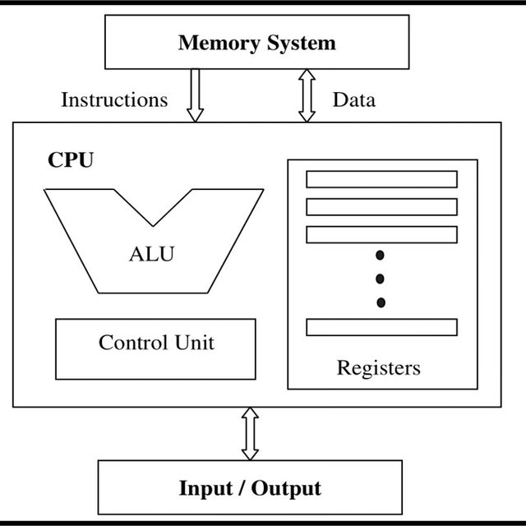
Microprocessor
A microcomputer is a computer similar to any other computer, except that the CPU functions of the microcomputer are performed by the microprocessor.
The microprocessor is one component of the microcomputer.
Similarly, the term peripheral is used for input/ output devices; however, occasionally processor can be called in this term.
The various components of the microcomputer and their function are described in the following diagram.

Slide 6
Microprocessor
It can be also defined as a programmable device that takes in numbers, performs on them arithmetic or logical operations according to the program stored in memory and then produces other numbers as a result.
Internally, the microprocessor is made up of 3 main units.
Arithmetic Logic Unit(ALU)
Control unit
Registers(to hold data while it is being manipulated)

Slide 7
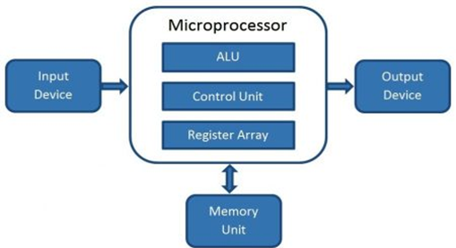
Microprocessor
Three basic characteristics differentiate microprocessors are:
  Instruction set: The set of instructions that the microprocessor can execute.
  Bandwidth: The number of bits processed in a single instruction.
  Clock speed: Given in megahertz (MHz), the clock speed determines how many instructions per second the processor can execute.

Slide 8
A Historical Background
In 500 BC, Babylonians invented the abacus, the first mechanical calculator.
In 1642, Pascal invented a calculator that was constructed of gears and wheels, It is used automobile’s odometer mechanism
In early 1800s, first practical geared mechanical machines used to automatically compute information dates
In 1937, Invented Analytical Engine, This engine was a steam-powered mechanical computer that stored a thousand 20-digit decimal numbers
In 1941, Konrad Zuse invented first electronic calculating machine
1946 at the University of Pennsylvania The first general-purpose, programmable electronic computer system was developed. It is called as ENIAC (Electronic Numerical Integrator and Calculator)
In 1947, transistor is developed at Bell labs
In 1958 integrated circuit invented by Jack Kilby of Texas Instruments
In 1971, the first microprocessor 4004(4bit) is invented at Intel Corporation
In later 1971, Intel developed 8008(8bit) microprocessor

Slide 9
Cont.,
In 1977, Intel Corporation introduced an updated version of the 8080—the 8085
In 1978, Intel released the 8086 (16bit) microprocessor
In 1986, Intel released the 80386 (32bit) microprocessor
In 1993, Intel released the Pentium(80586) (64bit) microprocessor
Pentium II, III and IV released continues years
In 2000, Intel released Itanium (Dual Core)(128bit data path)(64bit architecture path)
In 2009-2010, Intel released i3(2 core), i5(6 core) and i7(8 core)

Slide 10
Processor No. of bits Clock speed (Hz) Year of introduction
4004 4 740K 1971
8008 8 800K 1972 8080 8 2M 1974 8085 8 3M 1976
8086 16 5, 8 or 10M 1978 8088 16 5, 8 or 10M 1979 80186 16 6M 1982 80286 16 8M 1982 80386 32 16 to 33M 1986 80486 32 16 to 100M 1989 Pentium 32 66M 1993 Pentium II 32 233 to 500M 1997 Pentium III 32 500M to 1.4G 1999 Pentium IV 32 1.3 to 3.8G 2000 Dual core 32 1.2 to 3 G 2006 Core 2 Duo 64 1.2 to 3G 2006 i3, i5 and i7 64 2.4G to 3.6G 2010

Slide 11
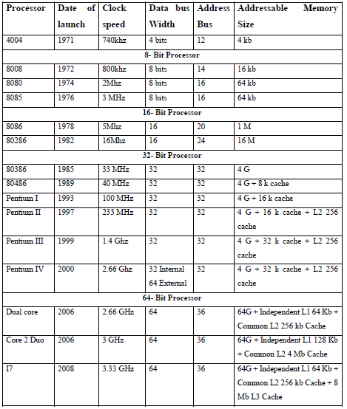
Cont.

Slide 12
Microprocessor based Personal Computer System
First and second generation computers are not microprocessor based computer
After finding the IC(Integrated Circuits), microprocessor based computers were started in the market
Some small companies replaced the mainframe computers with microprocessor computers
Companies such as DEC (Digital Equipment Corporation, now owned by Hewlett-Packard Company) have stopped producing mainframe computer systems in order to concentrate their resources on microprocessor-based computer systems
This topic shows the structure of the microprocessor based personal computer system
  Memory and I/O system
  Operating system

Slide 13
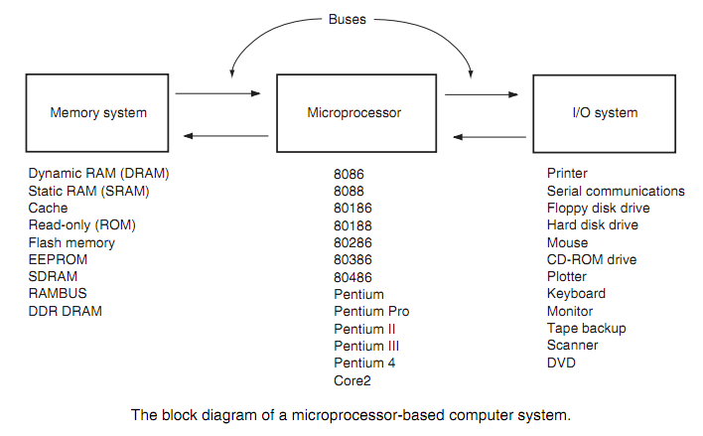
Notes:
Microprocessor
Debalkew G.

Slide 14
Cont.,
Memory and I/O system
Memory system is divided in to three main parts
System Area: It contains the programs either on ROM or flash memory and RAM
Transient Program Area(TPA): holds the OS and other program that control the computer system. It also stores any currently active or inactive application programs.
Extended memory System(XMS): it can only be addressed by software running in protected mode.
The PC and XT computers contain 640K bytes of TPA and 384K bytes of system memory for a total memory size of 1M bytes.
If the computer is based upon a really old 8086 or 8088 (a PC or XT), the TPA and systems area exist, but there is no extended memory area.
Notes:
Microprocessor
Debalkew G.

Slide 15
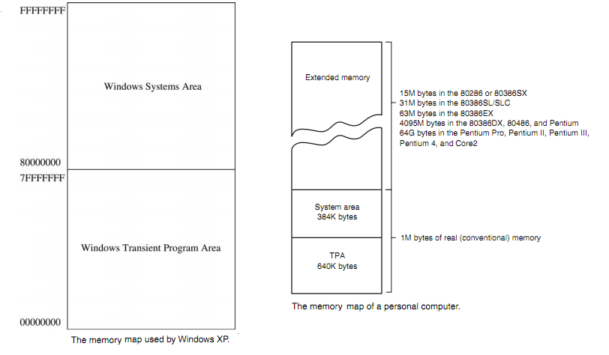
Notes:
Microprocessor
Debalkew G.

Slide 16
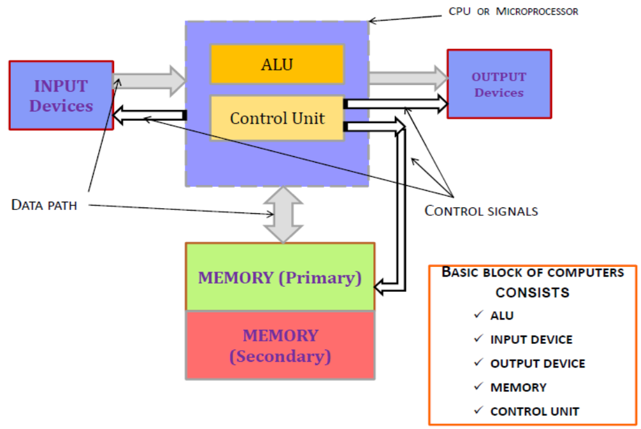
General Architecture of micro computer system
The computer system mainly consists three components
Processor unit which is the combination of ALU, CU and registers
Memory (primary, secondary)
I/O interfaces

Slide 17
Cont.,
Buses: A common group of wires that interconnect components in a computer system. It transfer address, data or control information between the processor, memory and I/O systems
The interconnections between these units are through 3 basic buses:
Address Bus : - which select memory location or I/O device for CPU.
Data Bus: - Move information b/n CPU & memory or I/O devices with size from 8 bits to 64 bits in microprocessor.

Slide 18
Processor Data and Address Bus Sizes
Processor
8088
8086
80286
80386dx
80486
80586/Pentium (Pro)
Data Bus
8
16
16
32
32
64
Address Bus
20
20
24
32
32
32
Max Addressable Memory
1,048,576 (1Mb)
1,048,576 (1Mb)
16,777,21 (16Mb)
4,294,976,296 (4Gb)
4,294,976,296 (4Gb)
4,294,976,296 (4Gb)
Microprocessor addresses a maximum of 2^{n} different memory locations, where n is a number of bits on the address bus

Slide 19
Cont.,
Control Bus:
Control bus contains lines that select the memory or I/O and cause them to perform a read or write operation.
It generate command signal to synchronize the CPU with I/O or memory.
In most computer systems, there are four control bus connections:
  MRDC(memory read control)
  MWTC(memory write control)
  IORC(I/O read control)
  IOWC(I/O write control)
  Note that the over bar indicates that the control signal is active-low

Slide 20
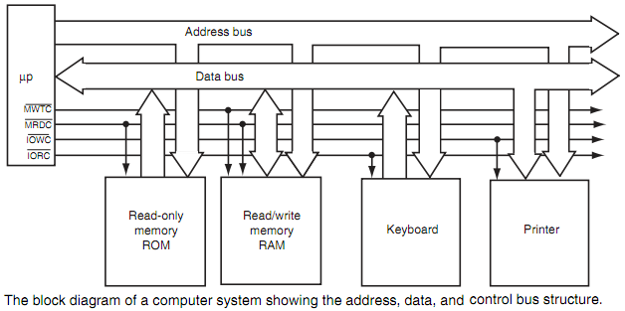
Cont.…

Slide 21
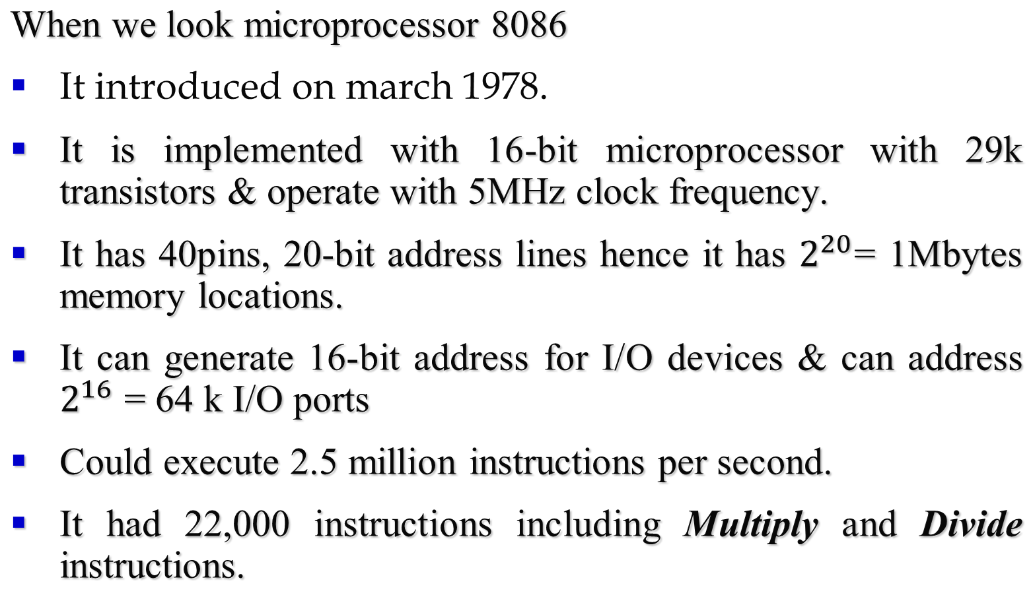
8086 Microprocessor & Its Architecture

Slide 22
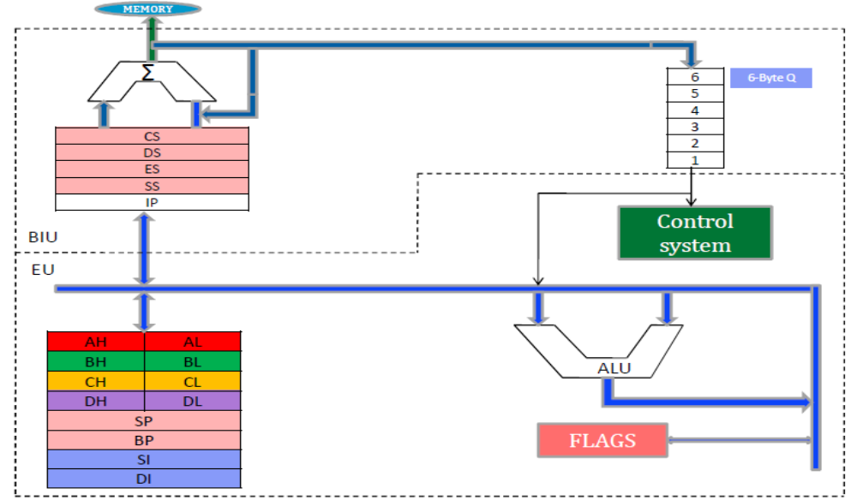
Architecture Of 8086
Microprocessor architecture is different from one another. Hence, when we look intel 8086 microprocessor architecture: -

Slide 23
Microprocessor & Its Architecture
Architecture of 8086 consists of 2 units of Bus Interface Unit (BIU) & Execution Unit (EU).
  The BIU sends out address and fetches instructions from memory, reads data from ports and memory and return data to ports and memory. In other words, handles all transfers of data and address on the buses for the execution unit
  EU:- Execution of 8086 tells BIU where to fetch instructions or data from, decodes instructions and executes instructions
    It contains control circuitry which directs internal operations
    A decoder in the EU, translates instructions fetched from memory into a series of actions
    It has 16-bit ALU which does all the arithmetic operations
  A flag is a flip-flop that indicates some status or condition produced by execution of an instruction. There are total 9 flags. Those are Status flags – 6 and Control flags- 3

Slide 24
Review of the basic number systems and conversion between different number systems
Microprocessor requires a working knowledge of binary, decimal, and hexadecimal numbering systems
Conversions between decimal and binary, decimal and hexadecimal, and binary and hexadecimal
Number Systems
  Decimal (Base is 10, 0 to 9)
  Octal (Base is 8, 0 to 7)
  Hexadecimal (Base is 16, 0 to 9, A, B, C, D, E, F)
  Binary (Base is 2, 0 and 1)
Positional Notation
  Positions to the left of the radix (number base) point -> positive power
  Positions to the rightof the radix (number base) point -> negative power
Number systems Conversion, Complements, Arithmetic operations studied in Introduction to computing

Slide 25
Review of the basic number systems and conversion between different number systems
To convert decimal to binary numbers then divide the decimal number by 2 until the remaining is less than 2.
Convert (25)₁₀ to binary number
(25)₁₀ = (11001)₂
Operation | Output | Remainder
25/2 | 12 | 1
12/2 | 6 | 0
6/2 | 3 | 0
3/2 | 1 | 1
1/2 | 0 | 1
Write from bottom to up

Slide 26
Review of the basic number systems and conversion between different number systems
Binary to Decimal:- multiplied from MSB to LSB with reducing the power of the base.
Convert (1101)₂ into a decimal number.
1 × 2³ + 1 × 2² + 0 × 2¹ + 1 × 2⁰
= 8 + 4 + 0 + 1
= 13
Octal to Decimal:- multiply the digits of octal number with decreasing power of the base number 8, starting from MSB to LSB and then add them all together.
Convert 22₈ to decimal number.
2 x 8¹ + 2 x 8⁰ = 18

Slide 27
Review of the basic number systems and conversion between different number systems
Hex/octal to binary:- convert each digit to binary number end combine it accordingly.
E.g Convert (89)₁₆ into a binary number.
8 = 1000 and 9 = 1001
Therefore, (89)₁₆ = (1000 1001)₂
Convert (214)₈ into a binary number.
2 → 010
1 → 001
4 → 100
Therefore,(214)₈ = (010 001 100)₂

Slide 28
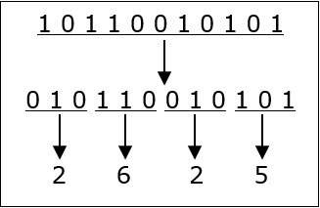
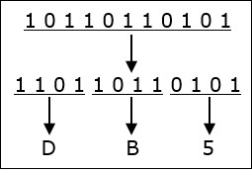
Review of the basic number systems and conversion between different number systems
Binary to Octal:- these steps are followed
  Starting from the least significant bit, make groups of three bits.
  If there are one or two bits less in making the groups, 0s can be added after the most significant bit
  Convert each group into its equivalent octal number
10110010101₂ = 2625₈
Binary to hex:- just follow Binary to Octal steps by make groups of four bits

Slide 29
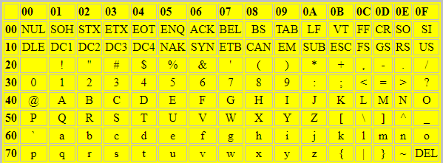
Computer data Formats
Successful programming requires precise understanding of data formats
Here some common computer data formats are:
  ASCII and Unicode
    American Standard Code for Information Interchange
    7 bit code
    Later extended ASCII is 8bit code
    Unicode is 8bit, 16bit, and 32bit variable code so it can use for huge number character representation in binary form
    The table given below shows the ASCII values of characters in hexadecimal number.
    Example Code the text string 'Hello.' in ASCII using hexadecimal digits
    H=48, e=65, l=6C, l=6C, o=6F, .=2E
    Thus the string is represented by the byte sequence 48 65 6C 6C 6F 2E

Slide 30
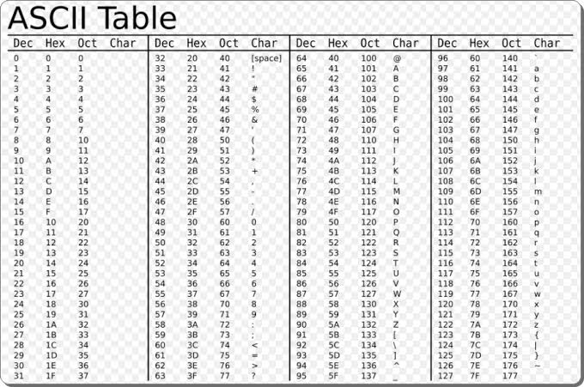
Computer data Formats

Slide 31
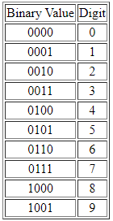
Computer data Formats
  Binary Coded Decimal (BCD) data
    Binary code decimal digits (0-9) are represented using FOUR bits. The valid combinations of bits and their respective values are
    If two BCD digits are stored per byte, its called Packed BCD.
      Packed BCD reduces the amount of time spent transmitting the numbers, as each data byte transmitted results in the sending of two BCD digits.
    If one BCD digits are stored per byte, its called unpacked BCD.

Slide 32
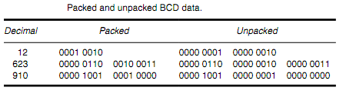
Computer data Formats
  e.g.

Slide 33
Programing languages
  A program is a set of instructions following the rules of the chosen language.
  Computer program is a list of ingredients (called variables) and a list of directions (called statements) that tell the computer what to do with the variables.
  Programming language is a vocabulary and set of grammatical rules (syntax) for instructing a computer to perform specific tasks.
    can be used to create computer programs.
  programming languages used as a communication media between humans and computer as natural languages used as communication media between humans.

Slide 34
Programing languages
  Programming languages can be divided into two different levels
  High-level Languages – Python, Visual Basic, Java, php, C, C++, SQL and many more.
  They are machine independent(portable) and are translated using either a compiler or interpreter.
  Are Close to human language
  Low-Level Languages – Hardware/Processor-specific assembly languages and machine code
  Machine language :- is programming language where instructions are in binary code and
  It is directly understood by a computer
  Faster than high level languages

Slide 35
Programing languages
  Assembly language – is a low- level language designed for specific type of processor
  One step higher than machine language
  Symbols are used instead of binary code
  Assembler – is used to convert assembly language to machine(exe) code.
  Its dependent on architecture of the system where it is the OS or the computer architecture
    i.e. it is dependent on the type of computer microprocessor

Slide 36
Why we learn Assembly language
  Assembly language
    used for better understanding about instructions of hardware and software
    Are better for the processing time Optimization than high-level languages
    Programmers are able to write the code to registers and able to retrieve memory address of pointer and values.
    helps understanding the process and memory functions
    helps understanding the work of processor and memory

Slide 37
Reading Assignment
  Read about Analytical Engine, von Neumann machine.
  Determine the difference between microprocessor and microcontroller.
  Read about the historical development of programming languages.
  Read about byte-size, word-size and double word-size data formats
  Read about evolution of programming languages

Slide 38
THANK YOU!!!

