Slide 1



AMG ERP TRANSFORMATION
Modernising ERP while protecting operations, margins, and business continuity
Prepared for: AMG Executive Team
Focus: ERP replacement, scope control, and risk reduction
STRATEGY SLIDE DECK
2026 | ERP Transformation Strategy | Confidential

Slide 2


EXECUTIVE SUMMARY: BUSINESS-LED TRANSFORMATION
Key Implementation Pillars
Strategic Vision
AMG should approach the ERP replacement as a comprehensive business transformation, not just a technology upgrade. The goal is to align systems with operational excellence.
BOM/MRP Reliability: Ensuring data integrity from engineering to the shop floor.
Financial Visibility: Real-time margin tracking and cost control across all projects.
Operational Continuity: Minimizing disruption during cutover with rigorous testing.
Controlled 12-month phased implementation focused on core stability.
Scope Discipline: Deferring non-critical automation and CRM/HRIS integration to Phase 2.
Prioritize Day-1 processes: Finance, Procurement, Inventory, and Manufacturing.
AMG ERP Transformation Strategy | Executive Summary
1

Slide 3


CURRENT-STATE ANALYSIS: RISKS OF LEGACY SYSTEMS
OPERATIONAL FRAGILITY
FINANCIAL IMPACT
BUSINESS RISKS
Legacy ERP >20 years old; critical systems at end-of-life.
BOM failures causing manufacturing delays and rework.
80%
Fragile nightly sync between Engineering BOM and ERP.
of custom orders experienced margin erosion last year.
Siloed CRM and HRIS data preventing unified insights.
Heavy reliance on Excel for reporting and workarounds.
Operational delays impacting delivery and customer trust.
Weak visibility into project-level contribution margins.
Unreliable labor tracking affecting true cost calculations.
AMG ERP Transformation Strategy | Current-State Problem
2

Slide 4


STRATEGIC PROGRAM OBJECTIVES & SUCCESS METRICS
Program Objectives
Measuring Success
Protect Continuity: Ensure zero operational downtime during the ERP transition.
Operational Stability
Stable go-live with no major business interruptions.
Modernize Core: Replace legacy systems with a scalable cloud-based ERP.
Data Integrity
100% accurate BOM and MRP processing post-launch.
Data Governance: Establish "Single Source of Truth" for items, BOMs, and costs.
Margin Transparency: Real-time visibility into custom order and project profitability.
Financial Control
Reliable and timely first month-end close in new system.
Process Efficiency: Eliminate manual Excel workarounds through automated reporting.
Visibility
Instant access to order-level contribution margin reports.
AMG ERP Transformation Strategy | Program Objectives
3

Slide 5
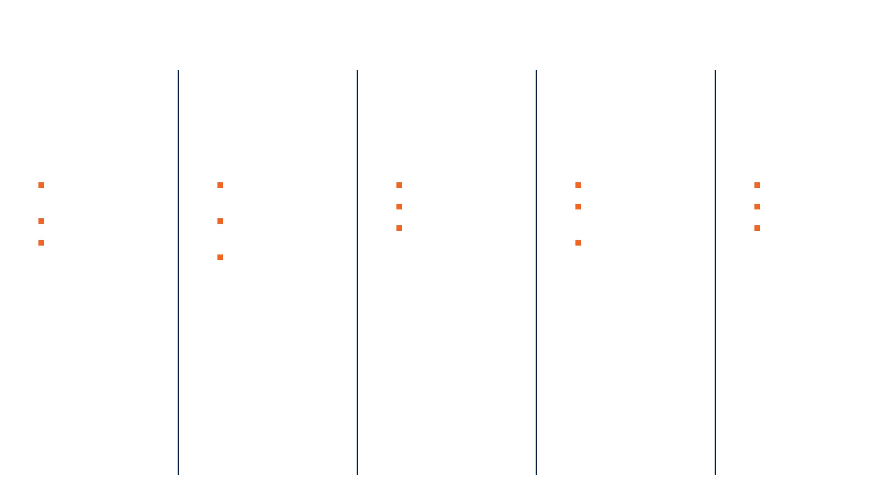

RECOMMENDED 5-PHASE IMPLEMENTATION ROADMAP
PHASE 1
PHASE 2
PHASE 3
PHASE 4
PHASE 5
MOBILISE & ASSESS
DESIGN FUTURE STATE
BUILD & INTEGRATE
TEST & PREPARE
GO-LIVE & STABILISE
Confirm scope & governance
Standardize core processes
ERP configuration
User Acceptance Testing
Controlled cutover
Critical integrations
Mock cutover simulations
Hypercare support
Identify process owners
Engineering BOM integration
Data cleansing & migration
Critical issue resolution
Risk & data assessment
Role-based training
Reporting requirements
AMG ERP Transformation Strategy | 12-Month Phased Roadmap
4

Slide 6
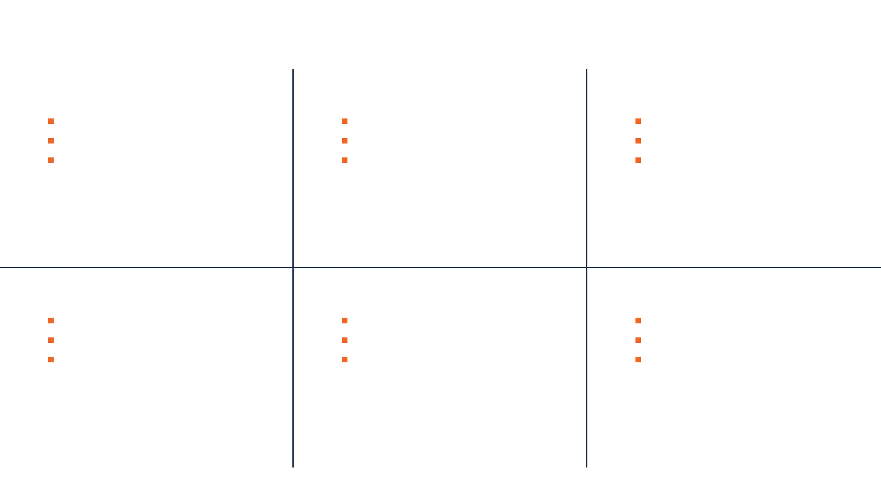






DAY-1 GO-LIVE SCOPE: CRITICAL OPERATIONS PRIORITY
Financials
Supply Chain
Operations
General Ledger & Financial Close
Procurement & Purchase Orders
Manufacturing/MRP & Work Orders
Accounts Payable & Receivable
Inventory & Warehouse Management
Routing & Scheduling Basics
Fixed Assets & Tax Management
Item Master & Costing
Sales Order Processing (Parts/Service)
Engineering
Core Reporting
Governance
Engineering BOM Integration
Financial Statements & Backlog
Security Roles & User Access
ECN Process Controls
WIP & Order Margin Tracking
Approval Workflows & Controls
Controlled BOM Migration
Inventory & Labour Cost Reports
Full Audit Trail Compliance
AMG ERP Transformation Strategy | Day-1 Go-Live Scope
5

Slide 7


SCOPE DEFERRAL: STRATEGIC RISK REDUCTION
Strategic Deferral Logic
Deferred Items (Post-Stabilization)
To control implementation risk, AMG must deliberately defer non-essential scope. This ensures the project team remains focused on the critical path to a stable go-live.
Full CRM or HRIS/Payroll replacement.
Advanced AI analytics and forecasting.
Full historical transaction migration.
THE GUIDING RULE
Complex custom workflows mimicking legacy systems.
"If it does not protect operations, financial close, compliance, BOM accuracy, or margin visibility, it should wait until Phase 2."
Non-critical mobile apps and self-service portals.
Heavy customization without legal or operational mandate.
AMG ERP Transformation Strategy | Scope Deferral
6

Slide 8




DATA MIGRATION & REPORTING STRATEGY
Data Migration Approach
Reporting & Validation
Clean Master Data: Migrate customers, vendors, items, BOMs, and cost structures only after cleansing.
Transition Layer: Unified reporting access to both legacy and new ERP data during cutover.
Open Balances: Focus on open orders, POs, inventory balances, and active projects.
Parallel Validation: Rigorous testing of financial reports against legacy outputs.
Historical Archiving: Keep older transactions in a searchable reporting warehouse, not the new ERP.
Mock Close: Perform at least one full month-end close simulation before final go-live.
AMG ERP Transformation Strategy | Data & Reporting
7

Slide 9
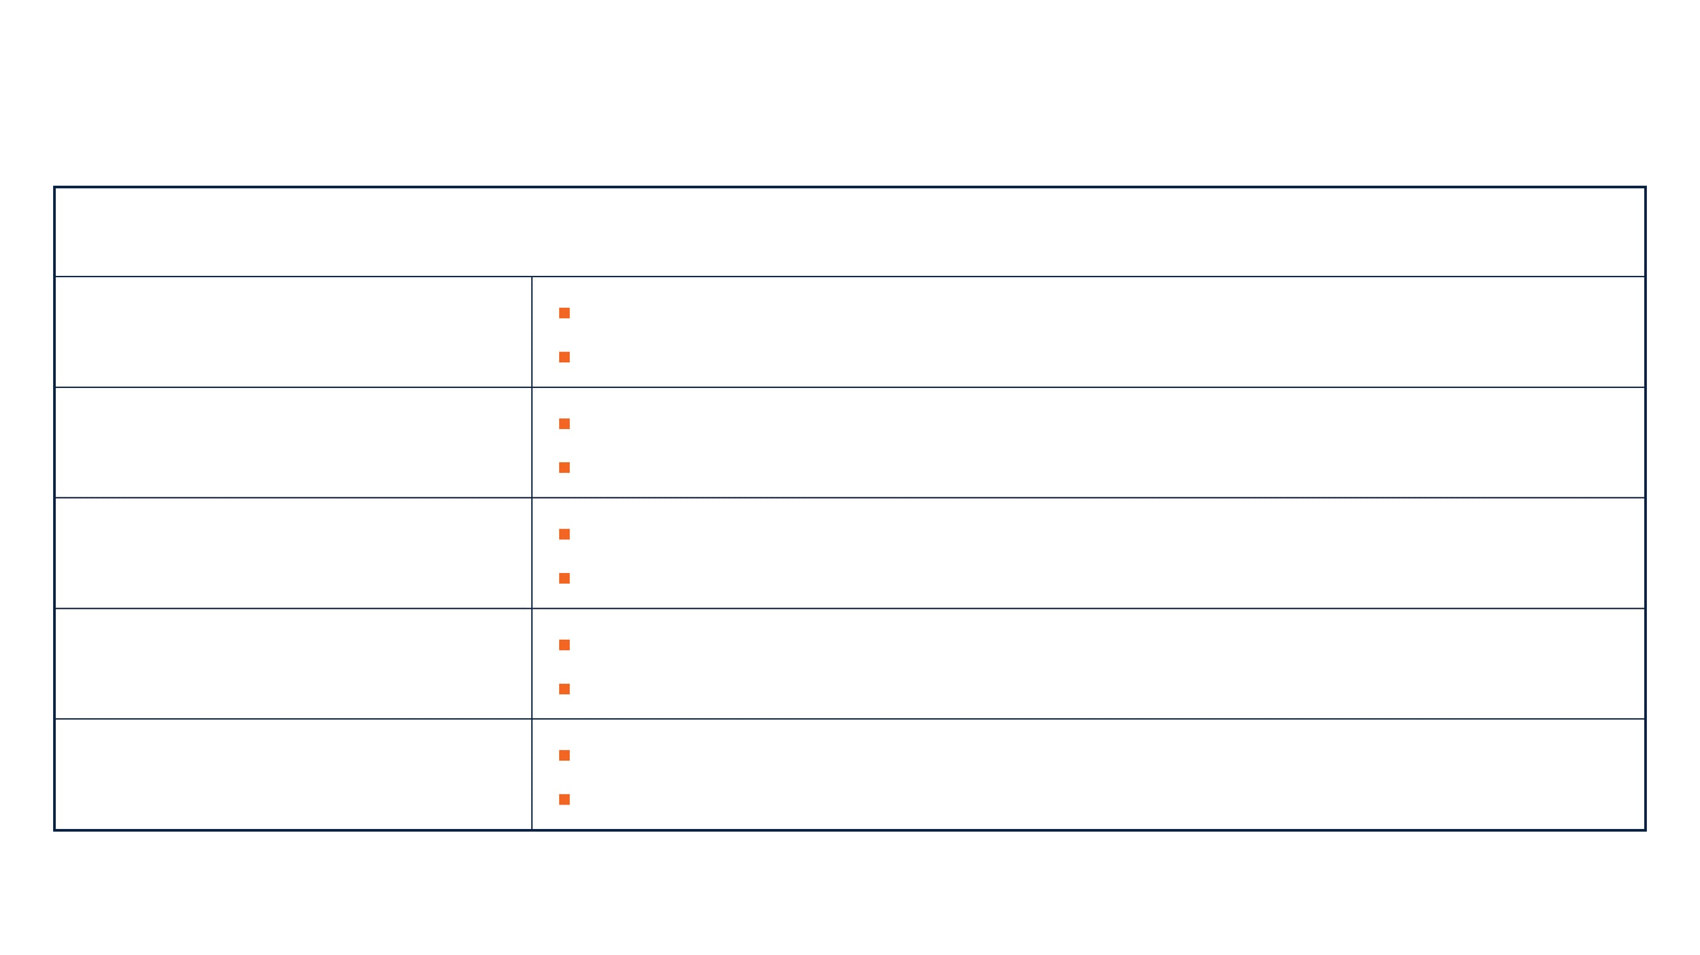

TOP PROGRAM RISKS & MITIGATION STRATEGIES
KEY PROGRAM RISK
MITIGATION STRATEGY
Scope Creep & Complexity
Executive steering committee oversight.
Strict change control and Day-1 scope rules.
Poor Data Quality
Early data profiling and cleansing ownership.
Multiple mock migrations and business validation.
BOM/MRP Disruption
Prioritize BOM governance and ECN process design.
Engineering-manufacturing cross-validation.
Month-End Close Failure
Finance-specific testing and parallel reporting.
Full mock month-end close before final cutover.
User Adoption Failure
Role-based training and early process walkthroughs.
Super user network and hypercare support.
AMG ERP Transformation Strategy | Risk Management
8

Slide 10


FINAL RECOMMENDATION & TARGET OUTCOMES
Strategic Outcomes
The Path Forward
AMG should proceed with a controlled 12-month cloud ERP transformation focused on operational stability, BOM accuracy, and financial control.
Stable Day-1 Go-Live
Zero operational downtime and reliable business continuity.
Margin Transparency
Real-time visibility into order-level contribution margins.
Standardize where possible; customize only where operationally essential.
Defer non-critical enhancements until after the stabilization phase.
Financial Integrity
Reliable financial close and accurate master data governance.
Digital Foundation
A scalable platform for future automation and AI initiatives.
AMG ERP Transformation Strategy | Final Recommendation
9

Slide 11
SOURCES
Abouttmc.com (Data and Reporting Strategy)
NetSuite UK (Recommended Phasing Approach)
10

Slide 12
THANK YOU

