Slide 1
Visualization on Used Cars
By Renuka Elumalai
Jigsaw Academy

Slide 2
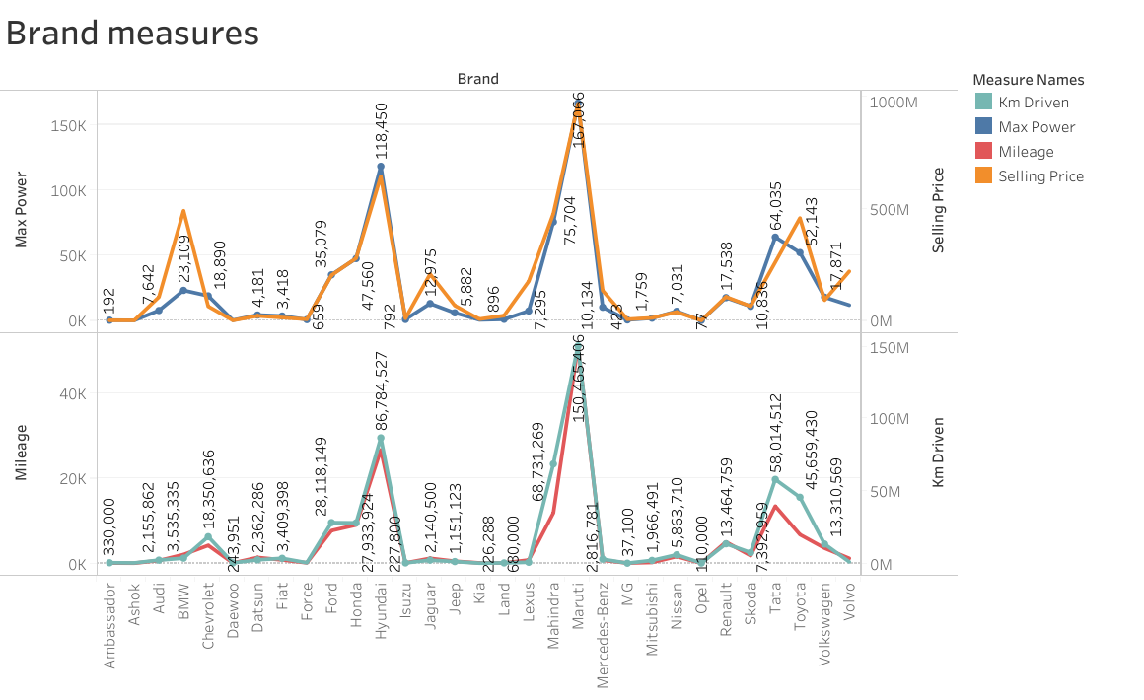
Among all the brands, Maruti gives the popular mileage and has the maximum power
Although the highest kilometers has been driven by Maruti it has the best selling price in the market

Slide 3
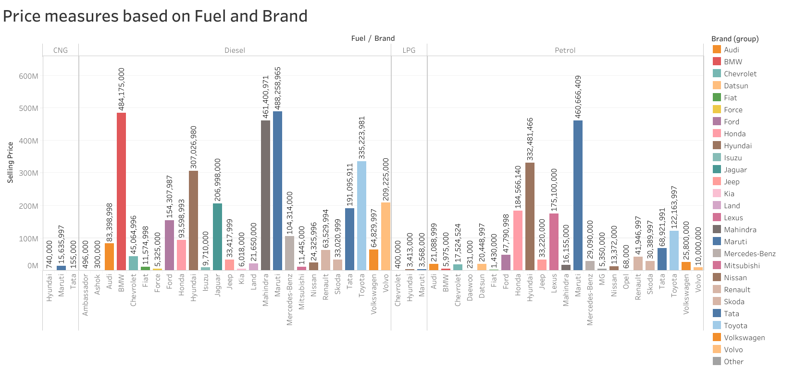
The brand Maruti uses all the fuel types and has the highest selling price in all the categories

Slide 4
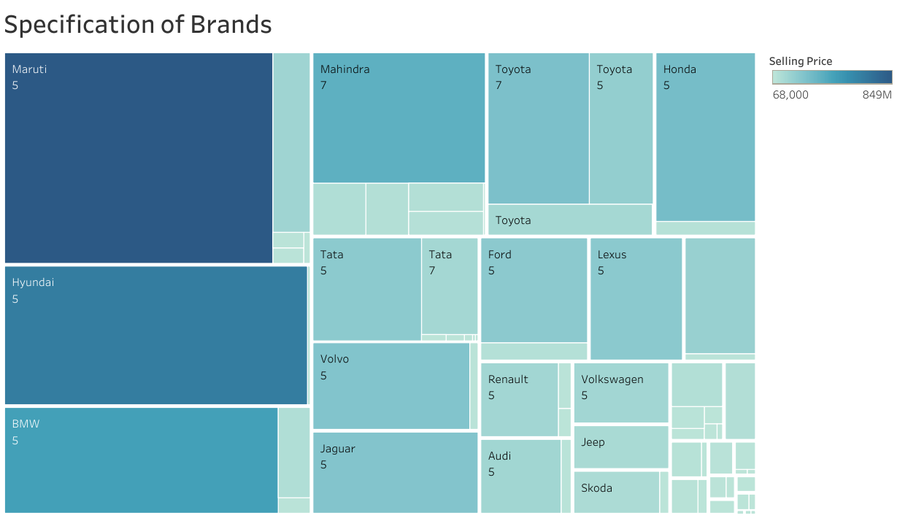
Most of the cars having 5 seaters and they have high selling rate

Slide 5
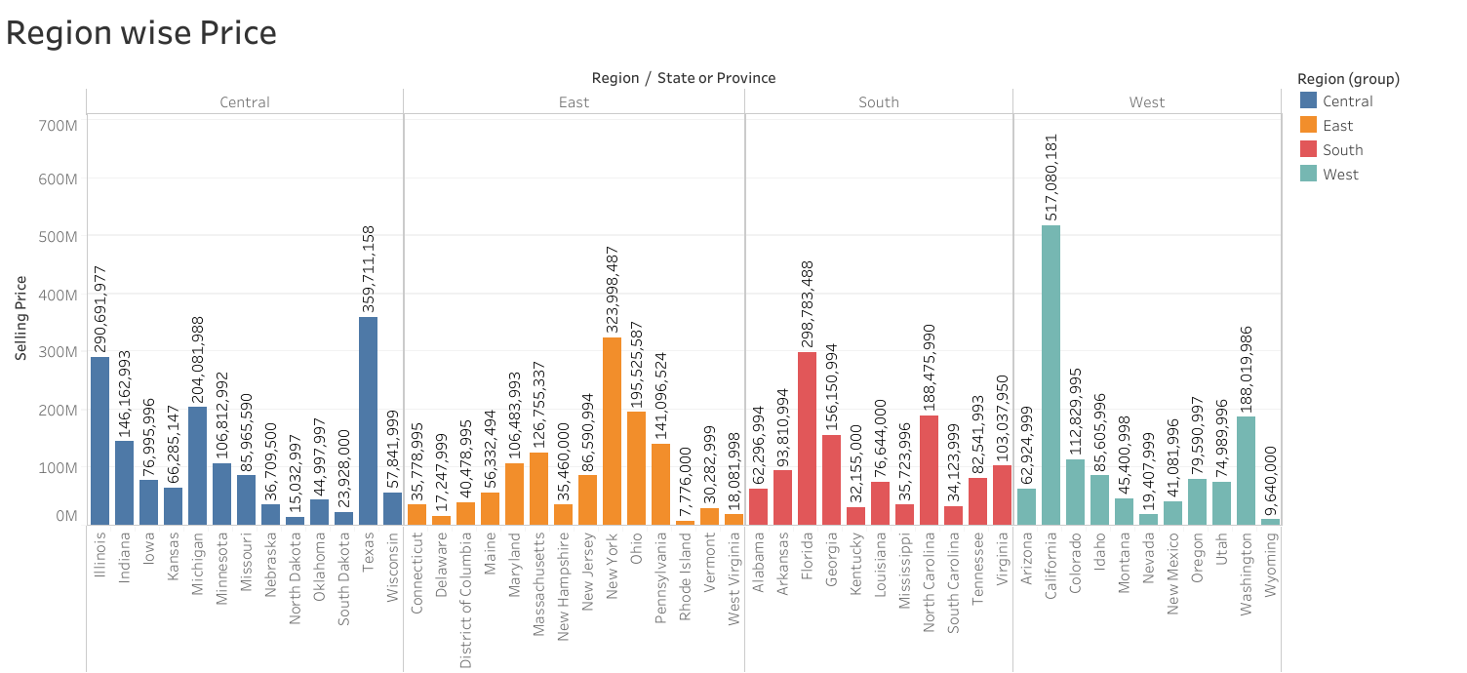
California from West region has highest cars selling price and Rhode Island from East region has least with no significant count difference across categories

Slide 6
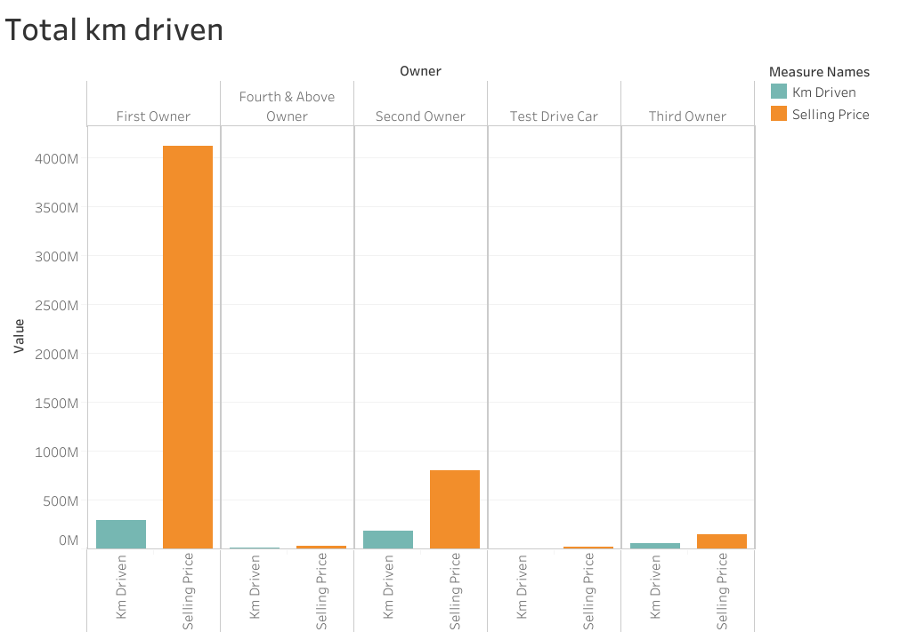
First time owners are more about 90% and they have more selling price
Whereas test drive cars have the least selling price even though they have lowest driven kilometers

Slide 7
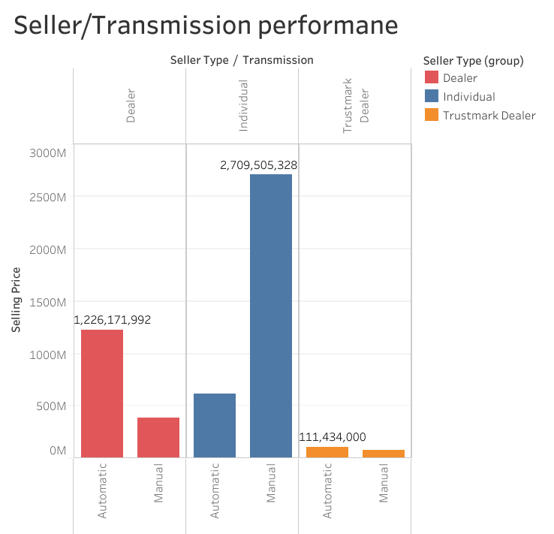
From the bar graph, the manual cars that have been sold individually has the highest selling price

Slide 8
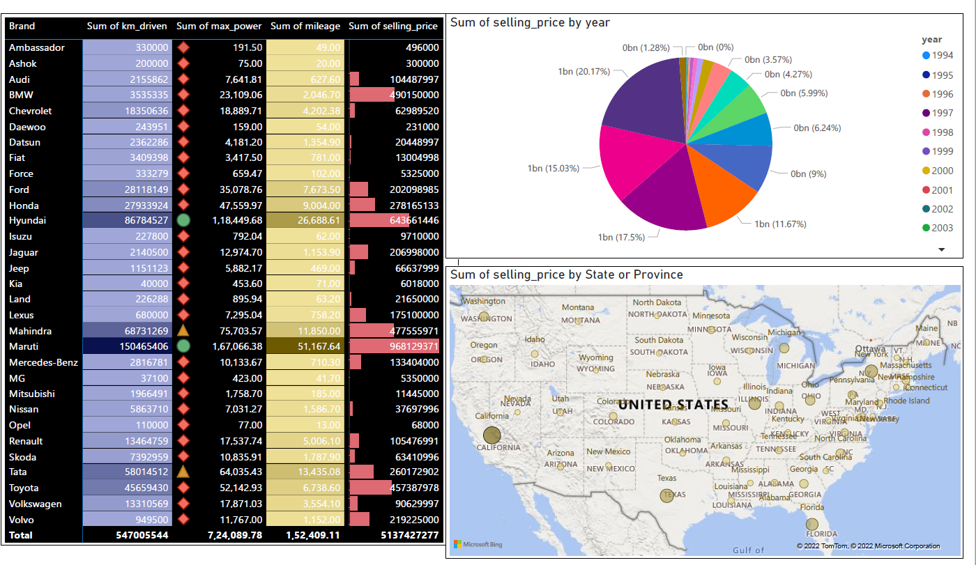
From the report, we can understand the brands Maruti, Hyundai and BMW are trending in market of used cars
The year 2019 has the highest selling price

Slide 9
Overall insights
Among all the brands, Maruti gives the popular mileage and has the maximum power
Although the highest kilometers has been driven by Maruti it has the best selling price in the market
The brand Maruti uses all the fuel types and has the highest selling price in all the categories
Most of the cars having 5 seaters and they have high selling rate
California from West region has highest cars selling price and Rhode Island from East region has least with no significant count difference across categories. However, South region has the overall highest selling price

Slide 10
First time owners are more about 90% and they have more selling price
Whereas test drive cars have the least selling price even though they have lowest driven kilometers
From the bar graph, the manual cars that have been sold individually has the highest selling price
From the report, we can understand the brands Maruti, Hyundai and BMW are trending in market of used cars
Majority of cars sold in the year 2019

