Slide 1
An introduction to the Salish sea model
Scientific software seminar
October 4th, 2018
Vicky do

Slide 2
Outline
SalishSea configuration & SalishSeaCast
Demo: submitting a model run to salish
Demo: looking at SalishSea model output

Slide 3
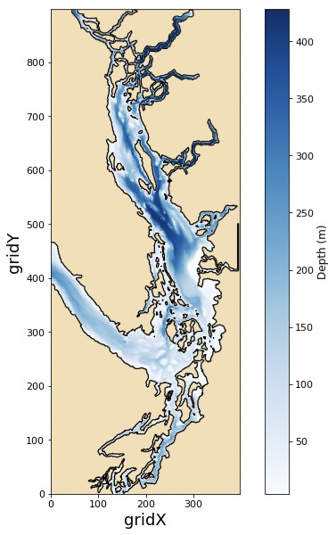
Salish sea domain and bathymetry

Slide 4
Gritty details
NEMO 3.6
40 x 898 x 398 grid cells
~500 m horizonal grid spacing
1 – 27 m vertical grid spacing
40 s horizontal time step
2 s vertical time step
Hourly output since fall 2014

Slide 5
forcing
>150 rivers, daily Fraser river data from ECCC
8 tidal constituents
Hourly 2.5 km resolution wind data from ECCC
Climatology for northern boundary
LiveOcean + observations for western boundary

Slide 6
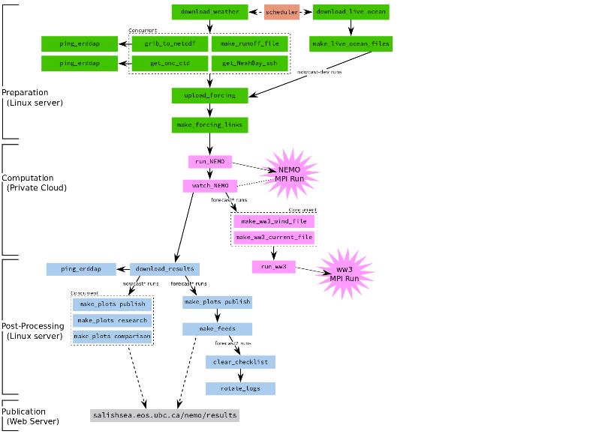
salishseacast

Slide 7
website
https://salishsea.eos.ubc.ca/storm-surge/forecast

Slide 8
Erddap server
https://salishsea.eos.ubc.ca/erddap/index.html

Slide 9
demo
Submitting a model run

