Slide 1
Hub - rasa

Slide 2


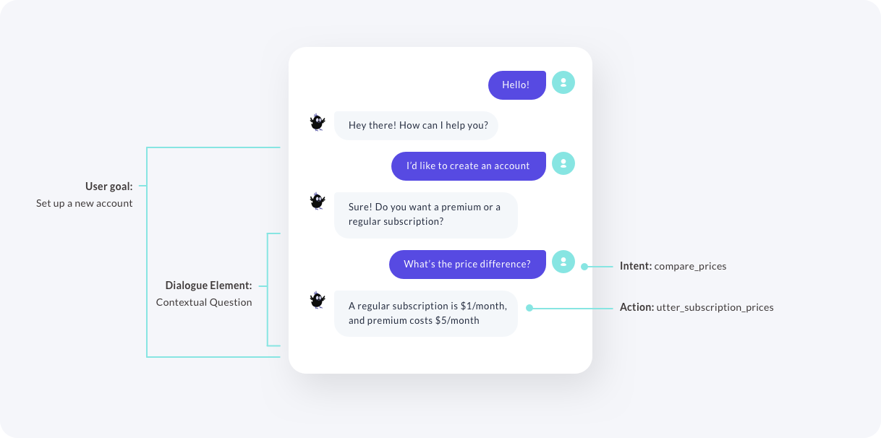
Presentation
Principe :
Créer un chatbot customisable rapidement
…

Slide 3
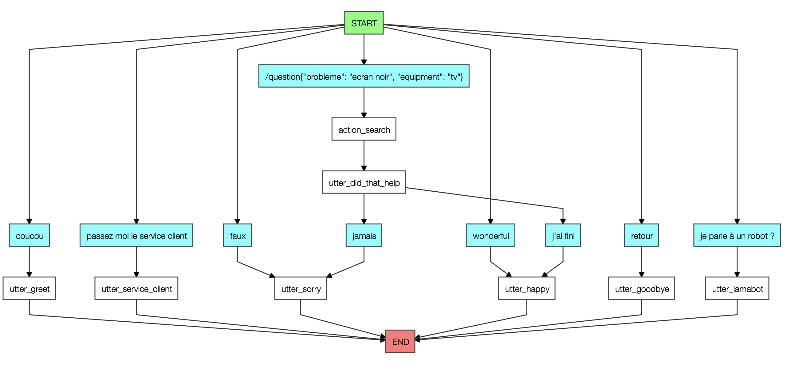
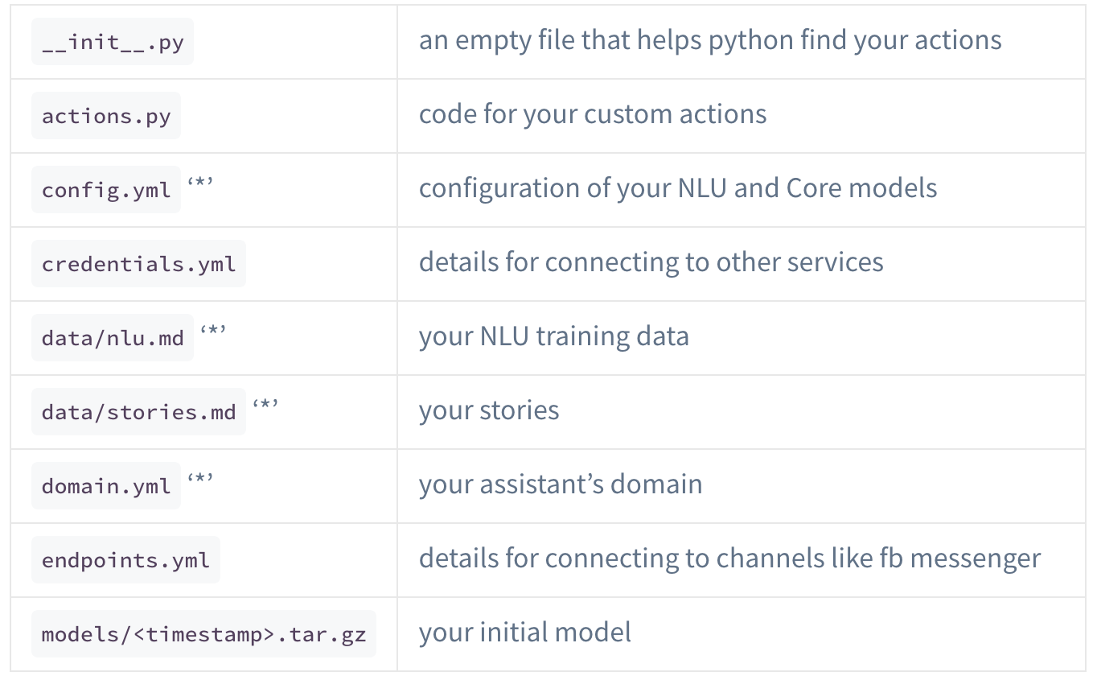
Presentation
Principe :
Créer un chatbot customizable rapidement
…

Slide 4
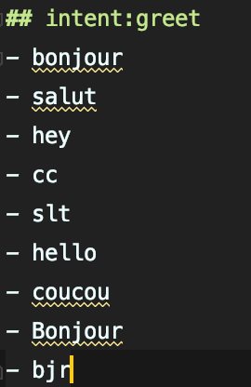
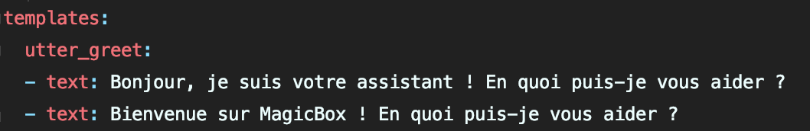
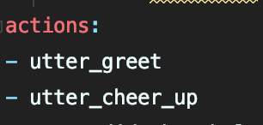
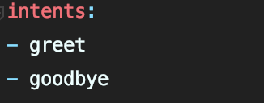
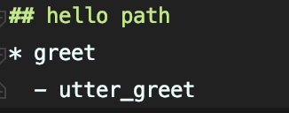
DOMAINS
INTENT
domain.yml
Nlu.md
Utters
Actions
Intents
Stories
stories.md

Slide 5
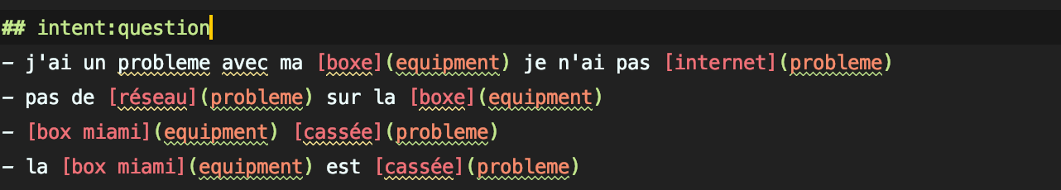
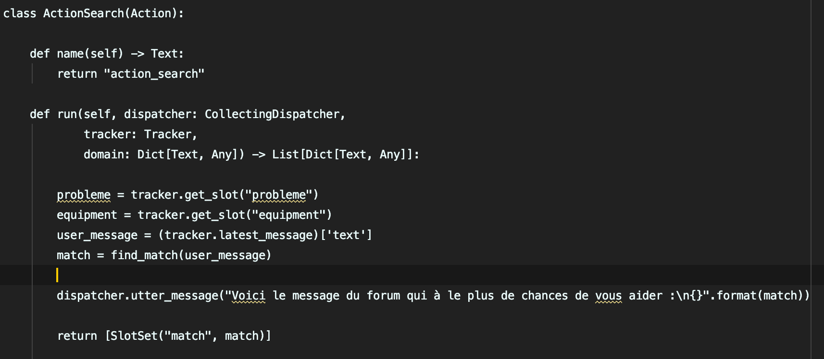
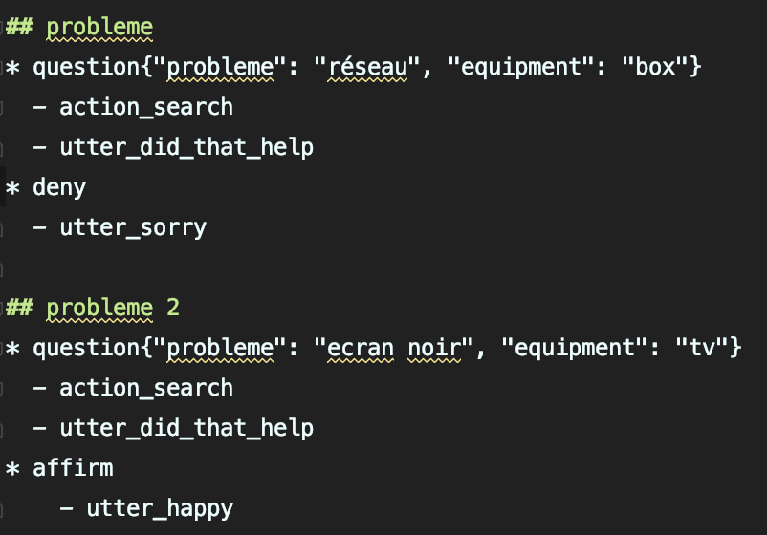
DOMAINS
INTENT
domain.yml
Nlu.md
Utters
Intents
Actions
Action
actions.py
Stories
stories.md

