Slide 1
5G NETWORK
SECURITY SYSTEM
Hackathon Mini Project
Detecting suspicious traffic, unauthorized access,
and threats to 5G network services
Presented by: ____________________
1

Slide 2
ABSTRACT
Project overview
Abstract
5G networks provide high-speed connectivity for mobile devices, IoT systems and digital services. Their growing use also creates security challenges, including suspicious traffic, unauthorized access and unusual connection behaviour.
The proposed 5G Network Security System monitors network-traffic information, identifies behaviour that may be abnormal, classifies the risk level and presents the results on a security dashboard. The dashboard helps a user understand alerts and review important network activity. This is a prototype concept that can be demonstrated with simulated traffic; it does not claim to monitor a live telecom operator network.
2

Slide 3
PROBLEM STATEMENT & OBJECTIVES
Why this system is needed
Problem Statement
Project Objectives
• 5G networks carry large amounts of data
• Unusual traffic can be difficult to notice manually
• Unauthorized access may put services at risk
• Security teams need clear, timely alerts
• Observe network-traffic features
• Flag suspicious patterns for review
• Categorize activity as Normal, Suspicious or High Risk
• Show key results in one dashboard
• Support faster investigation by a user
3

Slide 4
SYSTEM WORKFLOW
From network activity to a security alert
01
02
03
04
05
06
07
5G / IoT Devices
Traffic Data
Data Collection
Feature Analysis
Threat / Risk Check
Dashboard
Alert & Review
Output: understandable risk status + reason for review + visible dashboard summary
4

Slide 5
WHAT THE SYSTEM CHECKS
Illustrative traffic indicators
Traffic volume
Connection frequency
Sudden increase or unusual packet count
Repeated or unexpected connection attempts
Source / destination
Protocol & duration
Unusual addresses or communication patterns
Unexpected protocol use or connection length
These indicators are examples; detection quality depends on the data and detection method.
5

Slide 6
RISK CLASSIFICATION
Simple, readable security status
NORMAL
SUSPICIOUS
HIGH RISK
Expected or familiar network behaviour.
Action: continue monitoring.
Behaviour differs from the expected pattern.
Action: review traffic details.
Strong signs of abnormal activity.
Action: investigate promptly and follow approved response steps.
Risk labels support human review; an alert is not proof that an attack occurred.
6

Slide 7
SECURITY DASHBOARD — SAMPLE VIEW
Illustrative values for presentation only
TOTAL DEVICES
NORMAL
SUSPICIOUS
HIGH RISK
250
218
24
8
NETWORK RISK SCORE
RECENT ALERT
73 / 100
Example score to demonstrate a dashboard indicator.
Device activity flagged for unusual traffic volume and connection frequency.
All counts and scores on this slide are mock demonstration data, not live network measurements.
7

Slide 8
FRONTEND & BACKEND EXPLANATION
How the parts work together — no code required
FRONTEND | What the user sees
BACKEND | What works behind the screen
• Security dashboard screen
• Device / traffic summary cards
• Charts and risk-level indicators
• Alert list with reason for each alert
• Filters to review suspicious activity
Possible tools: HTML, CSS, JavaScript or React; Chart.js for charts.
• Receives or loads traffic records
• Prepares useful traffic features
• Applies rule-based or ML-based detection
• Calculates a risk level / score
• Sends results to the dashboard
• Stores events for later review
Possible tools: Python with Flask/FastAPI; SQLite or MySQL.
8

Slide 9
TECHNOLOGY & DATA FLOW
Suggested prototype architecture
DATA INPUT
ANALYSIS LAYER
USER INTERFACE
Simulated 5G / IoT traffic
Example fields:
• Timestamp
• Source & destination
• Protocol
• Packet / byte count
• Connection frequency
Python backend
• Data cleaning
• Feature extraction
• Rule checks or ML anomaly detection
• Risk classification
Web dashboard
• Summary cards
• Traffic charts
• Alert list
• Risk status and reasons
Prototype dataset: simulated data or a suitable public network-security dataset. A trained model is needed only if the selected ML method requires one.
9

Slide 10
BENEFITS, LIMITATIONS & FUTURE SCOPE
A realistic hackathon prototype
Benefits
Current Limitations
Future Scope
• Clear traffic summary
• Easier alert review
• Risk-based prioritization
• Supports awareness of abnormal patterns
• Demo data may not reflect real 5G traffic
• False alerts can occur
• Accuracy depends on data and detection method
• Not a replacement for telecom-grade security
• Live traffic integration with authorization
• Better trained detection models
• Device behaviour timeline
• Alert notifications and audit logs
10

Slide 11
CONCLUSION
Making network activity easier to understand
Key Takeaway
The 5G Network Security System is a dashboard-based prototype concept for identifying potentially suspicious network activity. It organizes traffic information, classifies risk, and explains why an event may need attention.
By separating the frontend (visual monitoring) from the backend (data processing and detection), the design is easy to explain, demonstrate and extend. The next step is to test it with suitable traffic data and evaluate its accuracy.
Thank you • Questions?
11

Slide 12
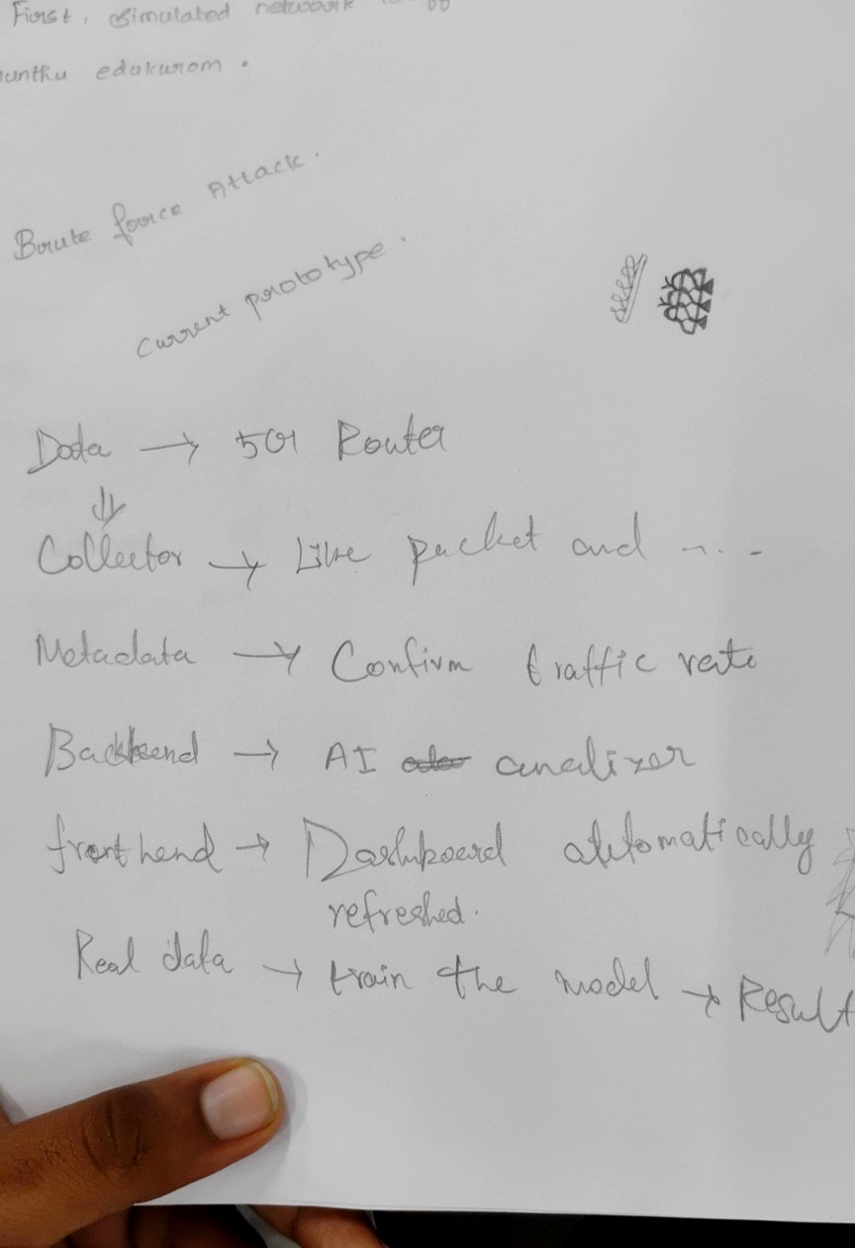
IMPLEMENTATION FLOW & PROTOTYPE NOTES

