Slide 1
Efficient Deployment of Police Forces in Vancouver Neighborhoods

Slide 2
Importance of optimum Police allocation
Helps in faster response
Improves evidence collection and investigation
Helps optimize public costs
Makes neighborhoods safe and secure.

Slide 3
Data Management and Filtering
Data from Kaggle containing crime records from 2003-2019 used for the analsysis. A dataset containing the crime statistics of each neighborhood in Vancouver along with type of crime.
Creating a new consolidated dataset of the Neighborhoods for the year 2019 crime records
Neighborhood coordinates are fetched using OpenCage Geocoder.
To explore the neighborhood crimes and applying Machine Learning algorithms to cluster the neighborhoods and portray the findings on Map using Folium.

Slide 4
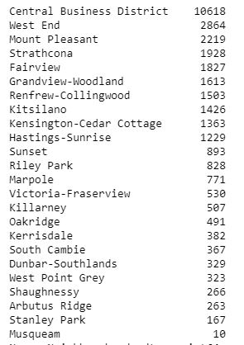
Total Crime Count

Slide 5
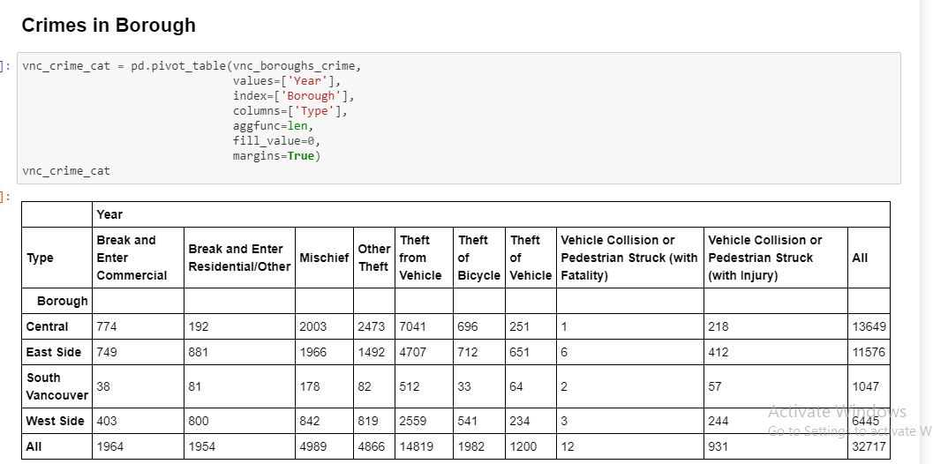
Crimes in Boroughs

Slide 6
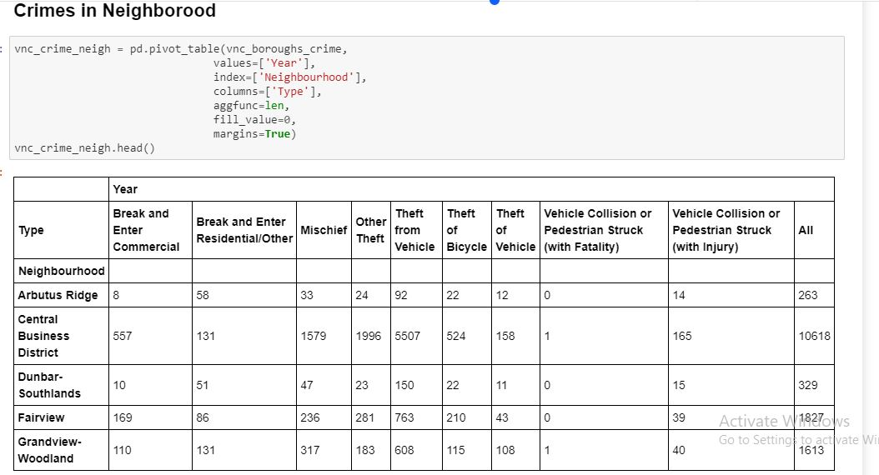
Crimes in Neighborhood

Slide 7
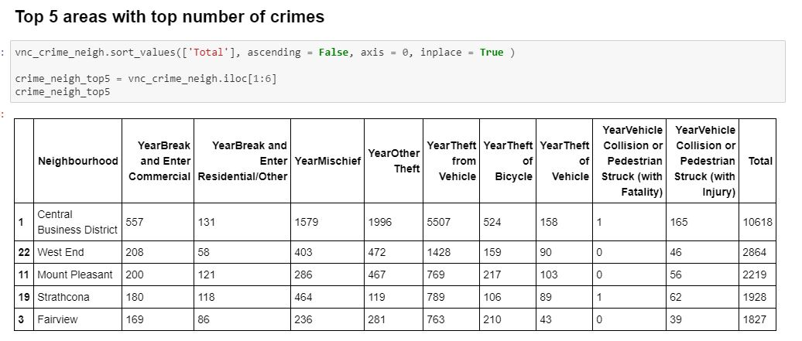
Crime prone Neighborhoods

Slide 8
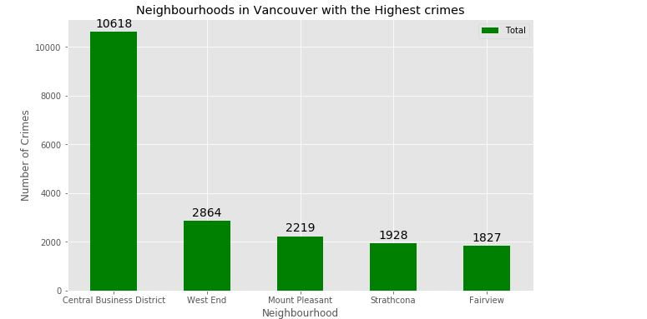
Crime prone Neighborhoods- Graph

Slide 9
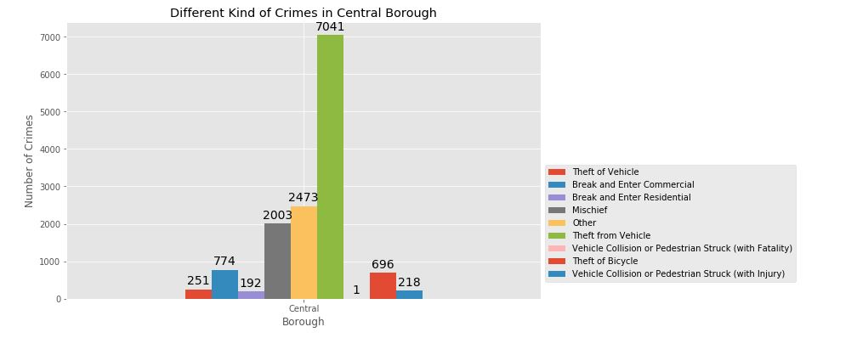
Eg. of crime in a particular Borough

Slide 10
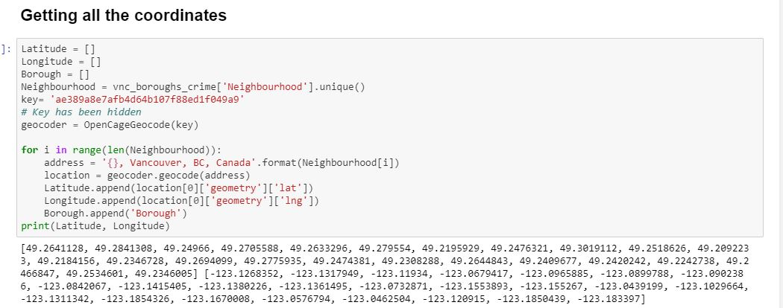
Coordinates using OpenGeoCoder

Slide 11
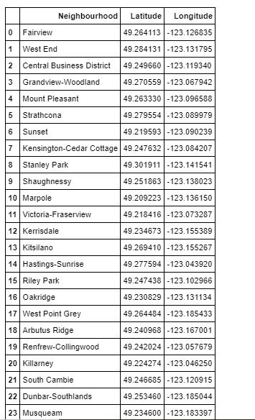
Coordinates attached to all the areas

Slide 12
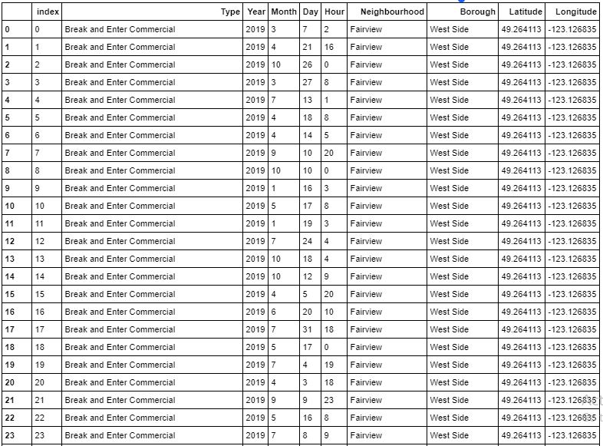
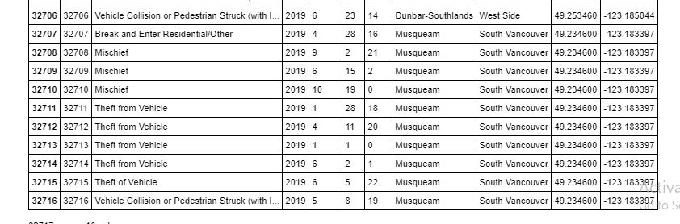
Main Table

Slide 13
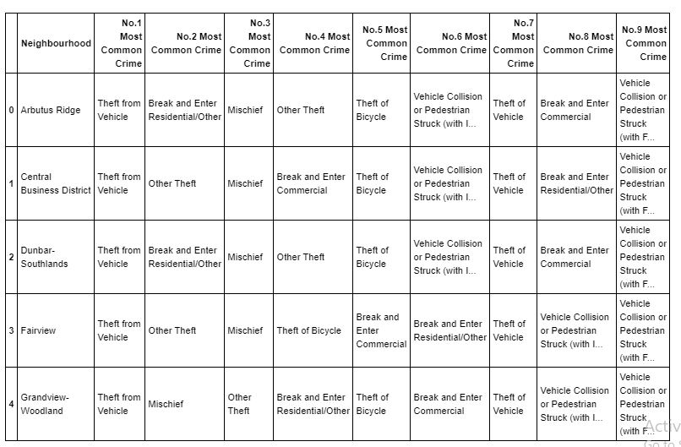
Most Committed Crimes

Slide 14
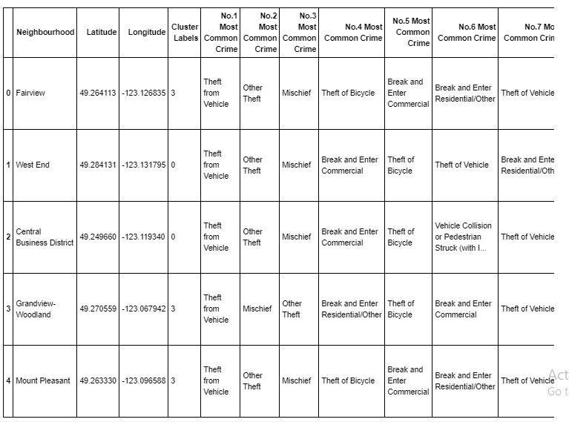
Cluster formation

Slide 15
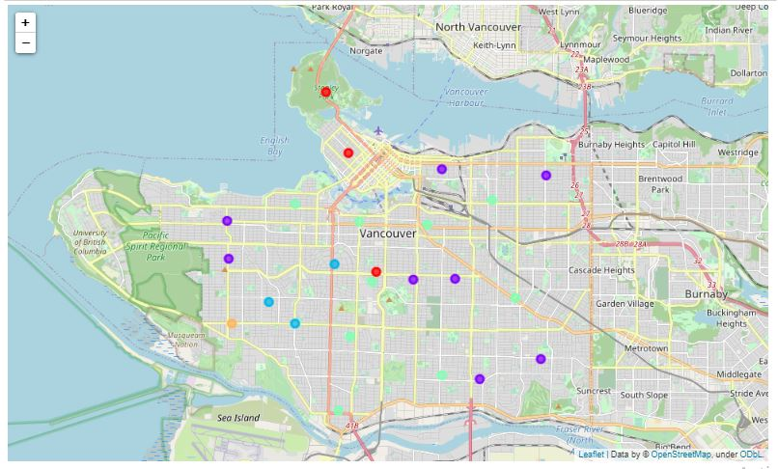
Cluster Depiction

Slide 16
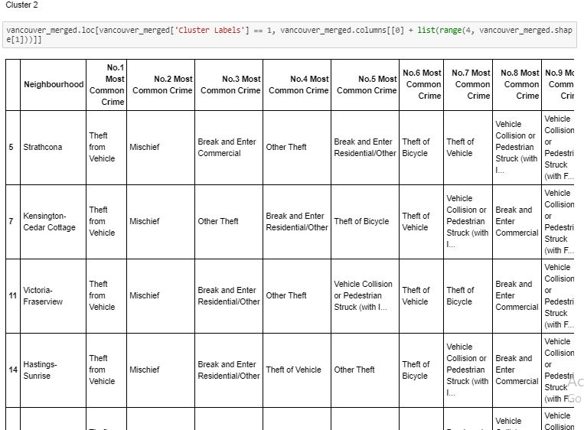
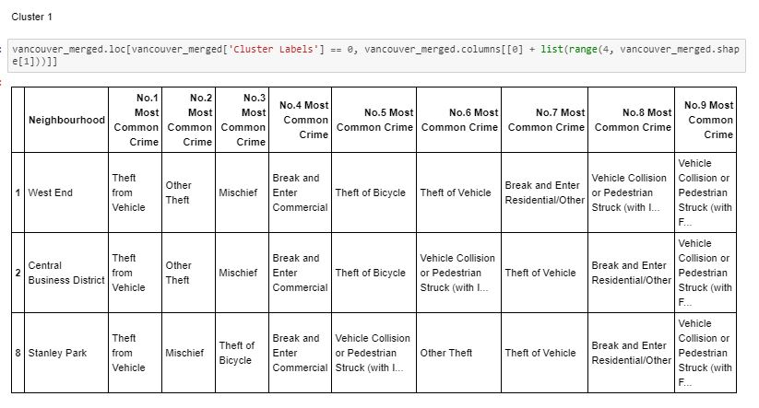
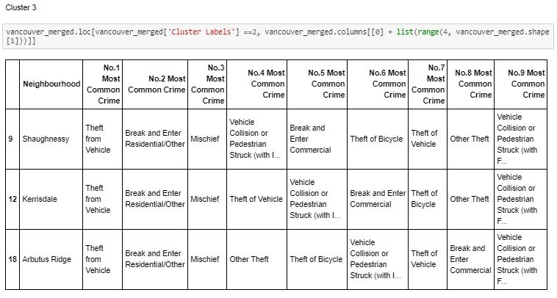
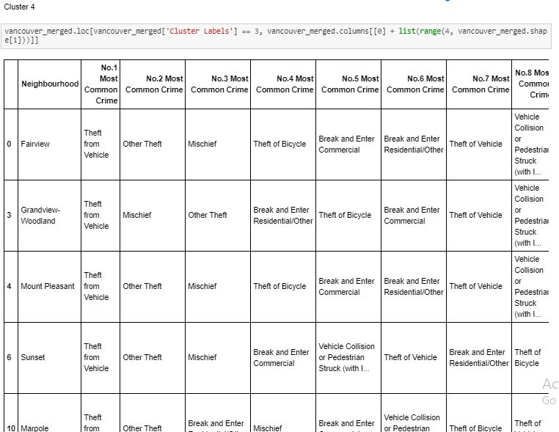
Analysis of different Clusters

Slide 17
Modeling
To choose the right areas/neighborhoods, clustering is required which is done using K- means clustering. It is form of unsupervised machine learning algorithm that clusters predefined data.
This method will be used to address the problem of finding the areas with most frequent crimes as per 2019 data.
Defining a function to fetch top crimes in the area
Clustering neighborhoods
Crime count per neighborhood
Probability of the same crimes happening again
Top 5 most frequent crimes

Slide 18
Results
Cluster 1 with West End , Central Business District And Stanlrey Park faces the problem of Theft from Vehicle , Other Theft , break and enter Residential/Other. Police deployment should be made accordingly
Cluster 2 has neighborhood such as Hastings – Sunrise, Grandview-Woodland, Strathcona, Sunset, Marpole, Kensington-Cedar Cottage, Kitsilano, Victoria-Fraserview, RileyPark , Killarney, South Cambie and these areas mostly face the problems of Theft from Vehicle, Mischief and Break and Enter Residential/Other . Police should work accordingly in this cluster.

Slide 19
Results
Cluster 3 comprises of Shaughnessy ,Kerrisdale, Arbutus Ridge and faces the crimes of Vehicle and Bicycle theft and also Break and enter.
Cluster 4 comprises Sunset, Marpole , South Cambie, Mount Pleasant,, Fairview , Renview- Collingwood. Theft from Vehicle , Mischiefs are common issues here. This area requires continuous patrolling.

Slide 20
Conclusion
We have discussed all the major areas with their crime record. We have distributed the areas as clusters for the ease of mobilizing and arranging personnel in these areas as required depending upon the frequency of crimes in that particular cluster

