Slide 1


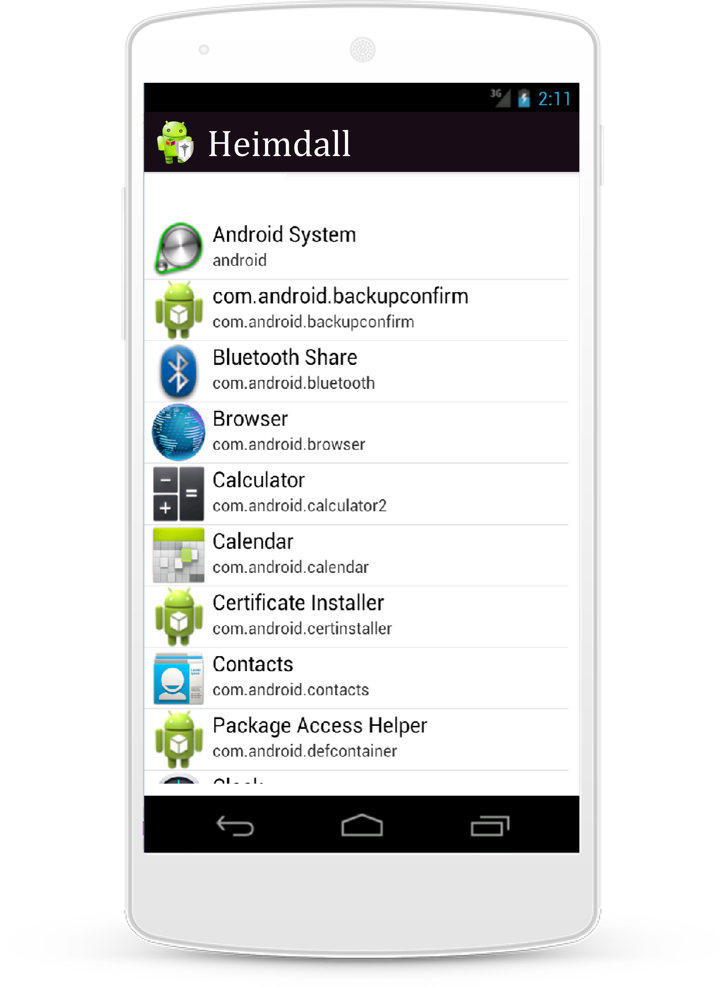
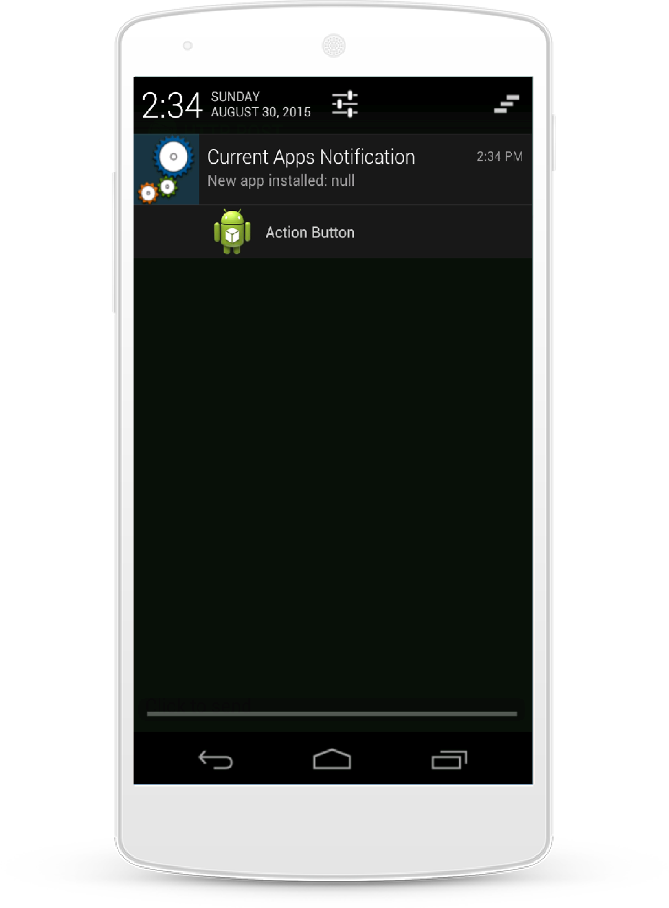
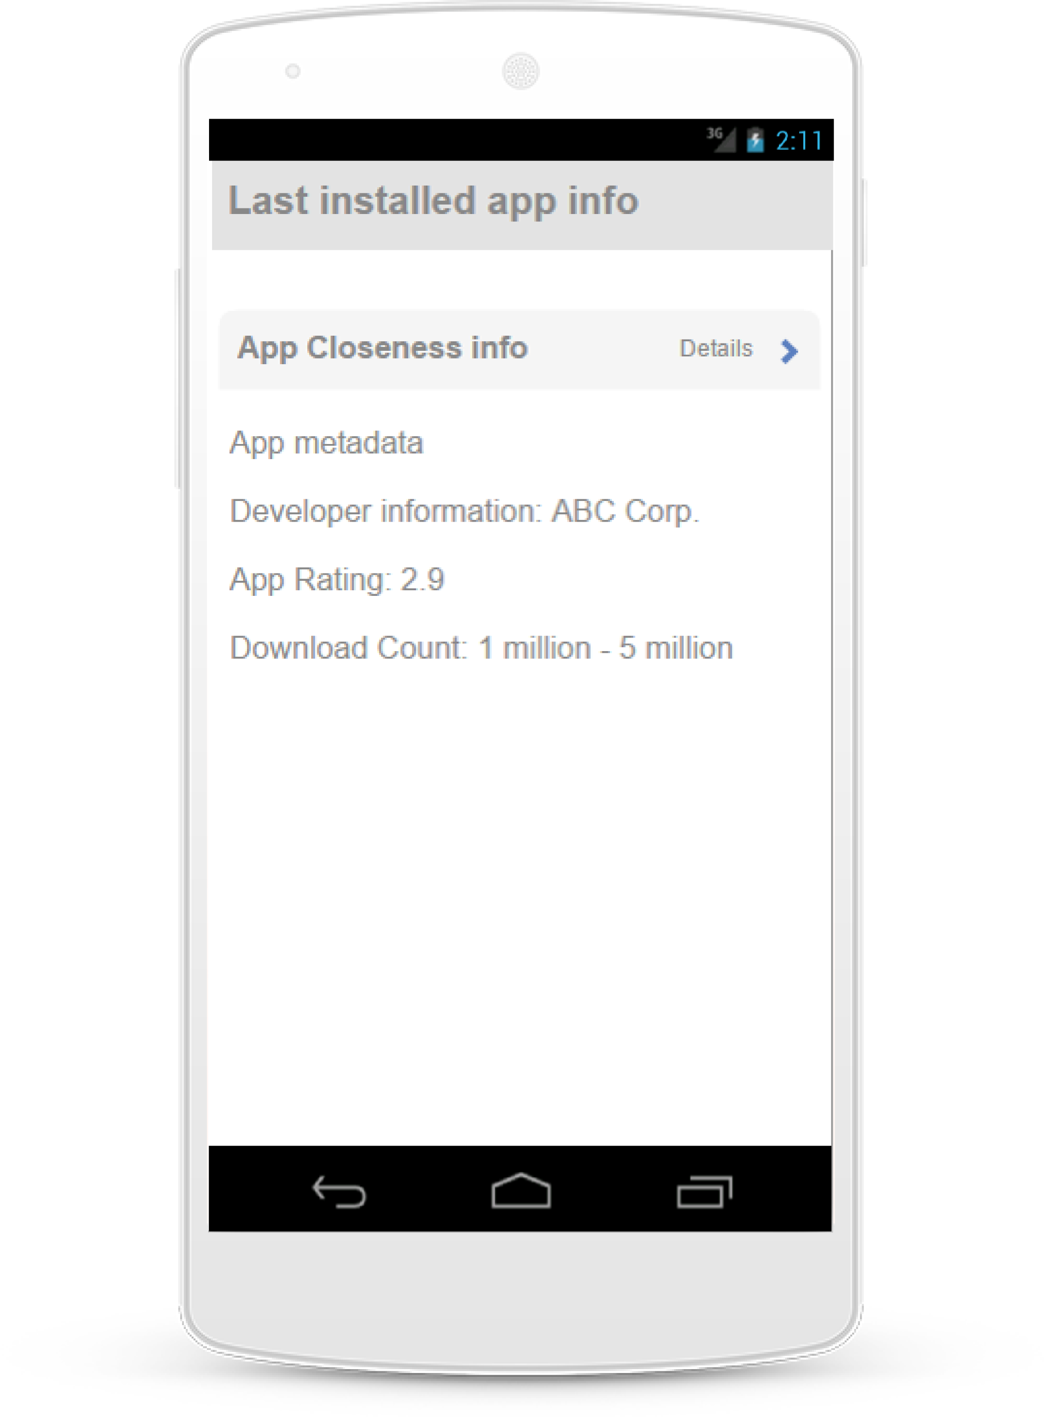
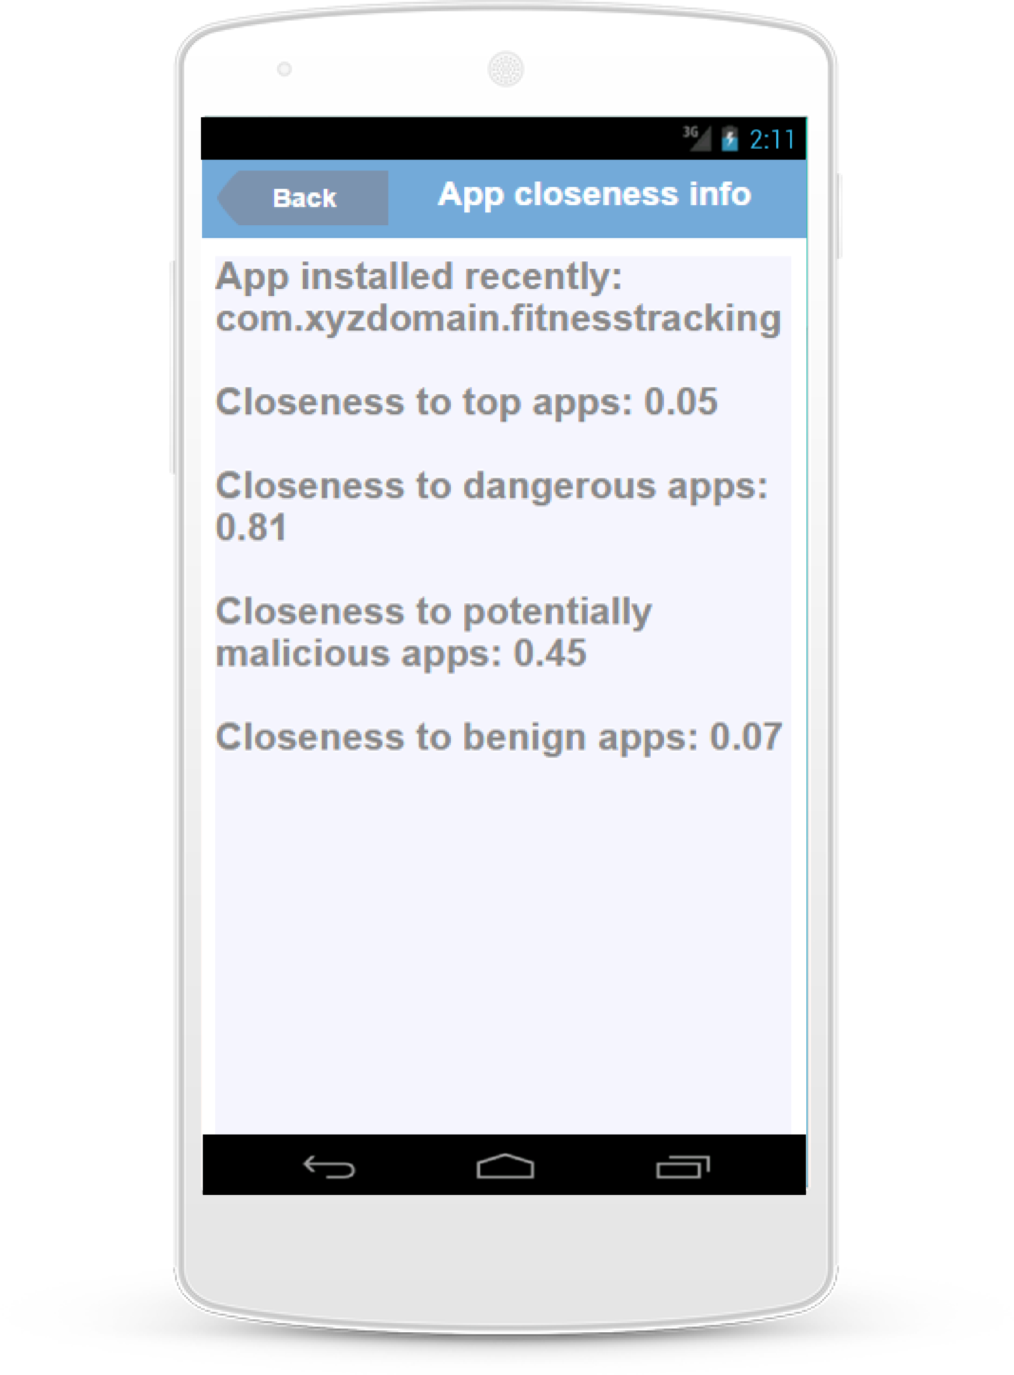
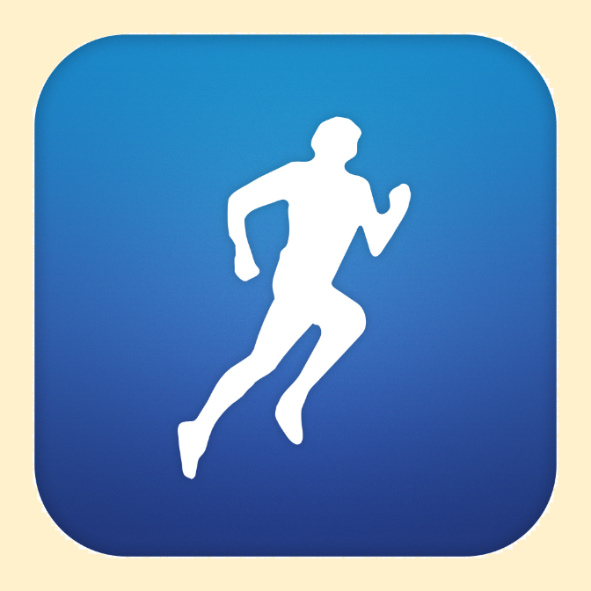
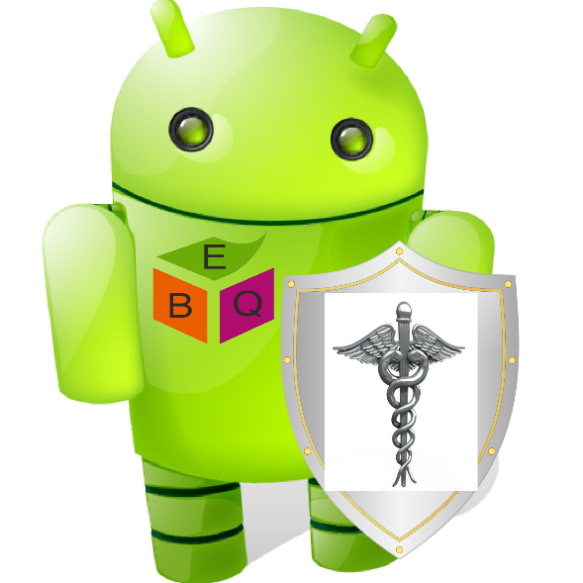

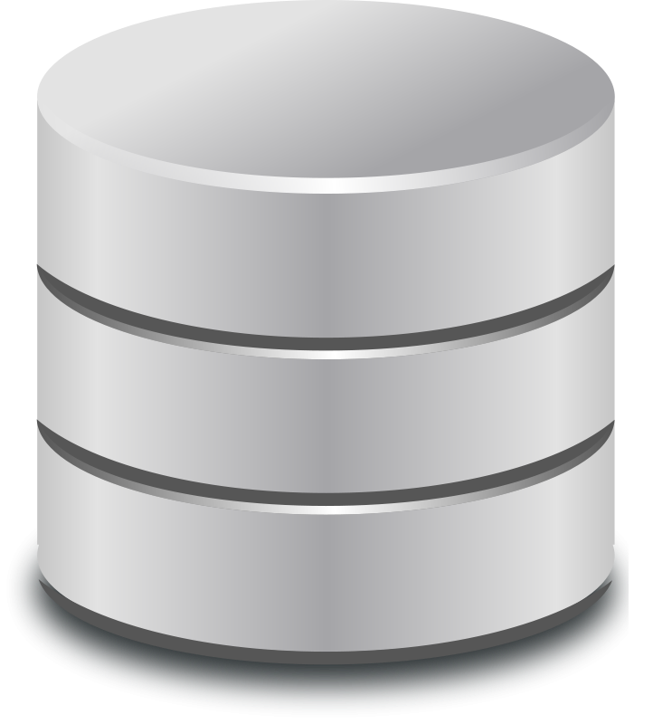
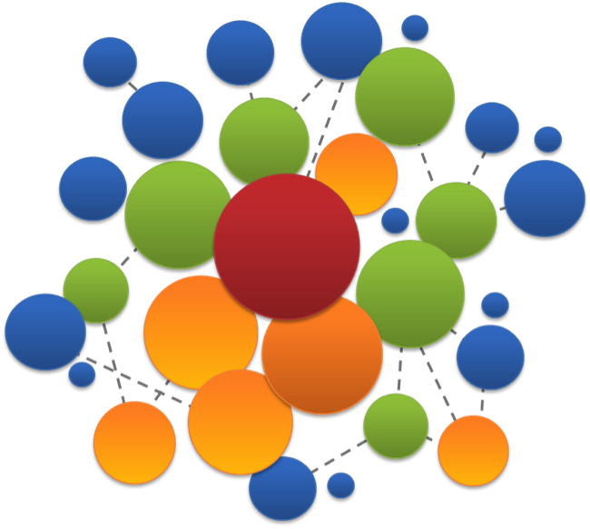

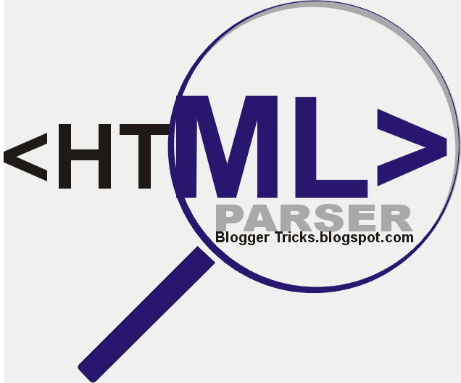
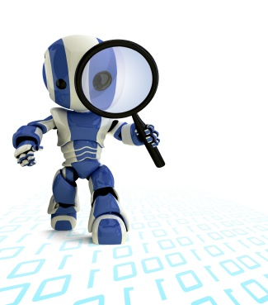
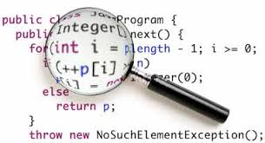

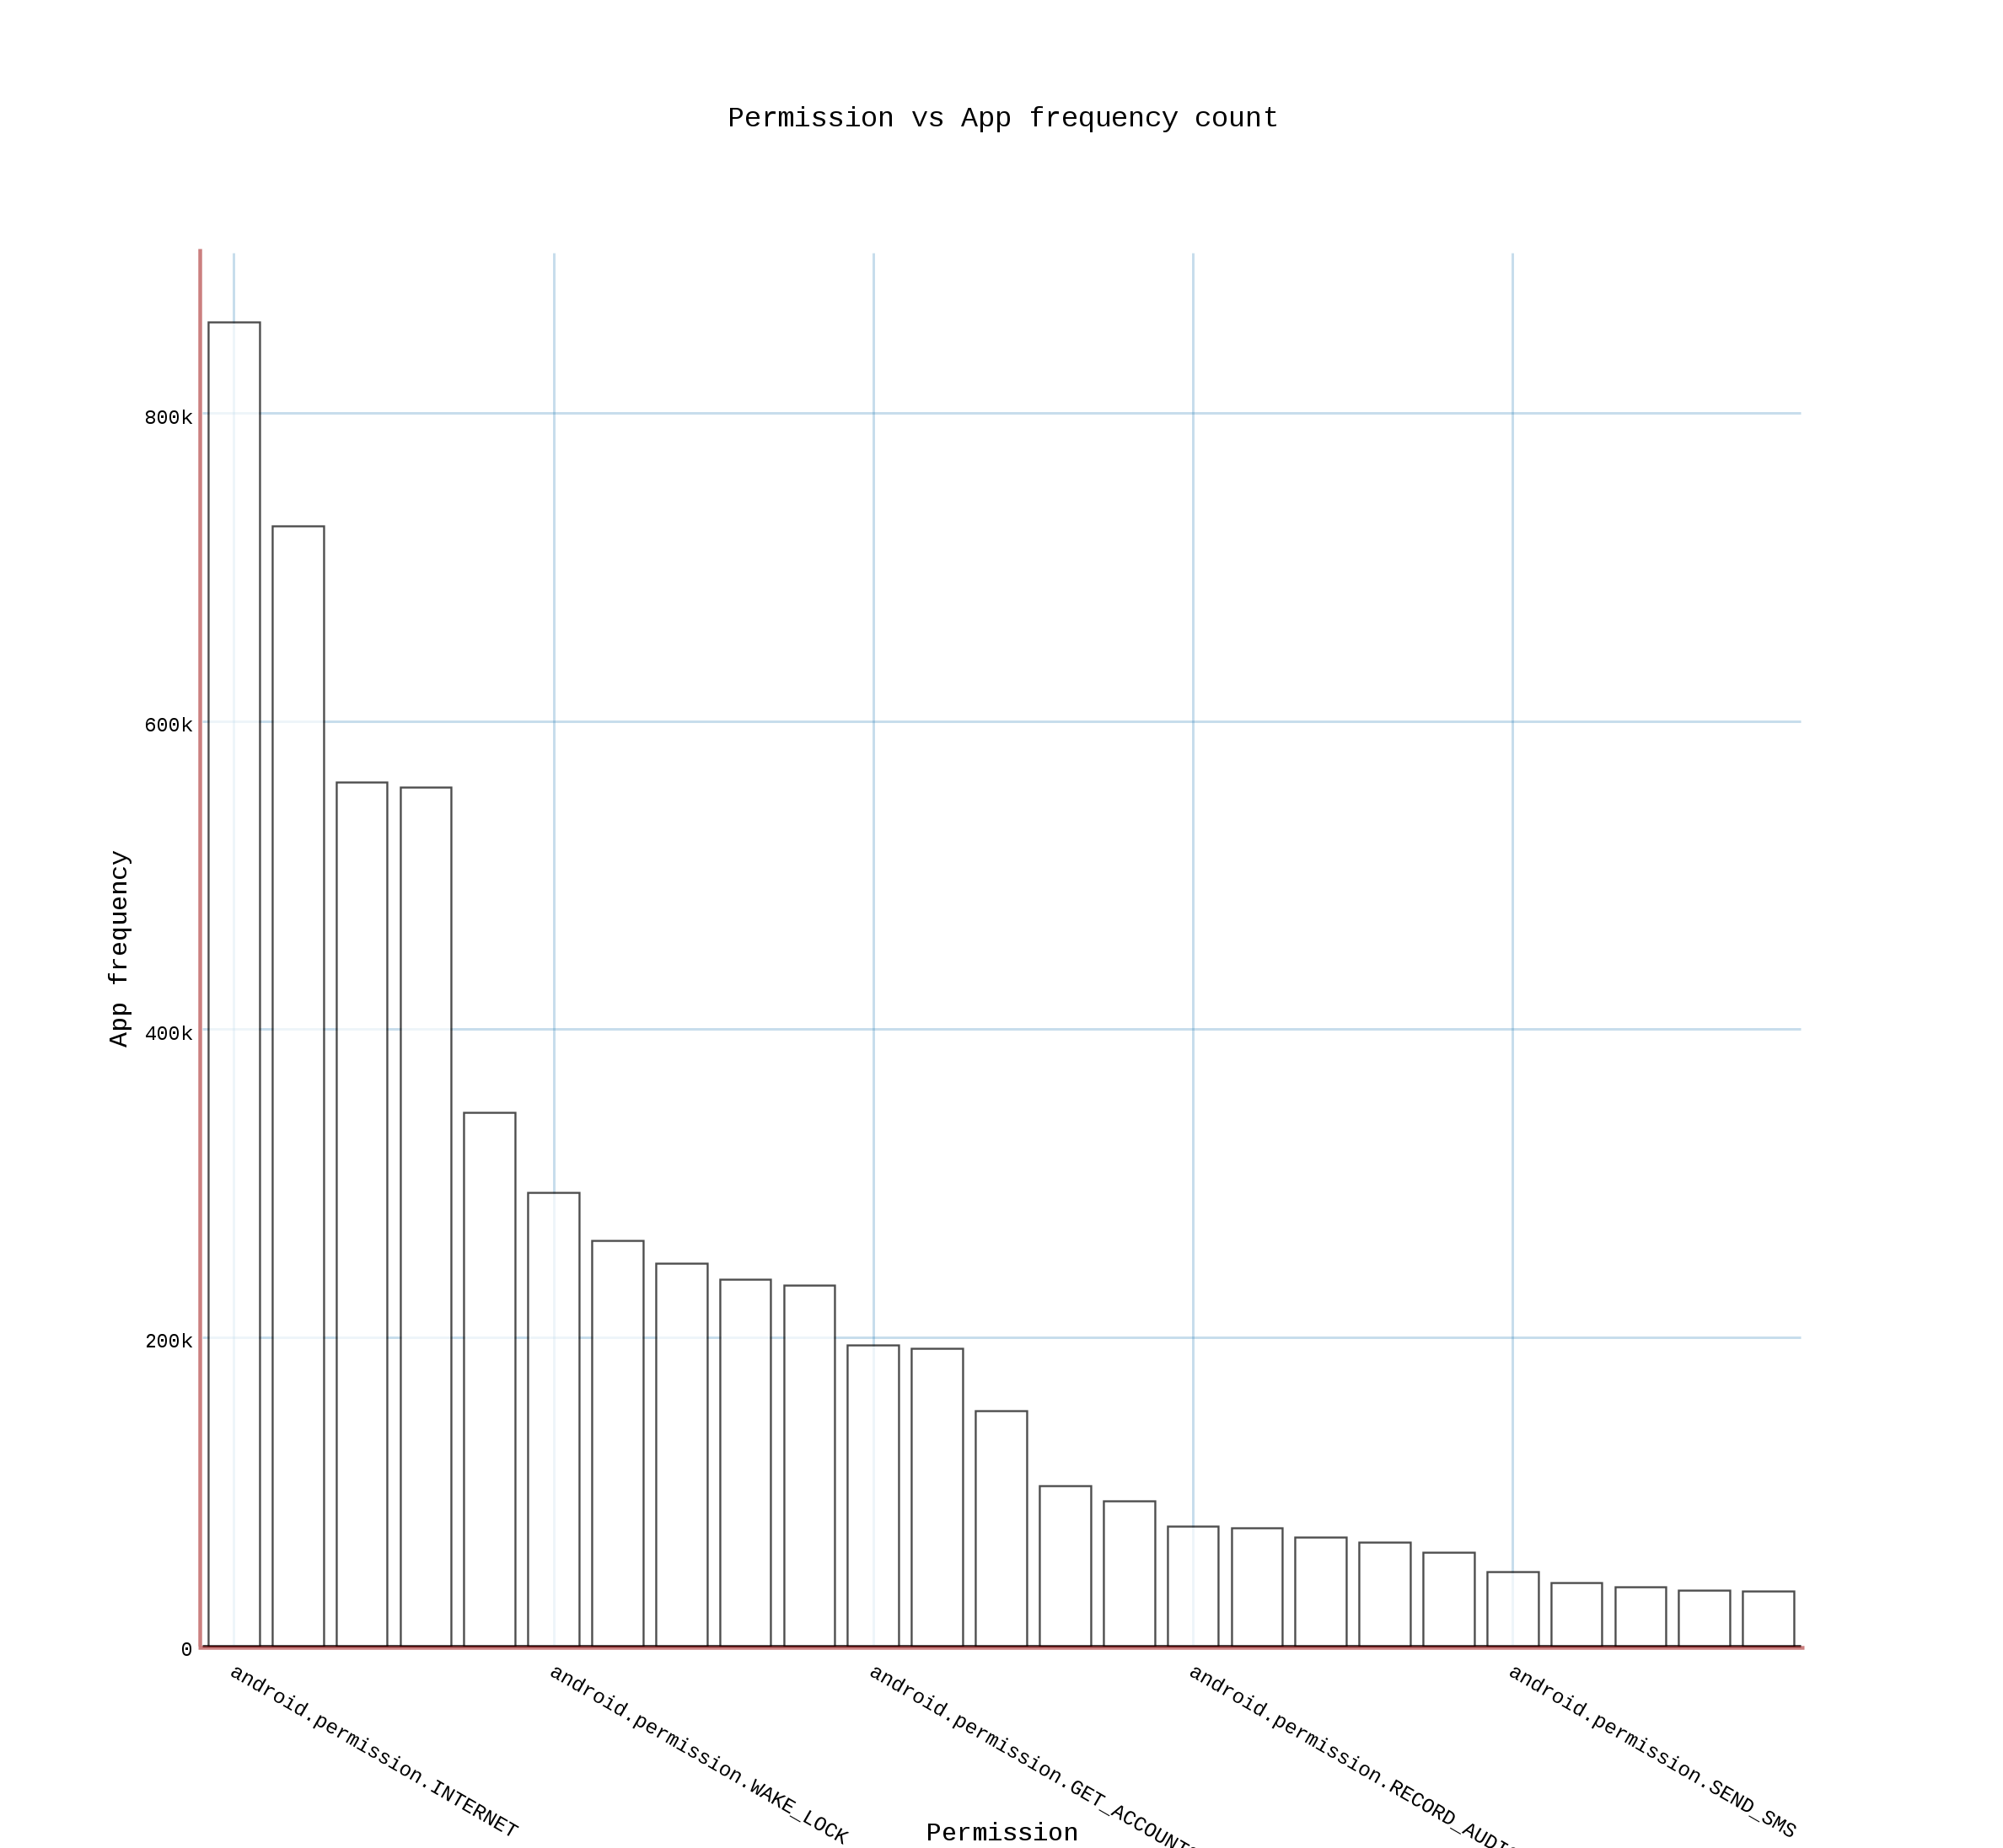
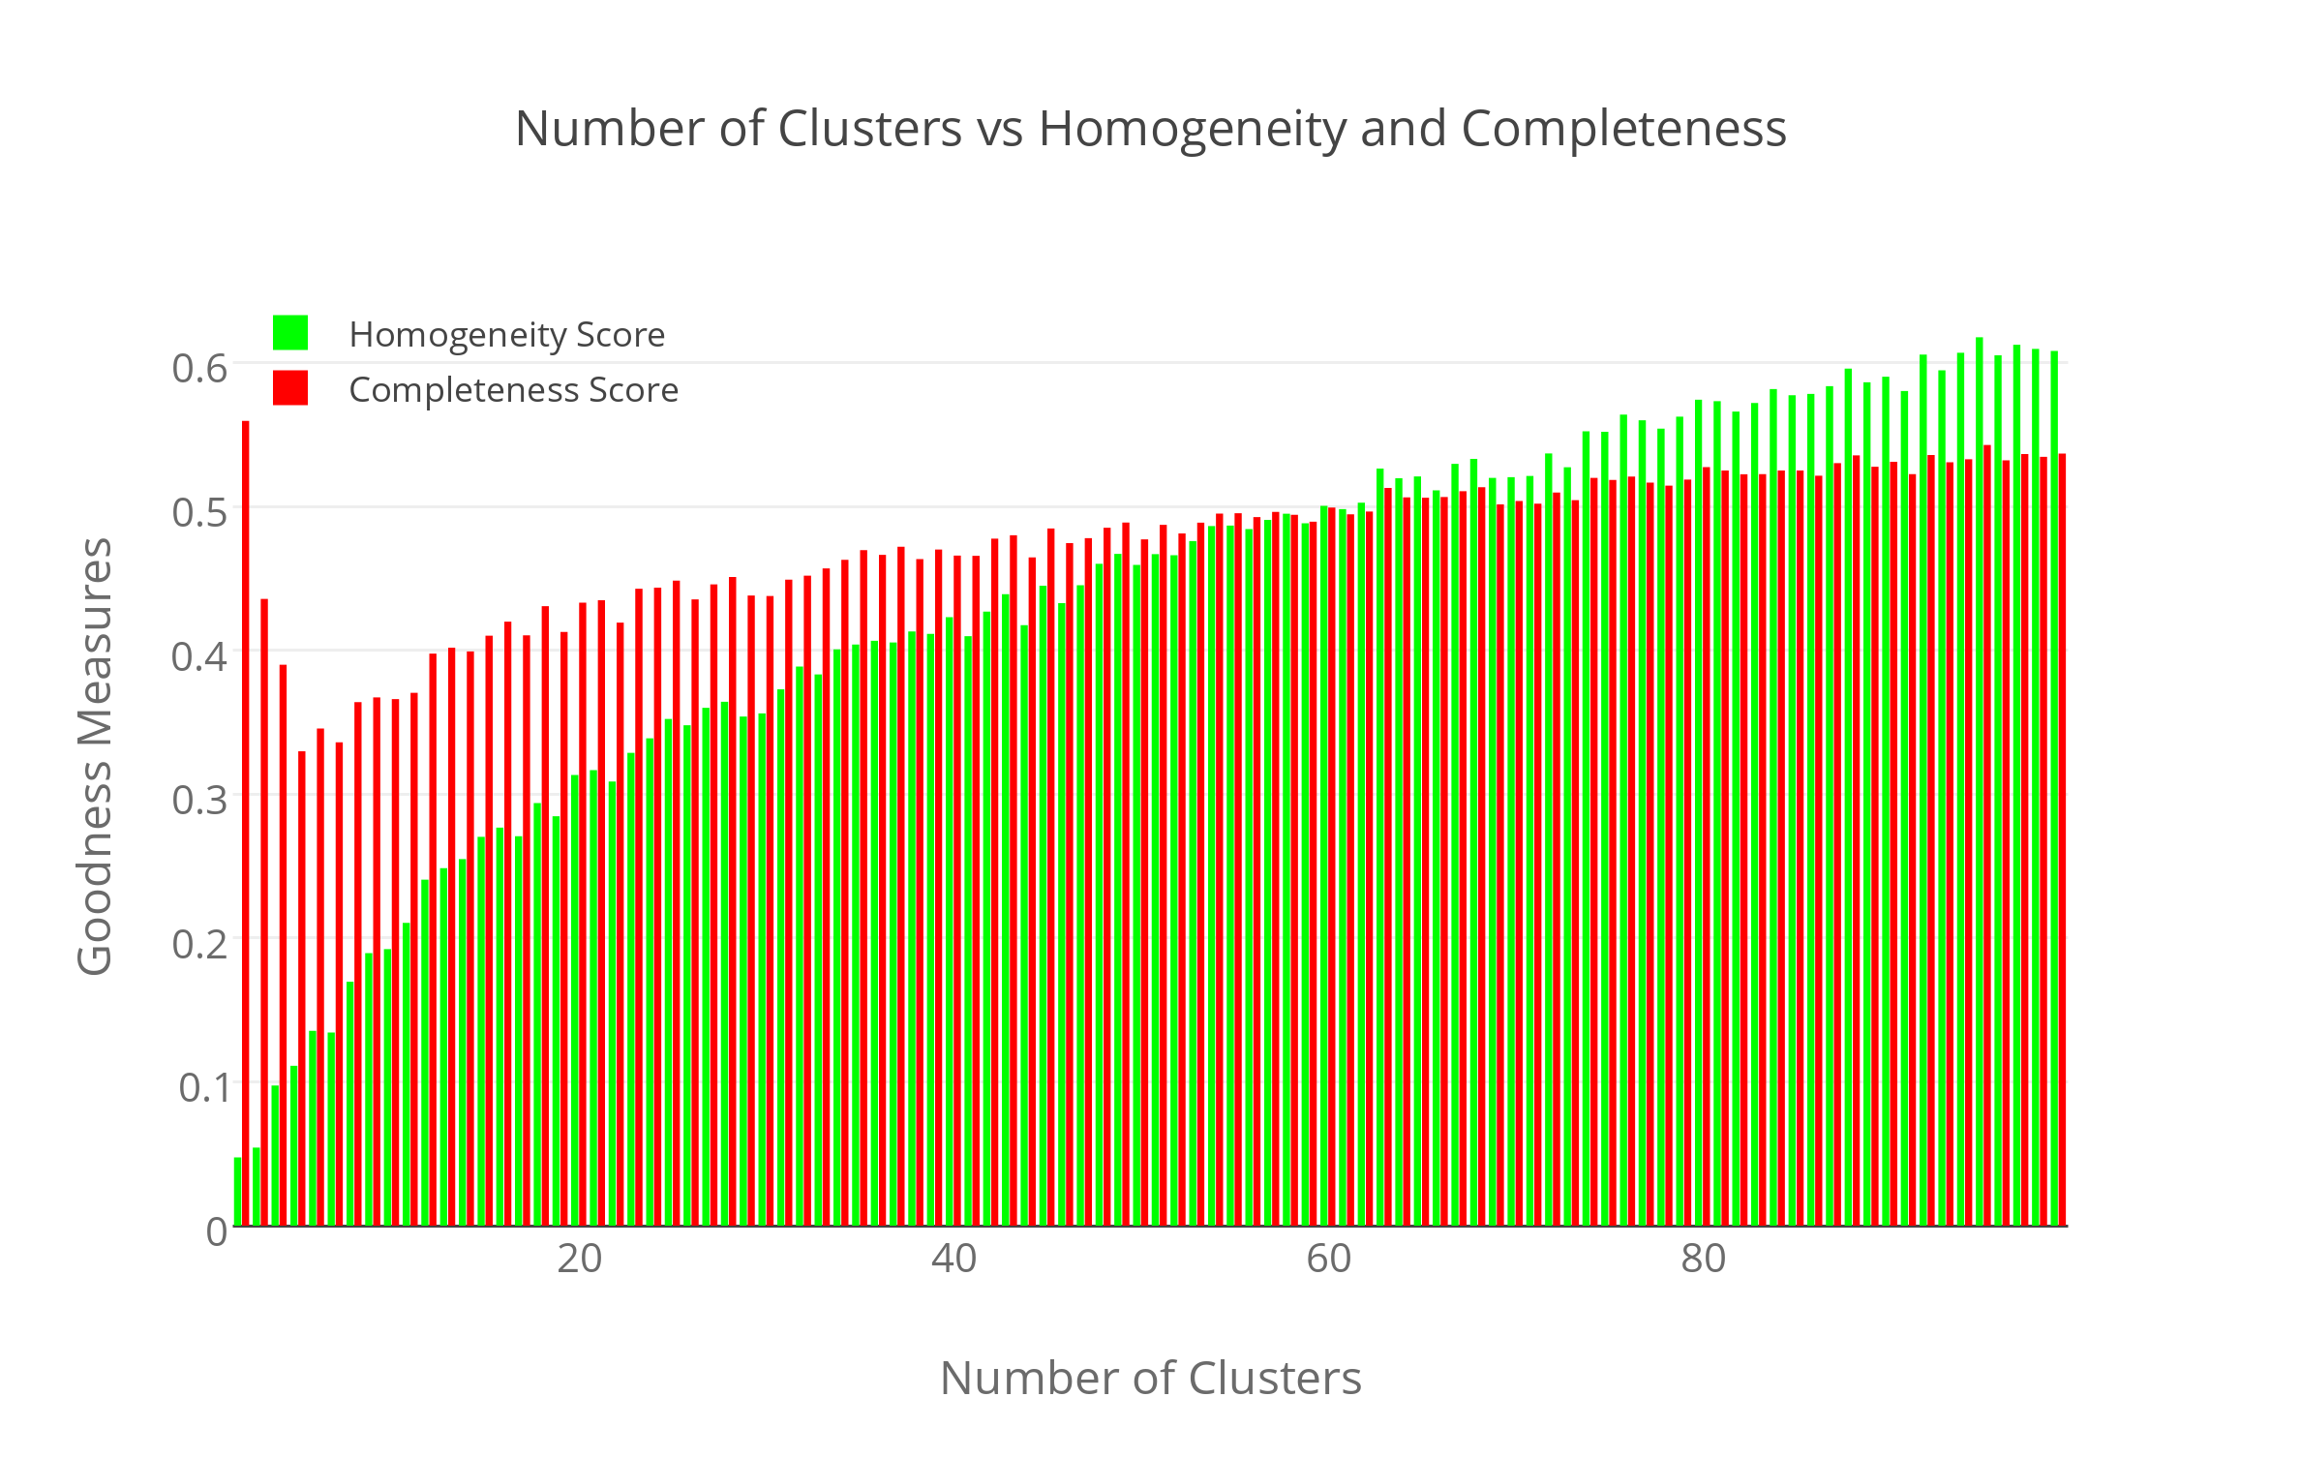
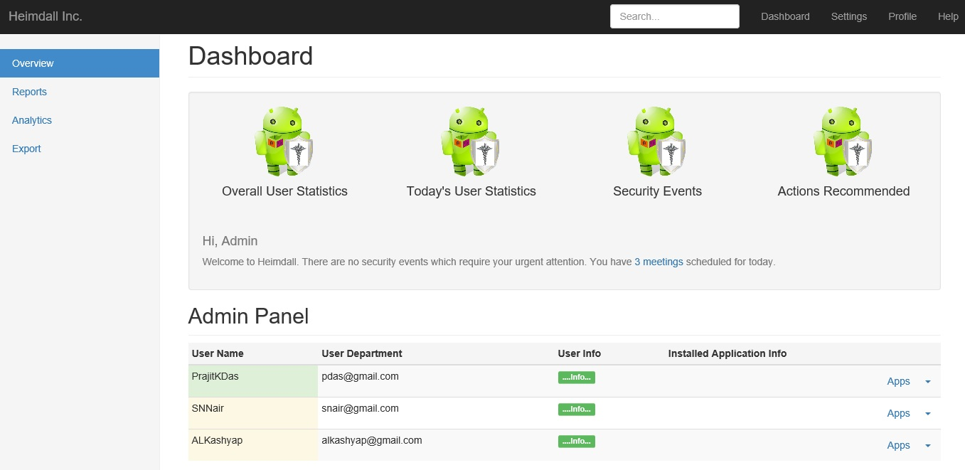
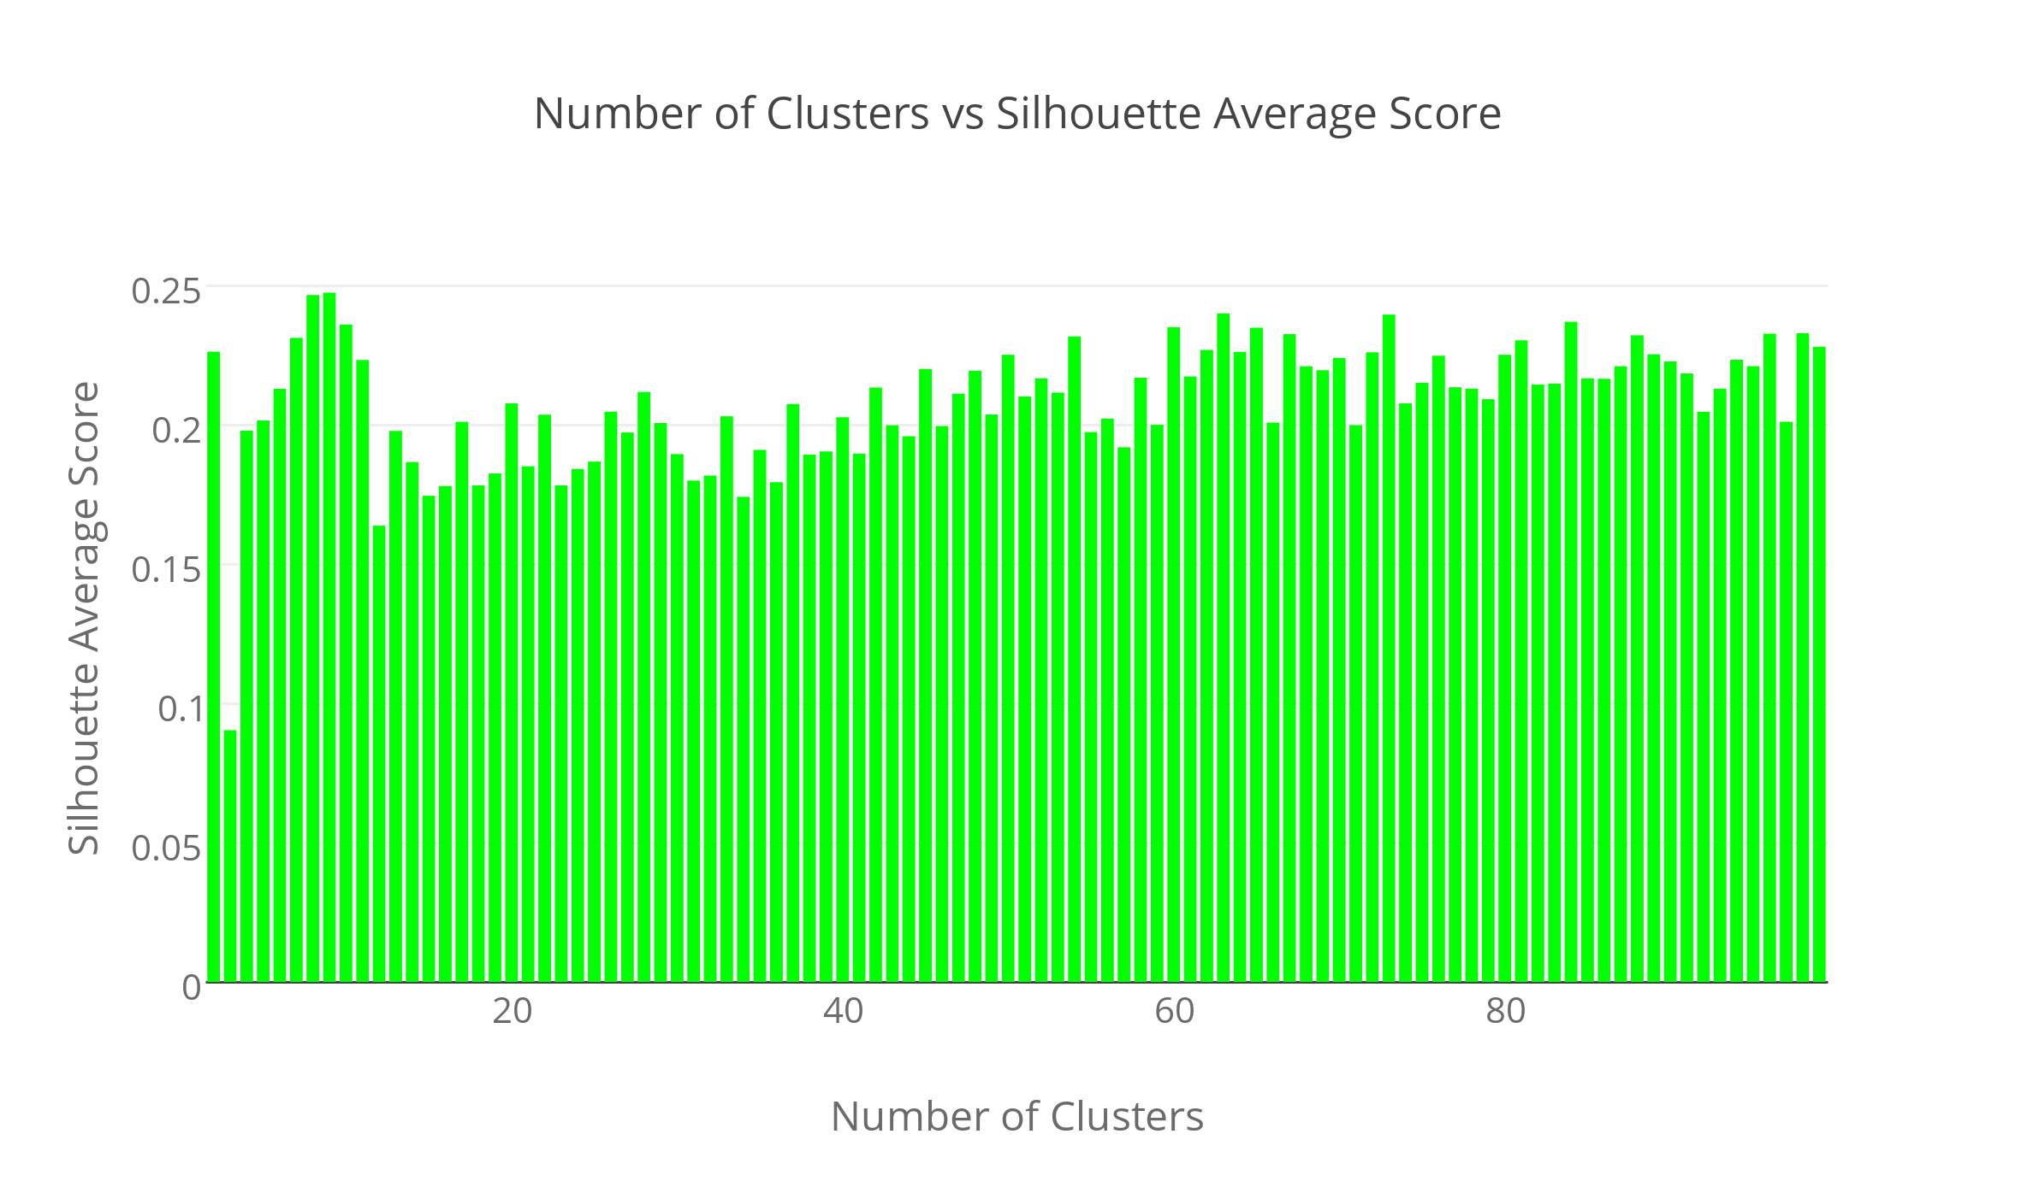

Heimdall: Protecting Users’ Health and Medical Data on Android
P. K. Das, S. Narayanan, A. Kashyap, S. Bobovych, N. Banerjee, A. Joshi, R. Robucci, T. Zhu, T. Finin
Heimdall informs mobile users and sysadmins on potentially dangerous apps
Hi! I am Heimdall!
I am here to protect you!
Stage 1: Data Collection
Stage 2: Unsupervised Learning
Stage 3: Code Analytics and Prediction
List of installed apps
New app installed notification
New app installed details
New app installed privacy and security details
System Architecture
Mobile App Visualizations
External and Internal cluster evaluation metrics used
Silhouette Score = (b - a) / max(a, b)
a: Mean intra-cluster distance
b: mean nearest-cluster distance between sample and nearest cluster that smple
Certain permissions are requested by a lot of apps
A lot of permissions = Feature vectors are there (with not equal amounts of information)
Dimensionality reduction algorithms like SVD have been used
Procedural Details
Admin Dashboard Visualization
Supported by MITRE and NSF Grants #0910838 and #1228198

