Slide 1


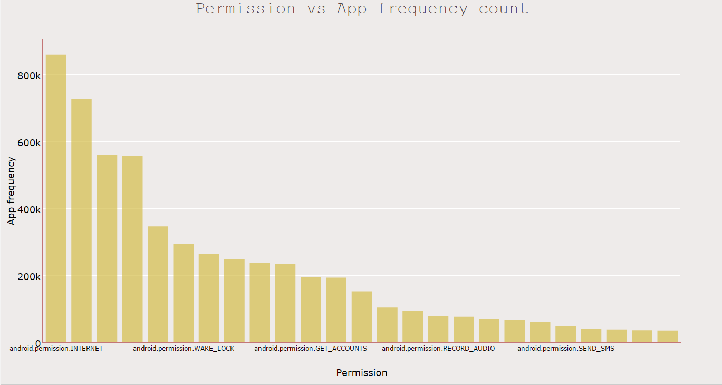
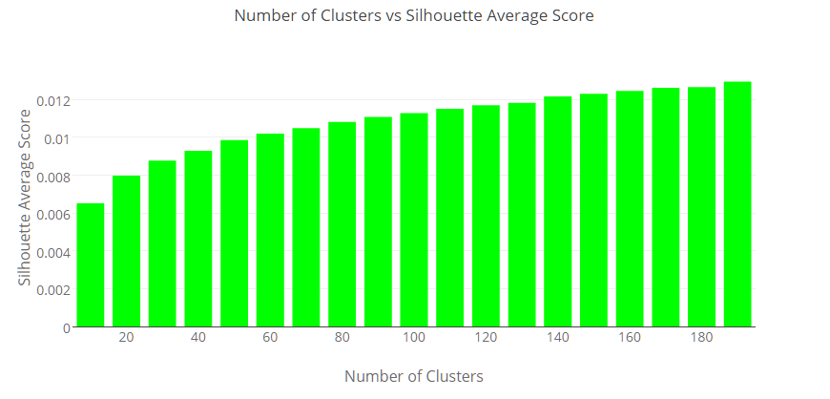
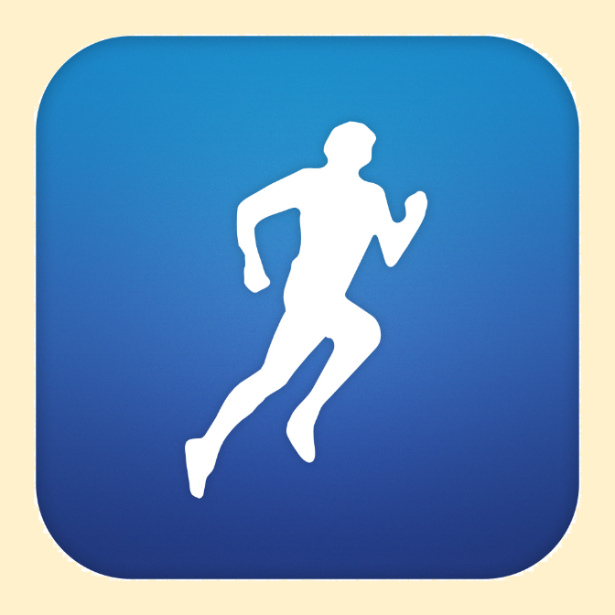

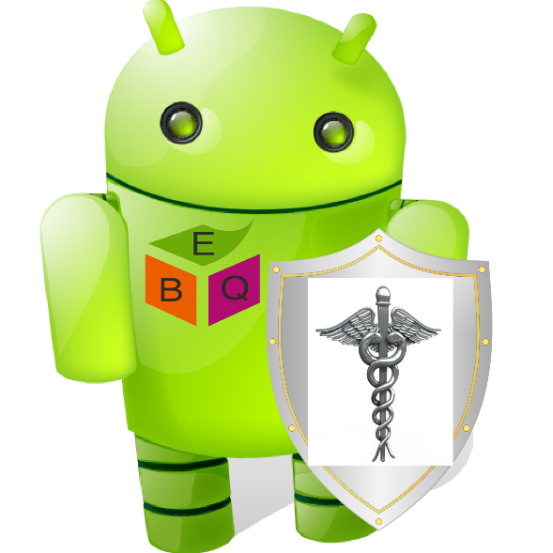
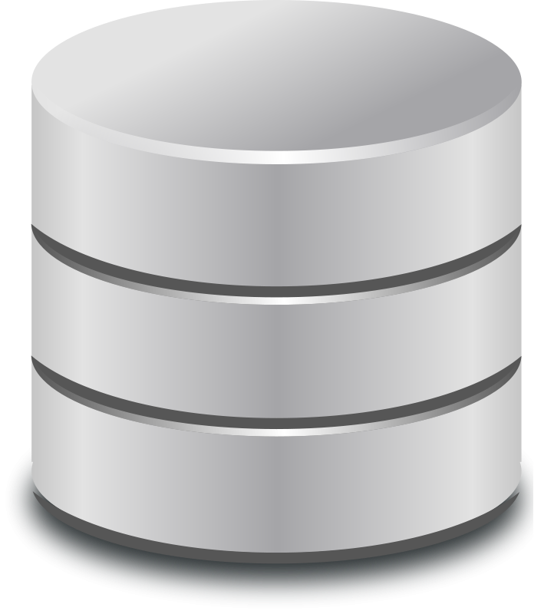
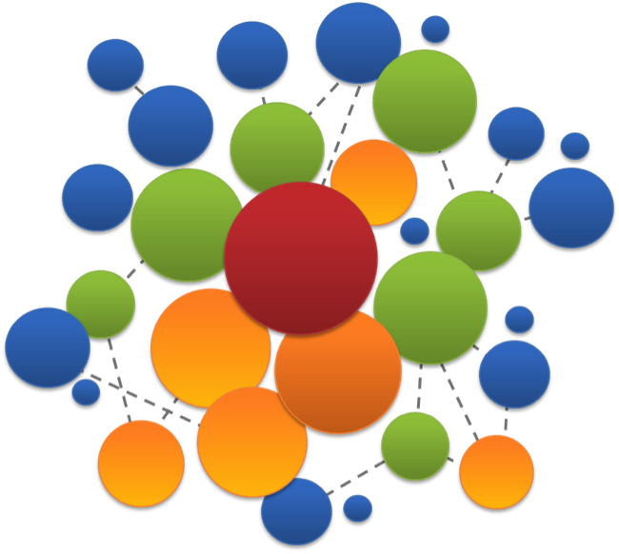

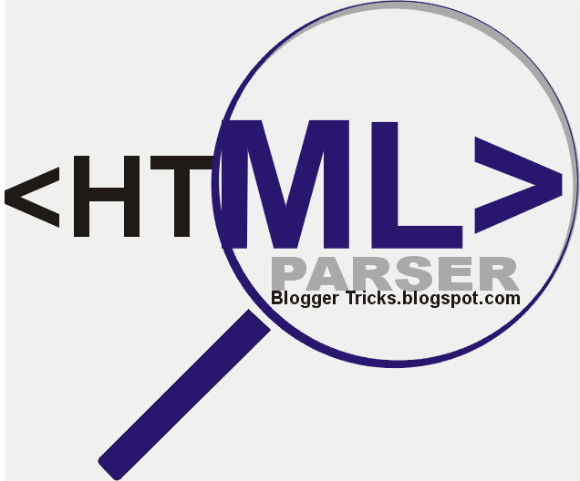
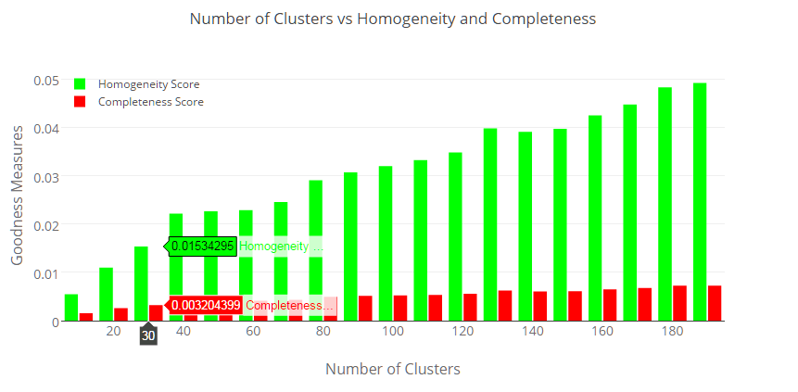
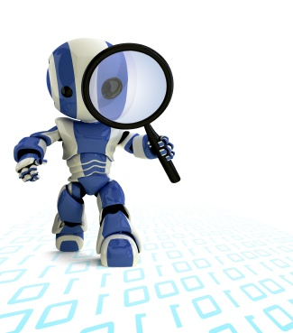
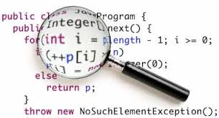

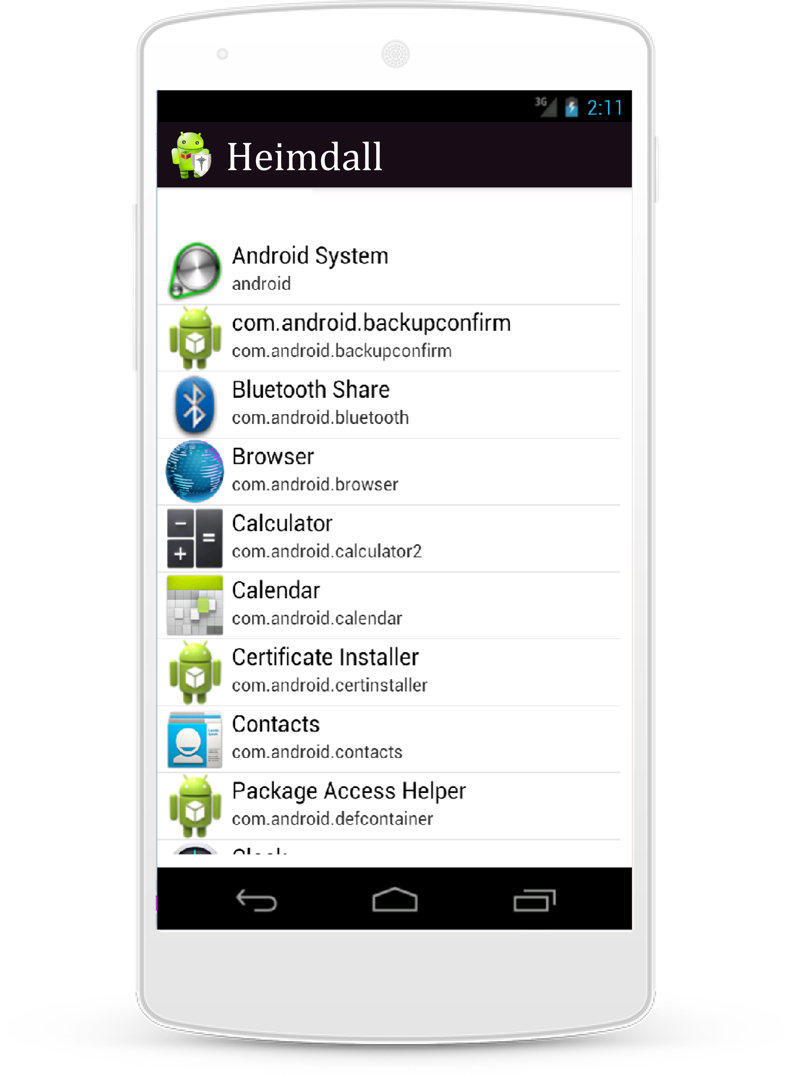
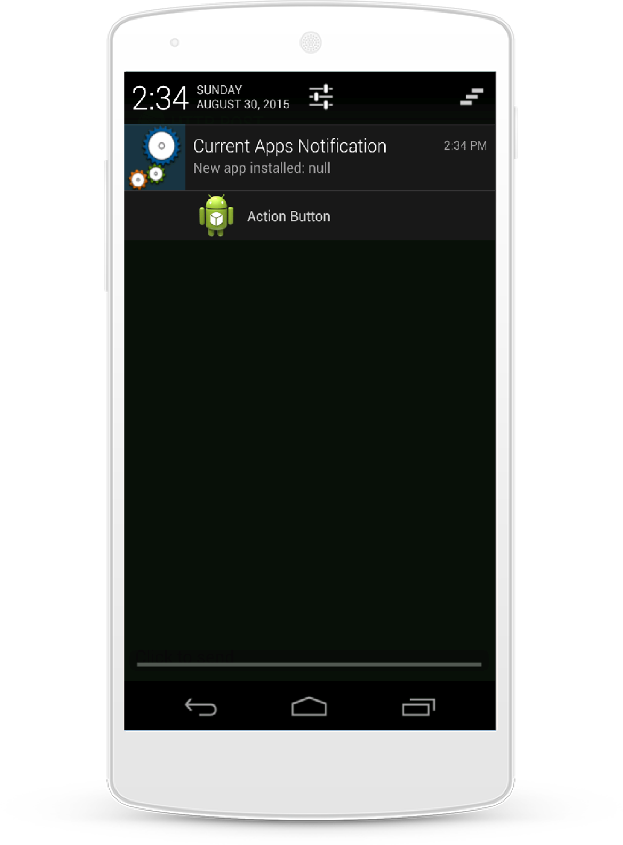
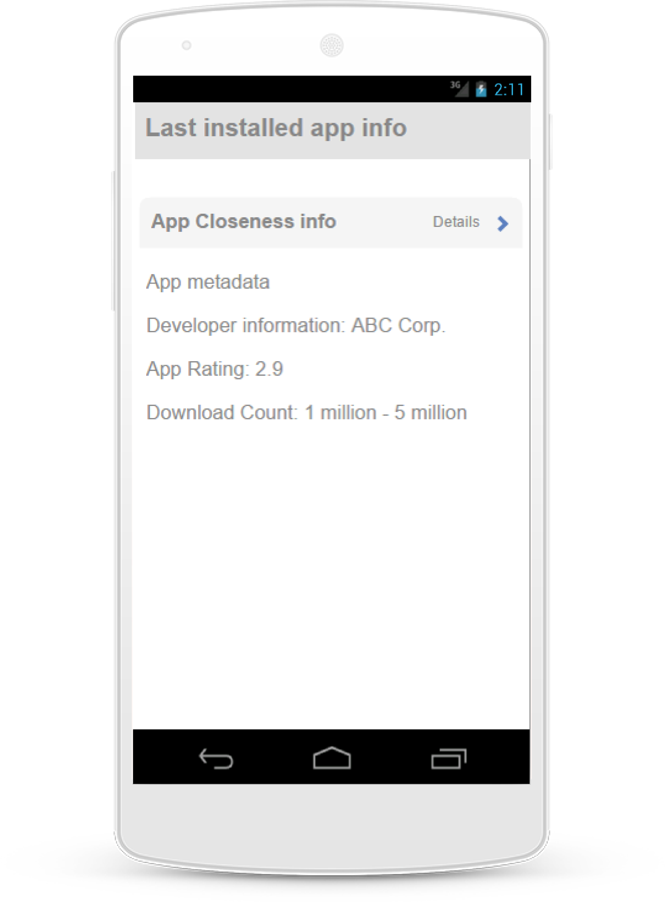
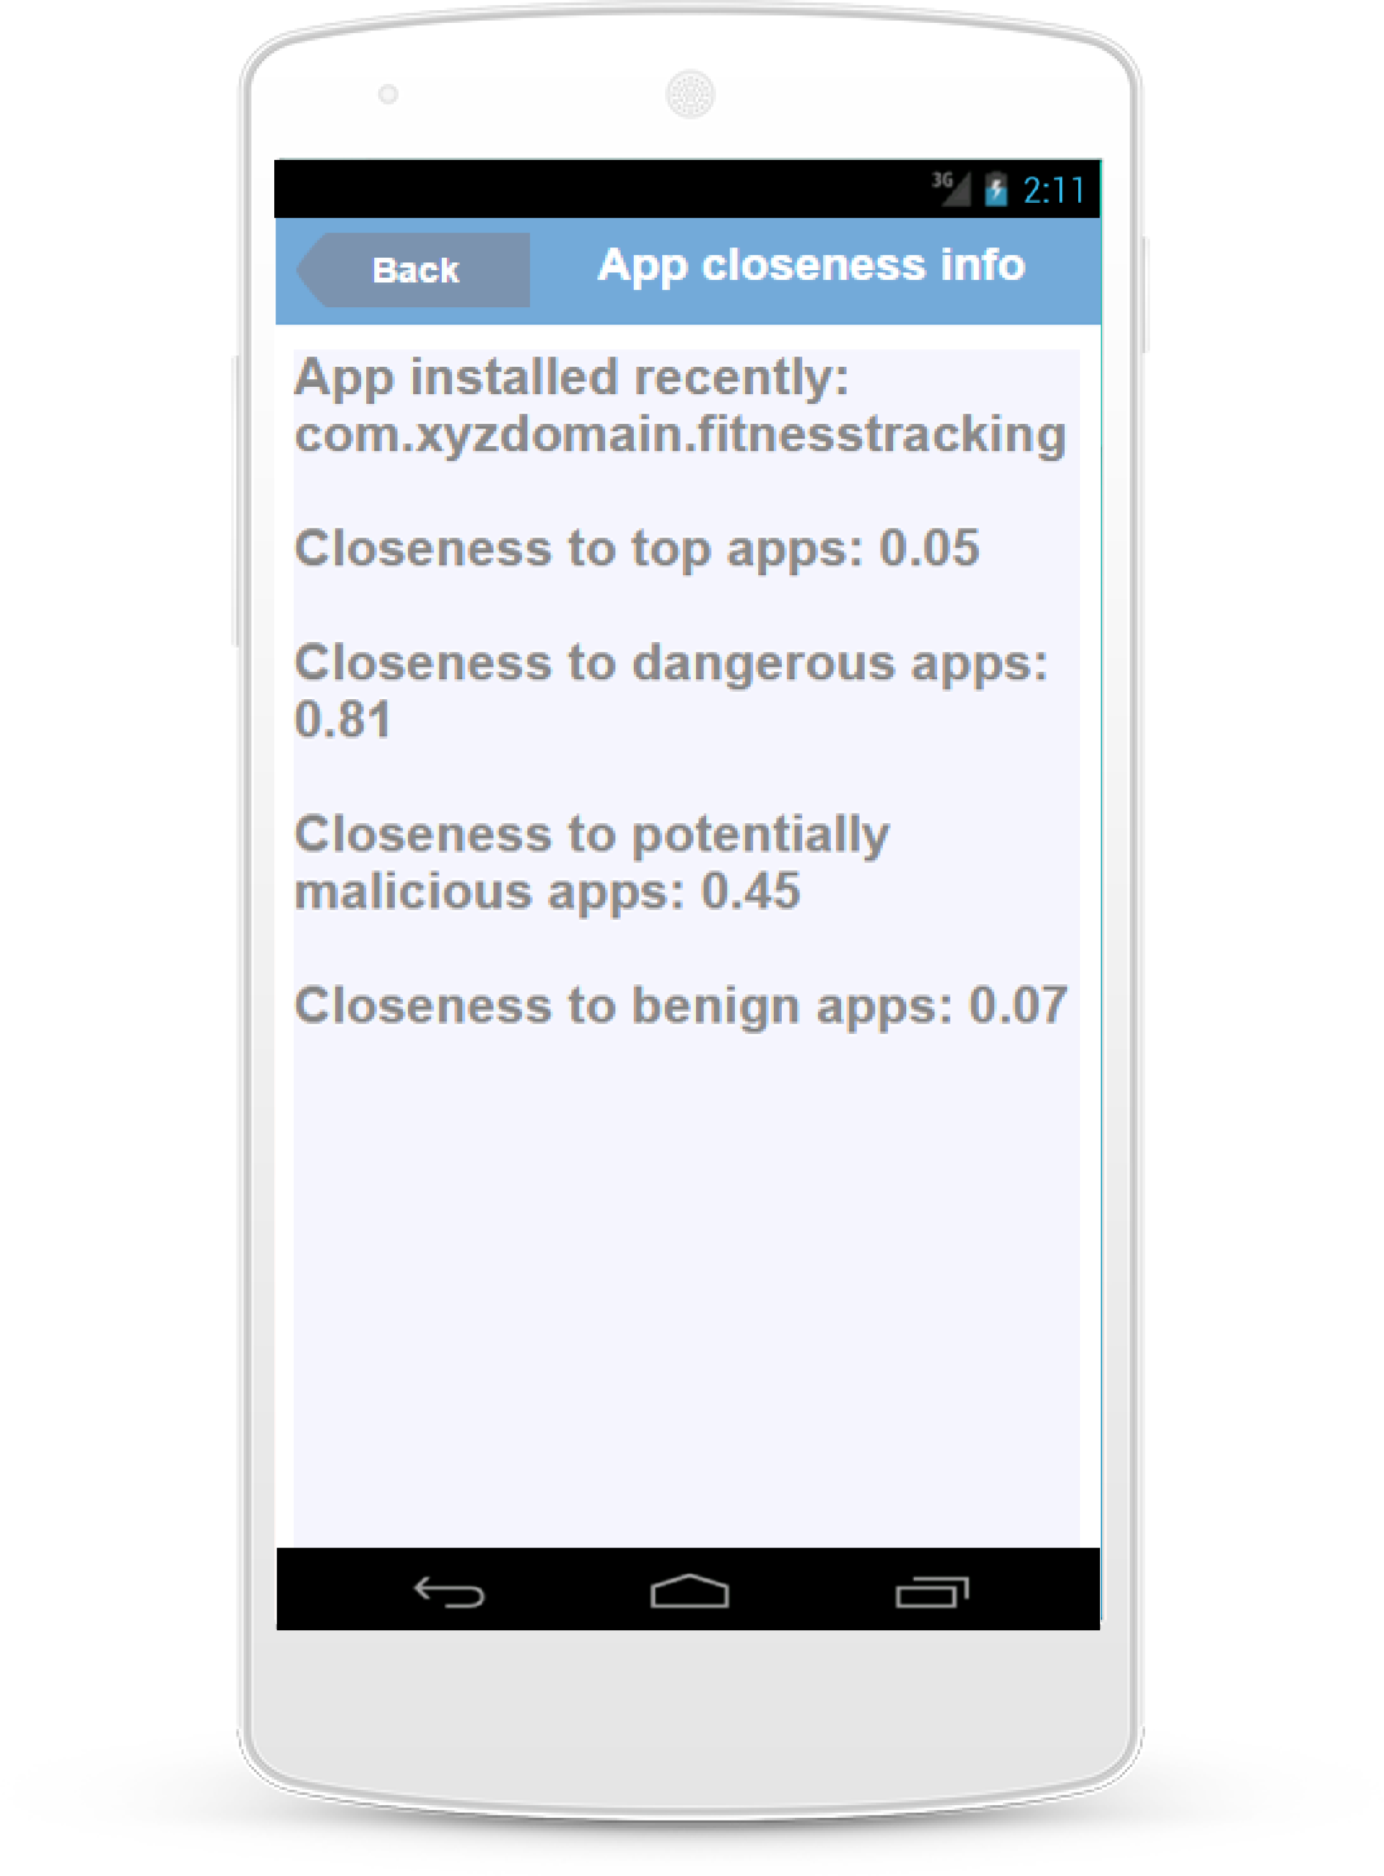
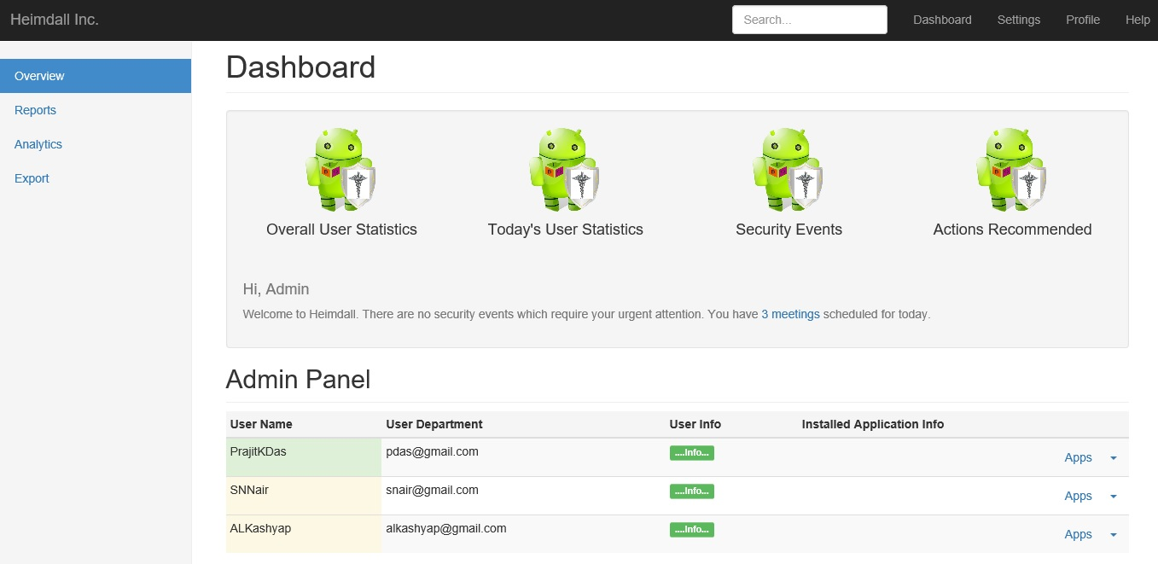

Heimdall: Protecting Users’ Health and Medical Data on Android
P. K. Das, S. Narayanan, A. Kashyap, S. Bobovych, N. Banerjee, A. Joshi, R. Robucci, T. Zhu, T. Finin
Heimdall informs mobile users and sysadmins on potentially dangerous apps
Hi! I am Heimdall!
I am here to protect you!
Stage 1: Data Collection
Stage 2: Unsupervised Learning
Stage 3: Code Analytics and Prediction
Homogeneity: clusters contain points which are members of a single class
Completeness: points of a given class are elements of the same cluster.
Few permissions requested by lot of apps
A lot of permissions = Lot of feature vectors (with not equally relevant information)
Dimensionality reduction algorithms like SVD have been used
EXTERNAL and INTERNAL cluster evaluation metrics used
Silhouette Score = (b - a) / max(a, b) where, a: Mean intra-cluster distance and b: mean nearest-cluster distance between sample and nearest cluster that sample does not belong to
System Architecture
Procedural Details
List of installed apps
New app installed notification
New app installed details
New app installed privacy and security details
Mobile App Visualizations
Admin Dashboard Visualization
Supported by MITRE and NSF Grants #0910838 and #1228198

