Slide 1


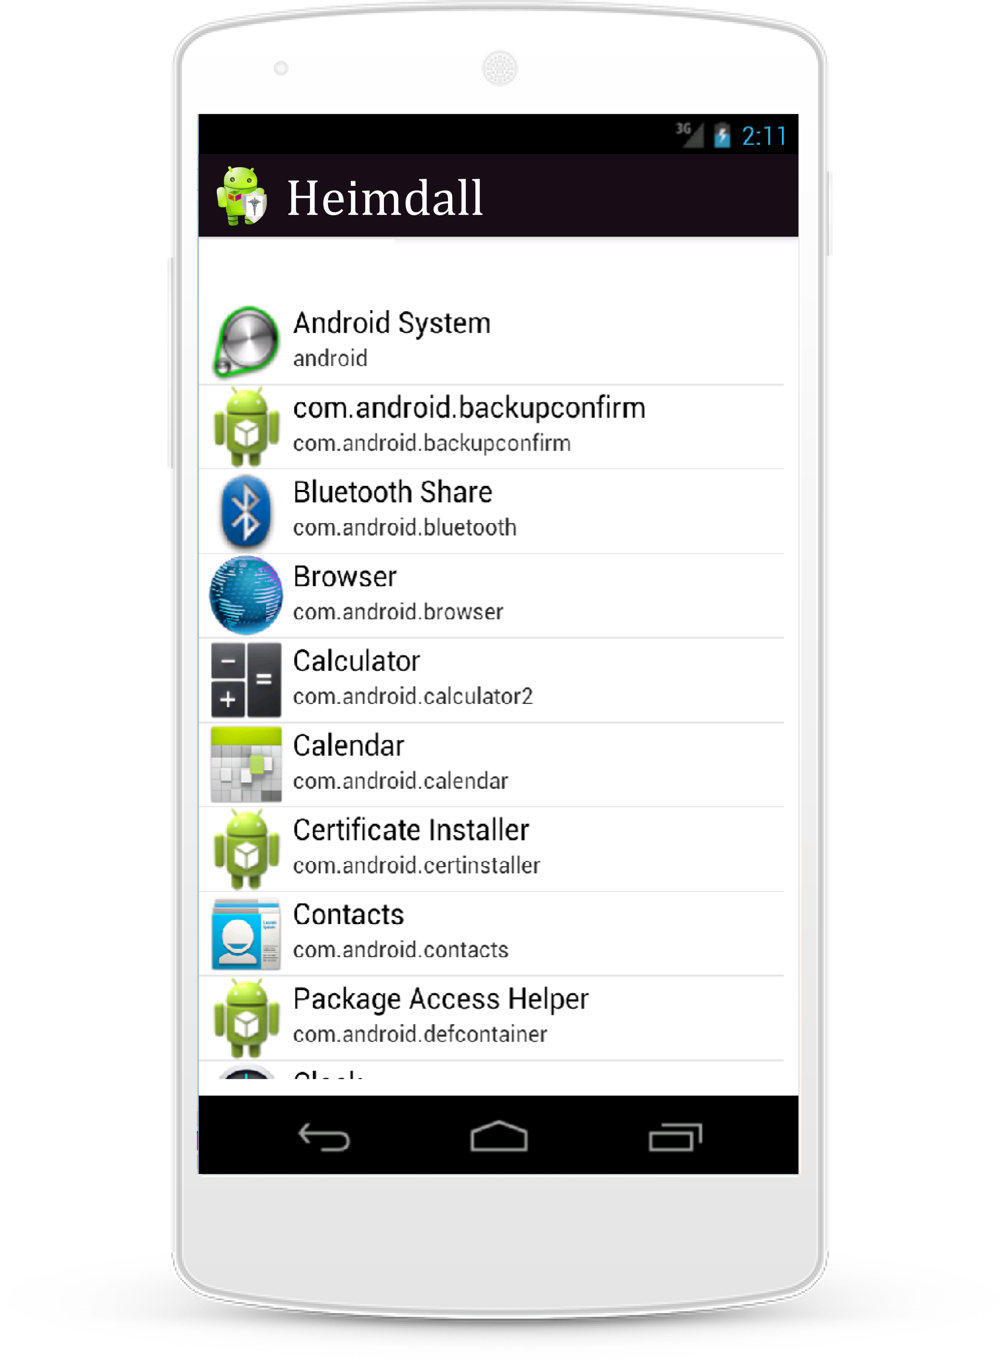
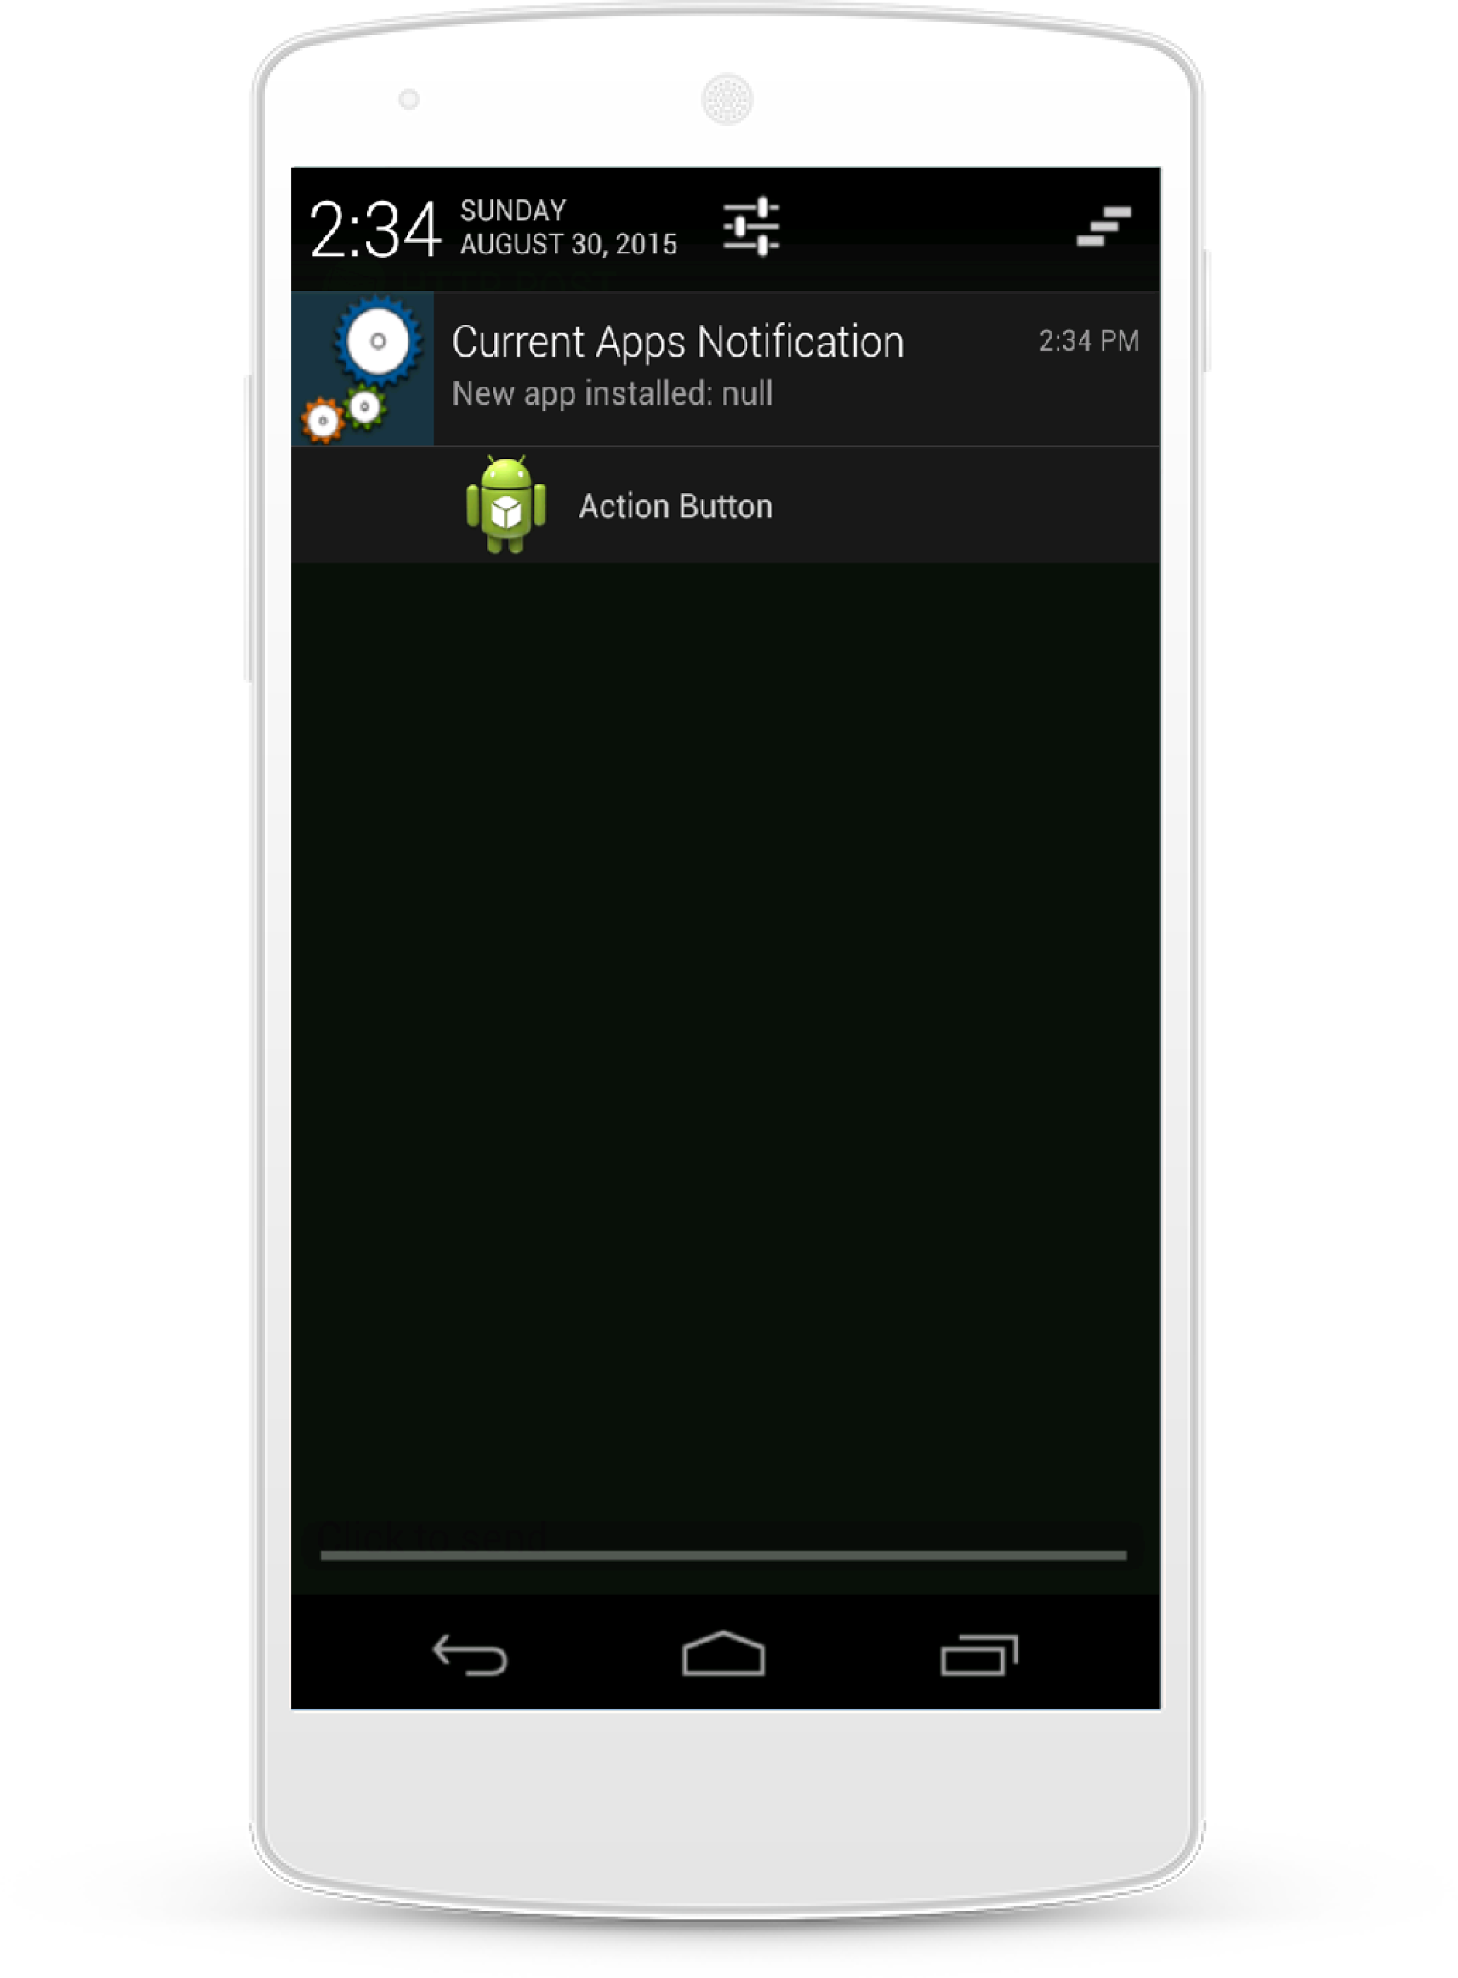
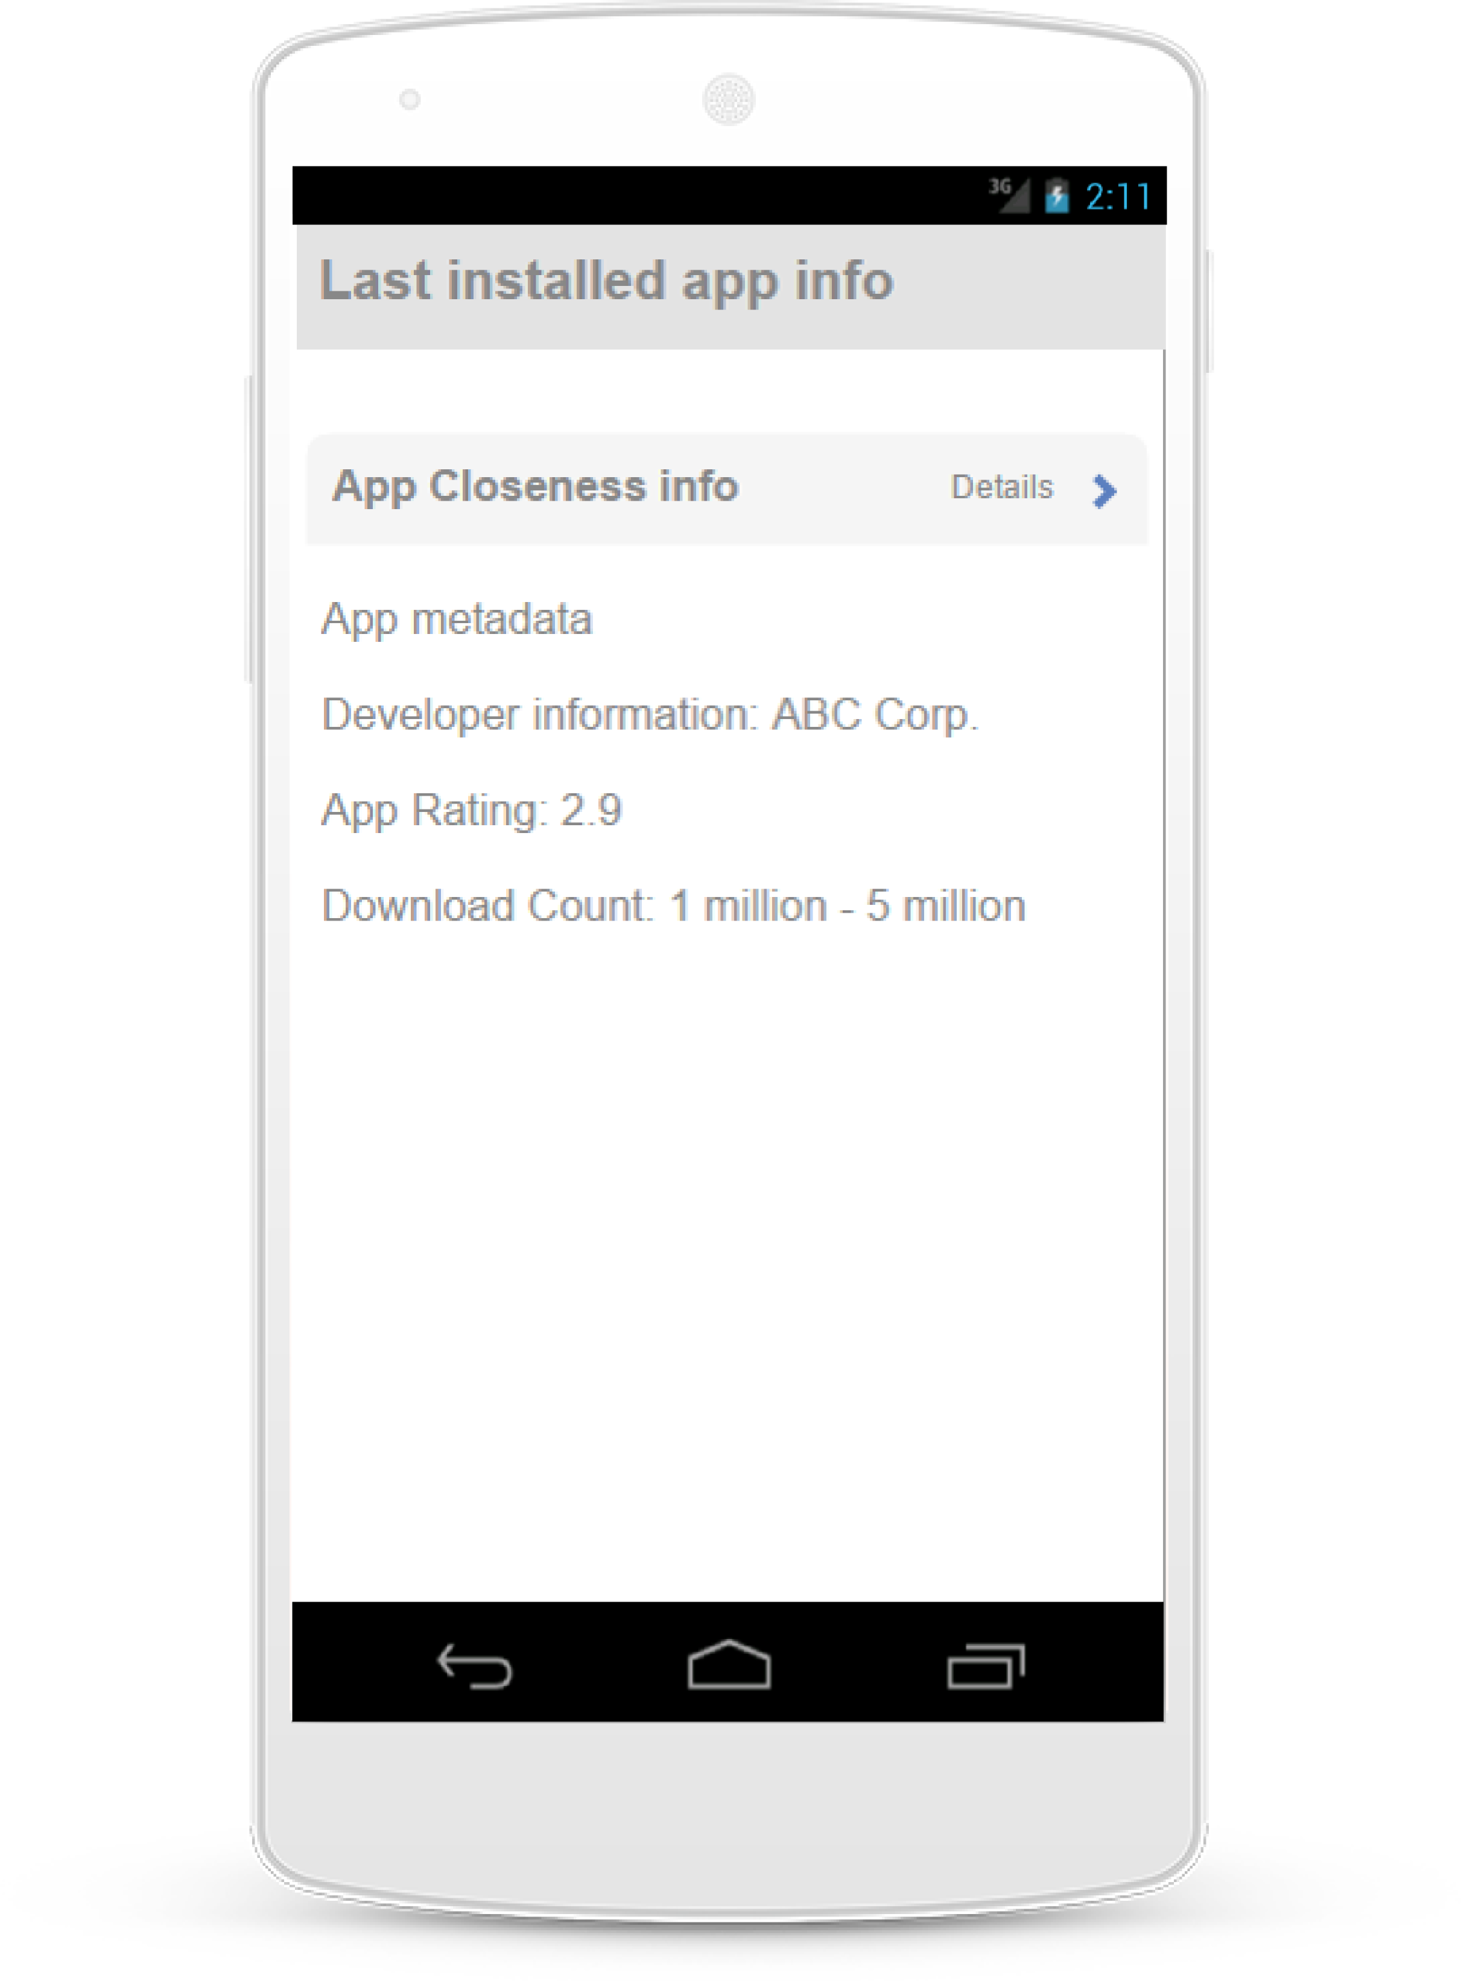
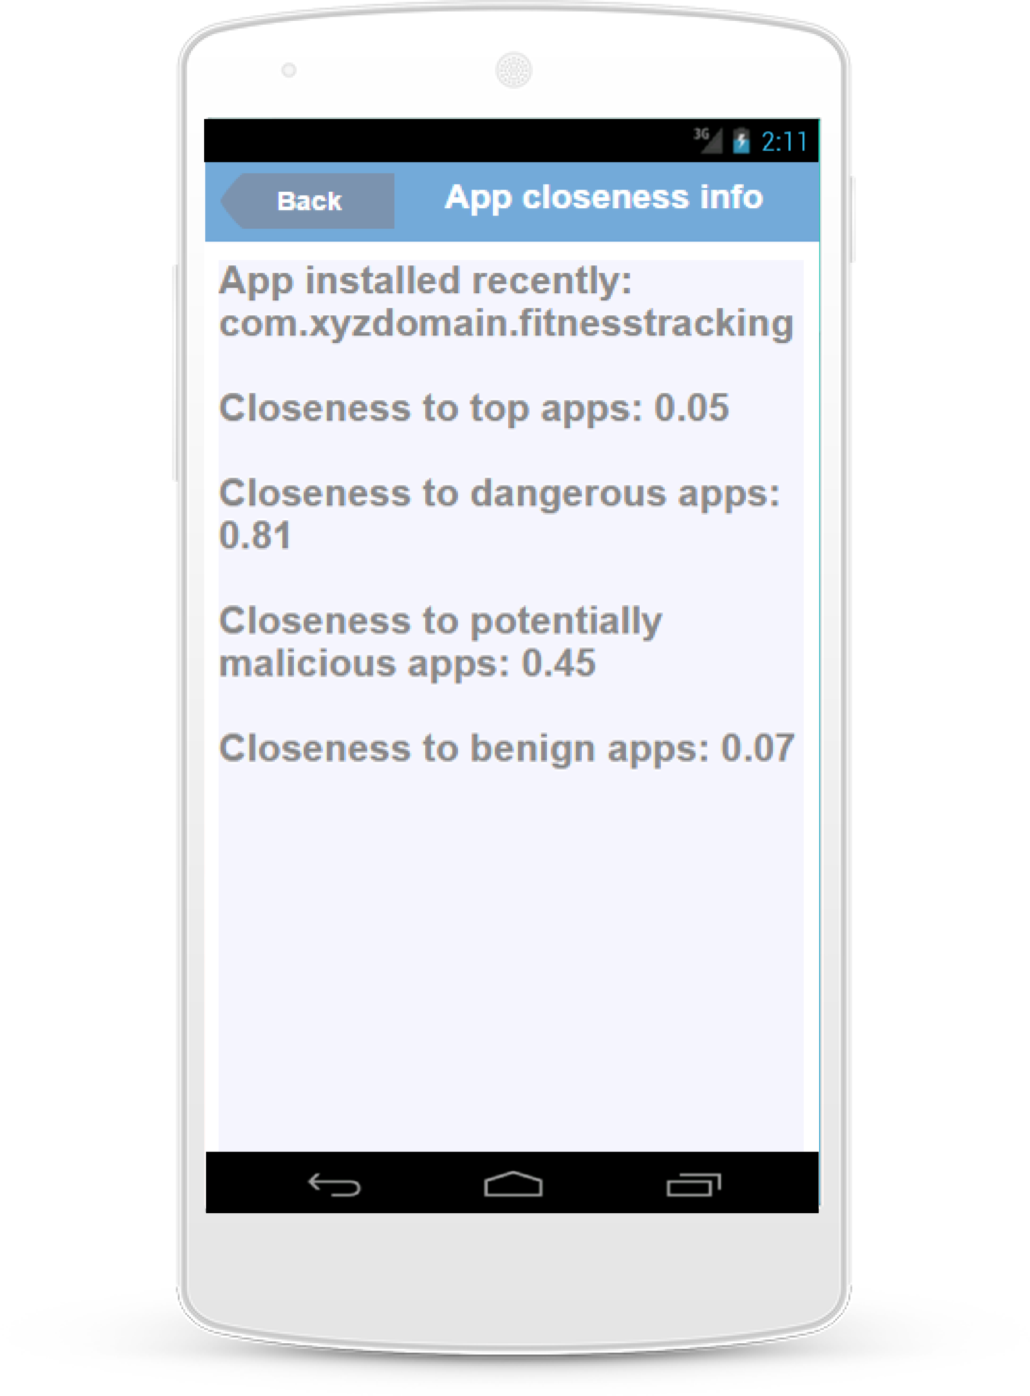

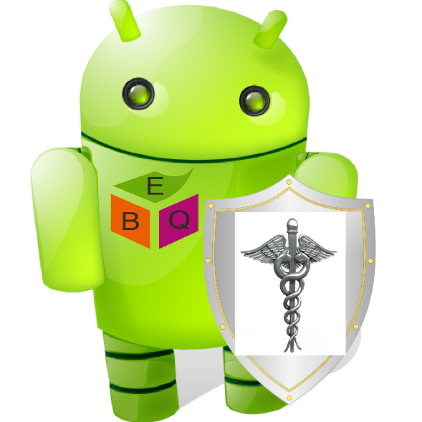

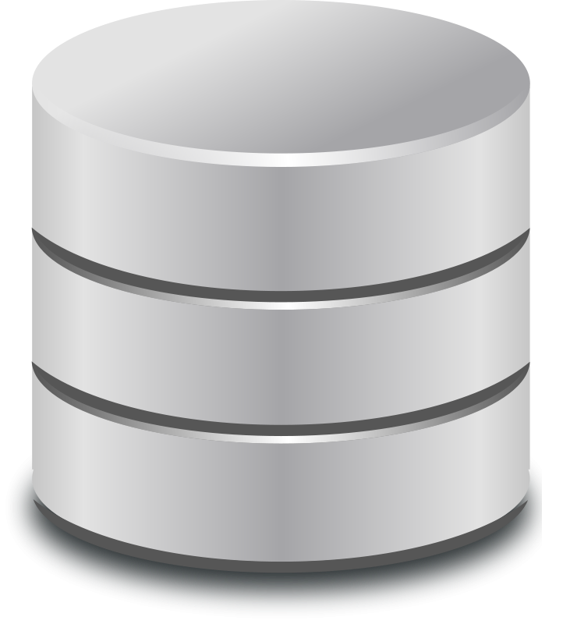
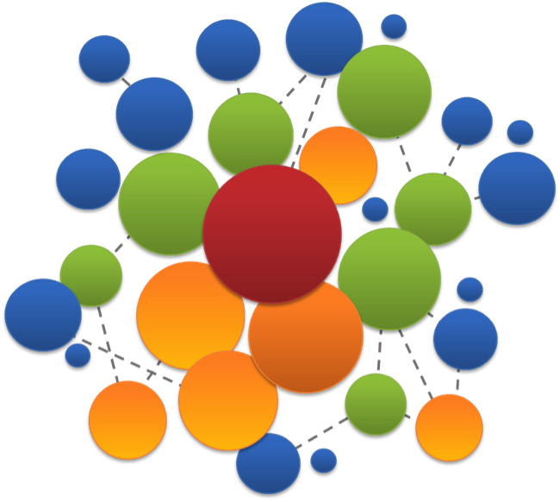


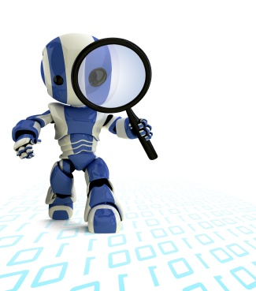
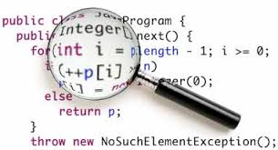

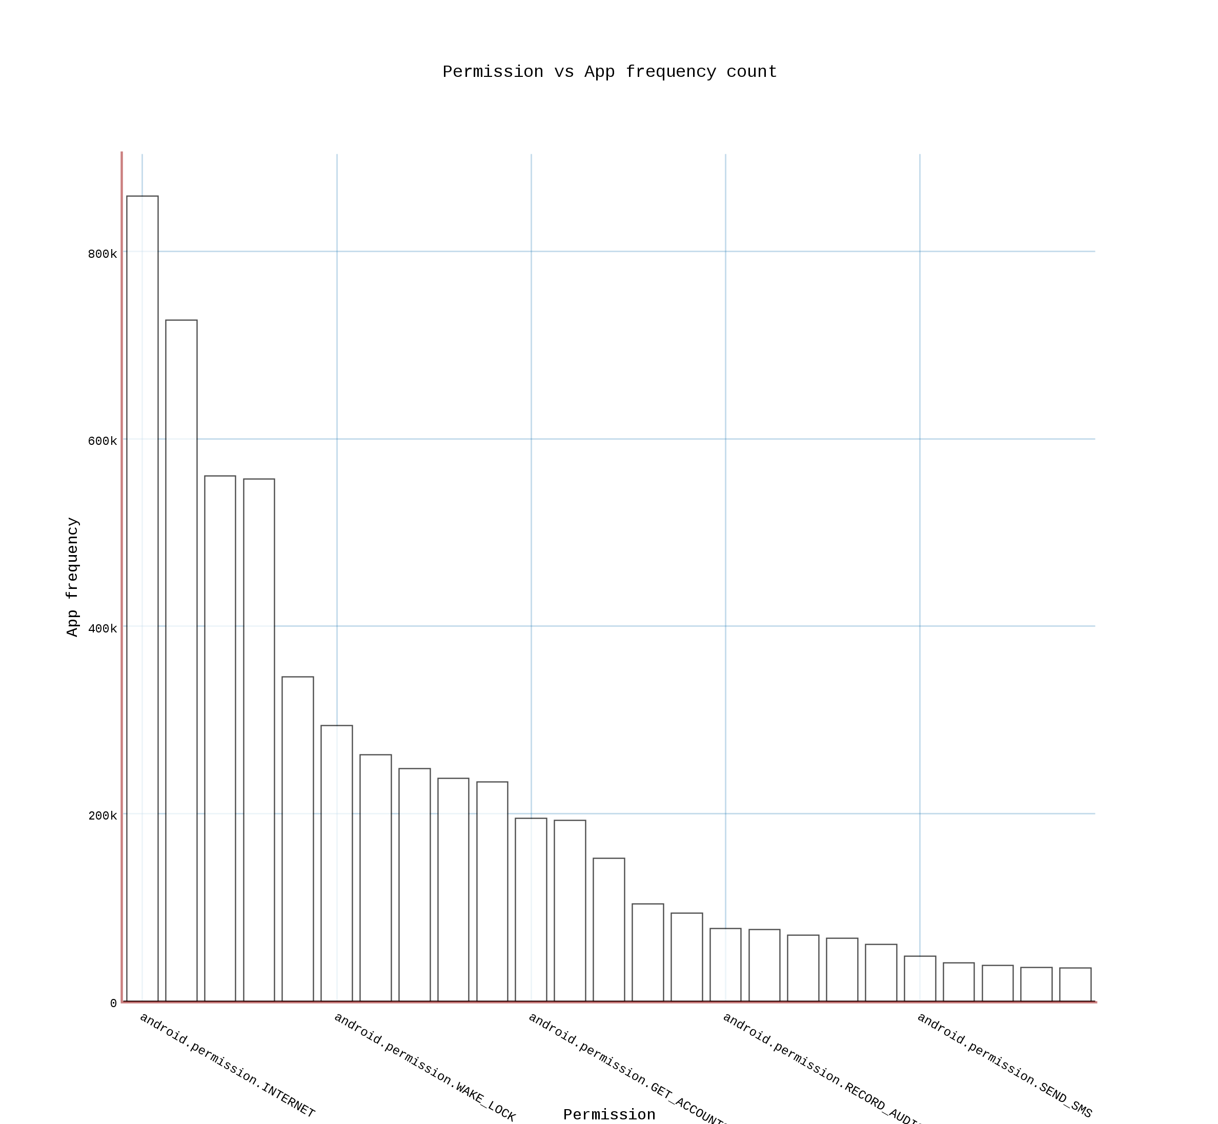
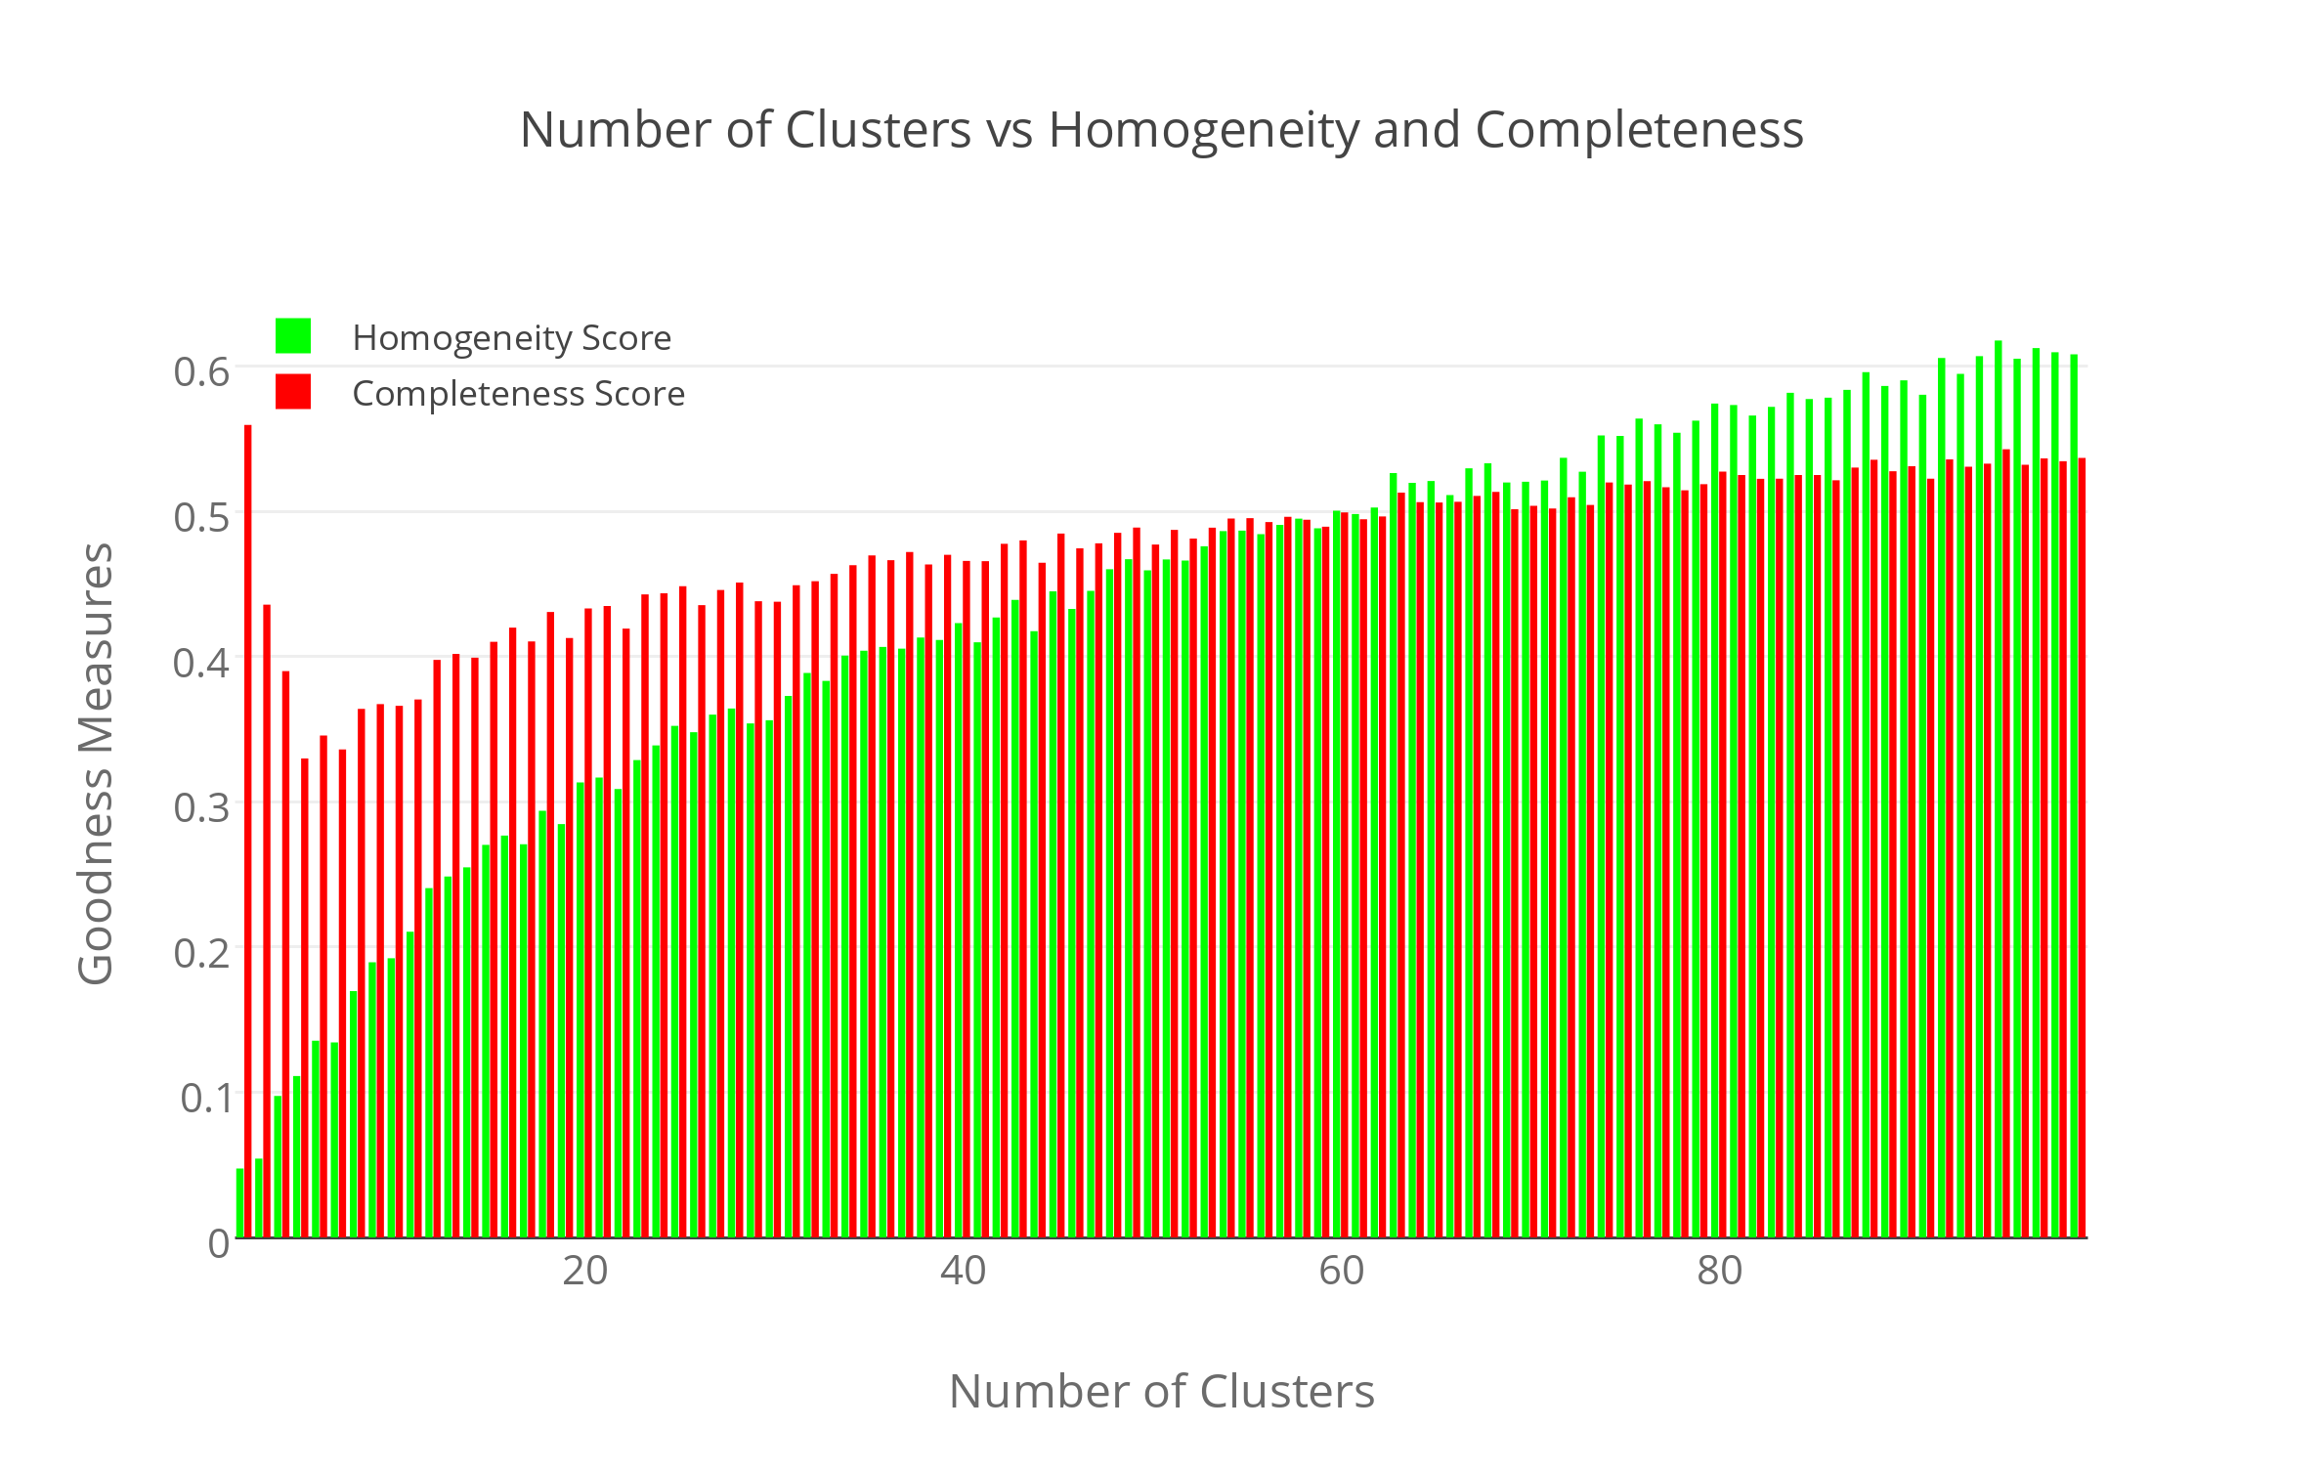
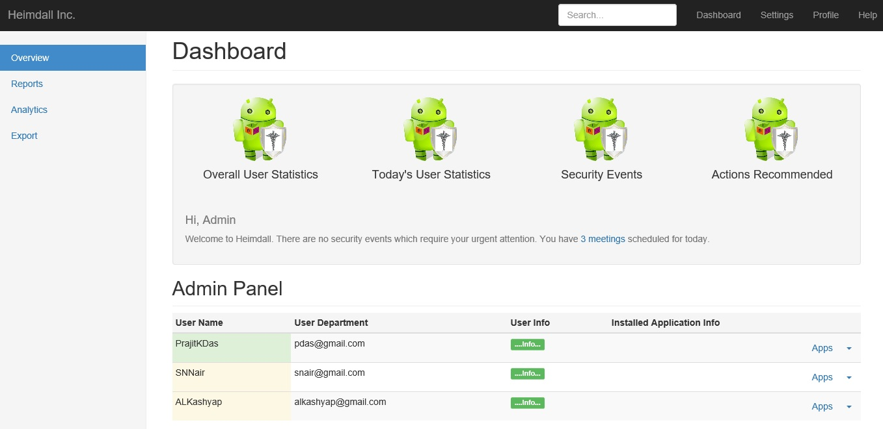
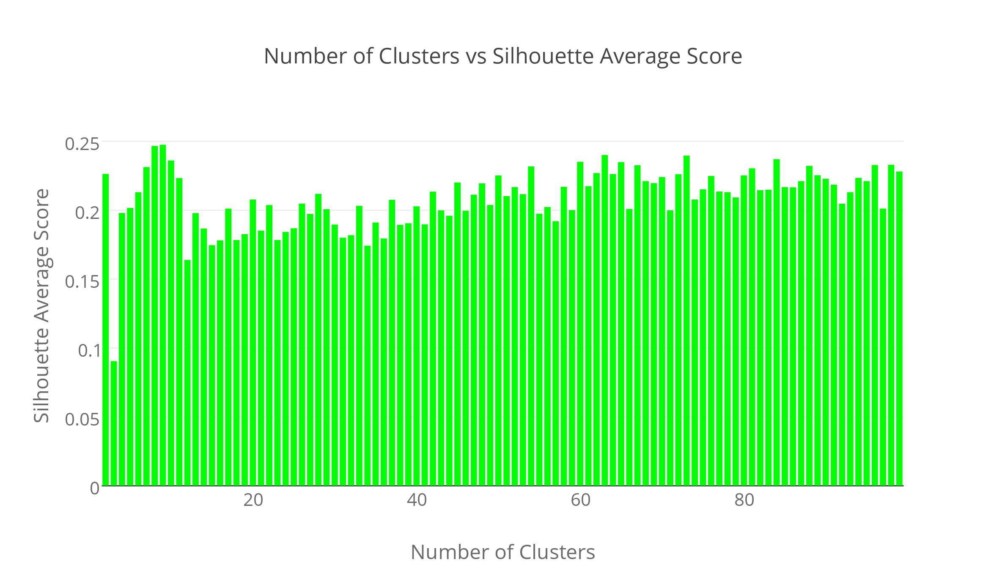

Heimdall: Protecting Users’ Health and Medical Data on Android
P. K. Das, S. Narayanan, A. Kashyap, S. Bobovych, N. Banerjee, A. Joshi, R. Robucci, T. Zhu, T. Finin
Heimdall informs mobile users and sysadmins on potentially dangerous apps
Hi! I am Heimdall!
I am here to protect you!
Stage 1: Data Collection
Stage 2: Unsupervised Learning
Stage 3: Code Analytics and Prediction
List of installed apps
New app installed notification
New app installed details
New app installed privacy and security details
System Architecture
Mobile App Visualizations
Procedural Details
Admin Dashboard Visualization
Supported by MITRE and NSF Grants #0910838 and #1228198

