Slide 1


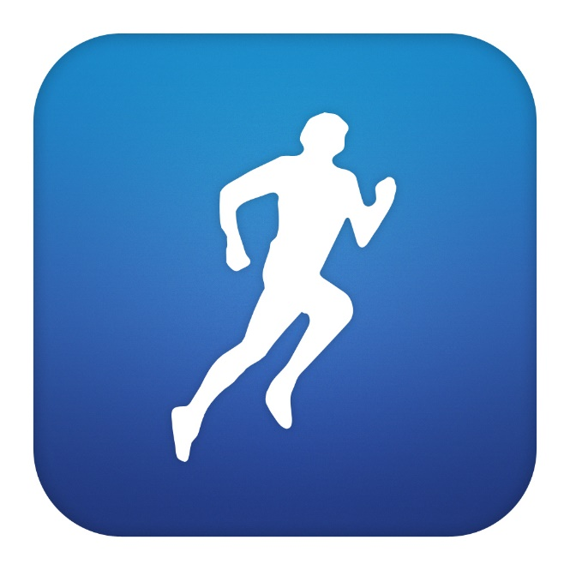

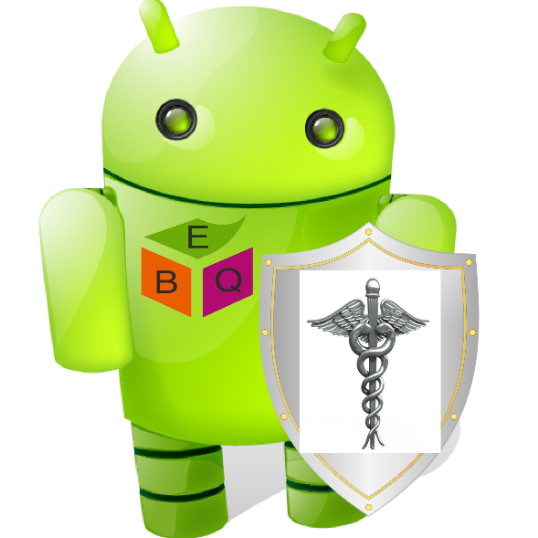

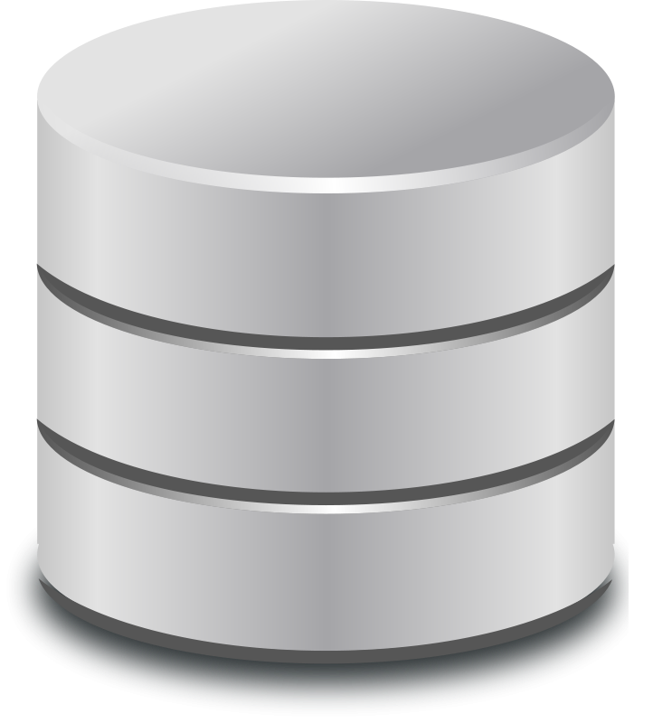
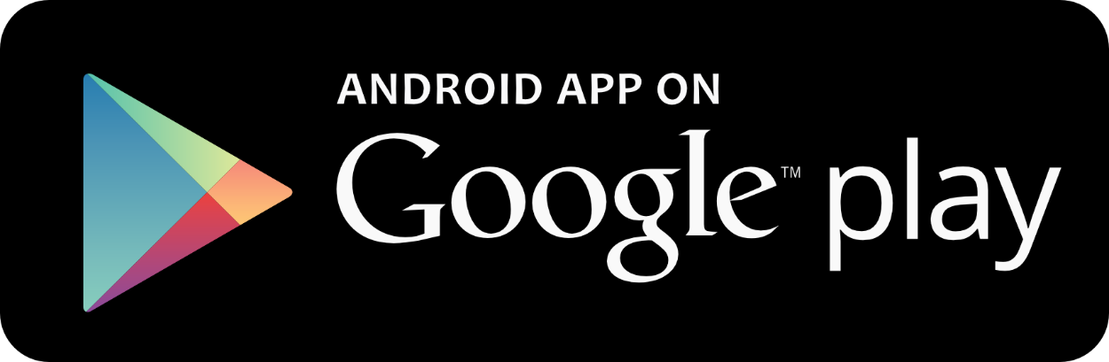

Heimdall: Protecting Users’ Health and Medical Data on Android
P. K. Das, S. Narayanan, A. Kashyap, S. Bobovych, N. Banerjee, R. Robucci, T. Zhu, A. Joshi, T. Finin
Heimdall informs users and admins on potentially dangerous apps
I am here to protect you!
System Architecture
Supported by NSF #0910838 and #1228198

