Slide 1


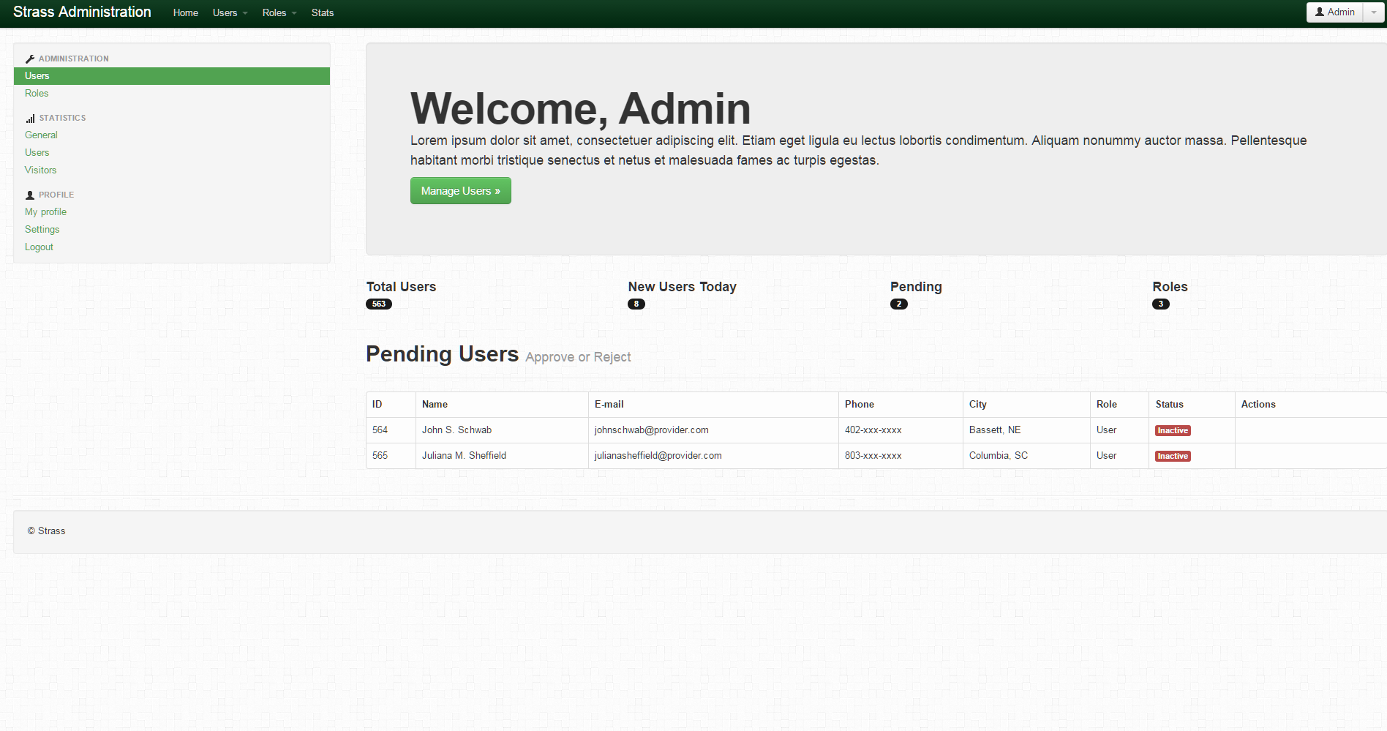

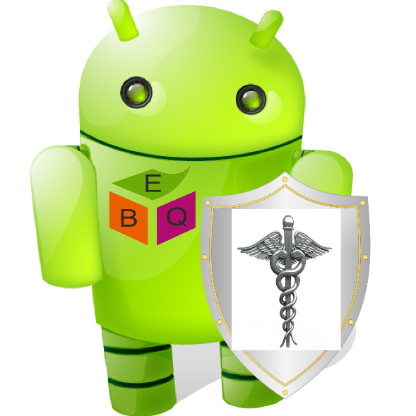

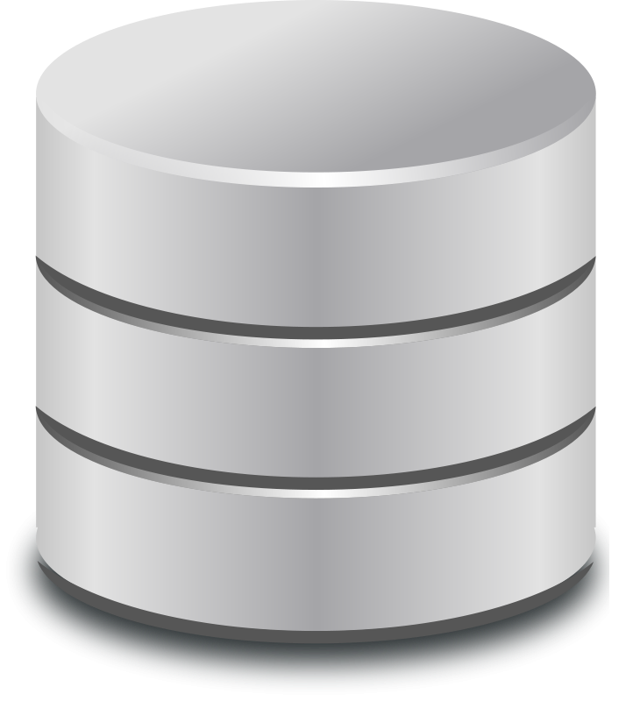
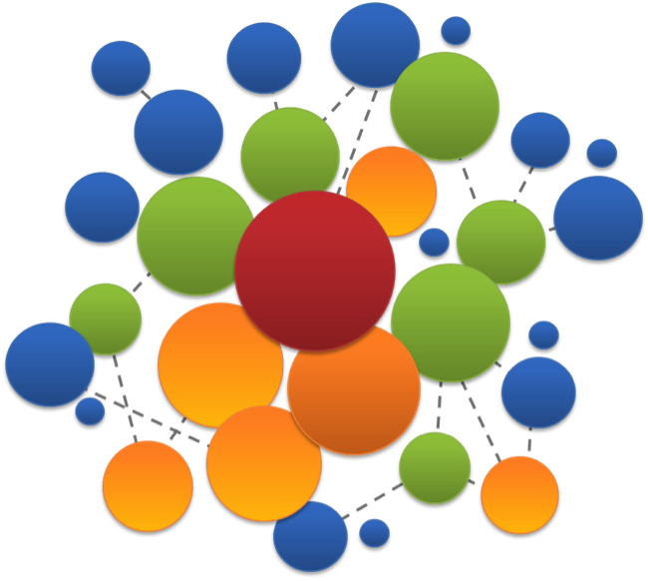


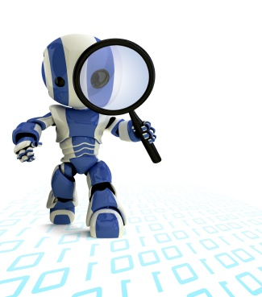
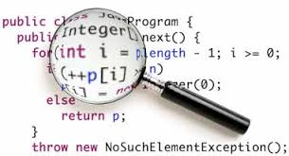

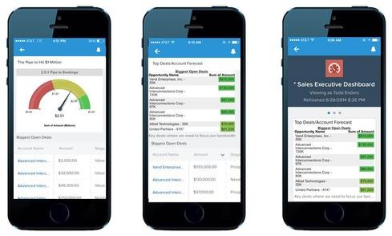

Heimdall: Protecting Users’ Health and Medical Data on Android
P. K. Das, S. Narayanan, A. Kashyap, S. Bobovych, N. Banerjee, R. Robucci, T. Zhu, A. Joshi, T. Finin
Heimdall informs users and admins on potentially dangerous apps
Hi! I am Heimdall!
I am here to protect you!
Stage 1: Data Collection
Stage 2: Unsupervised Learning
Stage 3: Code Analytics and Prediction
System Architecture
Admin Dashboard Visualization
Mobile Visualization
Recommendations
Supported by NSF #0910838 and #1228198

