Slide 1
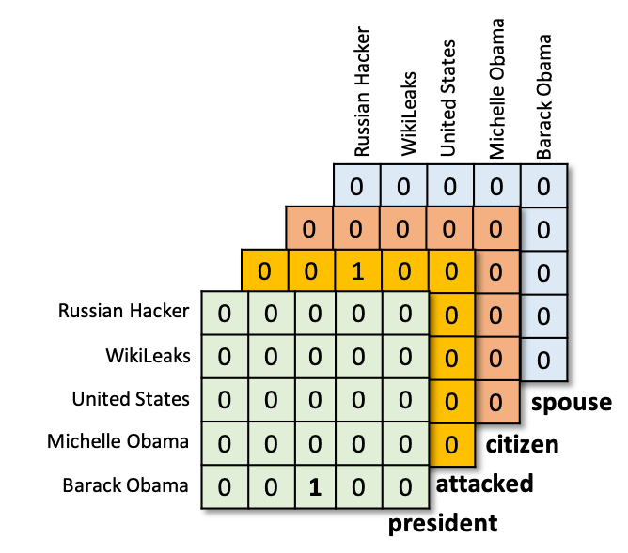

Knowledge Graph Fact Prediction via Knowledge-Enriched Tensor Factorization
Ankur Padia, Konstantinos Kalpakis, Francis Ferraro and Tim Finin
University of Maryland, Baltimore County
Baltimore, MD, USA
International Semantic Web Conference, 2019

Slide 2
Knowledge graphs of one kind or another have been used for more than 60 years for AI tasks, especially those involving language understanding

Slide 3
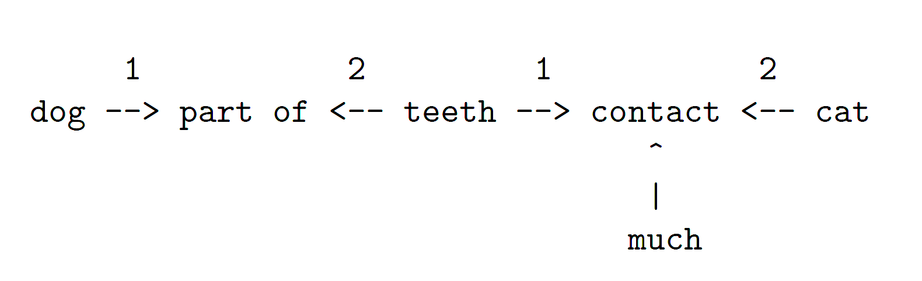
An early example from 1955
Richens’ representation of ”dog bites cat”
Richens, R.H. and Booth, A.D. ‘Some methods of mechanised translation’, in Locke, W.N. and Booth, A.D. (Eds.) Machine translation of languages, pp. 24-46, 1955.

Slide 4
Today it’s important to combine knowledge graphs and machine learning to make both better

Slide 5
Knowledge Graphs⬄Machine Learning
Both important in intelligent computing systems
KG⇨ML: Use existing KGs to support ML applications
KG⇦ML: Use ML to enrich and improve KGs
KGFP has elements of both
Uses simple meta-knowledge extracted from an existing KG as data to ...
Improve a machine learning system’s ability to predict relations that should be in the graph

Slide 6
KGFP Contributions
KGFP predicts likely relations in a KG and outperforms RESCAL and similar systems
Identifies relations believed to hold (link verification) rather than a ranked list of possible relations (link ranking)
Does not require KG schemas, but computes a relational similarity matrix from an existing graph
Evaluated on eight existing KG datasets, including ones based on DBpedia and Freebase

Slide 7
Knowledge Graph
Belief 1: Russian_Hacker attacked United_States .
Belief 2: Barack_Obama Spouse Michelle_Obama .
Belief 3: Barack_Obama President United_States .
Belief 4: Barack_Obama citizen United_States .
Belief 5: Wikileaks isa non-profit_organization .
Russian Hacker
Wiki-Leaks
attacked
United States
?
?
citizen
?
Barack Obama
Michelle Obama
president
spouse

Slide 8
Knowledge Graph as Tensor
Russian Hacker
Wiki-Leaks
attacked
Russian Hacker
Michelle Obama
United States
Barack Obama
WikiLeaks
United States
Russian Hacker
0 | 0 | 1 | 0 | 0
0 | 0 | 0 | 0 | 0
0 | 0 | 0 | 0 | 0
0 | 0 | 0 | 0 | 0
0 | 0 | 0 | 0 | 0
?
?
citizen
?
WikiLeaks
Barack Obama
Michelle Obama
United States
president
Michelle Obama
spouse
Barack Obama
attacked
Notes:
We

Slide 9
Knowledge Graph as Tensor
Russian Hacker
Wiki-Leaks
attacked
Russian Hacker
Michelle Obama
Russian Hacker
Michelle Obama
United States
Barack Obama
United States
Barack Obama
WikiLeaks
WikiLeaks
United States
Russian Hacker
0 | 0 | 1 | 0 | 0
0 | 0 | 0 | 0 | 0
0 | 0 | 0 | 0 | 0
0 | 0 | 0 | 0 | 0
0 | 0 | 0 | 0 | 0
0 | 0 | 0 | 0 | 0
0 | 0 | 0 | 0 | 0
0 | 0 | 0 | 0 | 0
0 | 0 | 0 | 0 | 0
0 | 0 | 1 | 0 | 0
?
?
WikiLeaks
citizen
?
United States
Michelle Obama
Barack Obama
Michelle Obama
president
Barack Obama
attacked
president
spouse

Slide 10
Knowledge Graph as Tensor
Russian Hacker
Michelle Obama
United States
Barack Obama
WikiLeaks
Russian Hacker
Wiki-Leaks
0 | 0 | 0 | 0 | 0
0 | 0 | 0 | 0 | 0
0 | 0 | 0 | 0 | 0
0 | 0 | 0 | 0 | 0
0 | 0 | 0 | 0 | 0
attacked
0 | 0 | 0 | 0 | 0
0 | 0 | 0 | 0 | 0
0 | 0 | 0 | 0 | 0
0 | 0 | 0 | 0 | 0
0 | 0 | 0 | 0 | 0
United States
0 | 0 | 1 | 0 | 0
0 | 0 | 0 | 0 | 0
0 | 0 | 0 | 0 | 0
0 | 0 | 0 | 0 | 0
0 | 0 | 0 | 0 | 0
?
?
citizen
Russian Hacker
0 | 0 | 0 | 0 | 0
0 | 0 | 0 | 0 | 0
0 | 0 | 0 | 0 | 0
0 | 0 | 0 | 0 | 0
0 | 0 | 1 | 0 | 0
?
WikiLeaks
Barack Obama
president
Michelle Obama
United States
spouse
spouse
Michelle Obama
citizen
Barack Obama
attacked
president
With enough data, we can predict that Michele Obama is a citizen of the US

Slide 11
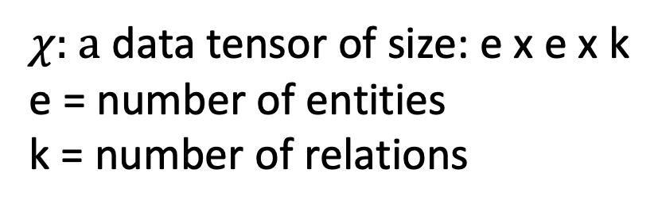

Learning Embeddings for Entities and Relations
$$χ$$
Russian Hacker
Michelle Obama
United States
Barack Obama
WikiLeaks
0 | 0 | 0 | 0 | 0
0 | 0 | 0 | 0 | 0
0 | 0 | 0 | 0 | 0
0 | 0 | 0 | 0 | 0
0 | 0 | 0 | 0 | 0
$χ\text{: }\text{a} \text{d}$ata tensor of size: e x e x k
e = number of entities
k = number of relations
0 | 0 | 0 | 0 | 0
0 | 0 | 0 | 0 | 0
0 | 0 | 0 | 0 | 0
0 | 0 | 0 | 0 | 0
0 | 0 | 0 | 0 | 0
0 | 0 | 1 | 0 | 0
0 | 0 | 0 | 0 | 0
0 | 0 | 0 | 0 | 0
0 | 0 | 0 | 0 | 0
0 | 0 | 0 | 0 | 0
Russian Hacker
0 | 0 | 0 | 0 | 0
0 | 0 | 0 | 0 | 0
0 | 0 | 0 | 0 | 0
0 | 0 | 0 | 0 | 0
0 | 0 | 1 | 0 | 0
WikiLeaks
United States
spouse
Michelle Obama
citizen
Barack Obama
attacked
president

Slide 12
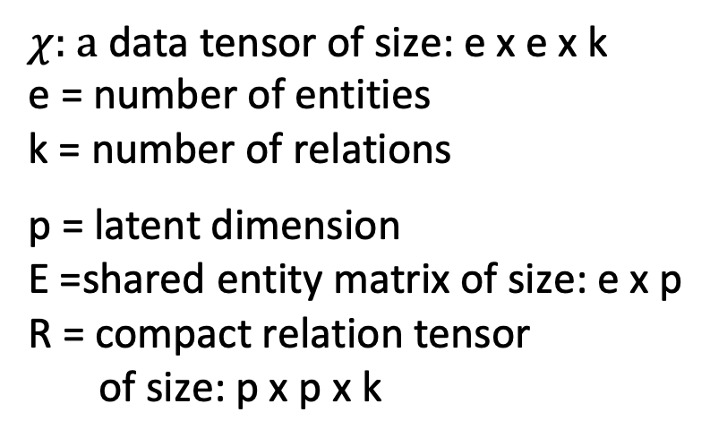

Learning Embeddings for Entities and Relations
Jointly learn Entity (E) and Relation (R) embeddings
$$χ$$
$≈ERE^{T}$
Russian Hacker
Michelle Obama
United States
Barack Obama
WikiLeaks
$χ\text{: }\text{a} \text{d}$ata tensor of size: e x e x k
e = number of entities
k = number of relations
p = latent dimension
E =shared entity matrix of size: e x p
R = compact relation tensor of size: p x p x k
0 | 0 | 0 | 0 | 0
0 | 0 | 0 | 0 | 0
0 | 0 | 0 | 0 | 0
0 | 0 | 0 | 0 | 0
0 | 0 | 0 | 0 | 0
0 | 0 | 0 | 0 | 0
0 | 0 | 0 | 0 | 0
0 | 0 | 0 | 0 | 0
0 | 0 | 0 | 0 | 0
0 | 0 | 0 | 0 | 0
0 | 0 | 1 | 0 | 0
0 | 0 | 0 | 0 | 0
0 | 0 | 0 | 0 | 0
0 | 0 | 0 | 0 | 0
0 | 0 | 0 | 0 | 0
Russian Hacker
0 | 0 | 0 | 0 | 0
0 | 0 | 0 | 0 | 0
0 | 0 | 0 | 0 | 0
0 | 0 | 0 | 0 | 0
0 | 0 | 1 | 0 | 0
WikiLeaks
United States
spouse
Michelle Obama
citizen
Barack Obama
attacked
president

Slide 13
Learning Embeddings for Entities and Relations
Jointly learn Entity (E) and Relation (R) embeddings
$$χ$$
$≈ERE^{T}$
Russian Hacker
Michelle Obama
United States
Barack Obama
WikiLeaks
0 | 0 | 0 | 0 | 0
0 | 0 | 0 | 0 | 0
0 | 0 | 0 | 0 | 0
0 | 0 | 0 | 0 | 0
0 | 0 | 0 | 0 | 0
We learn parameters to minimize error in reconstructing tensor from entity and relation embeddings
Since Obama president US = 1
We want E(Obama) ● R(president) ● E(US)^{T} → 1
0 | 0 | 0 | 0 | 0
0 | 0 | 0 | 0 | 0
0 | 0 | 0 | 0 | 0
0 | 0 | 0 | 0 | 0
0 | 0 | 0 | 0 | 0
0 | 0 | 1 | 0 | 0
0 | 0 | 0 | 0 | 0
0 | 0 | 0 | 0 | 0
0 | 0 | 0 | 0 | 0
0 | 0 | 0 | 0 | 0
Russian Hacker
0 | 0 | 0 | 0 | 0
0 | 0 | 0 | 0 | 0
0 | 0 | 0 | 0 | 0
0 | 0 | 0 | 0 | 0
0 | 0 | 1 | 0 | 0
WikiLeaks
United States
spouse
Michelle Obama
citizen
Barack Obama
attacked
president

Slide 14



Objective Function to Jointly Learn Embeddings
We modify RESCAL’s approach, adding a new component with prior knowledge derived from the graph
minimize
$$||χ −ERE^{T}{||}^{2}$$
+
Avoid Overfitting
+
Use prior information
E, R
reconstruction error
$λ_{a}||E{||}^{2}$+ $∑_{1}^{k}λ_{r}||{R_{k}||}^{2}$
Base model – RESCAL (Nickel et al. ICML 2011)
C_{ij} similarity matrix based on one of four similarity models
$$C_{ij}||{R_{i}−R_{j}||}^{2}$$
KGFP relation similarity matrix

Slide 15
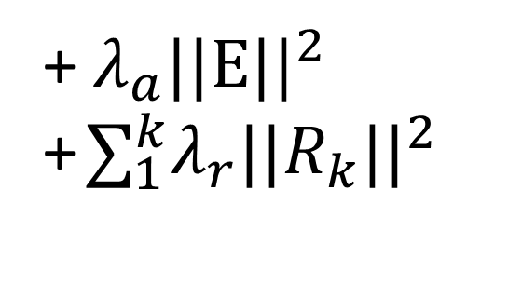
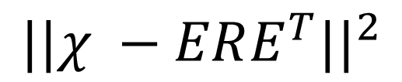
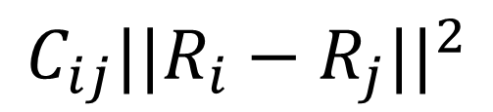

Relation Similarity as Prior Information
minimize
+
E, R
Russian Hacker
Michelle Obama
United States
Barack Obama
WikiLeaks
0 | 0 | 0 | 0 | 0
0 | 0 | 0 | 0 | 0
0 | 0 | 0 | 0 | 0
0 | 0 | 0 | 0 | 0
0 | 0 | 0 | 0 | 0
spouse
attacked
0 | 0 | 0 | 0 | 0
0 | 0 | 0 | 0 | 0
0 | 0 | 0 | 0 | 0
0 | 0 | 0 | 0 | 0
0 | 0 | 0 | 0 | 0
citizen
president
0 | 0 | 1 | 0 | 0
0 | 0 | 0 | 0 | 0
0 | 0 | 0 | 0 | 0
0 | 0 | 0 | 0 | 0
0 | 0 | 0 | 0 | 0
Russian Hacker
0 | 0 | 0 | 0 | 0
0 | 0 | 0 | 0 | 0
0 | 0 | 0 | 0 | 0
0 | 0 | 0 | 0 | 0
0 | 0 | 1 | 0 | 0
1.0
 | 1.0
 |  | 1.0
 |  |  | 1.0
spouse
WikiLeaks
citizen
United States
spouse
attacked
Michelle Obama
citizen
president
Barack Obama
attacked
KGFP relation similarity matrix
president

Slide 16
Relation Similarity
symmetry | How often do Ri & Rj share subject or object
agency | How often do Ri & Rj share same subject
patient | How often do Ri & Rj share same object
transitivity | How often is Ri’s object Rj’s subject
reverse transitivity | How often is Ri’s subject Rj’s object
obama
obama
obama
obama
USA
obama
USA
We evaluated five simple, easy to compute relation similarity metrics for every pair of relations in initial KG

Slide 17
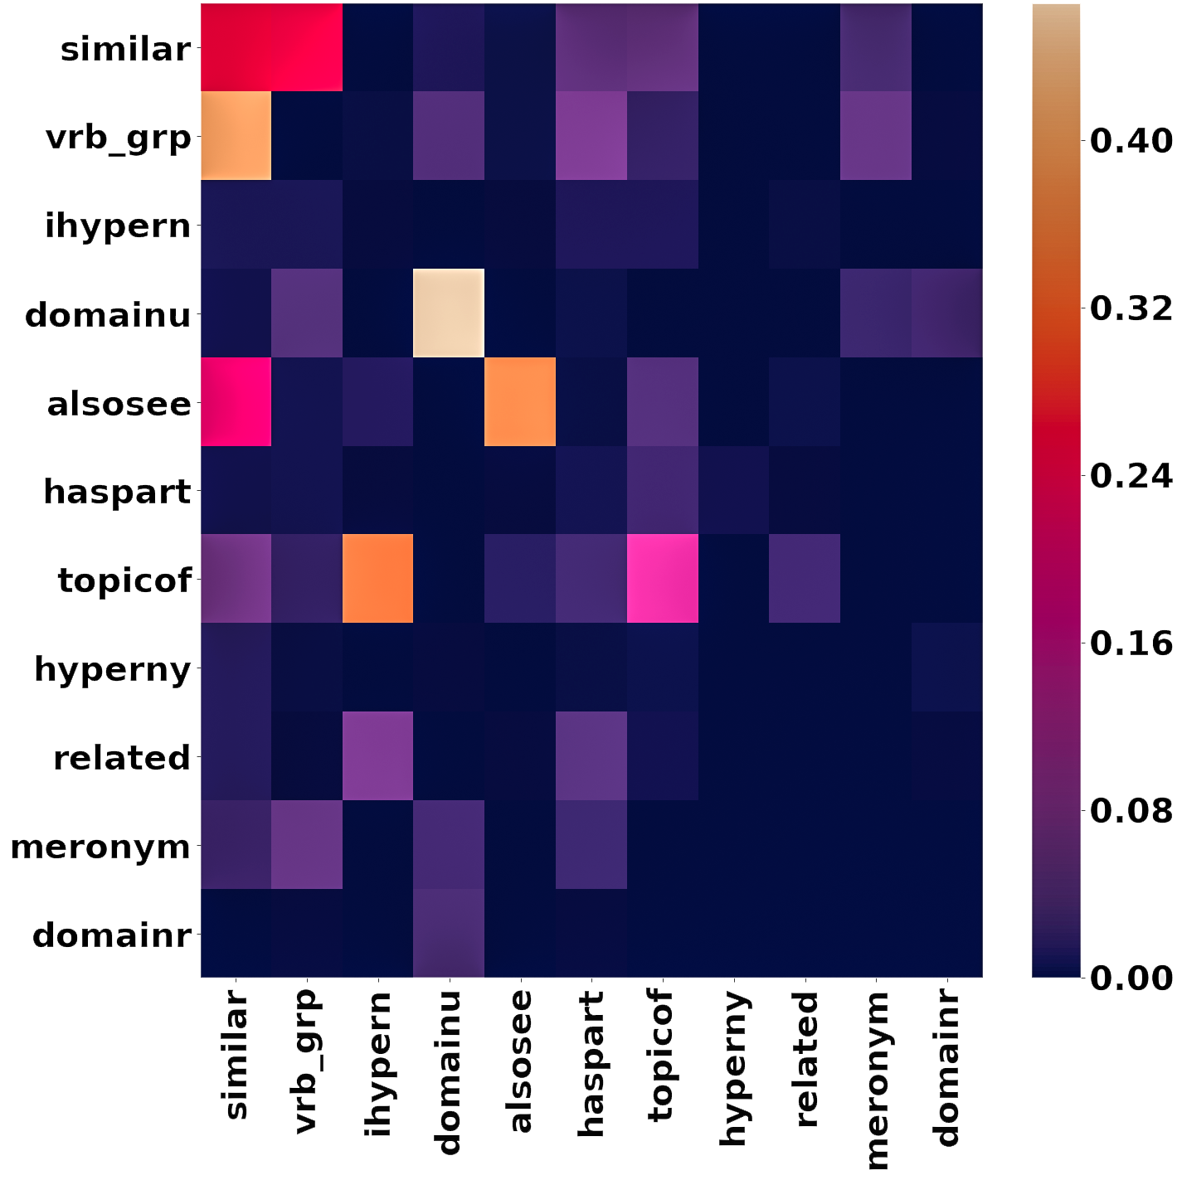
Transitivity Best
Which similarity metric is best depends on the KG
Experiments showed transitivity gave best performance overall
Especially for graphs derived from DBpedia and Freebase
Heatmap for WIN18RR relation similarity matrix using transitivity shown

Slide 18
Evaluation on eight datasets
Dataset | Domain | Entities | Relations | Facts | Avg. Deg | Graph Density
Kinship | Social | 104 | 26 | 10.7K | 102.75 | 0.98798
UMLS | Medical | 135 | 49 | 6.8K | 50.01 | 0.37048
FB15-237 | General | 14.5K | 237 | 310.1K | 21.32 | 0.00147
DB10k | General | 4.3K | 140 | 10.0K | 2.27 | 0.00052
FrameNet | Language | 22.3K | 16 | 62.3K | 2.79 | 0.00013
WN18 | Language | 40.9K | 18 | 151.4K | 3.7 | 0.00009
FB13 | General | 81.1K | 13 | 360.5K | 4.45 | 0.00005
WN18RR | Language | 40.9K | 11 | 93.0K | 2.27 | 0.00005
low high
Comparison with SOTA tensor factorization & translation-based models
Used Precision-Recall AUC evaluation metric
Note that Kinship and UMLS are outliers w.r.t. graph density

Slide 19
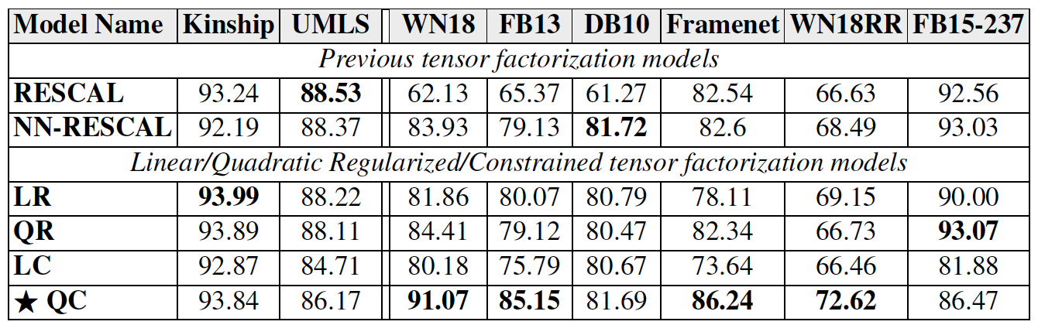
Experimental results
Fact prediction AUC performance for all models. The quadratic-constrained model is best overall for graphs with low density, which include the those derived from DBpedia and Freebase.

Slide 20
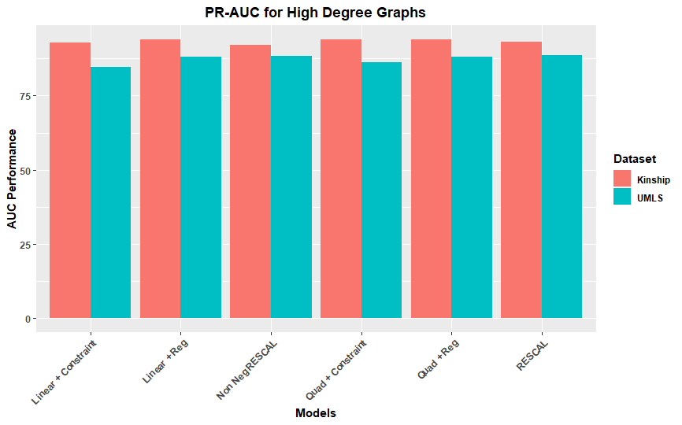
Results: High Density KGs
When graph density high, regularization or constraining does not help much and results are similar to RESCAL

Slide 21
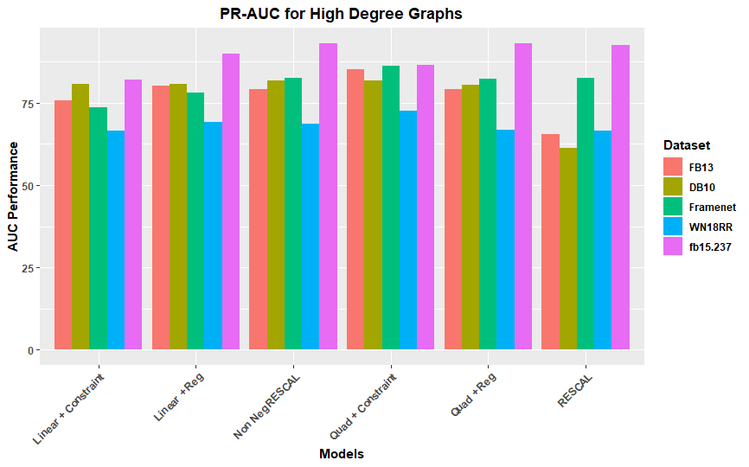
Results: Low Density KGs
When graph density low, the quadratic + constraint model is significantly better

Slide 22
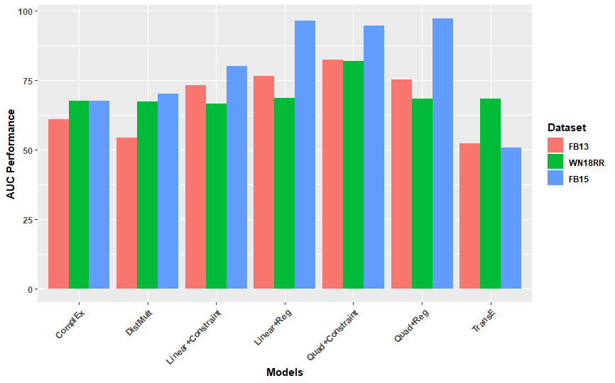
Results: Compared to Neural Systems
KGFP performed better than TransE, ComplEx & DistMult for our experiments on low density graphs

Slide 23
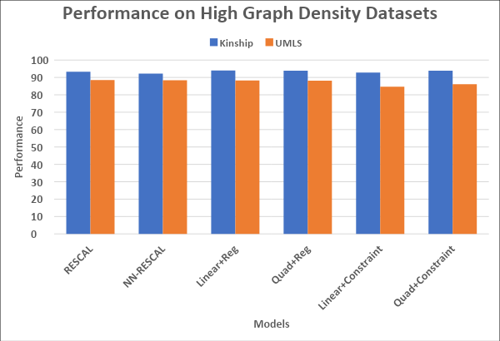
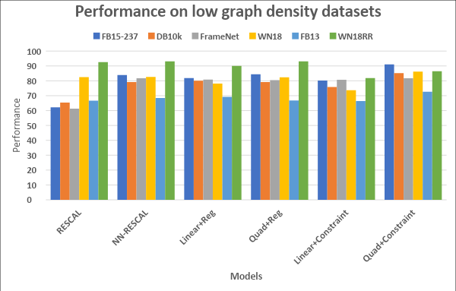
Results: Area Under Curve
Evaluated four models, finding Quadratic+Constrained best overall (statistically significant) for typical graphs with low density, e.g., Freebase, Dbpedia and FrameNet

Slide 24
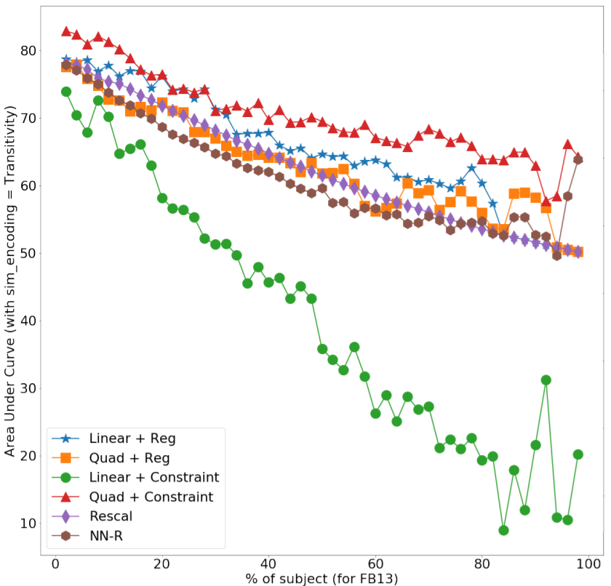
Prior Information and Sparsity
How models perform with fewer positive examples varies
Graph shows how AUC drops for FB13 as subjects are removed
Quadratic+constraint model is more robust w.r.t. having fewer examples

Slide 25
KGFP time and space complexity
Similar to RESCAL & RESCAL-NN, significantly better than neural methods
 | FB13 | FrameNet | DB10k | FB15-237
relations | 13 | 16 | 140 | 237
entities | 81,061 | 62,344 | 4,397 | 14,541
RESCAL | 29 | 10 | 170 | 2196
RESCAL-NN | 41 | 22 | 872 | 4631
KGFP | 71 | 12 | 326 | 5428
Time in seconds for 100 iterations
Details available in journal paper preprint

Slide 26
Future Work
Exploring additional relation similarity models
Using KGFP to help identify NLP information extraction system errors
Using KGFP as a module in a system to clean noisy knowledge graphs by identifying unlikely relations
Apply KGFP to cybersecurity knowledge graphs created from STIX cyberthreat intelligence feeds, NVD and other semi-structured cybersecurity data resources

Slide 27
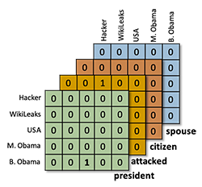
Conclusions
KGFP is a novel tensor factorization approach for KG fact prediction, giving SOTA results on many graphs
Exploits relation similarity extracted from existing graphs, with the transitivity prior generally best
Performs well on relatively sparse graphs like DBpedia and Freebase

Slide 28
More information
Code & datasets: https://github.com/Ebiquity/KGFP
Preprint of JWS paper
ISWC journal track paper
For more information, contact Dr. Ankur Padia, Philips Research Americas, pankur1@umbc.edu

