Slide 1
AioT & RISC-V
Automatic speech recognition
ASR demo

Slide 2
AIoT
Artificial Intelligence of Things (AIoT) is the combination of artificial intelligence technologies with the Internet of Things

Slide 3
SiATM
Olof Åstrand
Florian Evaldsson

Slide 4
ATM
Air traffic Management

Slide 5
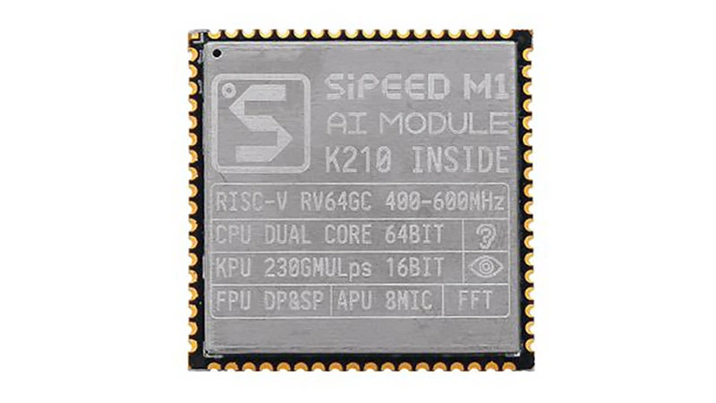
SiPEED AIoT module

Slide 6
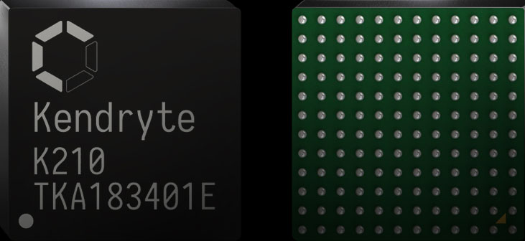
K210
https://kendryte.com/

Slide 7
K210
RISC-V Dual Core 64bit, with FPU
Typical application scenarios < 1W
Power consumption of chip < 300mW
OS: FreeRTOS
NN Model: TinyYOLOv2 (after pruned)
DNN Framework: TensorFlow/Keras/Darknet
Peripherals FPIOA/UART/GPIO/SPI/I²C/I²S/WDT/TIMER/RTC, etc.

Slide 8
RISC-V
RISC-V
Is a opensource
Instruction Set Architecture (ISA) spec
Base
Extensions

Slide 9
RISC-V Base
RV32I Base Integer Instruction Set, 32-bit
RV32E Base Integer Instruction Set (embedded), 32-bit, 16 registers
RV64I
RV128I

Slide 10
RISC-V Extension
C , Standard Extension for Compressed Instructions
F, Standard Extension for Single-Precision Floating-Point
M,A,D,G,Q,L,C,B,J,T,P...

Slide 11
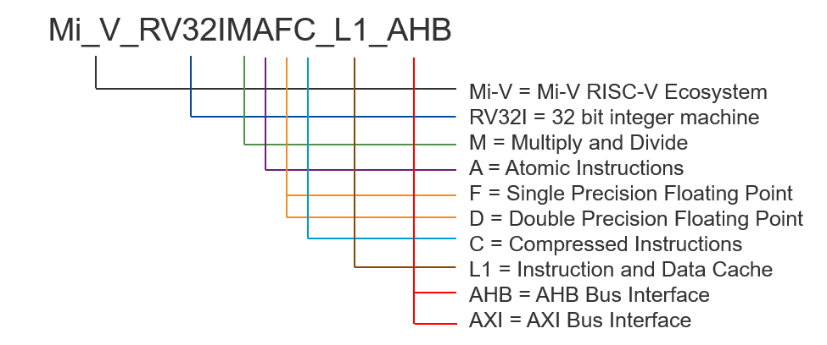
https://www.microsemi.com

Slide 12
Links
https://www.seeedstudio.com/Sipeed-M1-dock-suit-M1-dock-2-4-inch-LCD-OV2640-K210-Dev-Board-1st-RV64-AI-board-for-Edge-Computing-p-3211.html

