Slide 1
DEEP LEARNING FOR PATIENT-SPECIFIC KIDNEY GRAFT SURVIVAL ANALYSIS
Group Members:
Nishat Zaman (011 151 264)
Nawshiba Tasnim Ahmed (011 161 145)
Ferdous Zaman (011 162 125)
Ebnul Mahmood Shovan (011 162 058)

Slide 2
INTRODUCTIONS
In previous presentation we didn't understood deep learning, survival function, hazard function, cox proportional hazard model etc. in this presentation we will discuss details about those topics.

Slide 3
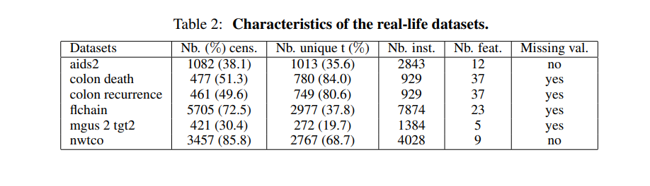
Dataset

Slide 4
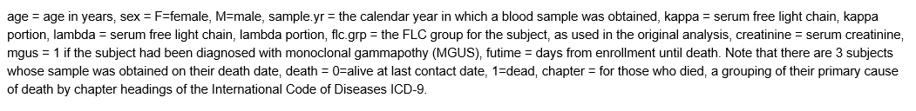
Dataset

Slide 5
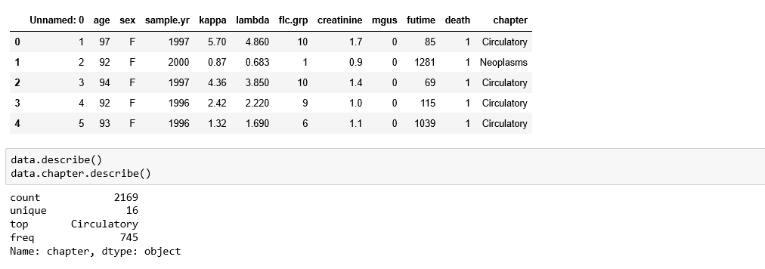
Dataset
Shape (7874, 12)

Slide 6
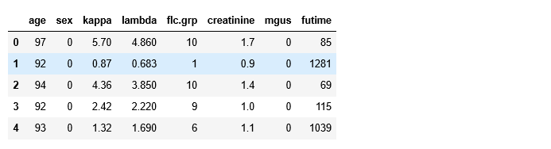
Dataset

Slide 7
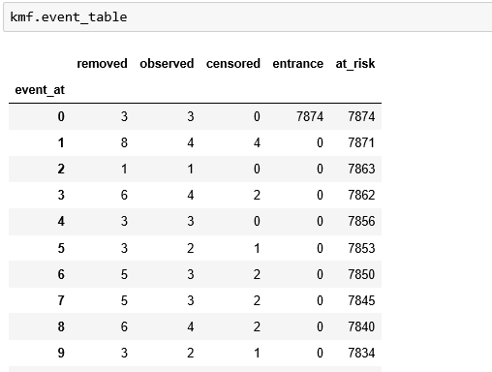
Dataset

Slide 8
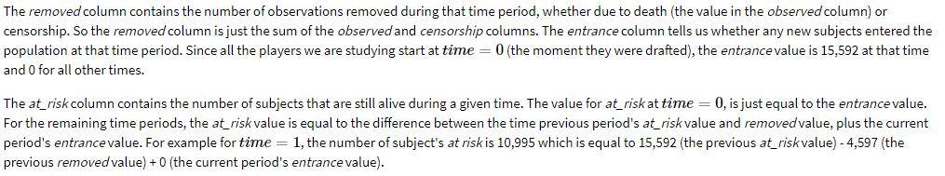
Dataset

Slide 9
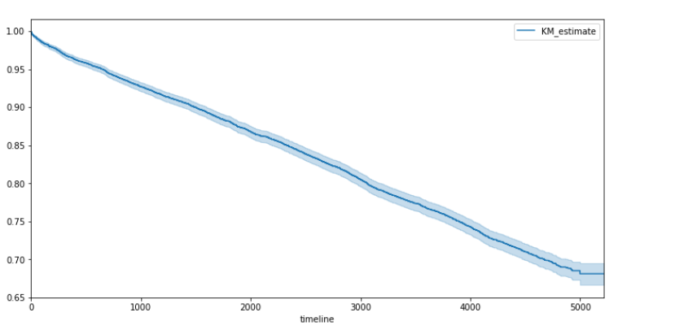
Dataset

