Slide 1

Map Reduce

Slide 2
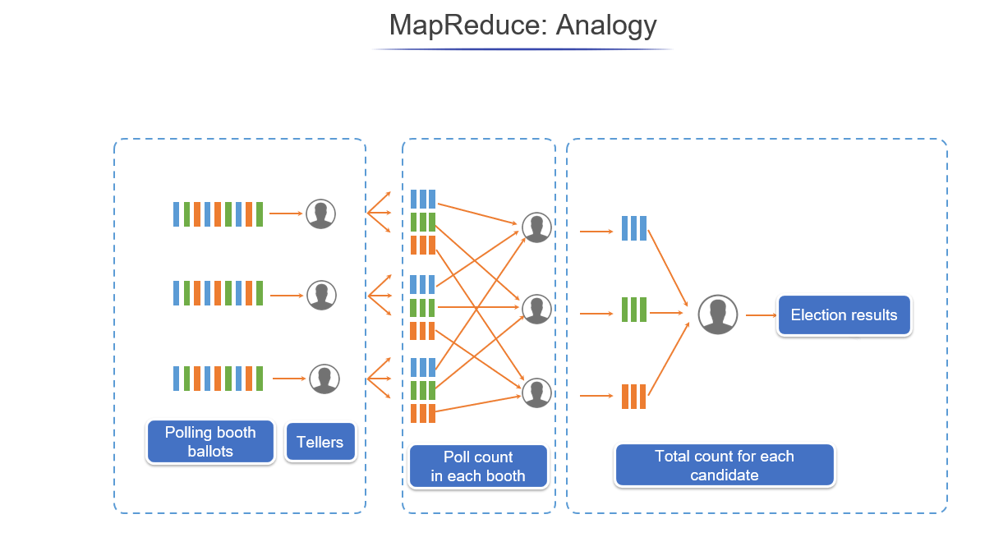

Slide 3
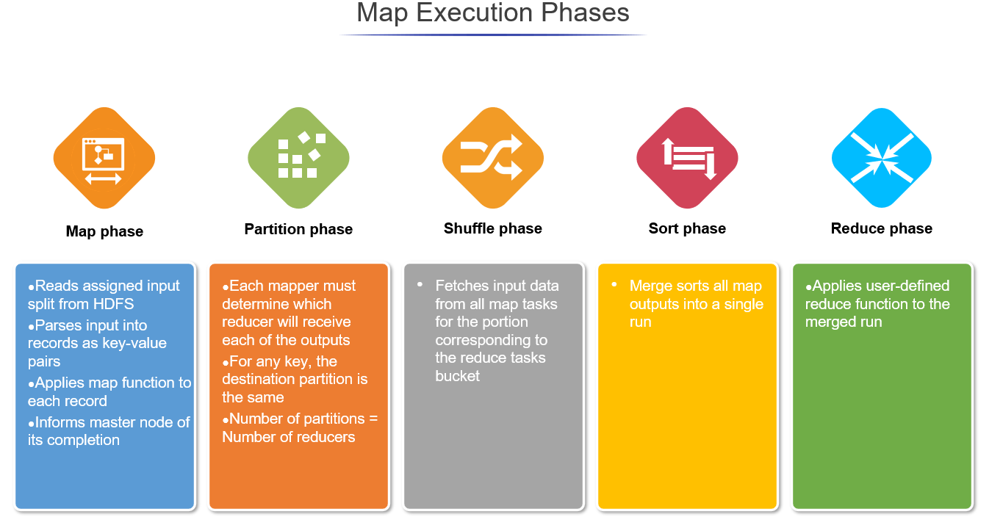

Slide 4
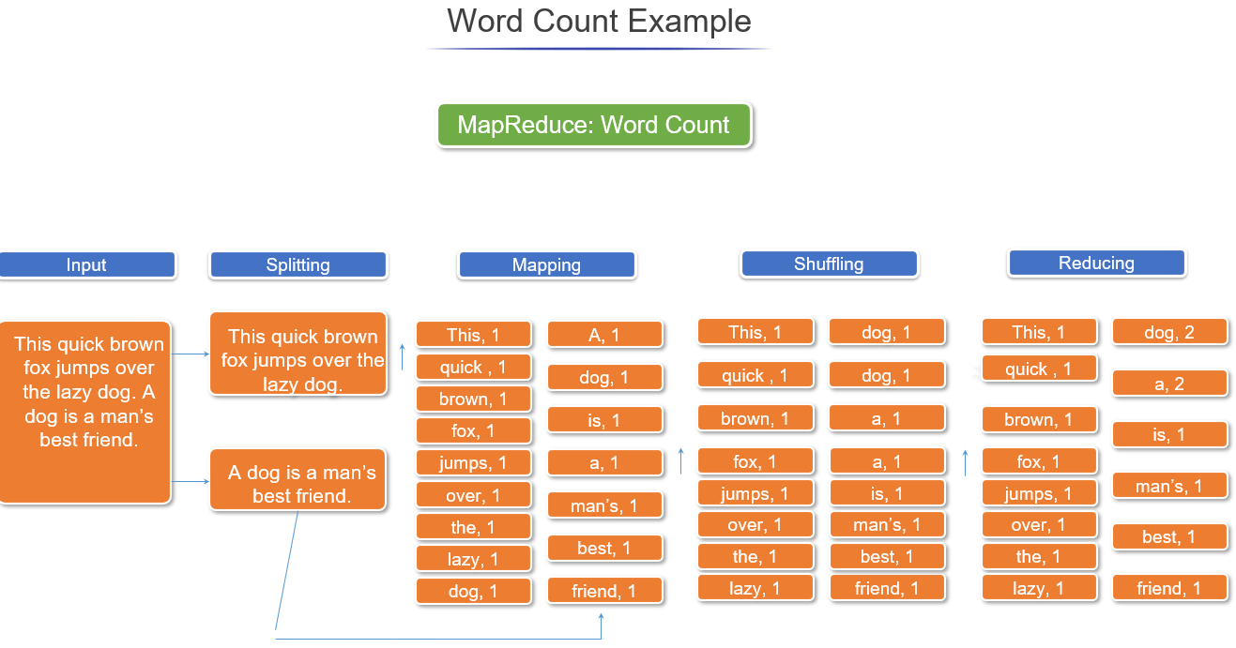

Slide 5
Explanation
MapReduce Tutorial: Explanation of MapReduce Program
The entire MapReduce program can be fundamentally divided into three parts:
Mapper Phase Code
Reducer Phase Code
Driver Code

