Slide 1
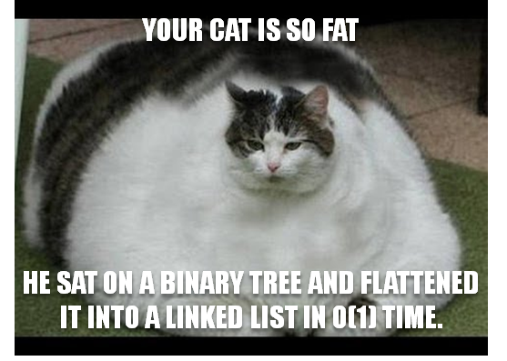
Binary Search Trees
^
SEARCH

Slide 2


Binary Search Trees
Why should you care?
Binary Search Trees are an extremely efficient way to store/search for data!
You can search a BST with billions of items in just microseconds!
They’re used in databases, operating systems, search engines, etc.
And because you’ll be asked about them in job interviews and on exams.
So pay attention!

Slide 3
Binary Search Trees
Binary Search Trees are a type of binary tree with specific properties that make them very efficient to search for a value in the tree.
Like regular Binary Trees, we store and search for values in Binary Search Trees…
“Larry”
root
“Fran”
“Ronda”
NULL
Here’s an example BST…
“Danny”
“Jack”
“Tom”
NULL
NULL
NULL
NULL
NULL
“Sam”
NULL
NULL

Slide 4
Binary Search Trees
BST Definition: A Binary Search Tree is a binary tree with the following property:
For every node X in the tree:
All nodes in X’s left sub-tree must be less than X.
“Larry”
root
All nodes in X’s right sub-tree must be greater than X.
“Fran”
“Ronda”
NULL
Let’s validate that this is a valid BST…
“Danny”
“Jack”
“Tom”
NULL
NULL
NULL
NULL
NULL
“Sam”
NULL
NULL

Slide 5
Binary Search Trees
Question: Which of the following are valid BSTs?
“Larry”
“Larry”
NULL
“Fran”
“Fran”
“Ronda”
NULL
NULL
NULL
“Danny”
“Manny”
NULL
“Danny”
“Nick”
NULL
NULL
NULL
NULL
“Alex”
“Amy”
“Nick”
NULL
NULL
NULL
NULL
NULL
“Maddy”
NULL
NULL

Slide 6
Operations on a Binary Search Tree
Here’s what we can do to a BST:
Determine if the binary search tree is empty
Search the binary search tree for a value
Insert an item in the binary search tree
Delete an item from the binary search tree
Find the height of the binary search tree
Find the number of nodes and leaves in the binary search tree
Traverse the binary search tree
Free the memory used by the binary search tree

Slide 7
Searching a BST
Input: A value V to search for
Output: TRUE if found, FALSE otherwise
Start at the root of the tree
Keep going until we hit the NULL pointer
If V is equal to current node’s value, then found!
If V is less than current node’s value, go left
If V is greater than current node’s value, go right
If we hit a NULL pointer, not found.
“Larry”
Gary == Larry??
Gary < Larry??
Gary == Fran??
Gary < Fran??
Gary > Fran??
Gary == Gary??
“Fran”
“Ronda”
NULL
NULL
Let’s search for Gary.
“Barry”
“Gary”
NULL
NULL
NULL
NULL

Slide 8
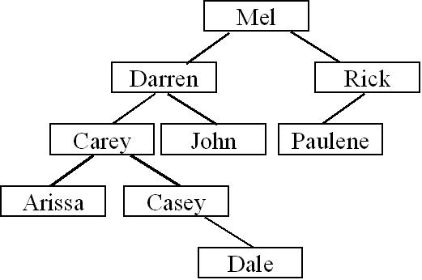
Searching a BST
Start at the root of the tree
Keep going until we hit the NULL pointer
If V is equal to current node’s value, then found!
If V is less than current node’s value, go left
If V is greater than current node’s value, go right
If we hit a NULL pointer, not found.
Show how to search for:
Khang
Dale
Sam

Slide 9
Searching a BST
Here are two different BST search algorithms in C++, one recursive and one iterative:
bool Search(int V,Node *ptr)
{
while (ptr != NULL)
{
if (V == ptr->value)
return(true);
else if (V < ptr->value)
ptr = ptr->left;
else
ptr = ptr->right;
} return(false); // nope
}
bool Search(int V, Node *ptr)
{
if (ptr == NULL)
return(false); // nope
else if (V == ptr->value)
return(true); // found!!!
else if (V < ptr->value)
return(Search(V,ptr->left));
else
return(Search(V,ptr->right));
}
Let’s trace through the recursive version…

Slide 10
Recursive BST Search
Lets search for 14.
pRoot
14 == 13??
ptr->
13
14 < 13??
14 == 17??
14 < 17??
14 == 14??
bool Search(int V, Node *ptr)
{
if (ptr == NULL)
return(false); // nope
else if (V == ptr->value)
return(true); // found!!!
else if (V < ptr->value)
return(Search(V,ptr->left));
else
return(Search(V,ptr->right));
}
bool Search(int V, Node *ptr)
{
if (ptr == NULL)
return(false); // nope
else if (V == ptr->value)
return(true); // found!!!
else if (V < ptr->value)
return(Search(V,ptr->left));
else
return(Search(V,ptr->right));
}
ptr->
7
17
bool Search(int V, Node *ptr)
{
if (ptr == NULL)
return(false); // nope
else if (V == ptr->value)
return(true); // found!!!
else if (V < ptr->value)
return(Search(V,ptr->left));
else
return(Search(V,ptr->right));
}
NULL
true
3
ptr->
14
19
NULL
NULL
NULL
NULL
NULL
NULL
void main(void)
{ bool bFnd; bFnd = Search(14,pRoot); }

Slide 11
Recursive BST Search
Lets search for 14.
pRoot
ptr->
13
true
bool Search(int V, Node *ptr)
{
if (ptr == NULL)
return(false); // nope
else if (V == ptr->value)
return(true); // found!!!
else if (V < ptr->value)
return(Search(V,ptr->left));
else
return(Search(V,ptr->right));
}
ptr->
7
17
bool Search(int V, Node *ptr)
{
if (ptr == NULL)
return(false); // nope
else if (V == ptr->value)
return(true); // found!!!
else if (V < ptr->value)
return(Search(V,ptr->left));
else
return(Search(V,ptr->right));
}
NULL
true
3
14
19
NULL
NULL
NULL
NULL
NULL
NULL
true
void main(void)
{ bool bFnd; bFnd = Search(14,pRoot); }

Slide 12
Recursive BST Search
Lets search for 14.
pRoot
true
ptr->
13
true
7
17
bool Search(int V, Node *ptr)
{
if (ptr == NULL)
return(false); // nope
else if (V == ptr->value)
return(true); // found!!!
else if (V < ptr->value)
return(Search(V,ptr->left));
else
return(Search(V,ptr->right));
}
NULL
true
3
14
19
NULL
NULL
NULL
NULL
NULL
NULL
int main(void)
{ bool bFnd; bFnd = Search(14,pRoot); }
true
true

Slide 13
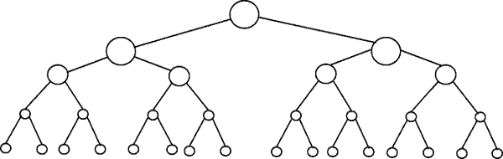
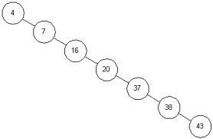
Big Oh of BST Search
Question: In the average BST with N values, how many steps are required to find our value?
50% eliminated!
50% eliminated!
50% eliminated!
Right! log₂(N) steps
50% eliminated!
Question: In the worst case BST with N values, how many steps are required find our value?
Right! N steps
Question: If there are 4 billion nodes in a BST, how many steps will it take to perform a search?
WOW! Now that’s PIMP!
Just 32!

Slide 14
Inserting A New Value Into A BST
To insert a new node in our BST, we must place the new node so that the resulting tree is still a valid BST!
Where would the following new values go?
Carly
Ken
Alice
Ken
Alice
Carly

Slide 15
Inserting A New Value Into A BST
Input: A value V to insert
If the tree is empty
Allocate a new node and put V into it
Point the root pointer to our new node. DONE!
Start at the root of the tree
While we’re not done…
If V is equal to current node’s value, DONE! (nothing to do...)
If V is less than current node’s value
If there is a left child, then go left
ELSE allocate a new node and put V into it, and
set current node’s left pointer to new node. DONE!
If V is greater than current node’s value
If there is a right child, then go right
ELSE allocate a new node and put V into it,
set current node’s right pointer to new node. DONE!

Slide 16
Now the C++ Code!
And here’s our Binary Search Tree class.
void insert(const std::string &value)
{
if (m_root == NULL) { m_root = new Node(value); return; }
Node *cur = m_root;
for (;;) {
if (value == cur->value) return;
if (value < cur->value) {
if (cur->left != NULL) cur = cur->left;
else
{
cur->left = new Node(value);
return;
}
}
else if (value > cur->value)
{
if (cur->right != NULL) cur = cur->right;
else
{
cur->right = new Node(value);
return;
}
}
}
}
Just as with a regular binary tree, we use a node struct to hold our items.
However let’s add a constructor to our Node so we can easily create a new one!
If our tree is empty, allocate a new node and point the root pointer to it – then we’re done!
class BinarySearchTree
{
public:
BinarySearchTree()
{
m_root = NULL;
}
void insert(const std::string &value)
{
…
}
private:
Node *m_root;
};
struct Node
{
std::string value;
Node *left,*right;
};
And our constructor initializes that root pointer to NULL when we create a new tree.
(This indicates the tree is empty)
Start traversing down from the root of the tree.
for(;;) is the same as an infinite loop.
Node(const std::string &myVal)
{
value = myVal;
left = right = NULL;
}
If our value is already in the tree, then we’re done - just return.
If the value to insert is less than the current node’s value, then go left.
If there is a node to our left, advance to that node and continue.
Now let’s see our complete insertion function in C++.
Otherwise we’ve found the proper spot for our new value! Add our value as the left child of the current node.
Our BST class has a single member variable – the root pointer to the tree.
If the value we want to insert is greater than the current node’s value, then traverse/insert to the right.

Slide 17
void insert(const std::string &value)
{
if (m_root == NULL) { m_root = new Node(value); return; }
Node *cur = m_root;
for (;;) {
if (value == cur->value) return;
if (value < cur->value) {
if (cur->left != NULL) cur = cur->left;
else
{
cur->left = new Node(value);
return;
}
}
else if (value > cur->value)
{
if (cur->right != NULL) cur = cur->right;
else
{
cur->right = new Node(value);
return;
}
}
}
}
m_root
NULL
“Larry”
NULL
NULL
void main(void) {
BinarySearchTree bst;
bst.insert(“Larry”);
...
bst.insert(“Phil”); }

Slide 18
void insert(const std::string &value)
{
if (m_root == NULL) { m_root = new Node(value); return; }
Node *cur = m_root;
for (;;) {
if (value == cur->value) return;
if (value < cur->value) {
if (cur->left != NULL) cur = cur->left;
else
{
cur->left = new Node(value);
return;
}
}
else if (value > cur->value)
{
if (cur->right != NULL) cur = cur->right;
else
{
cur->right = new Node(value);
return;
}
}
}
}
m_root
cur→
“Larry”
Phil == Larry??
Phil == Ronda??
?
Phil < Larry??
Phil < Ronda??
“Fran”
“Ronda”
NULL
NULL
?
“Barry”
“Phil”
NULL
NULL
NULL
NULL
Phil > Larry??
void main(void) {
BinarySearchTree bst;
bst.insert(“Larry”);
...
bst.insert(“Phil”); }

Slide 19
Inserting A New Value Into A BST
As with BST Search, there is a recursive version of the Insertion algorithm too. Be familiar with it!
Question: Given a random array of numbers if you insert them one at a time into a BST, what will the BST look like?
Question: Given a ordered array of numbers if you insert them one at a time into a BST, what will the BST look like?

Slide 20
Big Oh of BST Insertion
So, what’s the big-oh of BST Insertion?
Right! It’s also O(log₂n)
Why? Because we have to first use a binary search to find where to insert our node and binary search is O(log₂n).
Once we’ve found the right spot, we can insert our new node in O(1) time.
Groovy Baby!

Slide 21
Finding Min & Max of a BST
How do we find the minimum and maximum values in a BST?
The minimum value is located at the left-most node.
The maximum value is located at the right-most node.
int GetMin(node *pRoot)
{
if (pRoot == NULL)
return(-1); // empty
while (pRoot->left != NULL)
pRoot = pRoot->left;
return(pRoot->value);
}
int GetMax(node *pRoot)
{
if (pRoot == NULL)
return(-1); // empty
while (pRoot->right != NULL)
pRoot = pRoot->right;
return(pRoot->value);
}
“Larry”
“Fran”
“Ronda”
NULL
NULL
“Barry”
“Phil”
NULL
NULL
NULL
NULL
Question: What’s the big-oh to find the minimum or maximum element?

Slide 22
Finding Min & Max of a BST
And here are recursive versions for you…
int GetMin(node *pRoot)
{
if (pRoot == NULL)
return(-1); // empty
if (pRoot->left == NULL)
return(pRoot->value);
return(GetMin(pRoot->left));
}
int GetMax(node *pRoot)
{
if (pRoot == NULL)
return(-1); // empty
if (pRoot->right == NULL)
return(pRoot->value);
return(GetMax(pRoot->right));
}
Hopefully you’re getting the idea that most tree functions can be done recursively…

Slide 23
Printing a BST In Alphabetical Order
Can anyone guess what algorithm we use to print out a BST in alphabetical order?
root
cur
“jane”
cur
cur
cur
“danny”
“waa”
cur
cur
cur
NULL
NULL
cur
“bill”
“frank”
cur
NULL
NULL
NULL
NULL
void InOrder(Node *cur)
{
if (cur == NULL) // if empty, return…
return;
InOrder(cur->left); // Process nodes in left sub-tree.
cout << cur->value; // Process the current node.
InOrder(cur->right); // Process nodes in right sub-tree.
}
Big-oh Alert!
So what’s the big-Oh of printing all the items in the tree?
Output:
bill
danny
frank
Right! O(n) since we have to visit and print all n items.
jane
waa

Slide 24
Freeing The Whole Tree
When we are done with our BST, we have to free every node in the tree, one at a time.
Question: Can anyone think of an algorithm for this?
void FreeTree(Node *cur)
{
if (cur == NULL) // if empty, return…
return;
FreeTree(cur->left); // Delete nodes in left sub-tree.
FreeTree (cur->right); // Delete nodes in right sub-tree.
delete cur; // Free the current node
}

Slide 25
Freeing The Whole Tree
cur->
“Larry”
cur->
“Fran”
“Ronda”
cur = NULL
NULL
NULL
void FreeTree(Node *cur)
{
if (cur == NULL)
return;
FreeTree(cur->left);
FreeTree (cur-> right);
delete cur;
}
cur->
void FreeTree(Node *cur)
{
if (cur == NULL)
return;
FreeTree(cur->left);
FreeTree (cur-> right);
delete cur;
}
“Barry”
“Gabby”
void FreeTree(Node *cur)
{
if (cur == NULL)
return;
FreeTree(cur->left);
FreeTree (cur-> right);
delete cur;
}
NULL
NULL
NULL
NULL
void FreeTree(Node *cur)
{
if (cur == NULL)
return;
FreeTree(cur->left);
FreeTree (cur-> right);
delete cur;
}

Slide 26
Freeing The Whole Tree
cur->
“Larry”
cur->
“Fran”
“Ronda”
NULL
NULL
cur->
“Barry”
“Gabby”
void FreeTree(Node *cur)
{
if (cur == NULL)
return;
FreeTree(cur->left);
FreeTree (cur-> right);
delete cur;
}
void FreeTree(Node *cur)
{
if (cur == NULL)
return;
FreeTree(cur->left);
FreeTree (cur-> right);
delete cur;
}
NULL
NULL
NULL
NULL
void FreeTree(Node *cur)
{
if (cur == NULL)
return;
FreeTree(cur->left);
FreeTree (cur-> right);
delete cur;
}

Slide 27
Freeing The Whole Tree
cur->
“Larry”
cur->
“Fran”
“Ronda”
NULL
NULL
cur->
“Gabby”
void FreeTree(Node *cur)
{
if (cur == NULL)
return;
FreeTree(cur->left);
FreeTree (cur-> right);
delete cur;
}
NULL
void FreeTree(Node *cur)
{
if (cur == NULL)
return;
FreeTree(cur->left);
FreeTree (cur-> right);
delete cur;
}
NULL
void FreeTree(Node *cur)
{
if (cur == NULL)
return;
FreeTree(cur->left);
FreeTree (cur-> right);
delete cur;
}

Slide 28
Freeing The Whole Tree
cur->
“Larry”
cur->
“Fran”
“Ronda”
NULL
NULL
void FreeTree(Node *cur)
{
if (cur == NULL)
return;
FreeTree(cur->left);
FreeTree (cur-> right);
delete cur;
}
void FreeTree(Node *cur)
{
if (cur == NULL)
return;
FreeTree(cur->left);
FreeTree (cur-> right);
delete cur;
}
Big-oh Alert!
So what’s the big-Oh of freeing all the items in the tree?
And so on…
It’s still O(n) since we have to visit all n items.

Slide 29
Deleting a Node from a Binary Search Tree
By simply moving an arbitrary node into Darren’s slot, we violate our Binary Search Tree ordering requirement!
Carey is NOT less than Arissa!
Next we’ll see how to do this properly….
Now, let’s learn how to delete an item from a BST.
It’s not as easy as you might think!
Let’s say we want to delete Darren from our tree…
NO!
Now how do I re-link the nodes back together?
X
Can I just move Arissa into Darren’s old slot?
Hmm.. It seems OK, but is our tree still a valid binary search tree?
Arissa

Slide 30
Deleting a Node from a Binary Search Tree
Here’s a high-level algorithm to delete a node from a Binary Search Tree:
Given a value V to delete from the tree:
Find the value V in the tree, with a slightly-modified BST search.
Use two pointers: a cur pointer & a parent pointer
If the node was found, delete it from the tree, making sure to preserve its ordering!
There are three cases, so be careful!

Slide 31

BST Deletion: Step #1
This algorithm is very similar to our traditional BST searching algorithm… Except it also has a parent pointer.
Step 1: Searching for value V
Every time we move down left or right, we advance the parent pointer as well!
Let’s delete Casey
When we’re done with our loop below, we want the parent pointer to point to the node just above the target node we want to delete.
parent = NULL
cur = root
While (cur != NULL)
If (V == cur->value) then we’re done.
If (V < cur->value)
parent = cur;
cur = cur->left;
C. Else if (V > cur->value)
parent = cur;
cur = cur->right;
Casey < Mel?
Casey < Darren?
Casey < Carey?
We’d want our parent pointer to point to Carey’s node.
parent
cur
parent
parent
cur
parent
cur
So if we were deleting Arissa…
cur
Now cur points at the node we want to delete, and parent points to the node above it!
parent
NULL

Slide 32
BST Deletion: Step #2
Once we’ve found our target node, we have to delete it. There are 3 cases.
Case 1:
Our node is a leaf.
Case 2:
Our node has one child
Case 3:
Our node has two children.
parent
cur
parent
cur
parent
cur

Slide 33
Step #2, Case #1 – Our Target Node is a Leaf
Let’s look at case #1 – it has two sub-cases!
Case 1, Sub-case #1: The target node is NOT the root node
Case 1:
Our node is a leaf.
ptr
Unlink the parent node from the target node (cur) by setting the parent’s appropriate link to NULL.
Then delete the target (cur) node.
In this case, our target node (cur) is our parent node’s right child…
So we’ll set parent->right to NULL to unlink the parent and cur.
parent
Our target node (cur) that we want to delete is NOT the root node!
cur
X

Slide 34
Step #2, Case #1 – Our Target Node is a Leaf
Let’s look at case #1 – it has two sub-cases!
Case 1, Sub-case #1: The target node is NOT the root node
Case 1:
Our node is a leaf.
ptr
Unlink the parent node from the target node (cur) by setting the parent’s appropriate link to NULL.
root
NULL
X
cur
Mel
Then delete the target (cur) node.
Case 1, Sub-case #2: The target node is the root node
parent
Our target node (cur) that we want to delete is the root node!
X
Set the root pointer to NULL.
cur
Then delete the target (cur) node.

Slide 35
Step #2, Case #2 – Our Target Node has One Child
Let’s look at case #2 now…
It also has two sub-cases!
Case 2, Sub-case #1: The target node is NOT the root node
Case 2:
Our node has one child
Relink the parent node to the target (cur) node’s only child.
parent
cur
X
Then delete the target (cur) node.
Our target node (cur) that we want to delete is NOT the root node!
only child

Slide 36
Step #2, Case #2 – Our Target Node has One Child
Let’s look at case #2 now…
It also has two sub-cases!
Case 2, Sub-case #1: The target node is NOT the root node
Case 2:
Our node has one child
Our target node (cur) that we want to delete is the root node!
Relink the parent node to the target (cur) node’s only child.
root
Then delete the target (cur) node.
cur
X
Mel
only child
Phil
Case 2, Sub-case #2: The target node is the root node
Nate
Sam
Relink the root pointer to the target (cur) node’s only child.
Then delete the target (cur) node.

Slide 37
Step #2, Case #3 – Our Target Node has Two Children
Let’s look at case #3 now. The hard one!
Case 3:
Our node has two children.
We need to find a replacement for our target node that still leaves the BST consistent.
We can’t just pick some arbitrary node and move it up into the vacated slot!
parent
For instance, what if we tried replacing Darren with Arissa?
cur
Arissa
Has two children!
Utoh! If we replace Darren with Arissa, our BST is no longer consistent!
Let’s move her up!
So, when deleting a node with two children, we have to be very careful!

Slide 38
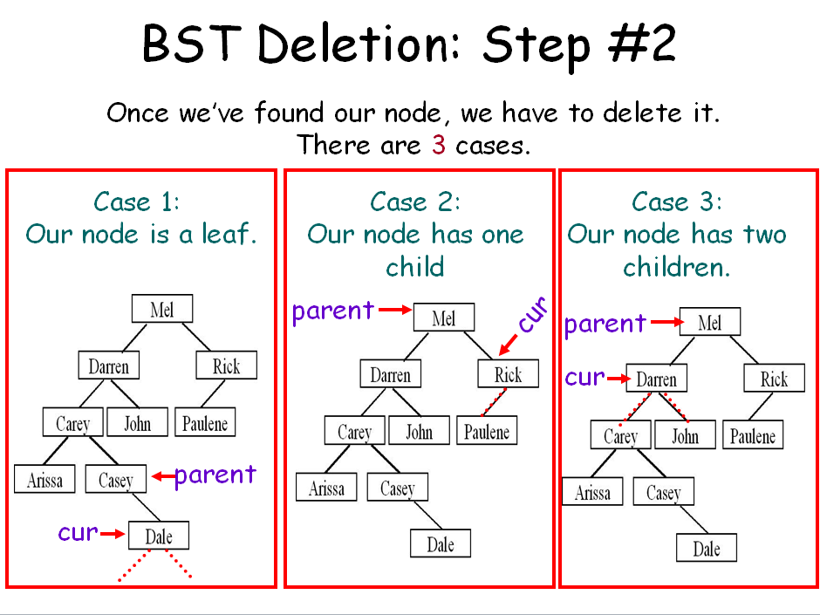
Step #2, Case #3 – Our Target Node has Two Children
…
Notice that our BST is still correct!
To delete a node like k that has two children….
We don’t actually delete the node itself!
k
Instead, we replace its value with one from another node!
These two values are the only suitable replacements for node k – so pick either one and copy it up.
These two values are the only suitable replacements for node k.
f
q
How? We want to replace k with either:
K’s left subtree’s largest-valued child
Notice that both of them are either a leaf or have just one child!
m
Or
2. K’s right subtree’s smallest-valued child
b
h
t
a
d
g
j
p
s
u
j
We use technique #1 or #2!
Why? Our replacement node is guaranteed to have either zero or one child!
c
e
n
So we pick one, copy its value up, then delete that node!
In this case, our node is a leaf, so we use Case 1.
For example, let’s use this node’s value.
Finally, we delete this node! How?

Slide 39
Step #2, Case #3 – Our Target Node has Two Children
…
Notice that our BST is still correct!
k
OK, now let’s try the other replacement node and see if it works!
f
q
And now let’s delete the replacement node… Which Case should we use?
m
b
h
m
t
In this case, our node has one child, so we use Case 2.
a
d
g
j
p
s
u
c
e
n

Slide 40
Step #2, Case #3 – Our Target Node has Two Children
…
Why is it guaranteed that our two replacement nodes have either zero or one child?
k
Well, we found the left subtree’s maximum value by going all the way to the right…
f
q
So by definition, it can’t have a right child!
b
h
m
t
No left child!
Either it has a left child or no children at all…
a
d
g
j
p
s
u
No right child!
The same holds true for the smallest value in our right subtree!
c
e
?
n
So this ensures we can use one of our simpler deletion algorithms for the replacement!
By definition, it can’t have a left child!

Slide 41
Deletion Exercise
Explain how you would go about deleting node k.
k
f
n
Explain how you would go about deleting node e.
b
h
l
p
Explain how you would go about deleting node i.
a
d
g
j
m
o
q
c
e
i
igloo
infer

Slide 42
Where are Binary Search Trees Used?
Remember the STL map?
#include <map>
using namespace std;
main()
{
map<string,float> stud2gpa;
stud2gpa[“Carey”] = 3.62;
stud2gpa[“David”] = 3.99;
stud2gpa[“Dalia”] = 4.0;
cout << stud2gpa[“David”];
}
stud2gpa
pRoot
NULL
ID
“Carey”
val
2.1
3.62
// BST insert!
left
NULL
right
NULL
ID
“David”
stud2gpa[“Carey”] = 2.1;
// BST search!
val
3.99
left
NULL
right
NULL
It uses a type of binary search tree to store the items!
ID
“Dalia”
val
4.0
left
right
NULL NULL

Slide 43
Where are Binary Search Trees Used?
The STL set also uses a type of BSTs!
#include <set>
using namespace std;
main()
{
}
The STL set and map use binary search trees (a special balanced kind) to enable fast searching.
// construct BST
Other STL containers like multiset and multimap also use binary search trees.
These containers can have duplicate mappings. (Unlike set and map)
set<int> a;
a.insert(2);
a.insert(3);
a.insert(4);
// insert into BST
a.insert(2);
int n;
n = a.size();
a.erase(2);
// delete from BST

Slide 44
Binary Tree Review
Question #1: Is the above tree a valid binary search tree?
Question #2: How about now?
Max

Slide 45
Binary Search Tree Insertion Review
Question #1: How would you go about inserting “Cathy”
Question #2: How would you go about inserting “Priyank”.
Notes:
Cathy would be Dale’s left child
Priyank would be Paulene’s right child

Slide 46
Balanced Search Trees
Question:
What happens if we insert the following values into a binary search tree?
5, 10, 7, 9, 8, 20, 18, 17, 16, 15, 14, 13, 12, 11
Right! We get an unbalanced tree!
Question:
What is the approximate big-oh cost of searching for a value in this tree?
O(N)… YUCK!

Slide 47
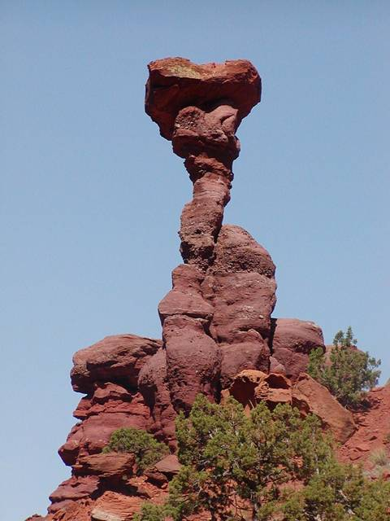
Balanced Search Trees
In real life, BSTs often end up looking just like our example, especially after repeated insertions and deletions.
It’d be nice if we could come up with an improved BST ADT that always maintains its balance.
This would ensure that all insertions, searches and deletions would be O(log n).

Slide 48
Balanced Search Trees
Well, guess what?
CS nerds have come to the rescue!
They’ve invented numerous improved binary search tree ADTs like 2-3 Trees, Red-Black Trees, and AVL Trees.
These BST variations work (mostly) just like a regular binary search tree…
but every time you add/delete a value, they automatically shift the nodes around so the tree is balanced!

Slide 49
Balancing a Tree On Insertion
For example, the AVL Tree tracks the height of ALL subtrees in the BST.
J
Consider node T…
B
T
R
Z
3
3
Its left subtree has a height of 3…
And its right subtree has a height of 3 too…

Slide 50
Balancing a Tree On Insertion
For example, the AVL Tree tracks the height of ALL subtrees in the BST.
Or consider node J…
The AVL tree tracks these subtree height values for every node in the tree!
J
B
T
3
4
R
Z
And its right subtree has a height of 4…
Its left subtree has a height of 3…

Slide 51
Balancing a Tree On Insertion
For example, the AVL Tree tracks the height of ALL subtrees in the BST.
After an insertion/deletion, if the height of the subtrees under any node is different by more than one level…
Then the AVL algorithm shifts the nodes around to maintain balance.
So the difference between J’s two subtrees is 2 levels!
J
J
J
While the shifting looks complex (it is ☺), it only takes O(log n) time!
T
B
T
B
T
B
3
5
4
4
4
So with just a little extra work, the tree is always balanced and can always be searched in log n time!
R
R
Z
Z
R
Z
For instance, J’s left subtree has a height of 3…
But now its right subtree has a height of 5!

Slide 52
Balanced Search Trees
You don’t need to know the gory details of any of these balanced BSTs for your final or projects.
Just remember, that balanced BSTs are always O(log n) for insertion and deletion.
And if you’re ever in a job/internship interview and are asked a BST question…
Always make sure to ask the interviewer if you may assume the BST is balanced!
It could make or break your interview!

Slide 53
Appendix Slides

Slide 54


Huffman Encoding: Applying Trees to Real-World Problems
Huffman Encoding is a data compression technique that can be used to compress and decompress files (e.g. like creating ZIP files).

Slide 55
Background
Before we actually cover Huffman Encoding, we need to learn a few things…
Remember the ASCII code?

Slide 56
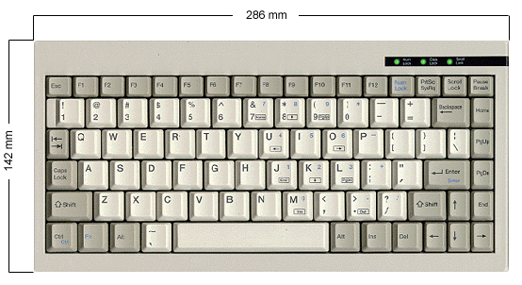

ASCII
Computers represent letters, punctuation and digit symbols using the ASCII code, storing each character as a number.
When you type a character on the keyboard, it’s converted into a number and stored in the computer’s memory!
50
65

Slide 57
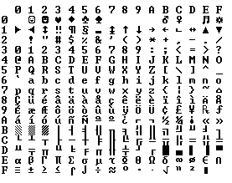
The ASCII Chart
48
0-15
16-31
32-47
48-63
64-79
80-95
96-111
112-127
65
97

Slide 58


Computer Memory and Files
So basically, characters are stored in the computer’s memory as numbers…
data
67
67
main()
{
char data[7] = “Carey”;
ofstream out(“file.dat”);
out << data;
out.close();
}
97
97
114
114
101
101
121
121
0
0
0
0
Similarly, when you write data out to a file, it’s stored as ASCII numbers too!

Slide 59
Bytes and Bits
Now, as you’ve probably heard, the computer actually stores all numbers as 1’s and 0’s (in binary) instead of decimal…
data
01000011
01000011
67
main()
{
char data[7] = “Carey”;
ofstream out(“file.dat”);
out << data;
out.close();
}
01100001
97
01110010
114
01100101
101
01111001
121
00000000
0
00000000
0
Each character is represented by 8 bits.
Each bit can have a value of either 0 or 1
(i.e. 1 = high voltage and 0 = low voltage)

Slide 60
Binary and Decimal
Every decimal number has an equivalent binary representation (they’re just two ways of representing the same thing)
Decimal Number
Binary Equivalent
0
00000000
1
00000001
2
00000010
3
00000011
4
00000100
…
…
255
11111111
So that’s binary…

Slide 61
Consider a Data File
Now lets consider a simple data file containing the data:
“I AM SAM MAM.”
As we’ve learned, this is actually stored as 13 numbers in our data file:
73 32 65 77 32 83 65 77 32 77 65 77 46
And in reality, its really stored in the computer as a set of 104 binary digits (bits):
01001001 00100000 01000001 01001101 00100000 01010011 01000001
01001101 00100000 01001101 01000001 01001101 00101110
(13 characters * 8 bits/character = 104 bits)

Slide 62
Data Compresion
So our original string “I AM SAM MAM.” requires 104 bits to store on our computer… OK.
01001001 00100000 01000001 01001101 00100000 01010011 01000001
01001101 00100000 01001101 01000001 01001101 00101110
The question is:
Can we somehow reduce the number of bits required to store our data?
And of course, the answer is YES!

Slide 63
Huffman Encoding
To compress a file “file.dat” with Huffman encoding, we use the following steps:
Compute the frequency of each character in file.dat.
Build a Huffman tree (a binary tree) based on these frequencies.
Use this binary tree to convert the original file’s contents to a more compressed form.
Save the converted (compressed) data to a file.

Slide 64
Huffman Encoding: Step #1
Step #1: Compute the frequency of each character in file.dat.
(i.e. compute a histogram)
FILE.DAT
S
M
M
I AM SAM MAM.
I
A
M
A
M
A
.
‘A’
‘I’
‘M’
‘S’
Space
Period
3
1
4
1
3
1

Slide 65
Huffman Encoding: Step #2
Step #2: Build a Huffman tree (a binary tree) based on these frequencies:
A. Create a binary tree leaf node for each entry in our table, but don’t insert any of these into a tree!
ch
B. While we have more than one node left:
1. Find the two nodes with lowest freqs.
2. Create a new parent node.
3. Link the parent to each of the children.
4. Set the parent’s total frequency equal to the sum of its children’s frequencies.
5. Place the new parent node in our grouping.
freq
2
1+1
left
right
‘A’
‘I’
‘M’
‘S’
Space
Period
3
1
4
1
3
1
ch
‘.’
ch
‘S’
ch
‘I’
ch
‘A’
ch
‘ ’
ch
‘M’
freq
1
freq
1
freq
1
freq
3
freq
3
freq
4
left
right
left
right
left
right
left
right
left
right
left
right
NULL
NULL
NULL
NULL
NULL
NULL
NULL
NULL
NULL
NULL
NULL
NULL

Slide 66
Huffman Encoding: Step #2
Step #2: Build a Huffman tree (a binary tree) based on these frequencies:
A. Create a binary tree leaf node for each entry in our table, but don’t insert any of these into a tree!
ch
B. While we have more than one node left:
1. Find the two nodes with lowest freqs.
2. Create a new parent node.
3. Link the parent to each of the children.
4. Set the parent’s total frequency equal to the sum of its children’s frequencies.
5. Place the new parent node in our grouping.
freq
2
left
right
ch
freq
3
ch
‘.’
ch
‘S’
left
right
freq
1
freq
1
left
right
left
right
NULL
NULL
NULL
NULL
ch
ch
‘I’
ch
‘A’
ch
‘ ’
ch
‘M’
freq
2
freq
1
freq
3
freq
3
freq
4
left
right
left
right
left
right
left
right
left
right
NULL
NULL
NULL
NULL
NULL
NULL
NULL
NULL
ch
‘.’
ch
‘S’
freq
1
freq
1
left
right
left
right
NULL
NULL
NULL
NULL

Slide 67
Huffman Encoding: Step #2
ch
freq
6
left
right
ch
freq
3
left
right
ch
ch
‘I’
ch
‘A’
ch
‘ ’
ch
‘M’
freq
2
freq
1
freq
3
freq
3
freq
4
left
right
left
right
left
right
left
right
left
right
NULL
NULL
NULL
NULL
NULL
NULL
NULL
NULL
ch
‘.’
ch
‘S’
freq
1
freq
1
left
right
left
right
NULL
NULL
NULL
NULL

Slide 68
Huffman Encoding: Step #2
ch
freq
13
left
right
ch
ch
freq
7
freq
6
left
right
left
right
ch
ch
‘A’
ch
‘ ’
ch
‘M’
freq
3
freq
3
freq
3
freq
4
left
right
left
right
left
right
left
right
NULL
NULL
NULL
NULL
NULL
NULL
ch
ch
‘I’
Ok. Now we have a single binary tree.
freq
2
freq
1
left
right
left
right
NULL
NULL
ch
‘.’
ch
‘S’
freq
1
freq
1
left
right
left
right
NULL
NULL
NULL
NULL

Slide 69
Huffman Encoding: Step #2
Step #2: Build a Huffman tree (a binary tree) based on these frequencies:
A. Create a binary tree leaf node for each entry in our table, but don’t insert any of these into a tree!
ch
B. Build a binary tree from the leaves.
freq
13
left
right
0
C. Now label each left edge with a “0” and
each right edge with a “1”
0
0
0
0
1
1
1
1
1
ch
ch
freq
7
freq
6
left
right
left
right
ch
ch
‘M’
ch
‘A’
ch
‘ ’
freq
3
freq
4
freq
3
freq
3
left
right
left
right
left
right
left
right
NULL
NULL
NULL
NULL
NULL
NULL
ch
ch
‘I’
freq
2
freq
1
left
right
left
right
NULL
NULL
ch
‘.’
ch
‘S’
freq
1
freq
1
left
right
left
right
NULL
NULL
NULL
NULL

Slide 70
Huffman Encoding: Step #2
Now we can determine the new bit-encoding for each character.
ch
freq
13
left
right
0
1
The bit encoding for a character is the path of 0’s and 1’s that you take from the root of the tree to the character of interest.
ch
ch
freq
7
freq
6
left
right
left
right
0
1
0
1
ch
ch
‘M’
ch
‘A’
ch
‘ ’
freq
3
freq
4
freq
3
freq
3
left
right
left
right
left
right
left
right
For example:
1
NULL
NULL
NULL
NULL
NULL
NULL
0
ch
ch
‘I’
S is encoded as 0001
freq
2
freq
1
left
right
left
right
A is encoded as 10
0
1
NULL
NULL
M is encoded as 01
ch
‘.’
ch
‘S’
Notice that characters that occurred more often in our message have shorter bit-encodings!
freq
1
freq
1
Etc…
left
right
left
right
NULL
NULL
NULL
NULL

Slide 71
Huffman Encoding: Step #3
Step #3: Use this binary tree to convert the original file’s contents to a more compressed form..
i.e. find the sequence of bits (1s and 0s) for each char in the message.
ch
freq
13
left
right
0
1
ch
ch
I AM SAM MAM.
freq
7
freq
6
left
right
left
right
0
1
0
1
001
11
10
01
11
0001
10
01
ch
ch
‘M’
ch
‘A’
ch
‘ ’
11
01
10
01
0000
freq
3
freq
4
freq
3
freq
3
left
right
left
right
left
right
left
right
1
NULL
NULL
NULL
NULL
NULL
NULL
0
ch
ch
‘I’
freq
2
freq
1
left
right
left
right
0
1
NULL
NULL
ch
‘.’
ch
‘S’
freq
1
freq
1
left
right
left
right
NULL
NULL
NULL
NULL

Slide 72
Huffman Encoding: Step #4
Step #4: Save the converted (compressed) data to a file.
001
11
10
01
11
0001
10
10
01
001
11
10
01
11
0001
01
11
01
0000
11
01
01
10
01
0000
10
compressed.dat
Notice that our new file is less than four bytes or 31 bits long!
Our original file is 13 bytes or 104 bits long!
originalfile.dat
01001001 00100000 01000001 01001101 00100000 01010011 01000001 01001101 00100000
01001101 01000001 01001101
00101110
We saved over 69%!

Slide 73
Ok… So I cheated a bit…
compressed.dat
If all we have is our 31 bits of data… its impossible to interpret the file!
Encoding:
‘A’ = “10”
‘ ‘ = “11”
‘M’ = “01”
‘I’ = “001”
‘.’ = “0000”
‘S’ = “0001”
Encoded Data:
001
11
10
01
11
0001
10
01
11
01
10
01
0000
Did 000 equal “I” or did 000 equal “Q”? Or was it 00 equals “A”?
So, we must add some additional data to the top of our compressed file to specify the encoding we used…
Now clearly this adds some overhead to our file…
But usually there’s a pretty big savings anyway!

Slide 74
Decoding…
Extract the encoding scheme from the compressed file.
Build a Huffman tree (a binary tree) based on the encodings.
Use this binary tree to convert the compressed file’s contents back to the original characters.
Save the converted (uncompressed) data to a file.
ch
compressed.dat
Output:
freq
ch
left
right
Encoding:
‘A’ = “10”
‘ ‘ = “11”
‘M’ = “01”
‘I’ = “001”
‘.’ = “0000”
‘S’ = “0001”
Encoded Data:
freq
I
_
A
M
_SAM_MAM.
0
left
right
1
0
NULL
1
ch
ch
ch
freq
freq
output.dat
left
right
ch
freq
left
right
left
right
freq
left
right
I AM SAM
MAM.
0
1
0
1
NULL
NULL
1
0
1
ch
ch
‘M’
ch
‘A’
ch
‘ ’
freq
ch
freq
freq
freq
‘M’
ch
‘A’
ch
‘ ‘
left
right
freq
left
right
left
right
left
right
NULL
freq
freq
left
right
NULL
NULL
NULL
NULL
NULL
0
1
left
right
left
right
NULL
NULL
NULL
NULL
NULL
NULL
001
11
10
ch
ch
‘I’
(When you hit a leaf node, output ch and then start again at the root!)
freq
(When you hit a leaf node, output ch and then start again at the root!)
01
11
0001
freq
left
right
left
right
10
01
11
01
0
1
NULL
NULL
10
01
0000
ch
‘.’
ch
‘S’
freq
freq
left
right
left
right
NULL
NULL
NULL
NULL

