Slide 1
MACHINE LEARNING PROJECT · SUPERVISED CLASSIFICATION
Breast Cancer Classification Using Machine Learning
Predicting benign and malignant tumors from nine cytological features, comparing five classifiers, and selecting the best one.
Project Team
Ebraam Saber
Peter Peshoy
David Farid
Dr. Mohamed Abdel Nasser
Eng. Matthew Mokhles

Slide 2
01 · PROJECT OVERVIEW
Why this project matters
“A missed malignant tumor is the most costly error.”
01
Classify
Predict Benign (0) or Malignant (1) from nine cytological features.
Breast tumors are assessed from cytological measurements of cell nuclei. The core question is whether a tumor is benign or malignant.
Errors carry different costs. A false negative, a malignant tumor predicted as benign, can delay treatment. A false positive is resolved with further tests. Model selection here therefore puts Recall first.
02
Compare
Evaluate five supervised algorithms under one preprocessing and tuning protocol.
03
Select
Choose the best model using the project ranking: Recall, F1-score, ROC-AUC, then Accuracy.

Slide 3
02 · DATASET
Breast Cancer Wisconsin (Original)
699
11
9
2
patient records in the original file
columns, including the identifier and target
predictive features, each scored from 1 to 10
classes: ID and Class
Predictive features
Clump Thickness
1 – 10
Uniformity of Cell Size
1 – 10
Uniformity of Cell Shape
1 – 10
Marginal Adhesion
1 – 10
Single Epithelial Cell Size
1 – 10
Bare Nuclei
1 – 10
Bland Chromatin
1 – 10
Normal Nucleoli
1 – 10
Mitoses
1 – 10
Target: Class, coded 2 = Benign and 4 = Malignant, then recoded to 0 = Benign and 1 = Malignant (the positive class). Sample_code_number is an identifier and is not used as a feature.

Slide 4
03 · DATA QUALITY
Missing values and duplicate records
16
8
54
236
missing values, all in Bare_Nuclei (2.29% of rows)
exact duplicate rows, identical in every column including the ID. Removed.
repeated Sample_code_number values (same patient sampled more than once)
duplicate rows when the ID is ignored. Only the 8 exact duplicates are removed.
Class distribution, original data (699 records)
What this means for modelling
Missing values sit in one feature (about 2%), so imputation is safer than dropping rows.
Only exact duplicates are removed, matching the notebook’s final preprocessing.
The moderate imbalance (about 65% / 35%) favours stratified splits and F1 and ROC-AUC reporting.
Benign
458 (65.52%)
Malignant
241 (34.48%)

Slide 5
04 · PREPROCESSING
From raw records to model-ready data
1
2
3
4
5
Remove duplicates
Drop identifier
Encode target
Stratified split
Impute and scale
699 → 691 records after removing 8 exact duplicates
Sample_code_number removed. 9 features remain.
Benign 2 → 0 and Malignant 4 → 1 (positive class)
80:20 split with class ratio preserved: 552 train, 139 test
Median imputation (training median 1.0). Z-score scaling for KNN, SVM and ANN.
Train / test split (stratified)
Training set: 552 (80%) · 190 malignant (34.4%)
Test: 139 (20%)
Malignant share is 34.4% in training and 34.5% in test (48 of 139 test cases).
Leakage control: imputation and scaling learn statistics, so they are fitted on training data only. Inside cross-validation, Pipelines refit them on each fold.

Slide 6
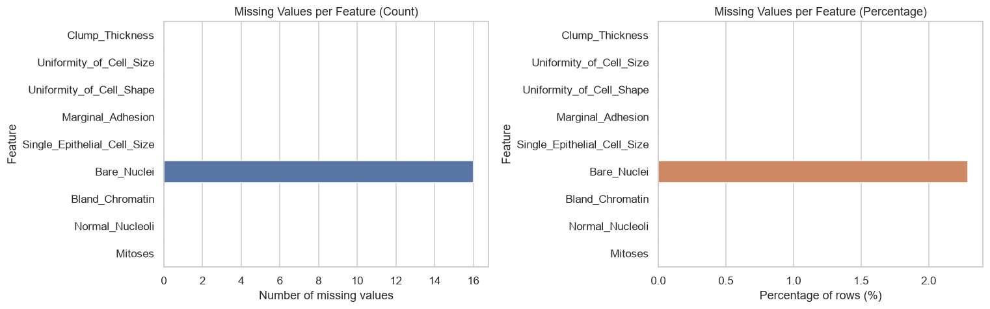
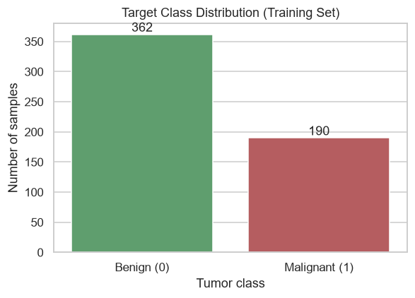
05 · EXPLORATORY DATA ANALYSIS
Missing values and class balance
Missing values Only Bare_Nuclei has gaps: 16 rows, or 2.29%. All other features are complete. Median imputation is a simple, safe choice for a small gap in one feature.
Class balance Training set: 362 benign and 190 malignant (about 65% / 35%). This supports stratified splitting and reporting Recall and F1 alongside Accuracy.
Source: project notebook, Section 3 (EDA). The missing-value chart uses raw data; the class chart uses the training set.

Slide 7
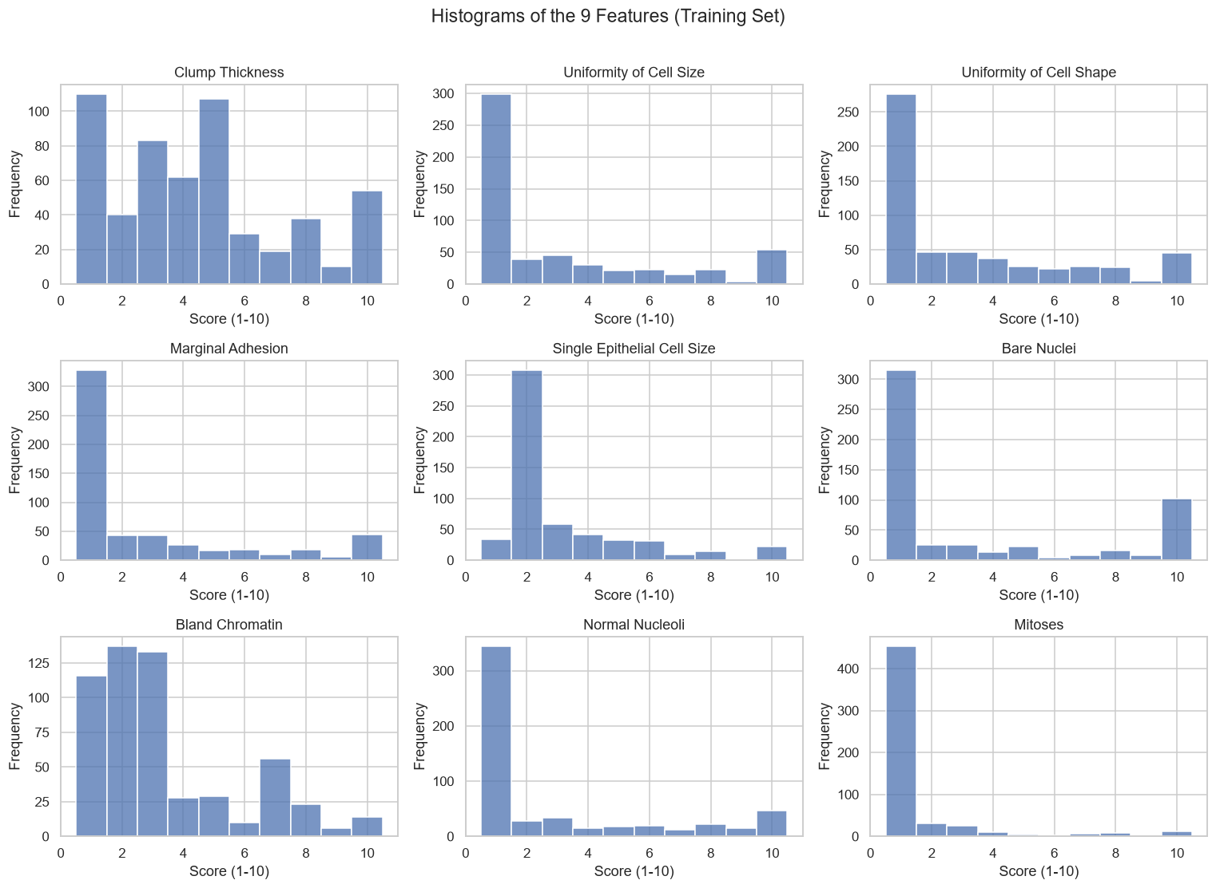
05 · EXPLORATORY DATA ANALYSIS
Most features are strongly right-skewed
Nine features, training set
Most samples score low (1 to 3) on most features, with a long tail toward 10.
Mitoses is the most extreme: almost every value equals 1.
Clump Thickness and Bland Chromatin are more spread out.
The ordinal 1 to 10 scale and skewness mean normality should not be assumed.

Slide 8
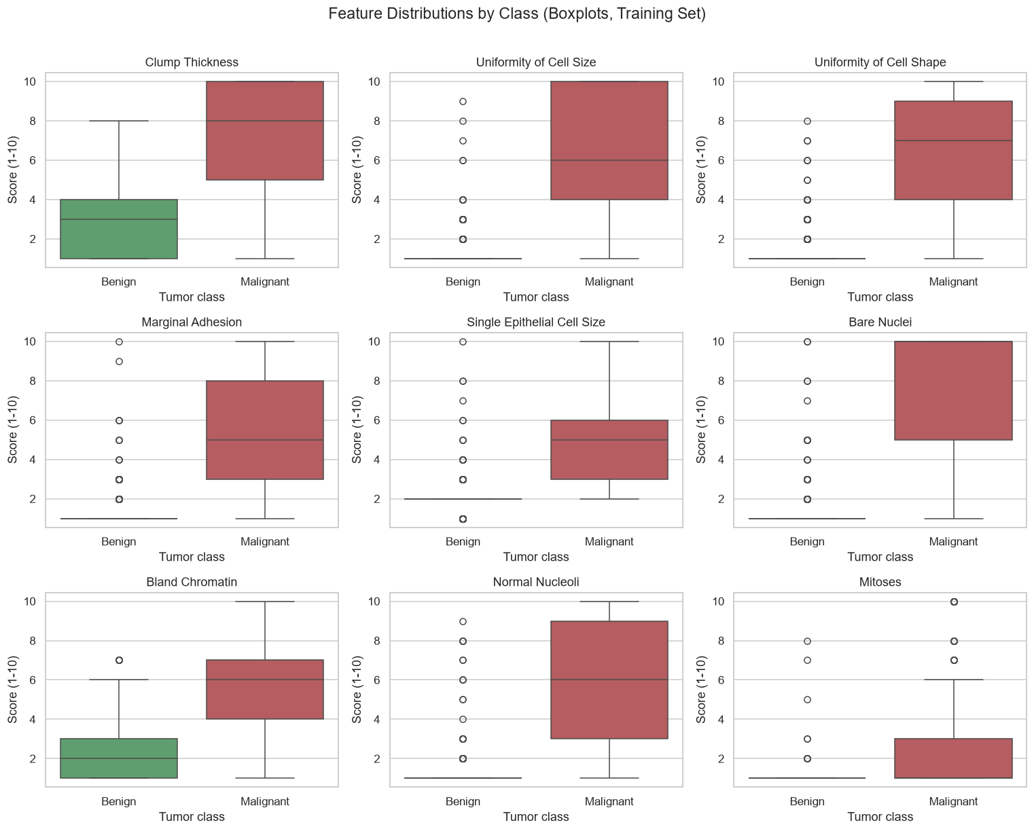
05 · EXPLORATORY DATA ANALYSIS
Malignant tumors score higher
Feature distributions by class, training set
For almost every feature, the malignant group sits much higher than the benign group.
Benign scores cluster at low values, with several outliers above the whiskers.
Mitoses shows the weakest separation between the two classes.
Outliers are valid clinical scores rather than data errors, so they are kept.

Slide 9
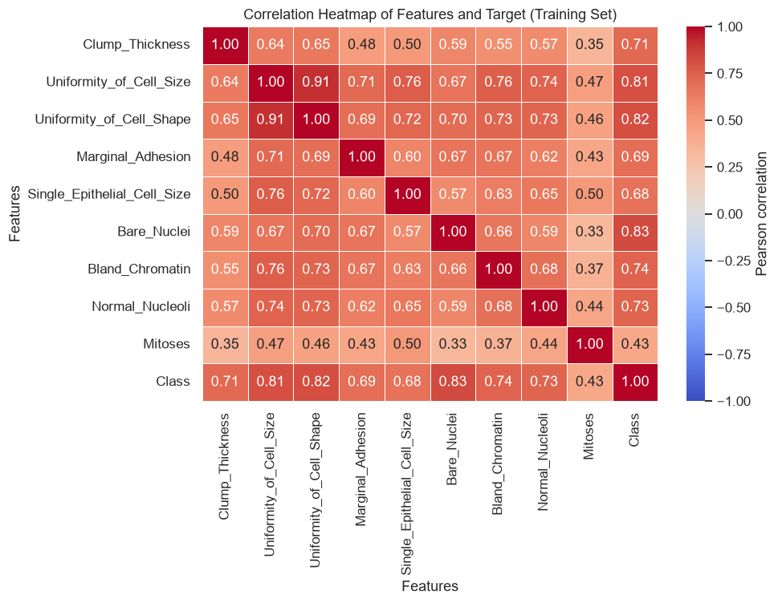
05 · EXPLORATORY DATA ANALYSIS
Bare_Nuclei correlates most with malignancy
Correlation with the target (Class)
All nine features correlate positively with malignancy. Uniformity of Cell Size and Uniformity of Cell Shape are strongly correlated with each other (r = 0.91), a multicollinearity worth noting.

Slide 10
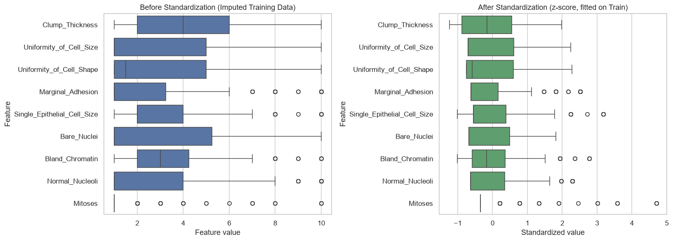
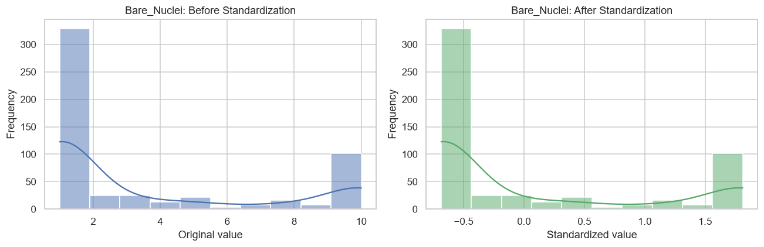
05 · EXPLORATORY DATA ANALYSIS
Standardization changes scale, not shape
Before Features sit on different scales. Mitoses is concentrated near 1, while Clump Thickness spans 1 to 10.
After Every feature has mean 0 and standard deviation 1. The scaler is fitted on training data only.
Bare_Nuclei The histogram keeps its shape after scaling, because standardization is a linear shift and rescale. This matters for KNN (distance), SVM (margin) and ANN (gradient descent). Tree-based models are scale-invariant and skip scaling.

Slide 11
06 · MACHINE LEARNING METHODOLOGY
Five classifiers, one fair protocol
01
02
03
04
05
K-Nearest Neighbors
Decision Tree
Random Forest
Artificial Neural Network
Support Vector Machine
Classifies a sample by majority vote among its k closest training samples in feature space.
Learns a hierarchy of if/else splits that best separate the classes. Interpretable, but prone to overfitting.
An ensemble of trees trained on bootstrap samples with random feature subsets. Predictions are averaged.
Layers of neurons with non-linear activations, trained by back-propagation.
Finds the maximum-margin boundary. The RBF kernel allows non-linear decision boundaries.
Scaling required
No scaling needed
No scaling needed
Scaling required
Scaling required
Pipeline for every model: SimpleImputer (median) → StandardScaler (where needed) → classifier. This keeps preprocessing inside each cross-validation fold.

Slide 12
06 · MACHINE LEARNING METHODOLOGY
Hyperparameter tuning with GridSearchCV
GridSearchCV
5-fold stratified CV
Tuning metric
Leakage-free
Exhaustive search over each model’s parameter grid
Class ratio preserved in every fold, on training data only
F1-score of the malignant (positive) class
Imputer and scaler are refitted inside each fold
Model | Best CV F1 | Selected hyperparameters
KNN | 0.9555 | k = 7 · p = 2 (Euclidean) · uniform weights
Decision Tree | 0.9297 | Gini · max depth = 4 · min samples leaf = 2 · min samples split = 2
Random Forest | 0.9512 | 300 trees · max depth = None · max features = sqrt · min samples leaf = 2
ANN (MLP) | 0.9530 | Hidden layer (32) · ReLU · alpha = 0.0001 · learning rate = 0.001
SVM | 0.9503 | Linear kernel · C = 0.1 · gamma = scale
Best cross-validation F1 scores from GridSearchCV on the training set. Hyperparameters as selected by the notebook.

Slide 13
07 · MODEL EVALUATION
How the models are evaluated
Priority 1
Priority 2
Priority 3
Priority 4
Reported
Recall
F1-score
ROC-AUC
Accuracy
Precision
TP / (TP + FN)
2 · P · R / (P + R)
Area under ROC curve
(TP + TN) / total
TP / (TP + FP)
Share of truly malignant cases that are detected. Low recall means missed cancers.
Harmonic mean of Precision and Recall for the malignant class.
Chance a random malignant case scores above a random benign case. Threshold-free.
Overall share of correct predictions. Can mislead on imbalanced data.
Of the cases flagged malignant, the share that truly are. Low precision means unnecessary follow-up.
Positive class: Malignant (1). With a 65% / 35% class split, Accuracy alone is not enough, so Recall and F1 lead the ranking.

Slide 14
08 · RESULTS
Confusion matrices on the test set
KNN
Decision Tree
Random Forest
ANN (MLP)
SVM
Actual ↓ Predicted →
Actual ↓ Predicted →
Actual ↓ Predicted →
Actual ↓ Predicted →
Actual ↓ Predicted →
90
1
86
5
89
2
89
2
89
2
TN
FP
TN
FP
TN
FP
TN
FP
TN
FP
4
44
5
43
4
44
2
46
3
45
FN
TP
FN
TP
FN
TP
FN
TP
FN
TP
FN 4 · FP 1
FN 5 · FP 5
FN 4 · FP 2
FN 2 · FP 2
FN 3 · FP 2
TP True positive
TN True negative
FP False positive
FN False negative
Malignant correctly detected.
Benign correctly cleared.
Benign flagged as malignant. Leads to extra tests.
Malignant missed. The most critical error.
ANN (MLP) has the fewest false negatives (2 of 48 malignant cases). KNN has the fewest false positives (1).

Slide 15
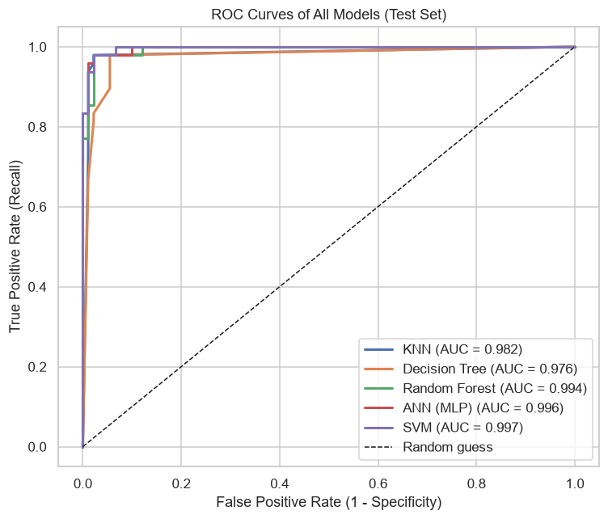
08 · RESULTS
ROC curves and AUC comparison
Test-set ROC-AUC (higher is better)
The top three models differ by less than 0.003 AUC. With 139 test samples, small AUC differences should be read with caution. Axis starts at 0.95.

Slide 16
08 · RESULTS
Test-set comparison of all five models
Model | Accuracy | Precision | Recall | F1-score | ROC-AUC
KNN | 0.9640 | 0.9778 | 0.9167 | 0.9462 | 0.9823
Decision Tree | 0.9281 | 0.8958 | 0.8958 | 0.8958 | 0.9755
Random Forest | 0.9568 | 0.9565 | 0.9167 | 0.9362 | 0.9938
ANN (MLP) selected | 0.9712 | 0.9583 | 0.9583 | 0.9583 | 0.9961
SVM | 0.9640 | 0.9574 | 0.9375 | 0.9474 | 0.9966
Best value per metric
Accuracy
Precision
Recall
F1-score
ROC-AUC
ANN (MLP)
KNN
ANN (MLP)
ANN (MLP)
SVM
0.9712
0.9778
0.9583
0.9583
0.9966
Values as reported in the notebook (four decimals). Magenta marks the best value in each column. Test set: 139 samples, 48 malignant.

Slide 17
08 · RESULTS
Robustness check with repeated cross-validation
RepeatedStratifiedKFold · 5 folds × 3 repeats = 15 evaluations per model · training set only
Model | CV Recall | CV F1 | CV ROC-AUC
KNN | 0.9561 ± 0.0314 | 0.9503 ± 0.0256 | 0.9888 ± 0.0108
Decision Tree | 0.9228 ± 0.0548 | 0.9160 ± 0.0318 | 0.9592 ± 0.0222
Random Forest | 0.9632 ± 0.0285 | 0.9498 ± 0.0228 | 0.9909 ± 0.0058
ANN (MLP) | 0.9632 ± 0.0316 | 0.9523 ± 0.0252 | 0.9927 ± 0.0056
SVM | 0.9579 ± 0.0330 | 0.9520 ± 0.0267 | 0.9941 ± 0.0042
What the folds show
ANN (MLP) and Random Forest share the highest mean CV recall (0.9632).
ANN (MLP) has the highest mean CV F1 (0.9523), with SVM close behind.
Decision Tree is the weakest and least stable model (recall std 0.0548).
Mean ± standard deviation across 15 folds. Magenta marks the highest mean in each column.
Why repeat? One 139-sample test split can change with one or two predictions. Repeated folds show how stable each score is.

Slide 18
09 · SELECTED MODEL
The selected model: ANN (MLP)
Why ANN (MLP) ranks first
SELECTED BY THE PROJECT RANKING
ANN (MLP)
Ranking priority: Recall → F1-score → ROC-AUC → Accuracy
1
ANN (MLP)
R 0.9583 · F1 0.9583 · AUC 0.9961
46 / 48
2
SVM
R 0.9375 · F1 0.9474 · AUC 0.9966
malignant test cases correctly detected (Recall 0.9583). Only 2 were missed.
3
KNN
R 0.9167 · F1 0.9462 · AUC 0.9823
4
Random Forest
R 0.9167 · F1 0.9362 · AUC 0.9938
89
2
2
46
TN
FP
FN
TP
5
Decision Tree
R 0.8958 · F1 0.8958 · AUC 0.9755
Accuracy 0.9712 · Precision 0.9583 · F1 0.9583 · ROC-AUC 0.9961
Not the winner of every metric: SVM leads ROC-AUC and KNN leads Precision. The test set is small, so one or two predictions can change the order. Repeated CV (F1 0.9523 ± 0.0252) supports ANN’s stability.

Slide 19
10 · CONCLUSION
Key findings and next steps
Key findings
Limitations
Future improvements
Test ROC-AUC ranges from 0.9755 to 0.9966 across all five models.
ANN (MLP) ranks first under the Recall-first priority, with 2 missed malignant cases.
Bare_Nuclei, Uniformity of Cell Shape and Uniformity of Cell Size correlate most with malignancy.
Repeated CV shows that the top models are close and stable.
Small test set: 139 samples, 48 malignant. Small gaps are not conclusive.
One train/test split and one dataset (Breast Cancer Wisconsin, Original).
Rows identical except for the ID were kept, which may slightly inflate scores.
No formal statistical significance tests were run.
Nested cross-validation for a more reliable comparison.
Tune the decision threshold to raise Recall further.
Add Logistic Regression and gradient boosting (e.g. XGBoost); calibrate probabilities.
Add explainability (feature importance, SHAP) for clinicians.
Test other imputation and feature selection; validate on the Diagnostic dataset.
ANN (MLP) detected 46 of 48 malignant tumors on unseen test data.
Breast Cancer Wisconsin (Original) · Supervised binary classification · Questions welcome

