Slide 1
Selected-2
project
Team No. 16

Slide 2
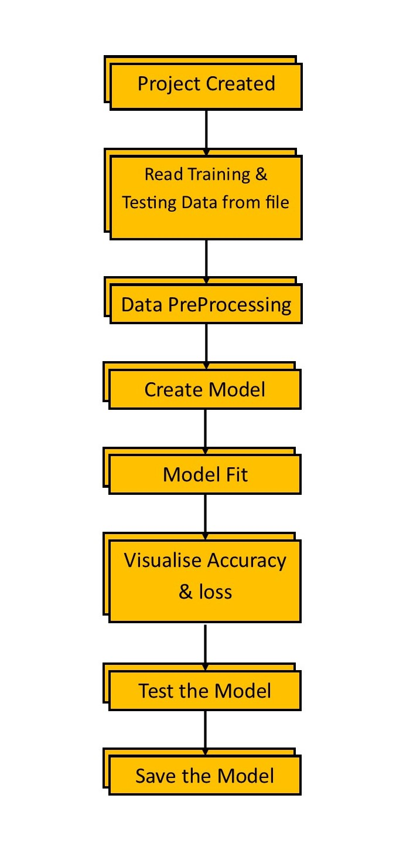

Introduction
This project is about how to recognize Arabic HandWritten characters using Deep Learning

Slide 3
Data preprocessing
Preparing Data

Slide 4
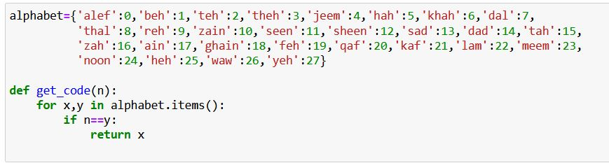
Dataset
Some modification on dataset such as split images to classes and get_code Function that return class name

Slide 5
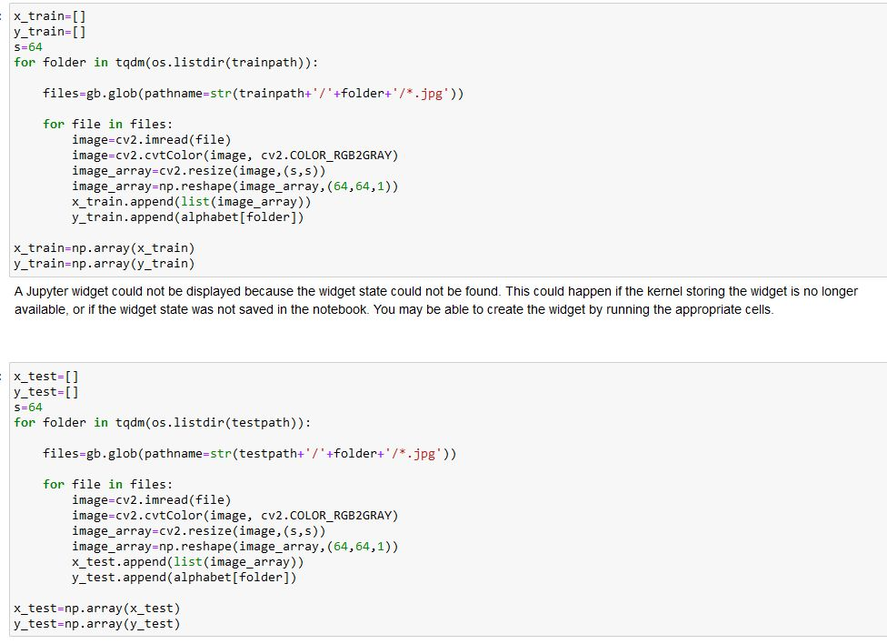
Dataset
CONT.
Read Training & Testing images

Slide 6
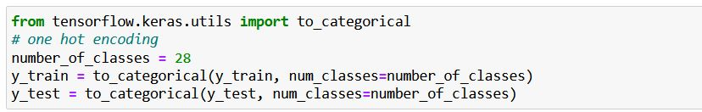
Dataset
CONT.
Data normalization
Convert Train & Test lables to one hot encoding
Split Train array to Train & validation

Slide 7
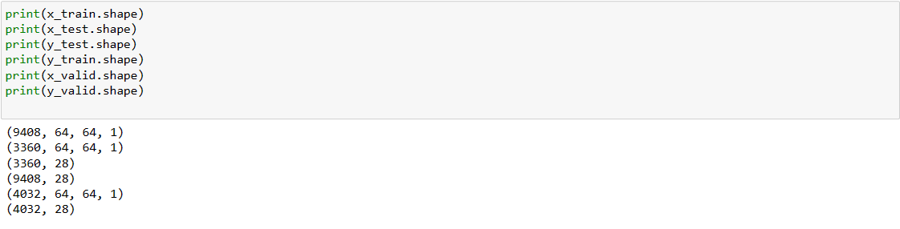
Dataset
CONT.
Shape of Train & Test & Validtion

Slide 8
Modeling
CNN Model

Slide 9
CNN Model
Model Function that contain (4 convolutional layer & 4 Batch Normlization Layer & 4 dropout Layer & 4 MaxPooling Layer & 1 AveragePooling Layer & 1 Dense Layer )
The activation function Used (ReLU)
The Optemizer (adam)
The Kernel_initializer (he_normal)

Slide 10
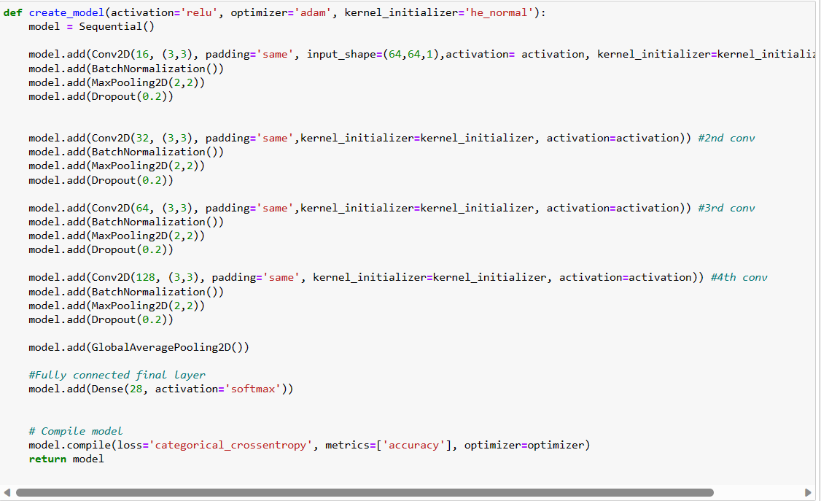
CNN Model
CONT.

Slide 11
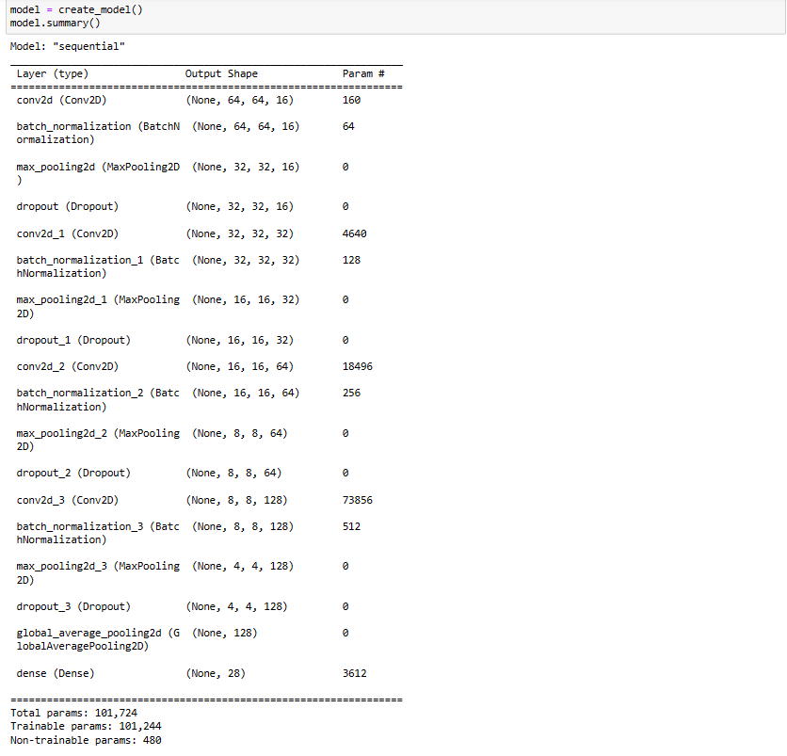
CNN Model
CONT.

Slide 12
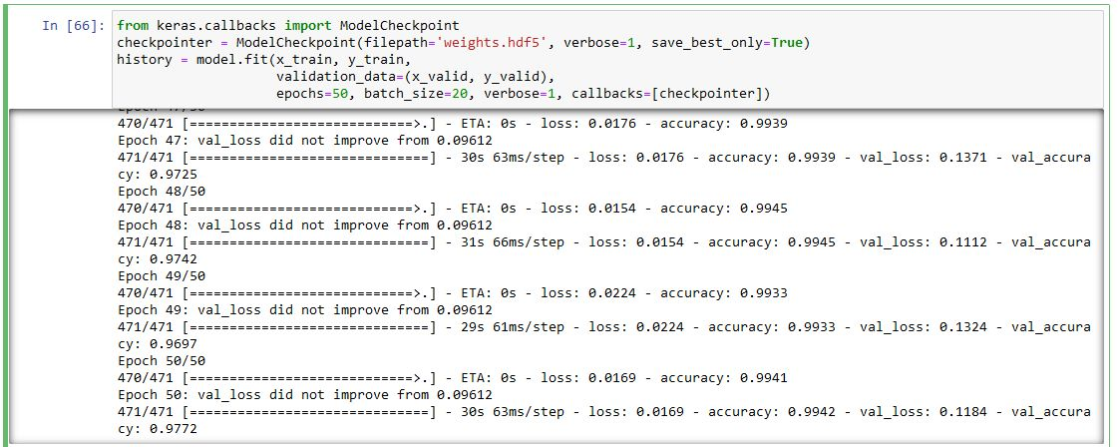
CNN Model
CONT.
Model Fitting

Slide 13
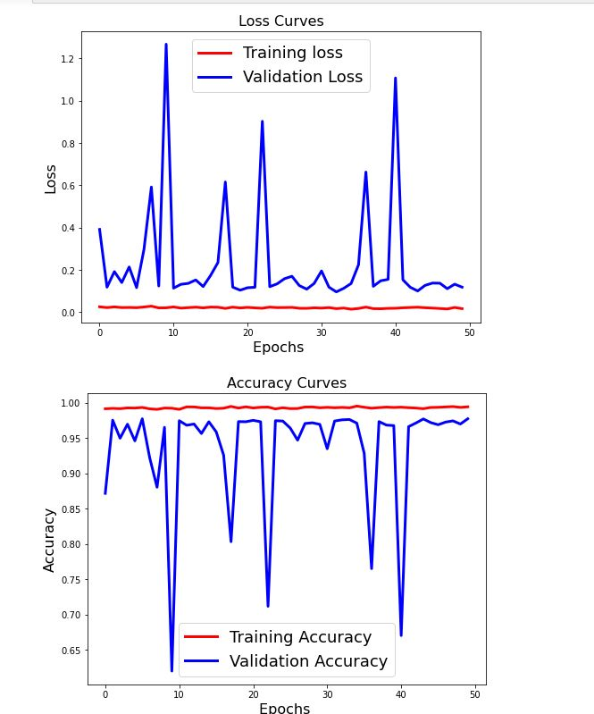
CNN Model
CONT.
Loss & Accuracy Curves

Slide 14
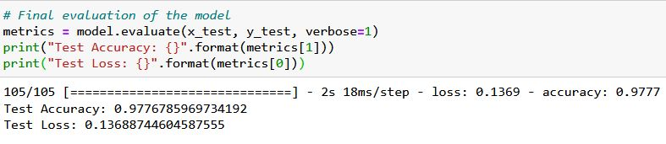
CNN Model
CONT.
Test Accuracy

Slide 15
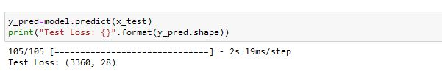
CNN Model
CONT.
Image Prediction

Slide 16
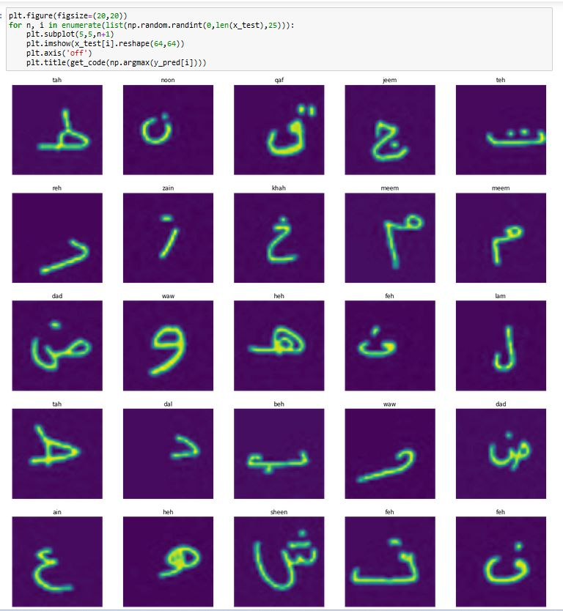
CNN Model
CONT.
Image Prediction

Slide 17

Thank you
TEAM GAMED

